Slide 1
Practice
Link to download mmysql - https://dev.mysql.com/doc/mysql-installation-excerpt/8.0/en/windows-installation.html

Slide 2


Slide 3
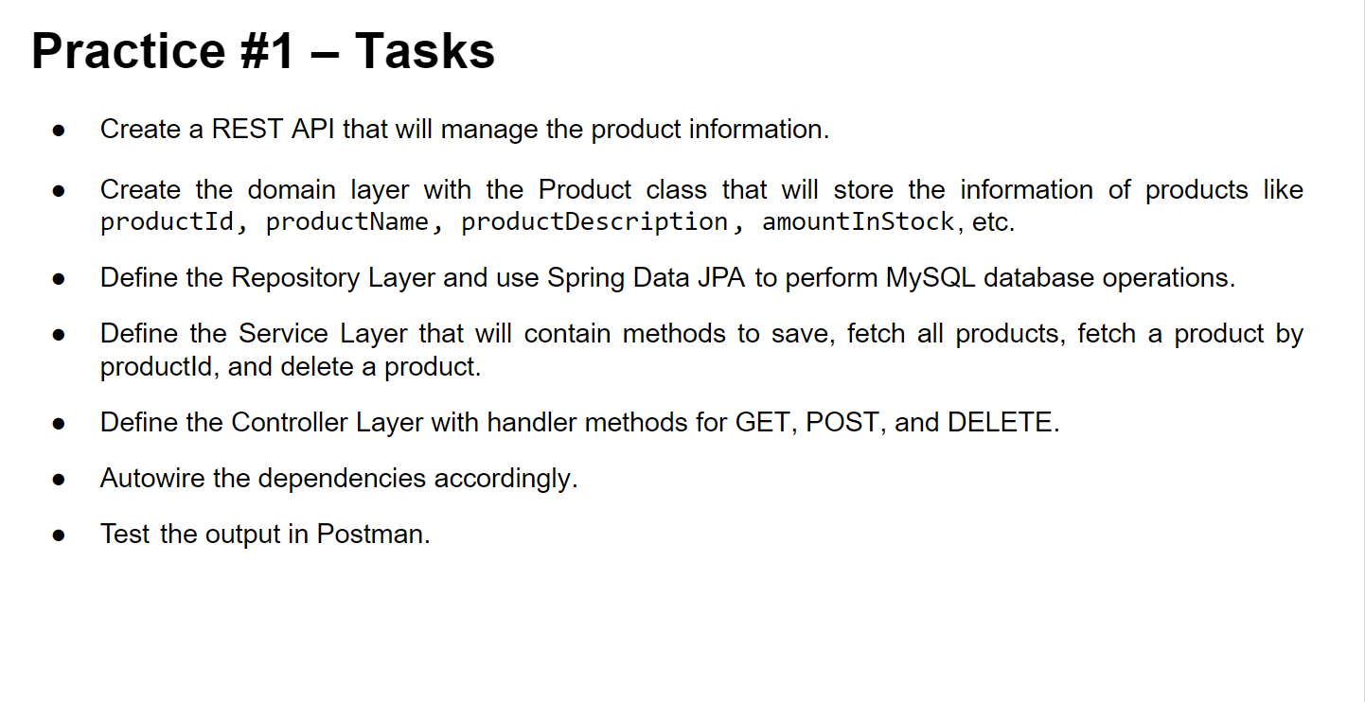

Slide 4


Slide 5
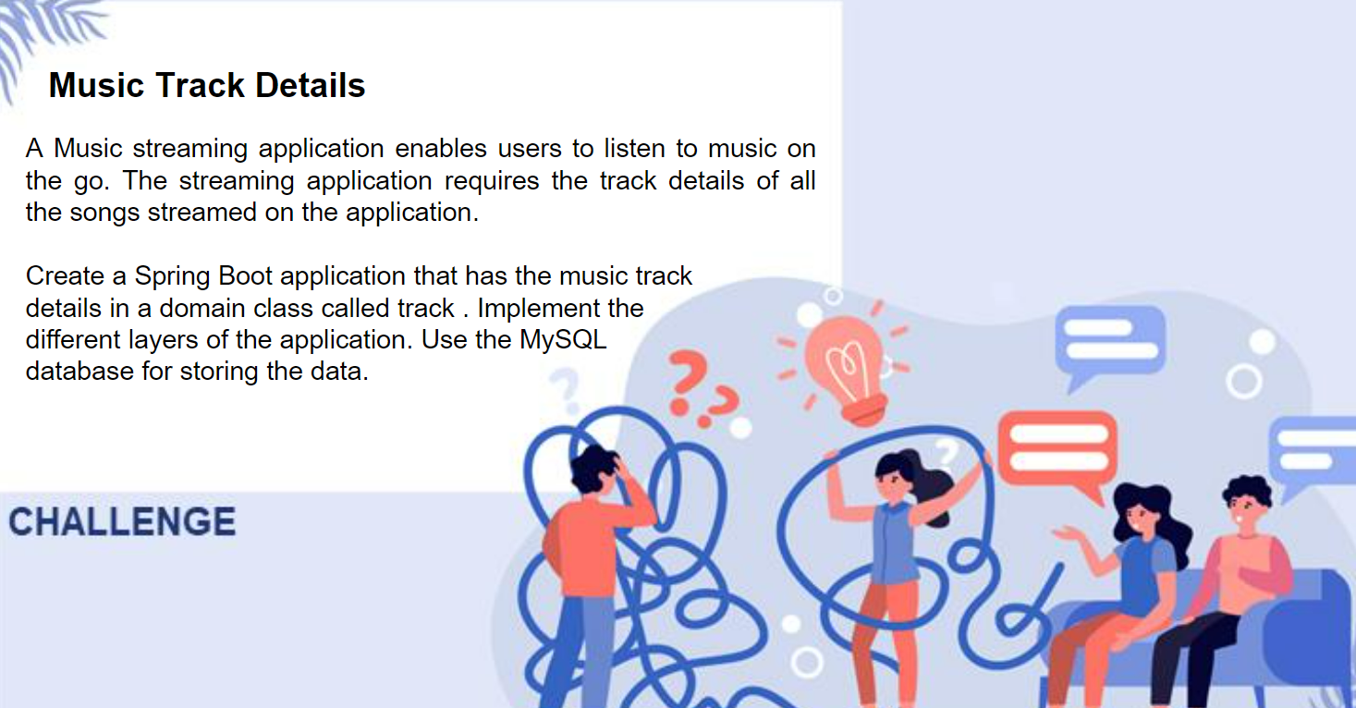

Slide 6
