Slide 1
AI-DRIVEN
PDF DOCUMENT COMPARISON
Author & Presenter : Sanduni Perera

Slide 2
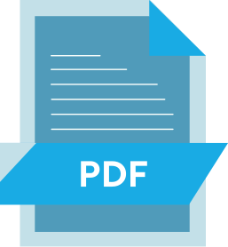
Problem & Objective
Problem Statement
Objective
  Automatically compare two PDF documents (text, tables, images) and highlight key differences.
  Manual comparison of product specifications is time consuming and error prone
  Differences in text, numeric tables, and images need to be identified accurately
Goal
  Demonstrate AI and Python-based automation for real-world use cases such as product specification validation and version control.

Slide 3
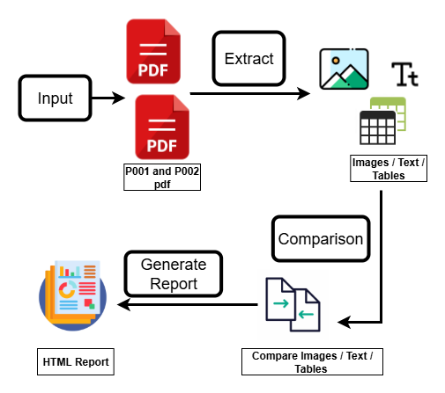
SOLUTION APPROACH
  Extract Data - Extract text, tables, and images from both PDFs using pdfplumber and camelot.
  Compare Text - Perform section-wise, line-by-line comparison, highlighting differences in red (P001) and green (P002).
  Compare Tables - Normalize rows/columns and compare numeric and textual values to find differences .
  Compare Images - Use AI-based similarity techniques (imagehash and SSIM) to assess image differences.
  Generate Report - Summarize all differences in an HTML report with visual highlights for text, tables, and images.

Slide 4
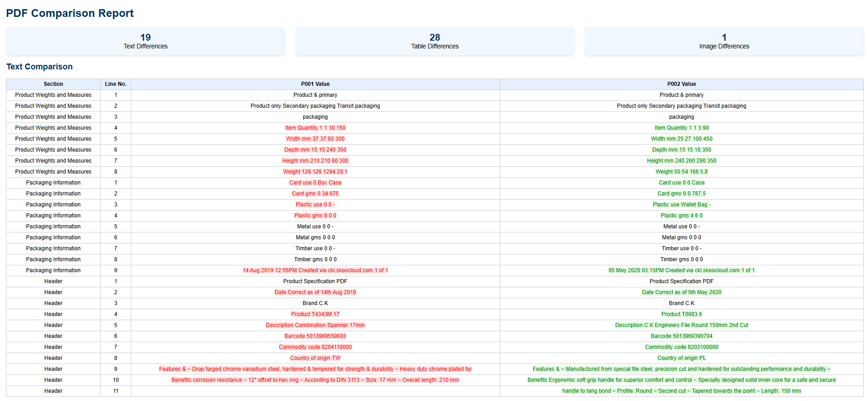
Results – Text Comparison

Slide 5
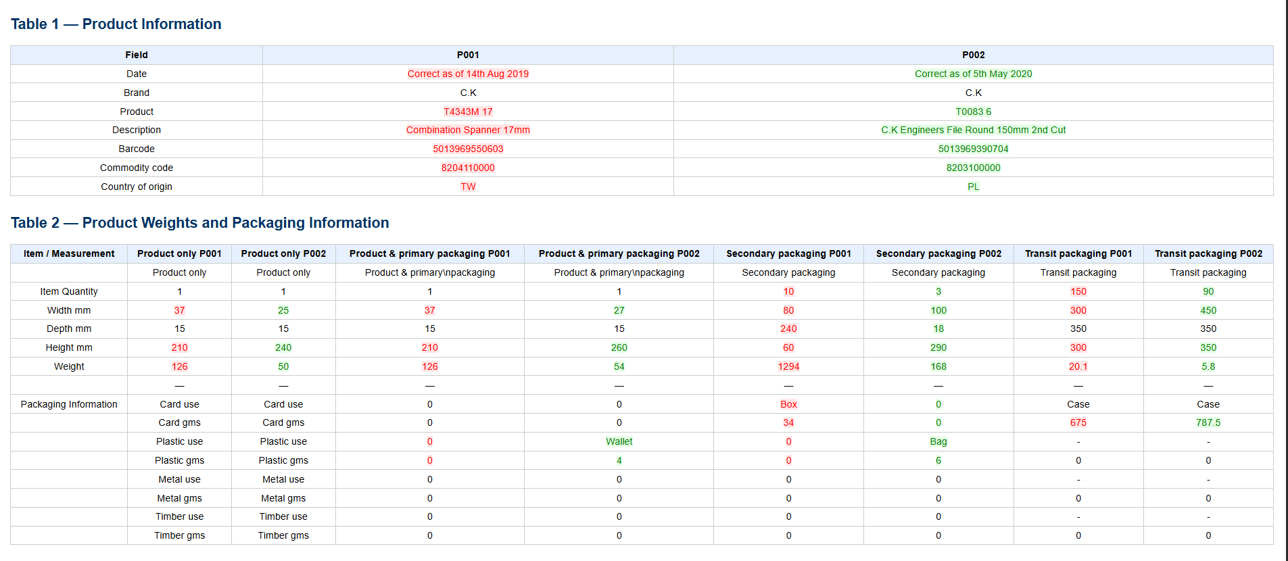
Results – Table Comparison

Slide 6
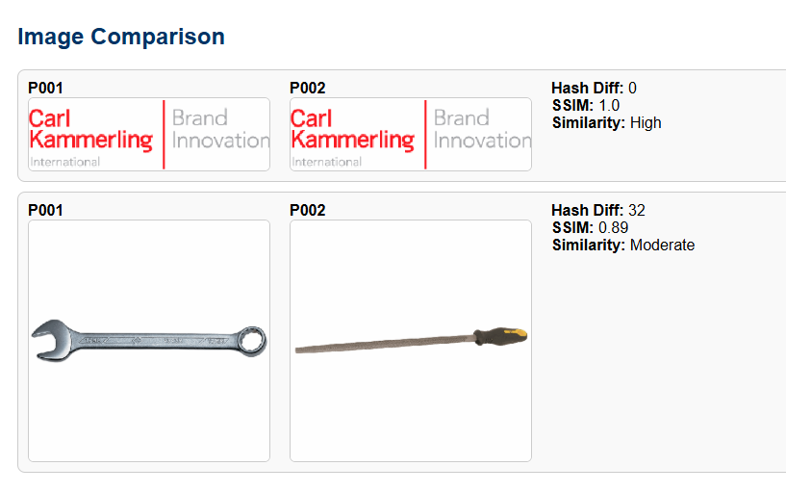
Results – Image Comparison

Slide 7
Form Recognizer - Automatically extracts text, tables, and layout from PDFs, improving accuracy and reducing manual parsing errors.
How Azure AI Services Fit Into the Solution
Text Analytics (Cognitive Services) - Detects key phrases, entities, and semantic differences, enabling smarter comparisons beyond exact string matches.
Computer Vision - Analyzes images, detects differences, and extracts text from scanned PDFs.
Azure Functions & Logic Apps - Serverless, on-demand processing, triggers automated workflows like email notifications and parallel processing.

Slide 8
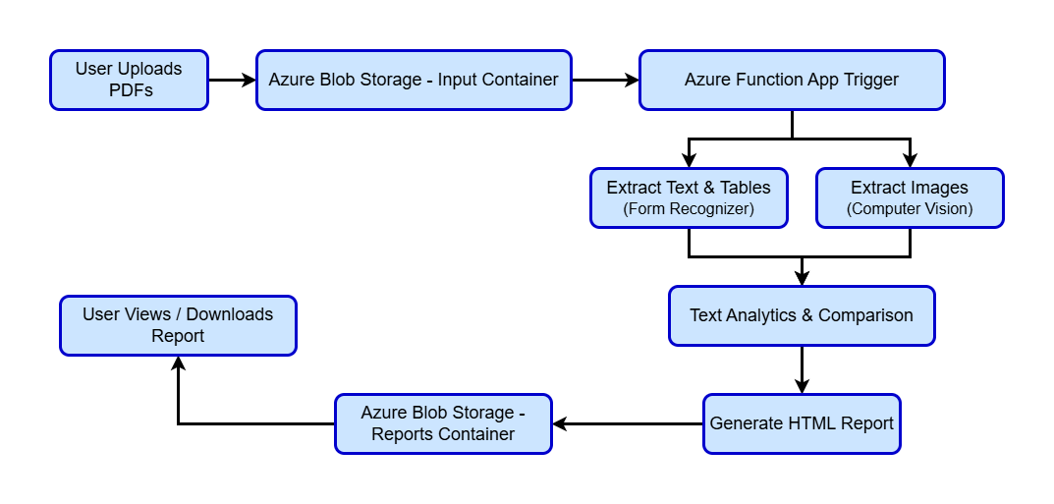
AZURE WORK FLOW

Slide 9

RECOMMENDATIONS FOR IMPROVEMENTS & SCALABILITY
  Automation - Integrate Logic Apps or Power Automate to notify users when reports are ready.
  Parallel Processing - Use Azure Functions to process multiple PDF uploads simultaneously for faster throughput.
  Semantic Comparison - Leverage Text Analytics for deeper understanding of content differences.
  Monitoring & Logging - Use Azure Monitor and Application Insights to track processing and handle errors efficiently.
  Future Enhancements - Consider integrating AI models to summarize PDF differences or classify document changes automatically.

Slide 10
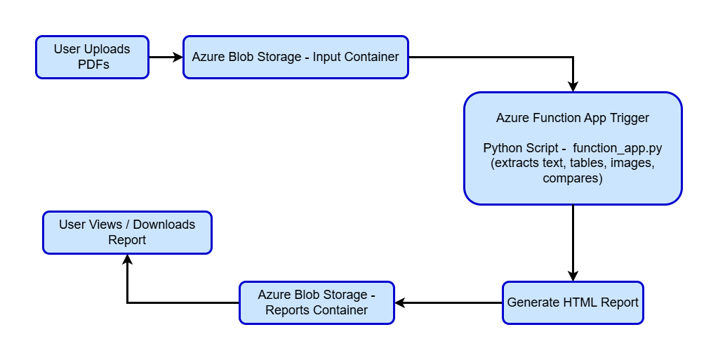
AZURE IMPLEMENTED WORK FLOW

Slide 11
REFERENCES
  Microsoft. Azure AI Services Overview. Microsoft Learn. - Available at: https://learn.microsoft.com/en-us/azure/ai-services/what-are-ai-services
  Microsoft. Azure AI Document Intelligence (Form Recognizer). Microsoft Learn. - Available at: https://learn.microsoft.com/en-us/azure/ai-services/document-intelligence
  Microsoft. Azure Blob Storage. Microsoft Learn. - Available at: https://learn.microsoft.com/en-us/azure/storage/blobs
  Microsoft. Azure Functions. Microsoft Learn. - Available at: https://learn.microsoft.com/en-us/azure/azure-functions
  Microsoft. Azure Text Analytics. Microsoft Learn. - Available at: https://learn.microsoft.com/en-us/azure/ai-services/text-analytics
  Microsoft. Azure Computer Vision. Microsoft Learn. - Available at: Automation: Integrate Logic Apps or Power Automate to notify users when reports are ready.

Slide 12
QUESTIONS?
THANK YOU FOR YOUR TIME AND ATTENTION.

