Slide 1
Population Regression
Group：3
Date：Aug.28

Slide 2
CONTENT
Project Description
Model Optimization
Problem Solving
Conclusion

Slide 3
Project Description

Slide 4
Project Description
In this project:
1
Build a machine learning model
2
Linear Regression
Why do we study population growth?
Evaluate the model &Make some analysis
3

Slide 5
Problem Solving
Singapore’s population prediction
China’s population prediction

Slide 6
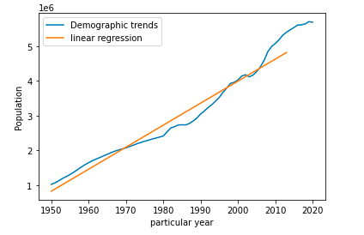
Singapore’s population regression
Training data:
Singapore population in 2013 and earlier years
Way:
Linear regression
The best fit line:
y=0.011 x-21.691
R² coefficient: 0.961
MSE : 0.0017

Slide 7
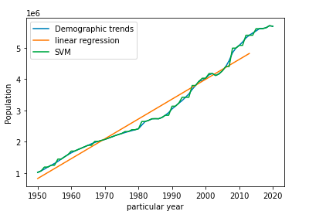
Singapore’s population prediction
Test data:
Singapore population in years greater than 2013
MSE: 0.0090
Year | Actual Population | Prediction
2014 | 5469724 | 4880287
2015 | 5535002 | 4943630
2016 | 5607283 | 5006974
2017 | 5612253 | 5070317
2018 | 5638676 | 5133660
2019 | 5703569 | 5197003
2020 | 5685807 | 5260346
2030 Singapore population: 000000006527211
2050 Singapore population: 000000007037872

Slide 8
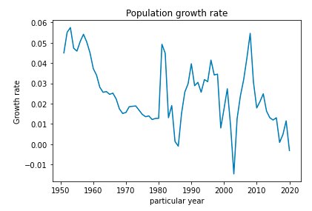
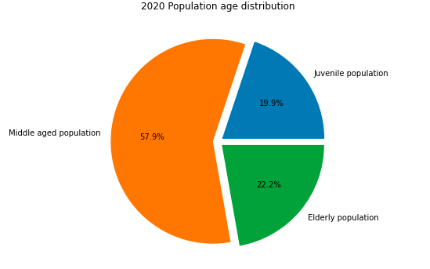
Result Analysis
2020 Population age discribution
Population growth rate of Singapore

Slide 9
Result Analysis
Policy
2020 Singapore population white paper:there is still a gap of 1 million people.
International environmental
1.The non resident population fell by 2.1%.
2.COVID-19 led to a decrease in the number of migrant workers.
Population growth pattern
Singapore's future population growth pattern will be dominated by immigrants, supplemented by natural growth.
Improve estimation
Reduce the weight of the adverse factor of population aging.

Slide 10
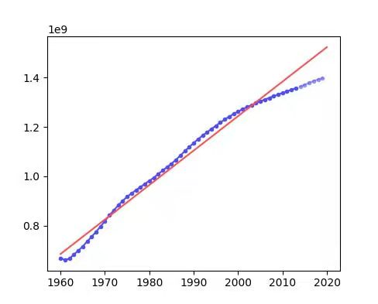
China’s population regression
Training data:
China population in 2013 and earlier years
Way:
Linear regression
The best fit line:
y=0.0100x-19.5957
R² coefficient: 0.983
MSE: 0.00043

Slide 11
China’s population prediction
Test data:
China population in years greater than 2013
MSE: 0.0045
Year | Actual Population | Prediction
2014 | 1364270000 | 1439834950
2015 | 1371220000 | 1453821420
2016 | 1378665000 | 1467807890
2017 | 1386395000 | 1481794350
2018 | 1392730000 | 1495780820
2019 | 1397715000 | 1509767290
2030 China population: 01663618416.36
2050 China population: 01943347743.60

Slide 12
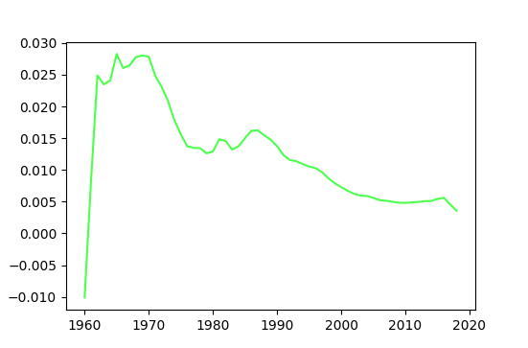
Result Analysis
Policy
Fertility measures implemented after China's reform and opening up.
Population growth rate of China
Improve estimation
Population growth pattern
Add China's legal control to the model.
China's population growth model has entered a modern model with low birth rate, low mortality and low natural growth rate.

Slide 13
Model Optimization

Slide 14
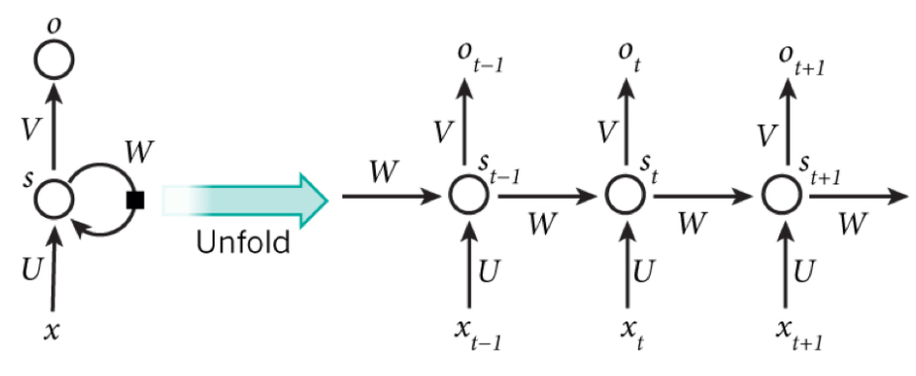
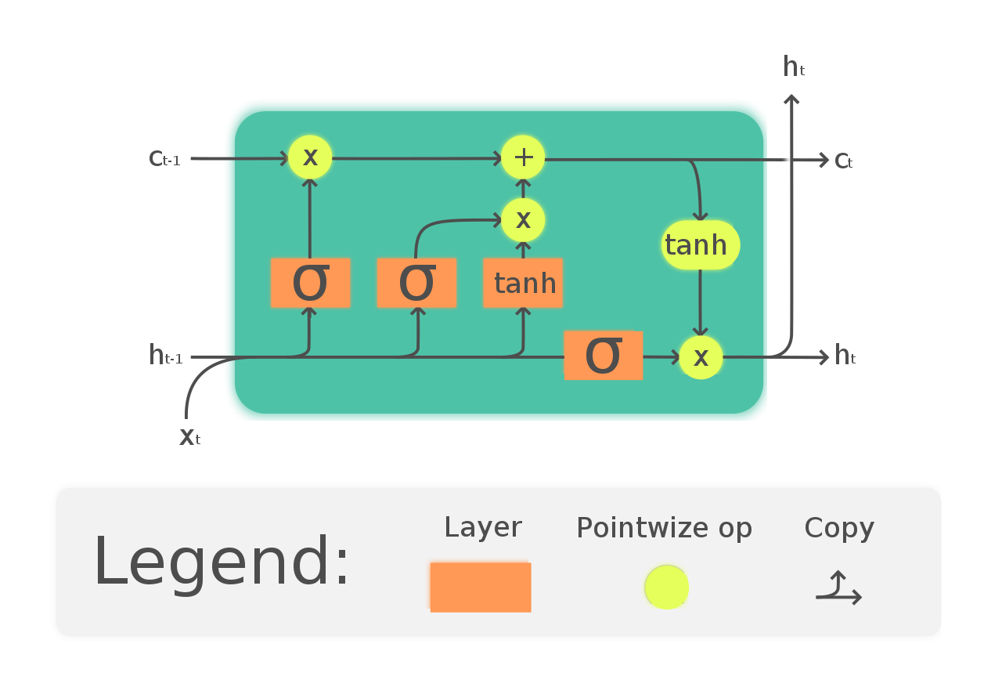
Model Optimization
1
RNN
Basic concepts

Slide 15
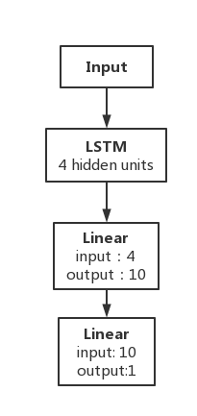
Model Optimization
Model Structure

Slide 16
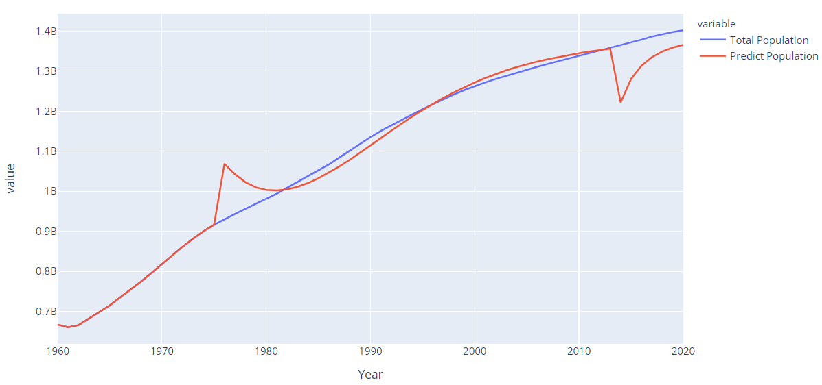
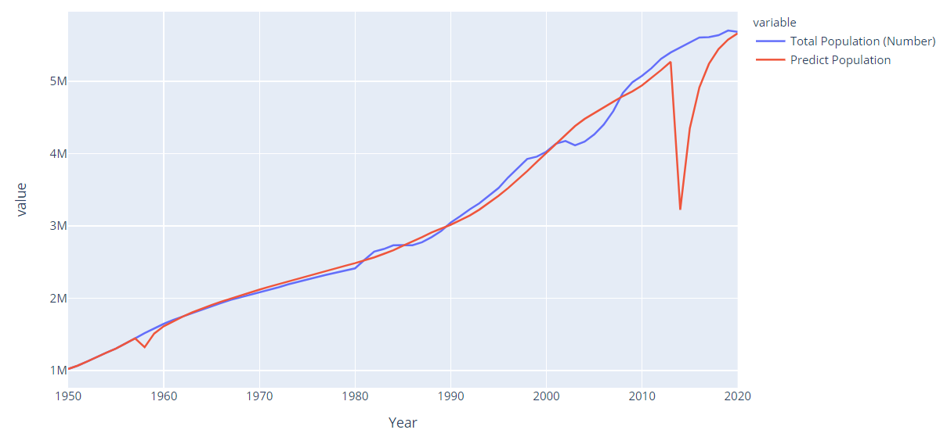
Model Optimization
Result presentation
VS
Singapore Data
China Data
Test Loss of Best Model:
0.031
Test Loss of Best Model:
0.0029

Slide 17
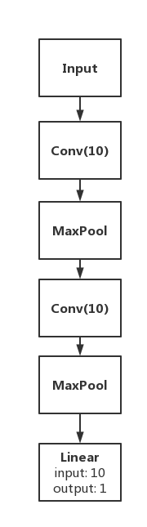
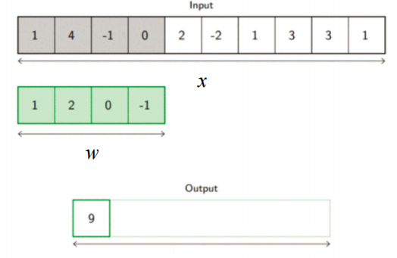
Model Optimization
2
CNN
Basic concepts
Model Structure

Slide 18
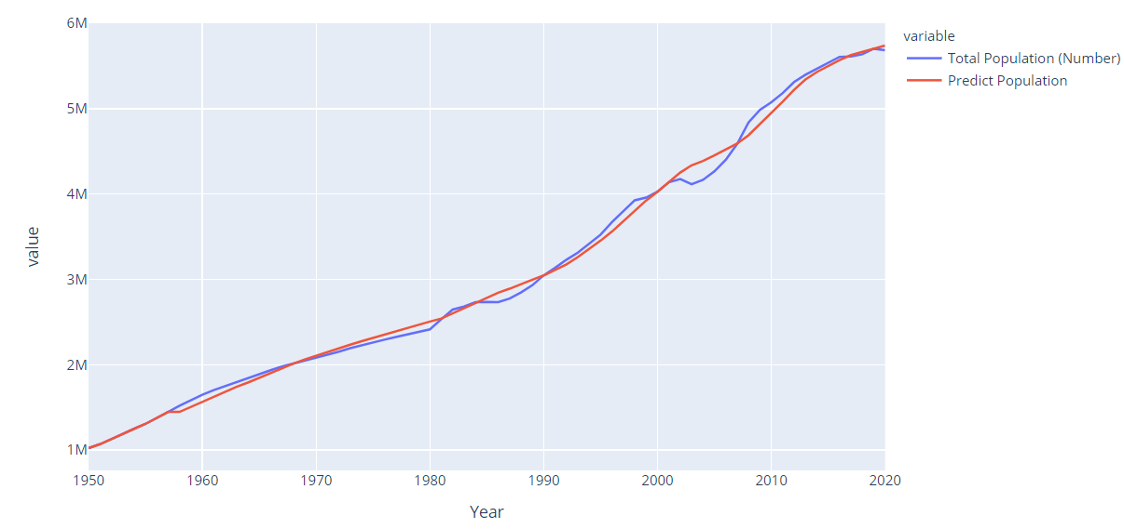
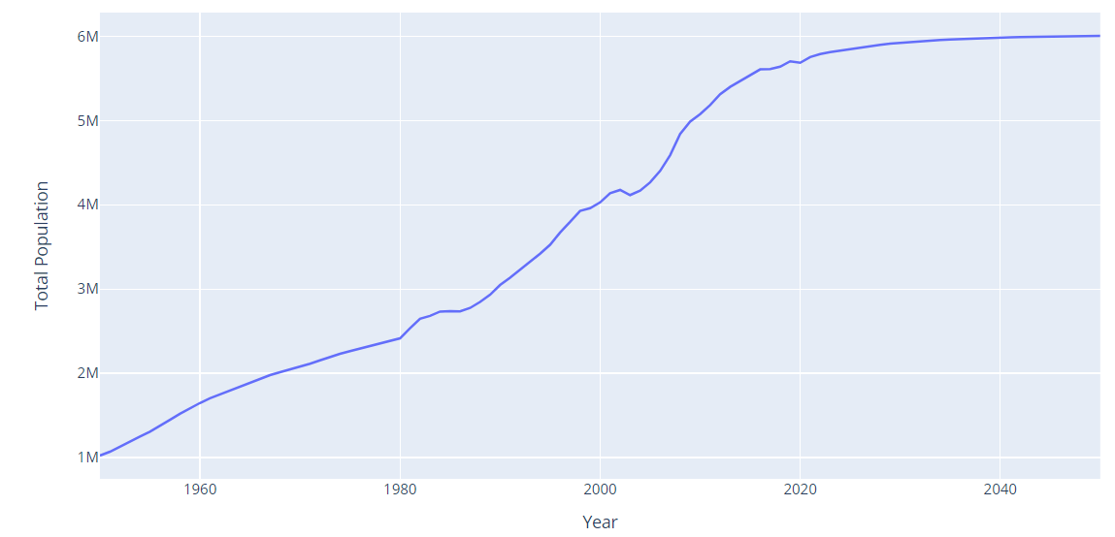
Model Optimization
Result presentation
Singapore Data
Test Loss of Best Model:
7.512*10⁻⁵
Prediction from 2021 to 2050:

Slide 19
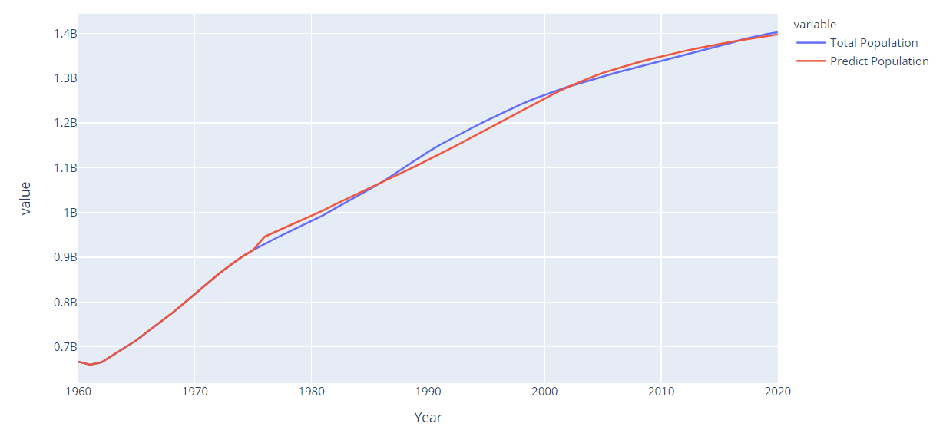
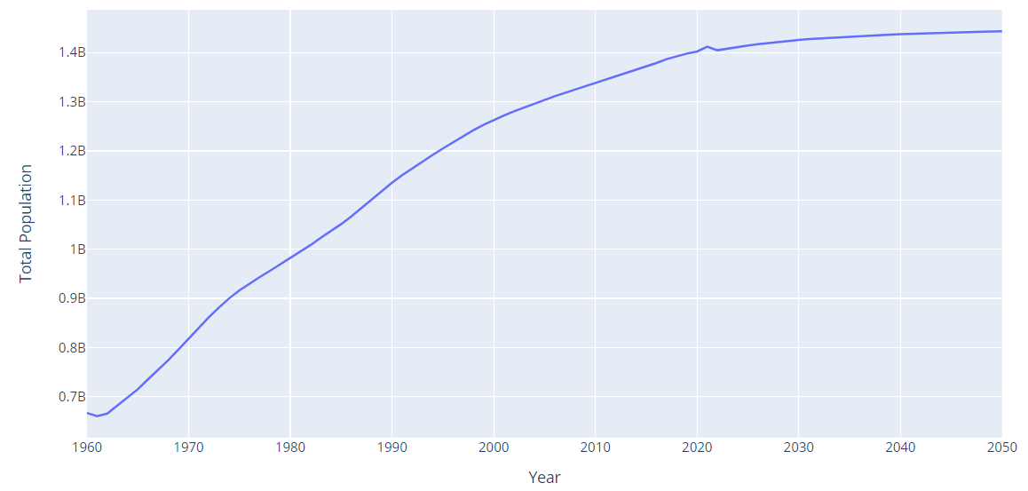
Model Optimization
Result presentation
China Data
Test Loss of Best Model:
9.486*10⁻⁶
Prediction from 2021 to 2050:

Slide 20
Conclusion

Slide 21
Conclusion
Singapore and China Population Prediction
Interesting Findings
1.Our RNN is highly volatile .
According to the predicted data for next 30 years, both of the countries’ population would increase but with a slower pace and eventually become stable at a certain level.
Interesting Findings
Model
2.Our CNN model performs well.
More complex model performs better than simple Linear Regression model, but it is not true that the more complex the better.

Slide 22
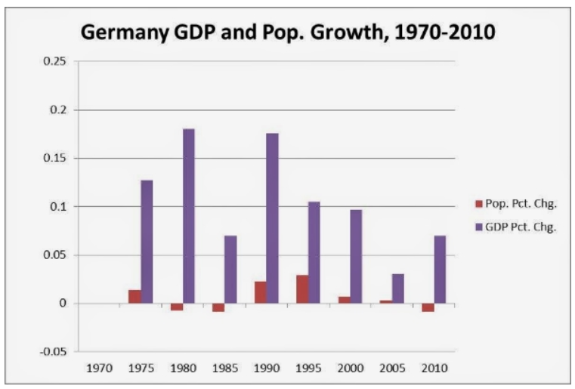
Future work
Population is the consequence of many factors, especially economy and politics.
In the future, our model should consider more factors like GDP, GINI index and so on to make a more accurate prediction.

Slide 23
THANKS!
Group：3
Date：Aug.28

