Slide 1

KN1D
Balbin, julio
Becerra, Carlo

Slide 2
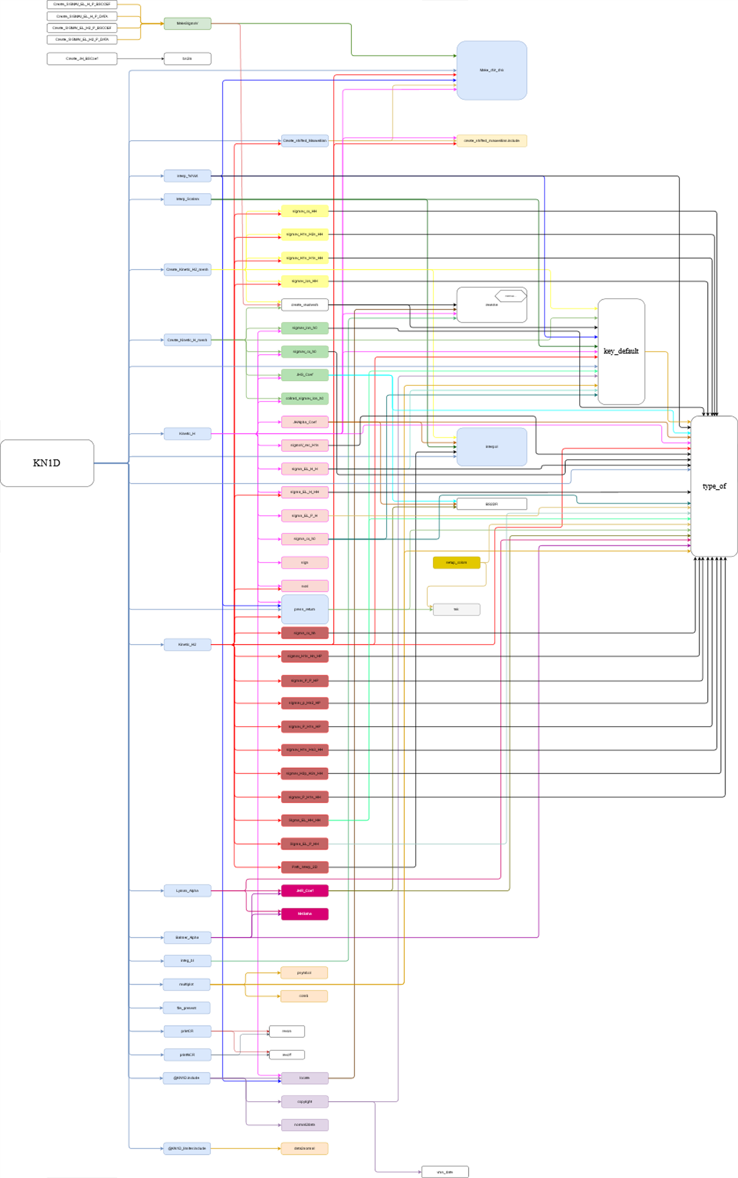
Tree of functions

Slide 3
KN1D
Kinetic_H
Kinetic_H2
Create_Kinetic_H_mesh
Create_Kinetic_H2_mesh
Interp_fVrVxX
Interp_Scalarx
Lyman_Alpha
Balmer_Alpha
@KN1D.include
@ KN1D_limiter.include
Create_shifted_Maxwellian
Make_dVr_dVx
press_return
interpol

Slide 4
Kinetic_H
sigmav_ion_h0
sigmav_cx_h0
JHS_Coef
JHAlpha_Coef
collrad_sigmav_ion_h0
sigmaV_rec_H1s
sigma_EL_H_H
sigma_EL_H_H
sigma_EL_P_H
sigma_cx_h0
sign
sval
locate
press_return
@create_shifted_maxwellian.include
Make_dVr_dVx

Slide 5
Kinetic_H2
@create_shifted_Maxwellian
sigmav_cx_HH
sigmav_H1s_H2s_HH
sigmav_H1s_H1s_HH
sigmav_ion_HH
sigma_EL_H_HH
sigma_cx_hh
sigmav_H1s_Hn_HP
sigmav_P_P_HP
sigmav_p_Hn2_HP
sigmav_P_H1s_HP
sigmav_H1s_Hn3_HH
sigmav_H2p_H2s_HH
sigmav_P_H1s_HH
sigma_EL_HH_HH
sigma_EL_P_HH
Path_Interp_2D
sval
press_return

Slide 6
Create_Kinetic_H_mesh
Create_Kinetic_H2_mesh
create_vrvxmesh
sigmav_ion_h0
sigmav_cx_h0
JHS_Coef
collrad_sigmav_ion_h0
create_vrvxmesh
sigmav_ion_HH
sigmav_H1s_H1s_HH
sigmav_H1s_H2s_HH
sigmav_cx_HH

Slide 7
Interp_fVrVxX
Interp_Scalarx
Make_dVr_dVx
press_return
locate
interpol
Lyman_Alpha
Balmer_Alpha
JHR_Coef
NHSaha
JHR_Coef
NHSaha

Slide 8
@KN1D.include
@KN1D_limiter.include
locate
normal2data
data2normal
Create_shifted_Maxwellian
@create_shifted_maxwellian.include
Make_dVr_dVx
Make_dVr_dVx

