Slide 1

Simulating event times from non-homogeneous Poisson Point Processes
Y Sereda, TA Trikalinos
{sereda_yuliia, thomas_trikalinos}@brown.edu

Slide 2
Disclosures
No pertinent financial conflicts
Work supported from grant U01 1U01CA265750 (Trikalinos, Jalal) from the National Cancer Institute

Slide 3
Outline
Introduction
(Poisson) Point Processes (PP) and their dual
Sampling from non homogeneous Poisson PP
Implementation in R
Numerical example

Slide 4
Outline
Introduction
(Poisson) Point Processes (PP) and their dual
Sampling from non homogeneous Poisson PP
Implementation in R
Numerical example

Slide 5
Introduction
For continuous time models, we need to sample event-times with time-varying hazards.
Single or competing events (times of cause-specific death)
Repeated events (times of lesions’ appearance)
Exposure history (times of smoking start and end)

Slide 6








Introduction
$λ_{i}$:= $λ_{i}(t)$
$$λ_{2}$$
Two CISNET Bladder Cancer population models COBRAS and Kystis model events in continuous time.
All events are modeled with (nonhomogeneous) Poisson Point Processes.
$$λ_{1}$$
1st Lesion (Papilloma)
2001-03-20
$$λ_{3 }$$
Smoking start
1971-07-10
Smoking end
1971-07-10
Birth
1950-01-08
Death,
other causes
1950-01-08
2nd Lesion (PUNLMP)
2003-10-14
$$λ_{2}$$
2nd Lesion (T1-LG)
2004-05-02
$$λ_{5 }$$
$$λ_{4 }$$
A simplified timeline of a person with bladder cancer (Kystis)

Slide 7
Outline
Introduction
(Poisson) Point Processes (PP) and their dual
Sampling from non homogeneous Poisson PP
Implementation in R
Numerical example

Slide 8
What is a Point Process over time
Point Processes (PP) model the location of events over time.
Poisson Point Processes are a type of memoryless PP: Events in any time interval are independent of events in any other disjoint interval.

Slide 9
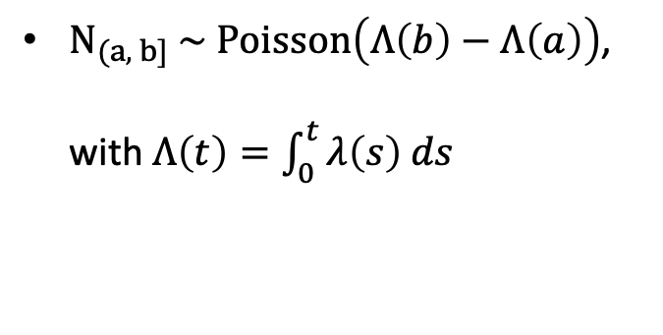
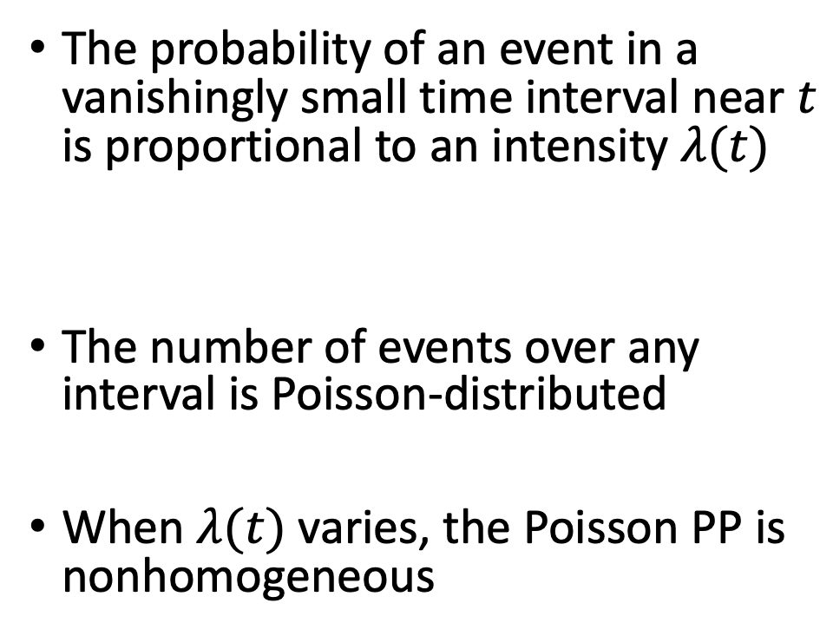
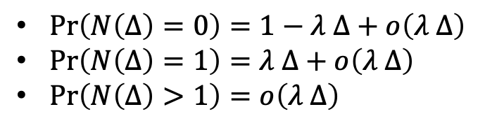
What is a Poisson PP
The probability of an event in a vanishingly small time interval near $t$ is proportional to an intensity $λ(t)$
The number of events over any interval is Poisson-distributed
When $λ(t)$ varies, the Poisson PP is nonhomogeneous
$\operatorname{Pr}\left(N\left(Δ\right)=0\right)=1−λ Δ+o\left(λ Δ\right)$
$\operatorname{Pr}\left(N\left(Δ\right)=1\right)=λ Δ+o\left(λ Δ\right)$
$\operatorname{Pr}\left(N\left(Δ\right)>1\right)=o\left(λ Δ\right)$
$N_{(a, b]} \sim Poisson\left(Λ\left(b\right)−Λ\left(a\right)\right)$, with $Λ\left(t\right)=\int_{0}^{t}{λ\left(s\right) ds}$

Slide 10
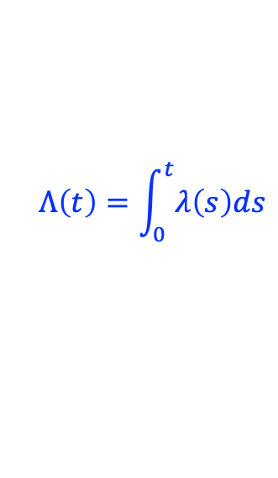

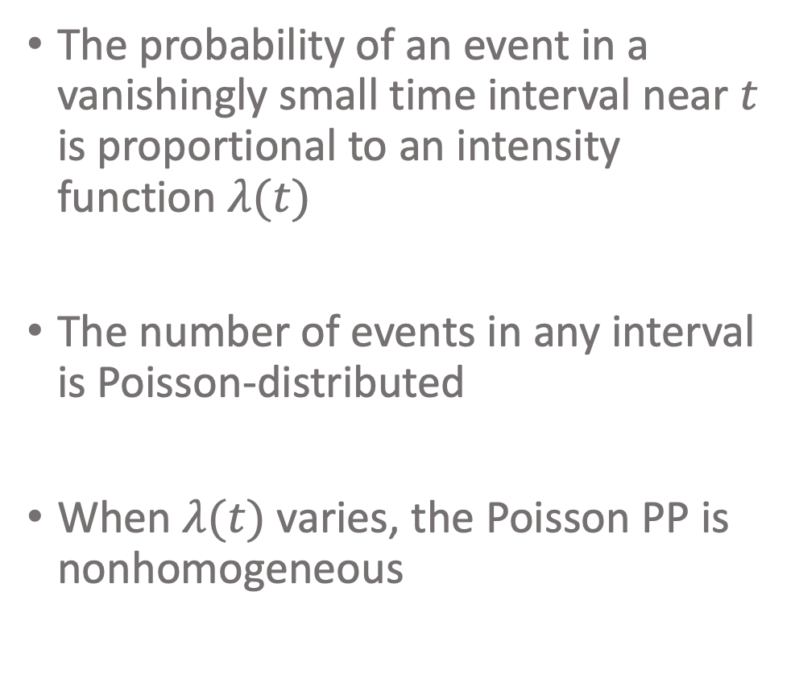

What is a Poisson PP
$$λ(t)$$
The probability of an event in a vanishingly small time interval near $t$ is proportional to an intensity function $λ(t)$
The number of events in any interval is Poisson-distributed
When $λ(t)$ varies, the Poisson PP is nonhomogeneous
$$Λ\left(t\right)=\int_{0}^{t}{λ\left(s\right)ds}$$
$$Λ\left(b\right)−Λ(a)$$
All cause death, females born in 1975 in the US (HMD)

Slide 11
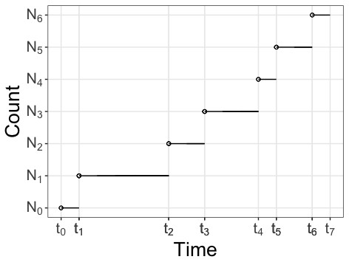
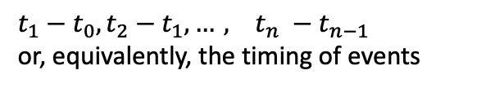
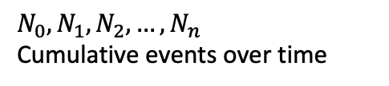
Duality with the Poisson Counting Process
Poisson Counting Process
$$N_{0}, N_{1}, N_{2},…, N_{n}$$
Cumulative events over time
Poisson Point Process
$t_{1}−t_{0}, t_{2}−t_{1},…, t_{n} −t_{n−1}$
or, equivalently, the timing of events

Slide 12
Outline
Introduction
(Poisson) Point Processes (PP) and their dual
Sampling from non homogeneous Poisson PP
Implementation in R
Numerical example

Slide 13
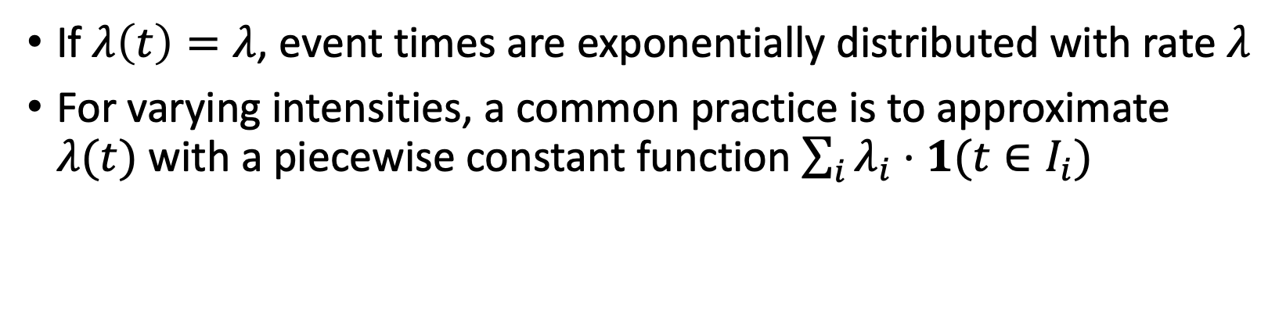
Sampling from Poisson PP
If $λ\left(t\right)=λ$, event times are exponentially distributed with rate $λ$
For varying intensities, a common practice is to approximate $λ(t)$ with a piecewise constant function $\sum_{i}{λ_{i}⋅1(t∈I_{i})}$
Challenging to automatically approximate a general $λ(t)$

Slide 14
Sampling from non homogeneous Poison PP
Two approaches that provably sample from the target NHPPP
Inversion (time warping)
Thinning
[More exist]

Slide 15
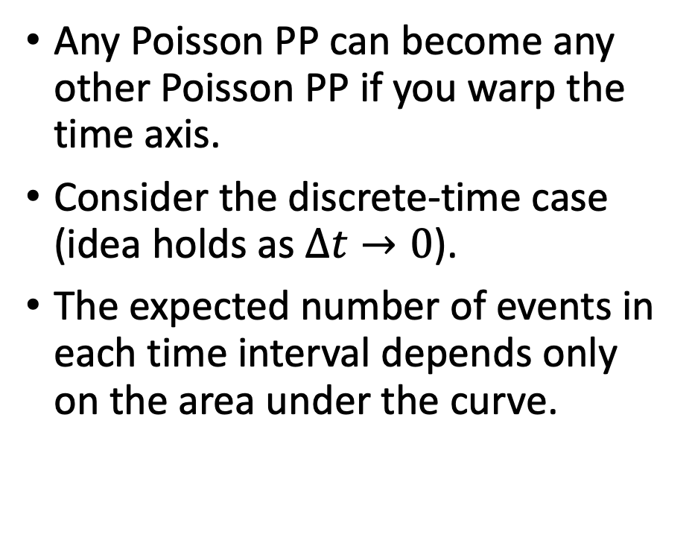
Inversion (time warping)
Any Poisson PP can become any other Poisson PP if you warp the time axis.
Consider the discrete-time case (idea holds as $∆t→0$).
The expected number of events in each time interval depends only on the area under the curve.

Slide 16



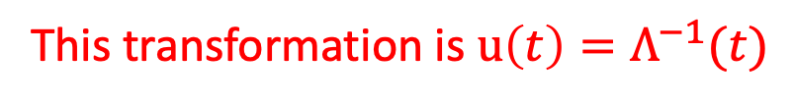
Inversion (time warping)
Change base of rectangles so that the height (intensity) is constant ($λ=1$).
$$λ\left(t\right)$$
$$λ\left(u\left(t\right)\right)$$
This transformation is $u\left(t\right)=Λ^{−1}(t)$

Slide 17
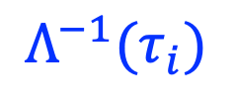
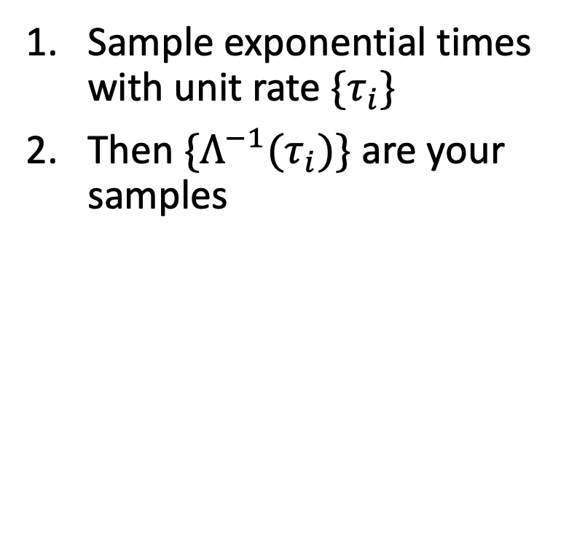
Inversion (time warping)
Sample exponential times with unit rate $\{τ_{i}\}$
Then $\{Λ^{−1}(τ_{i})\}$ are your samples
$$Λ^{−1}(τ_{i})$$
Points of non-homogeneous Poisson PP
Points of homogeneous Poisson PP

Slide 18
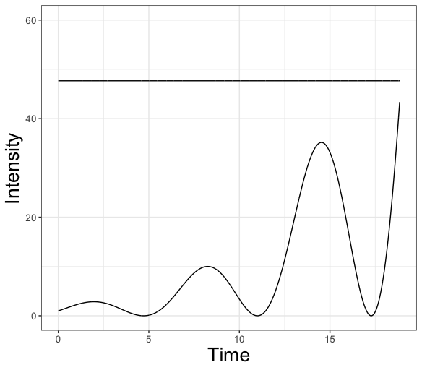
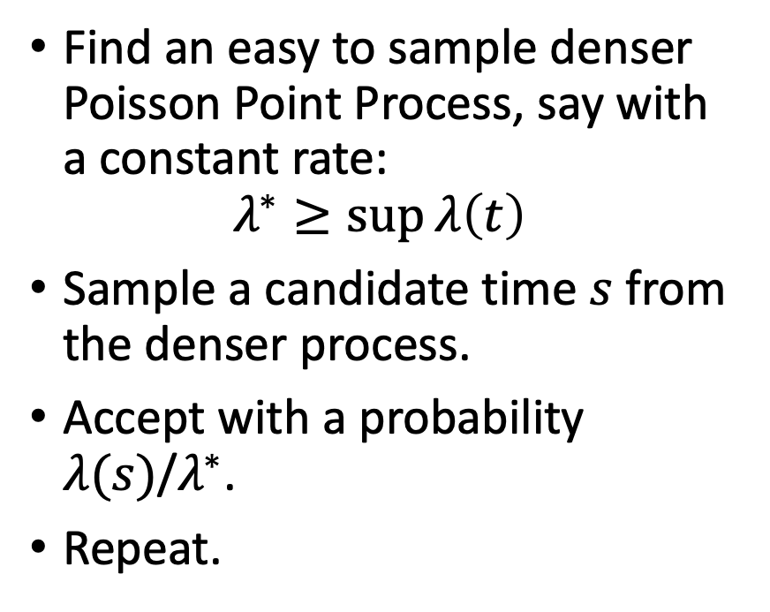


Thinning
Find an easy to sample denser Poisson Point Process, say with a constant rate:
$$λ^{∗}≥\sup{λ\left(t\right)}$$
Sample a candidate time $s$ from the denser process.
Accept with a probability $λ(s)$/$λ^{∗}$.
Repeat.
$$λ^{∗}=1.1⋅sup{λ\left(t\right)}$$
$$λ\left(t\right)$$

Slide 19
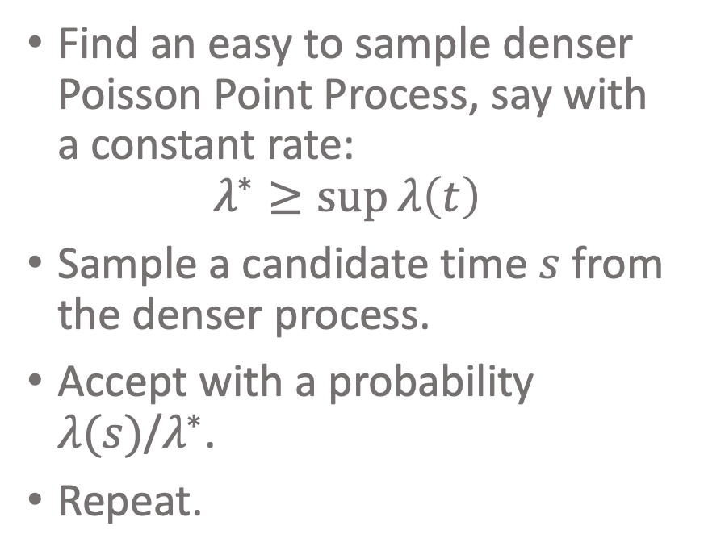


Thinning
Find an easy to sample denser Poisson Point Process, say with a constant rate:
$$λ^{∗}≥\sup{λ\left(t\right)}$$
Sample a candidate time $s$ from the denser process.
Accept with a probability $λ(s)$/$λ^{∗}$.
Repeat.
1.1*$\sup{λ\left(t\right)}$
$$λ\left(t\right)$$

Slide 20
Outline
Introduction
(Poisson) Point Processes (PP) and their dual
Sampling from non homogeneous Poisson PP
Implementation in R
Numerical example

Slide 21
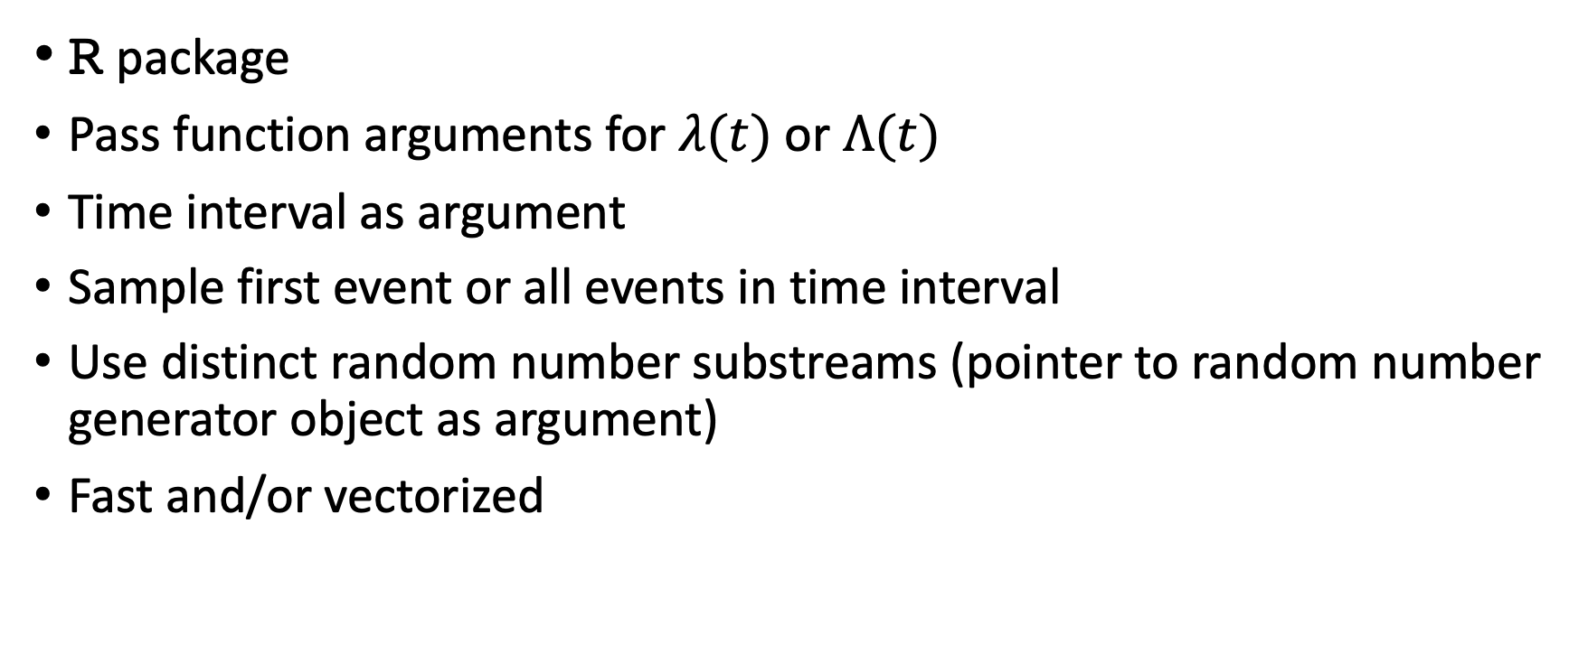
Desiderata
R package
Pass function arguments for $λ(t)$ or $Λ(t)$
Time interval as argument
Sample first event or all events in time interval
Use distinct random number substreams (pointer to random number generator object as argument)
Fast and/or vectorized

Slide 22
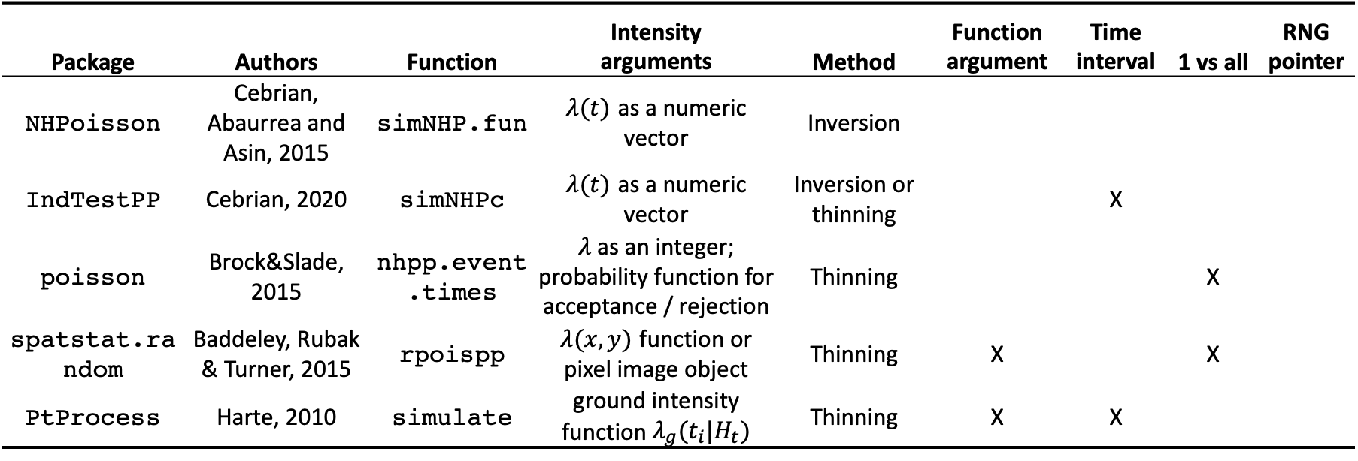
Simulating from NHPPP in R
Package | Authors | Function | Intensity arguments | Method | Function argument | Time interval | 1 vs all | RNG pointer
NHPoisson | Cebrian, Abaurrea and Asin, 2015 | simNHP.fun | $λ(t)$ as a numeric vector | Inversion
IndTestPP | Cebrian, 2020 | simNHPc | $λ(t)$ as a numeric vector | Inversion or thinning |  | X
poisson | Brock&Slade, 2015 | nhpp.event.times | $λ$as an integer; probability function for acceptance / rejection | Thinning |  |  | X
spatstat.random | Baddeley, Rubak & Turner, 2015 | rpoispp | $λ(x,y)$ function or pixel image object | Thinning | X |  | X
PtProcess | Harte, 2010 | simulate | ground intensity function $λ_{g}(t_{i}|H_{t})$ | Thinning | X | X

Slide 23
R package (nhppp)

Slide 24
Outline
Introduction
(Poisson) Point Processes (PP) and their dual
Sampling from non homogeneous Poisson PP
Implementation in R
Numerical example

Slide 25
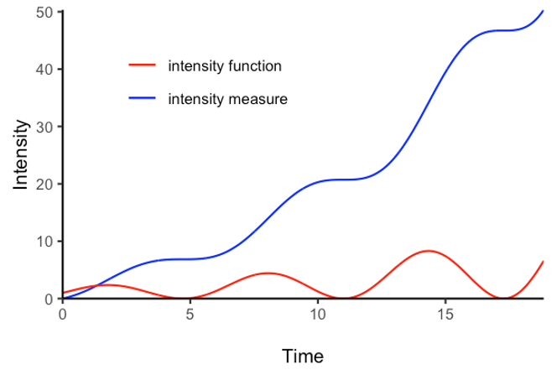
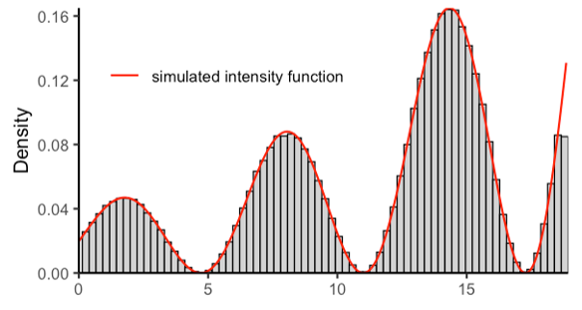
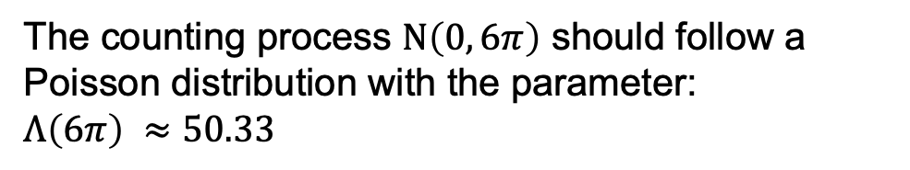
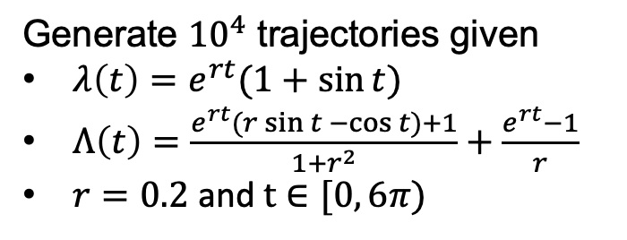


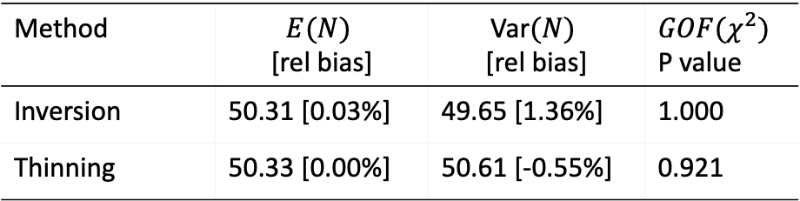
Numerical example
The counting process $N\left(0, 6π\right)$ should follow a Poisson distribution with the parameter:
$Λ\left(6π\right) ≈50.33$
Generate ${10}^{4}$ trajectories given
$λ\left(t\right)=e^{rt}(1+\sin{t)}$
$Λ\left(t\right)=\frac{e^{rt}(r\sin{t −\cos{t})+1}}{1+r^{2}}+\frac{e^{rt}−1}{r}$
$r=0.2$ and $t∈[0, 6π)$
Method​ | $E(N)$ ​ [rel bias]​ | ​Var$(N)$ ​ [rel bias]​ | $GOF(χ^{2})$ ​ P value​
Inversion | 50.31 [0.03%]​ | 49.65 [1.36%]​ | 1.000​
Thinning​ | 50.33 [0.00%]​ | 50.61 [-0.55%]​ | 0.921​
$$Λ\left(t\right)$$
Target intensity function
$$λ\left(t\right)$$

Slide 26
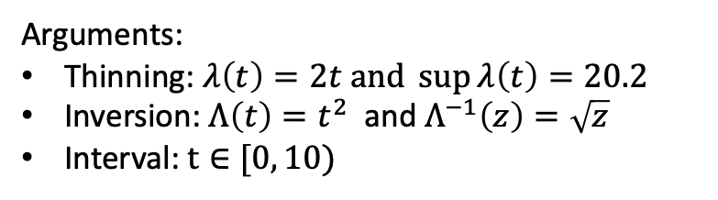




Computational efficiency in R (time, 10 000 runs)
$$M=1080 μs$$
$$M=944 μs$$
Arguments:
Thinning: $λ\left(t\right)=2t and \sup{λ\left(t\right)=20.2}$
Inversion: $Λ\left(t\right)=t^{2}$and $Λ^{−1}\left(z\right)=\sqrt{z}$
Interval: $t∈[0, 10)$
$$M=27 μs$$
$$M=8 μs$$

Slide 27
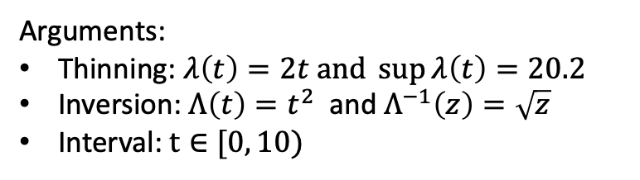




Computational efficiency in R (time, 10 000 runs)
$$M=163 μs$$
$$M=944 μs$$
Arguments:
Thinning: $λ\left(t\right)=2t and \sup{λ\left(t\right)=20.2}$
Inversion: $Λ\left(t\right)=t^{2}$and $Λ^{−1}\left(z\right)=\sqrt{z}$
Interval: $t∈[0, 10)$
$$M=4 μs$$
$$M=8 μs$$

Slide 28

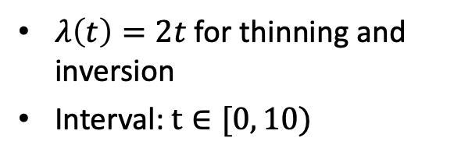



What if we don’t have “the best” arguments?
$$M=927 μs$$
$$M=914 μs$$
$λ\left(t\right)=2t$ for thinning and inversion
Interval: $t∈[0, 10)$
$$M=977 μs$$
$$M=8 μs$$

Slide 29

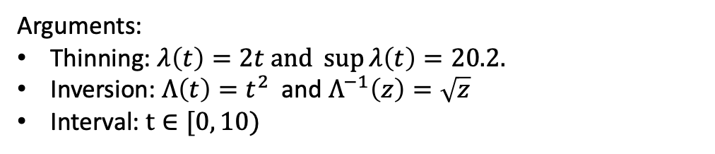







Computational efficiency in R vs. C++ (time, 10 000 runs)
Arguments:
Thinning: $λ\left(t\right)=2t and \sup{λ\left(t\right)=20.2.}$
Inversion: $Λ\left(t\right)=t^{2}$and $Λ^{−1}\left(z\right)=\sqrt{z}$
Interval: $t∈[0, 10)$
$$M=4 μs$$
$$M=163 μs$$
$$M=8 μs$$
$$M=944 μs$$
$$M=2 μs$$
$$M=4 μs$$
$$M=5 μs$$
$$M=19 μs$$

Slide 30
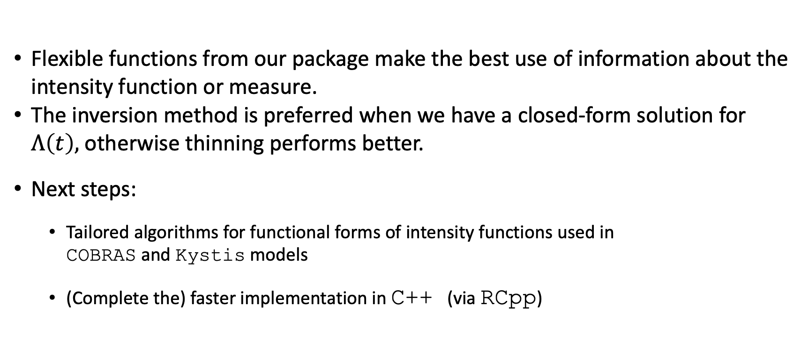
Final remarks
Flexible functions from our package make the best use of information about the intensity function or measure.
The inversion method is preferred when we have a closed-form solution for $Λ\left(t\right),$ otherwise thinning performs better.
Next steps:
Tailored algorithms for functional forms of intensity functions used in COBRAS and Kystis models
(Complete the) faster implementation in C++ (via RCpp)

Slide 31
Thank You
{sereda_yuliia, thomas_trikalinos}@brown.edu

