Slide 1
Section 3: Sampling

Slide 2
Three important properties of NHPPPs

Slide 3
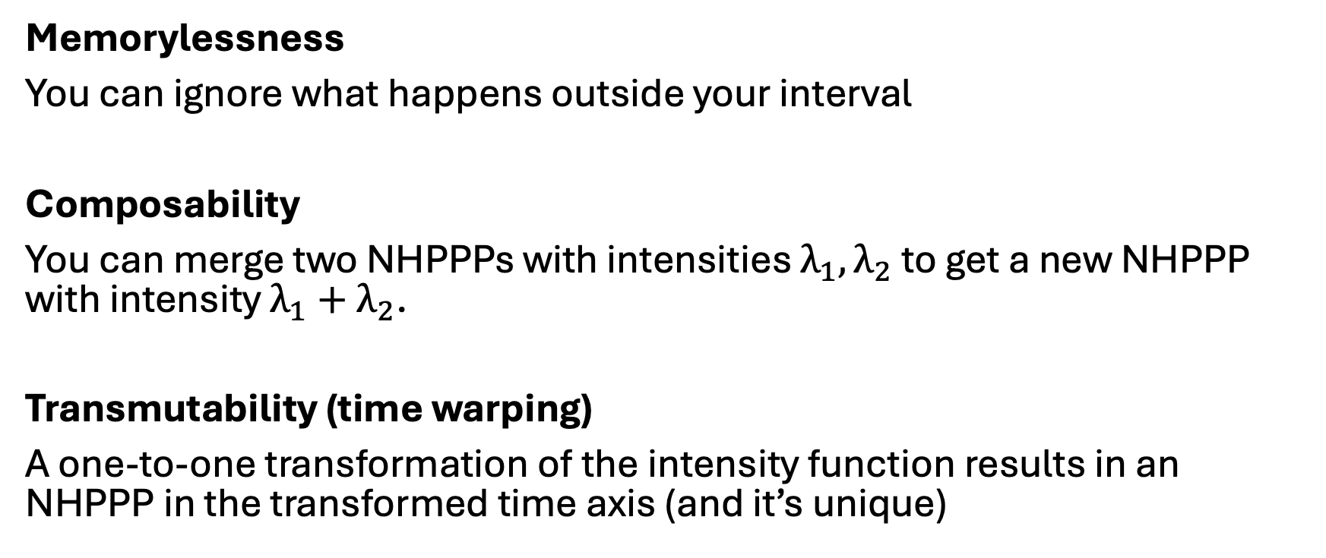
Three important properties for sampling
Memorylessness
You can ignore what happens outside your interval
Composability
You can merge two NHPPPs with intensities $λ_{1}, λ_{2}$ to get a new NHPPP with intensity $λ_{1}+λ_{2}$.
Transmutability (time warping)
A one-to-one transformation of the intensity function results in an NHPPP in the transformed time axis (and it’s unique)

Slide 4
Composability

Slide 5
Transmutability

Slide 6






Constant intensity function (homogeneous PPP)
Sampling from a constant intensity function is easy.
The interarrival times have an exponential distribution.
$λ$ constant
$$Z_{(i)}−Z_{\left(i−1\right)}\sim Exponential(λ)$$
$$Z_{(0)}$$
$$Z_{(1)}$$
$$Z_{(2)}$$
$$Z_{(4)}$$

Slide 7
Piecewise constant intensity function (NHPPP)
Look at each piecewise constant interval separately
In each interval you have a constant intensity (easy)
Return the union of all events
Sampling from piecewise constant intensities is easy (memorylessness)

Slide 8
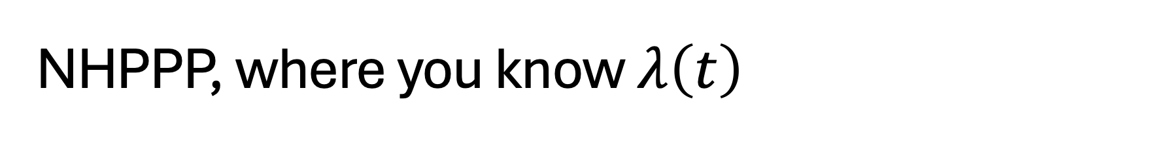
NHPPP, where you know $λ\left(t\right)$
The general case is more challenging

Slide 9
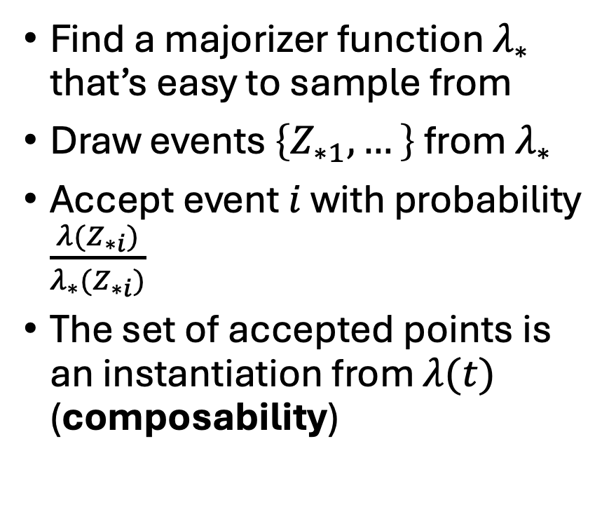
NHPPP, where you know $λ\left(t\right)$
Find a majorizer function $λ_{∗}$ that’s easy to sample from
Draw events $\left\{Z_{∗1},…\right\}$ from $λ_{∗}$
Accept event $i$ with probability $\frac{λ(Z_{∗i})}{λ_{∗}(Z_{∗i})}$
The set of accepted points is an instantiation from $λ(t)$ (composability)

Slide 10
Next … Section 4: Hands-on example (simple case)

