Slide 1
Sunday 27th of October 8:30 to 12:00
Time | Description | Discussant
[15 min] | (0) Introductions and administrivia | Trikalinos
[25 min] | (1) DES as a composition of point processes | Alarid-Escudero
[30 min] | (2) NHPPPs – key properties | Trikalinos
[30 min] | (3) Sampling from NHPPPs | Sereda
[15 min] | Break
[80 min] | (4) Guided exercise: Implement a simple cancer natural history DES for one person The many-person case Packaging | [All] Chrysanthopoulou Sereda/Alarid-Escudero Trikalinos
[10 min] | (5) Advanced Topic Teaser on self-excitatory processes: point processes that are not NHPPPs and when you may need them | Trikalinos
[15 min] | General Q & A | All

Slide 2
Section 2: Theory

Slide 3
The building block

Slide 4
The point process
A scheme that generates a sequence of events (points) over a time interval
interval of interest

Slide 5
The point process
A scheme that generates a sequence of events (points) over time
An instantiation (trajectory) of the process is a sequence of 0, 1 or more events in the interval, but none outside it
events or points,
(same thing)
interval of interest

Slide 6
The point process
A scheme that generates a sequence of events (points) over time
Each instantiation is random
another instantiation (trajectory)

Slide 7
The point process
A scheme that generates a sequence of events (points) over time
Each instantiation is random
another instantiation
(with no events)

Slide 8
The point process
A scheme that generates a sequence of events (points) over time
Each instantiation is random
yet another instantiation

Slide 9
The point process
The arrival times (times of the events) are random
They start from whenever we zeroed the clock
arrival times

Slide 10
The point process
The interarrival times are the lengths of the interarrival time intervals
The arrival times and interarrival times give the same information (… thus, the interarrival times are random)
interarrival intervals

Slide 11
The point process
Hereon, we refer only to arrival times
interarrival intervals
arrival times

Slide 12
Modeling non-repeatable events
If the point process models a nonrepeatable event, we care only about the earliest event.
Will it occur in the interval, and, and if so, when?
Example: model a cause of death
ignore these events
(they are undefined –
they have no meaning)
earliest event

Slide 13
Modeling repeatable events
If the point process models a repeatable event, we care are about all events.
Will any occur in the interval, and, and if so, when?
Example: model the emergence of tumors, or the start of symptomatic episodes
all events are defined – all events have a meaning

Slide 14
The Poisson point process
There are many types of point processes
We will consider only a one type – the Poisson point process

Slide 15
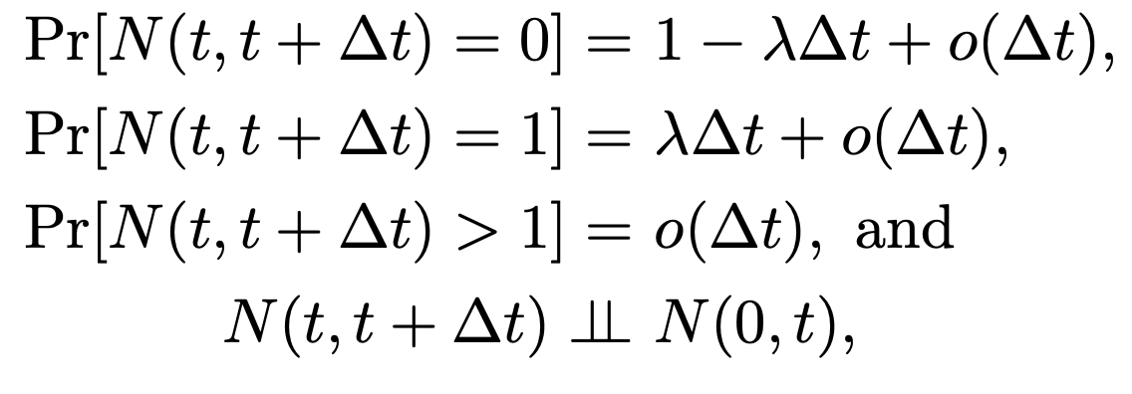



The Poisson point process
Number of events between $t$ and $t+Δt$
If for a sequence of events
for some $λ>0$ and as $Δt→0$, then that sequence is a Poisson point process
$o(Δt)$ becomes 0 very fast

Slide 16
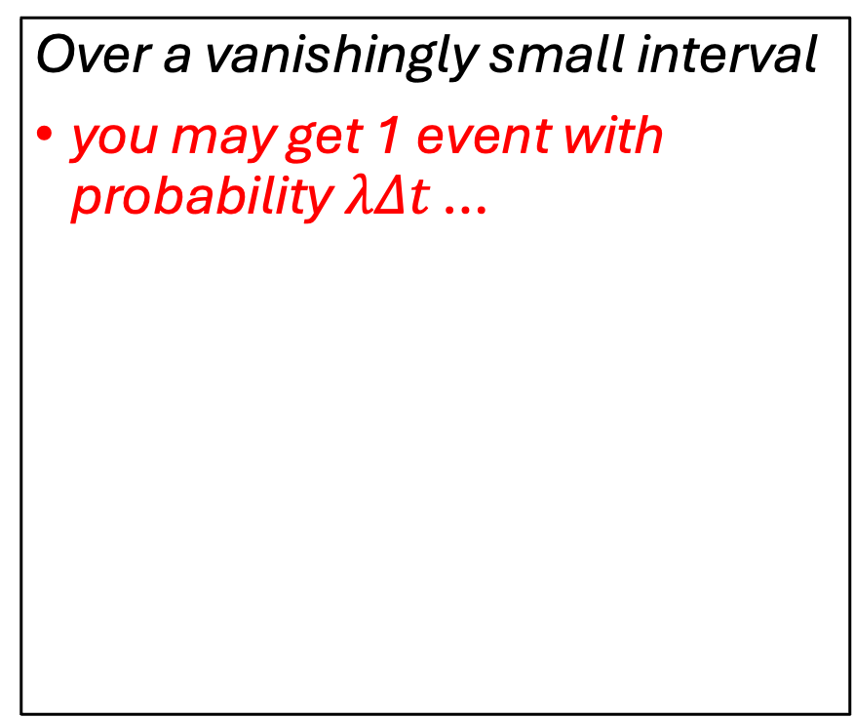

The Poisson point process (in English)
If for a sequence of events
for some $λ>0$ and as $Δt→0$, then that sequence is a Poisson point process
Over a vanishingly small interval
you may get 1 event with probability $λΔt$ …
0

Slide 17
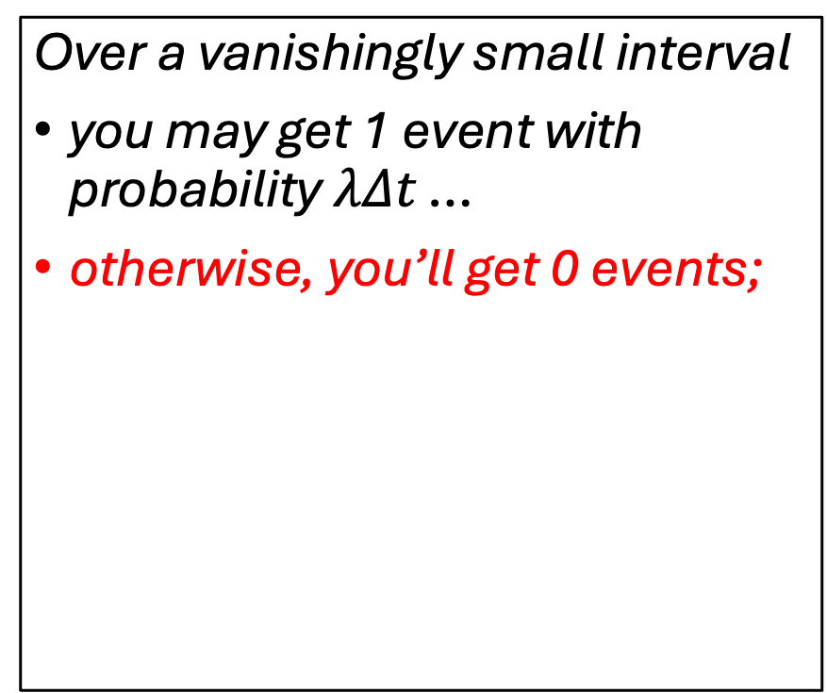
The Poisson point process (in English)
If for a sequence of events
for some $λ>0$ and as $Δt→0$, then that sequence is a Poisson point process
Over a vanishingly small interval
you may get 1 event with probability $λΔt$ …
otherwise, you’ll get 0 events;
0

Slide 18
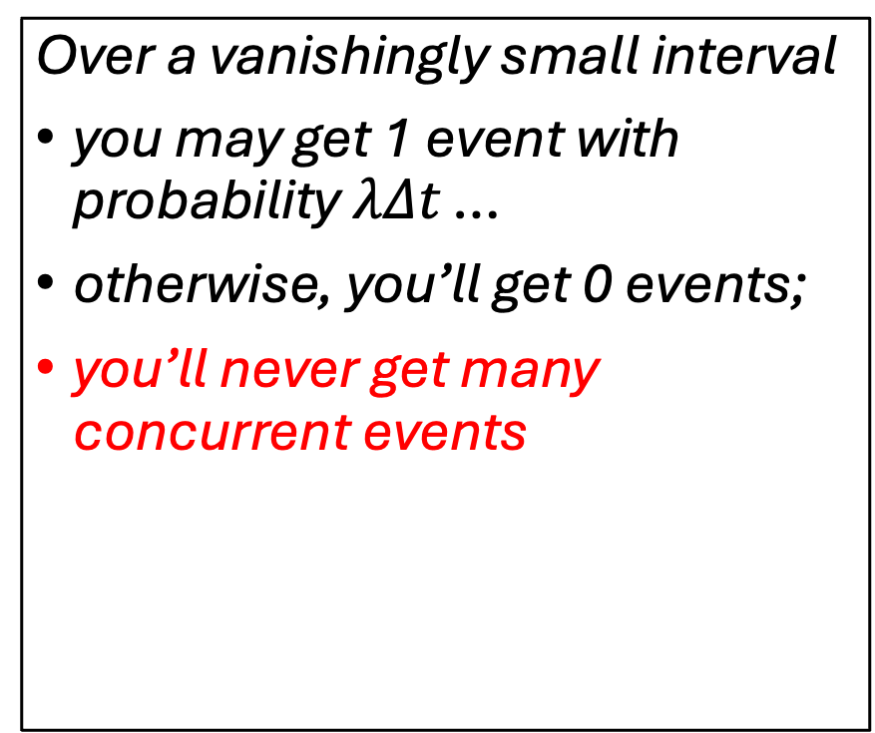
The Poisson point process (in English)
If for a sequence of events
for some $λ>0$ and as $Δt→0$, then that sequence is a Poisson point process
Over a vanishingly small interval
you may get 1 event with probability $λΔt$ …
otherwise, you’ll get 0 events;
you’ll never get many concurrent events
0

Slide 19
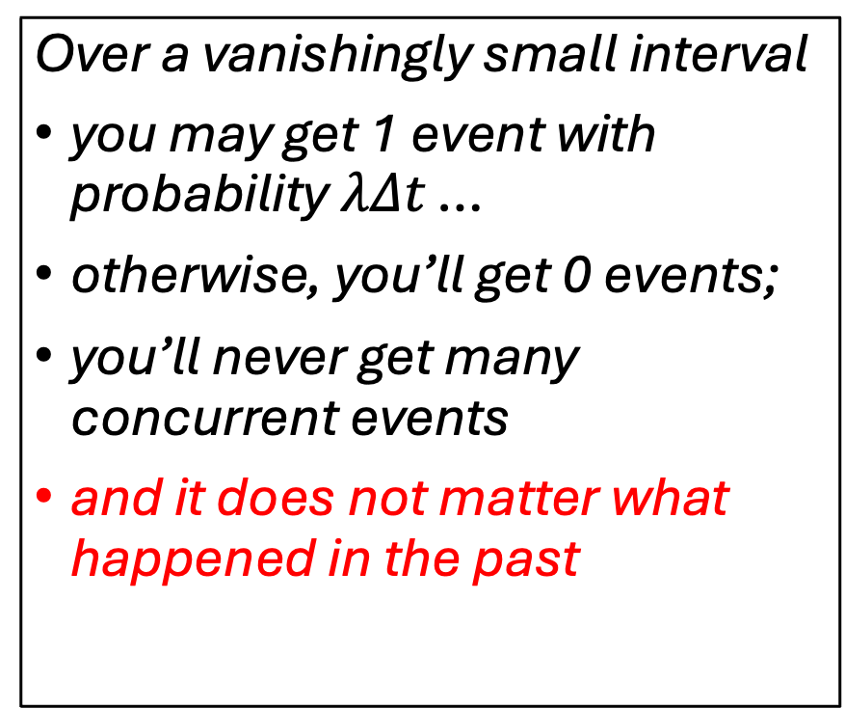
The Poisson point process (in English)
If for a sequence of events
for some $λ>0$ and as $Δt→0$, then that sequence is a Poisson point process
Over a vanishingly small interval
you may get 1 event with probability $λΔt$ …
otherwise, you’ll get 0 events;
you’ll never get many concurrent events
and it does not matter what happened in the past
0

Slide 20

The intensity function $λ$ in the example
Event times for five instantiations

Slide 21
The intensity function $λ$ in the example
A histogram of the event times for 100 instantiations

Slide 22
The intensity function $λ$ in the example
… for 1000 instantiations

Slide 23
The intensity function $λ$ in the example
… and for 10000 instantiations

Slide 24
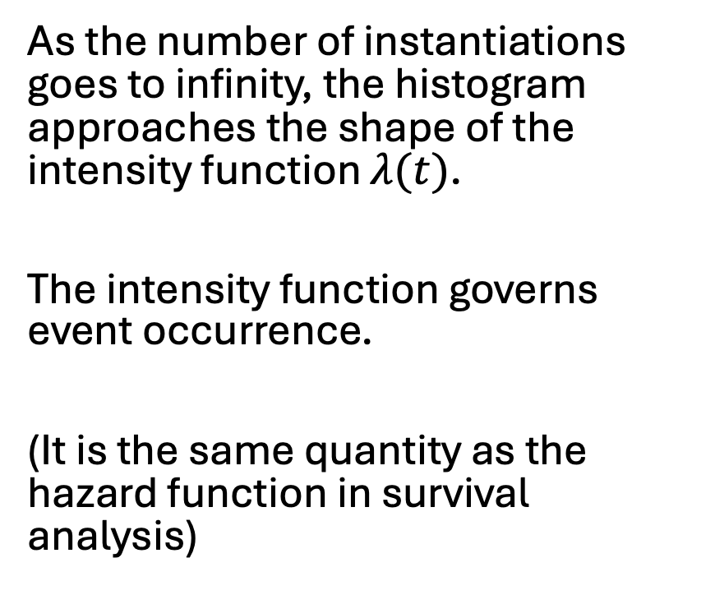

The intensity function $λ$ in the example
As the number of instantiations goes to infinity, the histogram approaches the shape of the intensity function $λ(t)$.
The intensity function governs event occurrence.
(It is the same quantity as the hazard function in survival analysis)
$$λ\left(t\right)$$
The intensity function is scaled by the expected number of events in the interval to be on the same plot

Slide 25
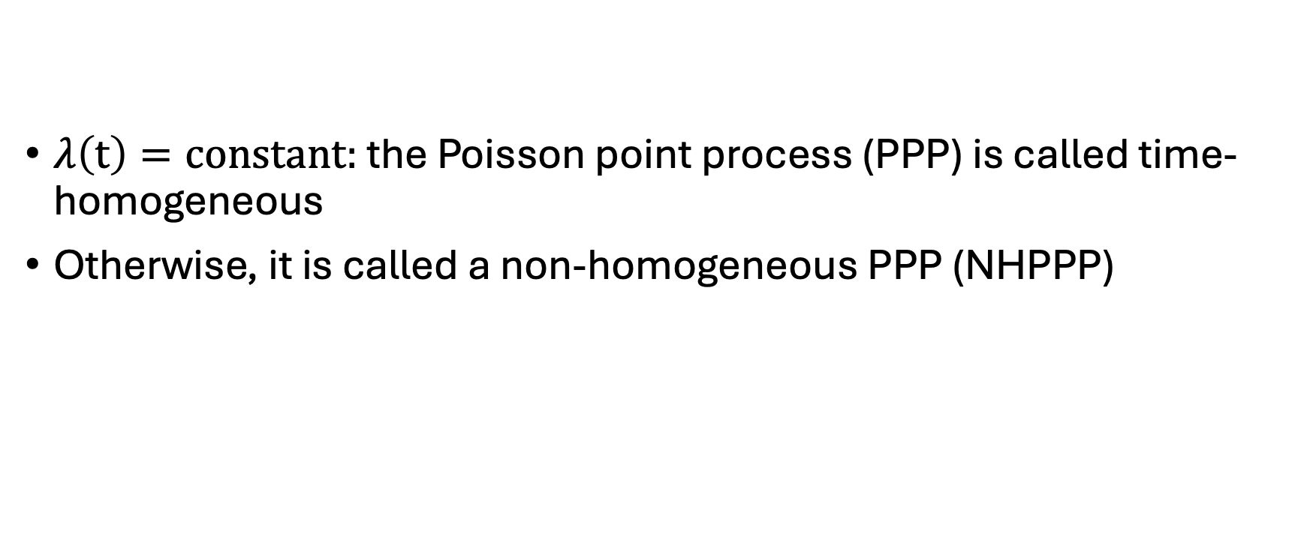
Time-homogeneous and non-homogeneous
$λ\left(t\right)=constant:$ the Poisson point process (PPP) is called time-homogeneous
Otherwise, it is called a non-homogeneous PPP (NHPPP)

Slide 26
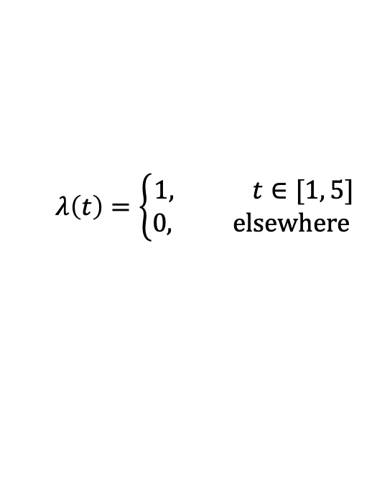
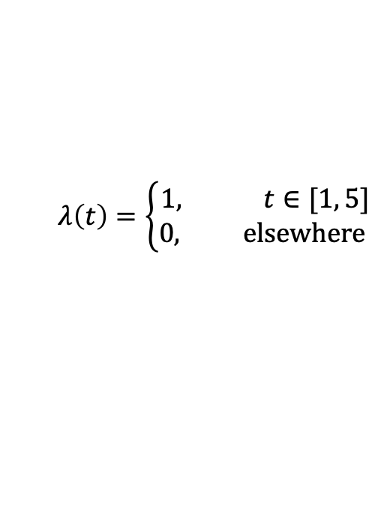
All events vs earliest event in the example
All events, 10K instantiations
Earliest event, 10K instantiations
$$λ\left(t\right)=\left\{\begin{aligned}1, t∈[1, 5] \\ &0, elsewhere \end{aligned}\right.$$
$$λ\left(t\right)=\left\{\begin{aligned}1, t∈[1, 5] \\ &0, elsewhere \end{aligned}\right.$$
The histogram of the earliest event times does not approach the shape of the intensity function

Slide 27
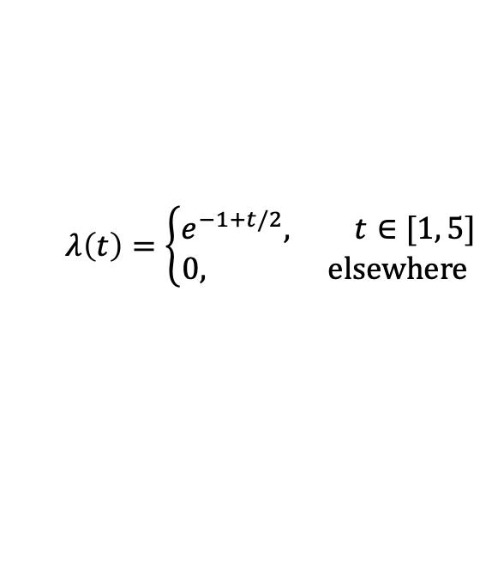
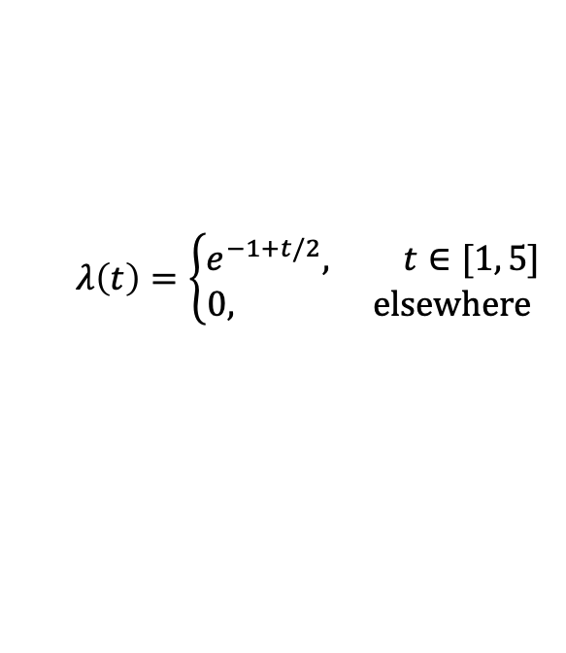
All events vs earliest event, different example
All events, 100K instantiations
Earliest event, 100K instantiations
$$λ\left(t\right)=\left\{\begin{aligned}e^{−1+t/2}, t∈[1, 5] \\ &0, elsewhere \end{aligned}\right.$$
$$λ\left(t\right)=\left\{\begin{aligned}e^{−1+t/2}, t∈[1, 5] \\ &0, elsewhere \end{aligned}\right.$$

Slide 28
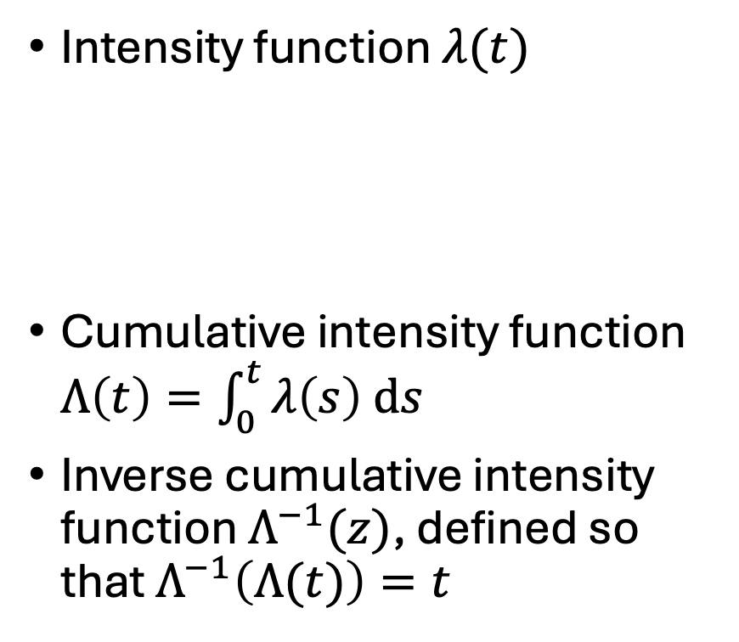
The three important functions
Intensity function $λ(t)$
Cumulative intensity function $Λ\left(t\right)=\int_{0}^{t}{λ\left(s\right) ds}$
Inverse cumulative intensity function $Λ^{−1}(z)$, defined so that $Λ^{−1}\left(Λ(t)\right)=t$
Always available
Sufficient to sample from any NHPPP efficiently and accurately
Not always available
If available, you accelerate sampling by several times

Slide 29

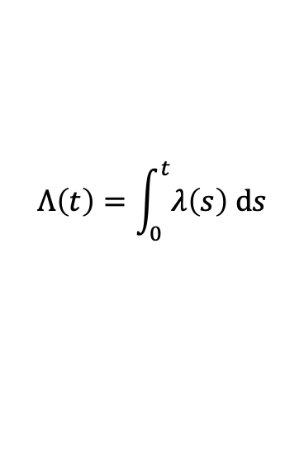
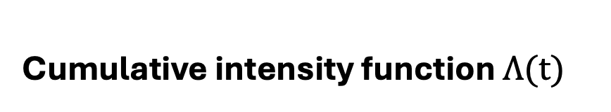
Intensity and cumulative intensity functions
Intensity function $λ(t)$
Cumulative intensity function $Λ(t)$
$$Λ\left(t\right)=\int_{0}^{t}{λ\left(s\right) ds}$$

Slide 30


Intensity and cumulative intensity functions
Intensity function $λ(t)$
Cumulative intensity function $Λ(t)$
$$Λ\left(3.6\right)−Λ(2.3)=1.3$$
$$𝔼\left[N\left(2.3, 3.6\right)\right]=1.3$$

Slide 31
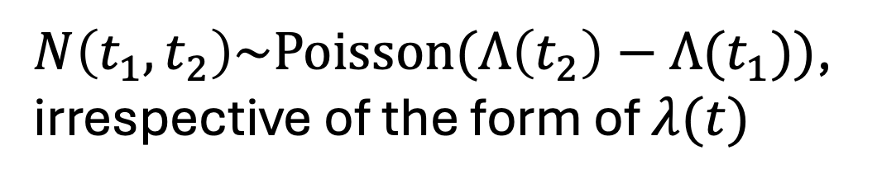


Intensity and cumulative intensity functions
$N\left(t_{1}, t_{2}\right)\sim Poisson(Λ\left(t_{2}\right)−Λ(t_{1}))$,
irrespective of the form of $λ(t)$
$$Λ\left(t_{1}\right)−Λ(t_{2})=𝔼\left[N\left(t_{1} t_{2}\right)\right]$$
$$𝔼\left[N\left(t_{1}, t_{2}\right)\right]=λ(t_{2}−t_{1})$$

Slide 32
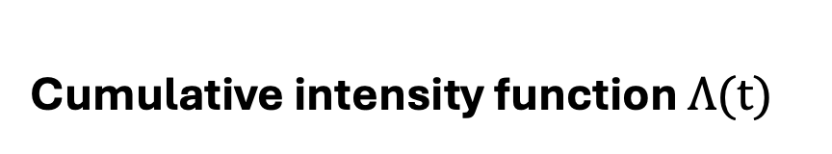
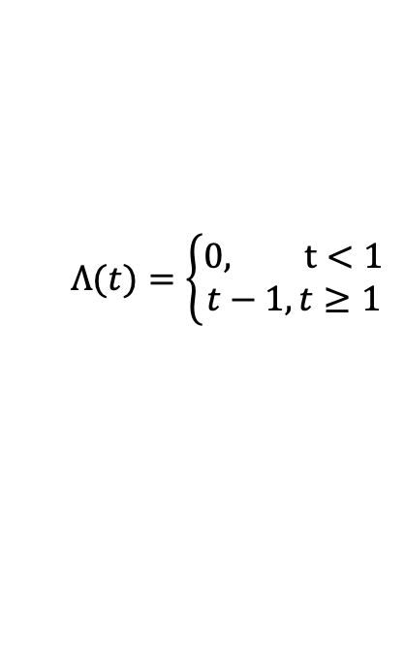
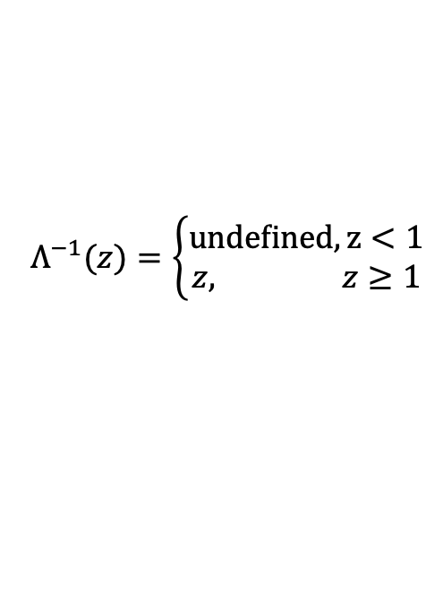
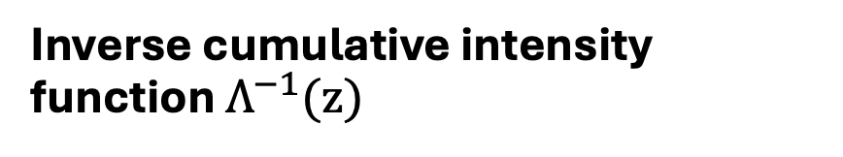
Cumulative intensity function and its inverse
Cumulative intensity function $Λ(t)$
Inverse cumulative intensity function $Λ^{−1}(z)$
$$Λ(t)=\left\{\begin{aligned}&0, t<1 \\ t−1,t≥1\end{aligned}\right.$$
$$Λ^{−1}(z)=\left\{\begin{aligned}undefined, z<1 \\ &z, z≥1\end{aligned}\right.$$

Slide 33
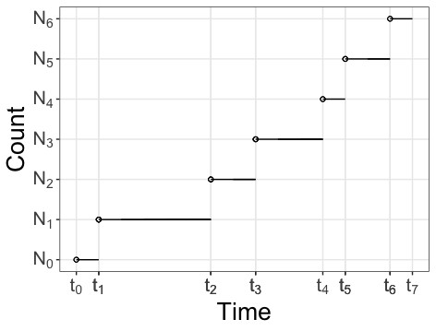

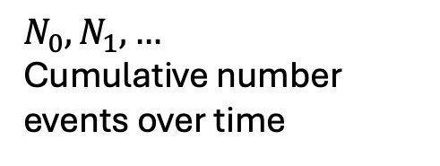
Duality with the Poisson counting process
Poisson counting process
$$N_{0}, N_{1}, …$$
Cumulative number events over time
Poisson point process
$$t_{0}, t_{1},…$$

Slide 34
How does this connect to survival analysis?
The theory of point processes is the foundation of survival analyses
Often survival analysis is about the time to the earliest event
The intensity function is the same hazard function
The cumulative intensity function is the same as the integrated or cumulative hazard function
All the tools that we describe here can be used for statistical simulations for survival analysis

Slide 35
Next … Section 3: Sampling

Slide 36
Sunday 27th of October 8:30 to 12:00
Time | Description | Discussant
[15 min] | (0) Introductions and administrivia | Trikalinos
[25 min] | (1) DES as a composition of point processes | Alarid-Escudero
[30 min] | (2) NHPPPs – key properties | Trikalinos
[30 min] | (3) Sampling from NHPPPs | Sereda
[15 min] | Break
[80 min] | (4) Guided exercise: Implement a simple cancer natural history DES for one person The many-person case Packaging | [All] Chrysanthopoulou Sereda/Alarid-Escudero Trikalinos
[10 min] | (5) Advanced Topic Teaser on self-excitatory processes: point processes that are not NHPPPs and when you may need them | Trikalinos
[15 min] | General Q & A | All

