Slide 1
Section 3: Sampling

Slide 2
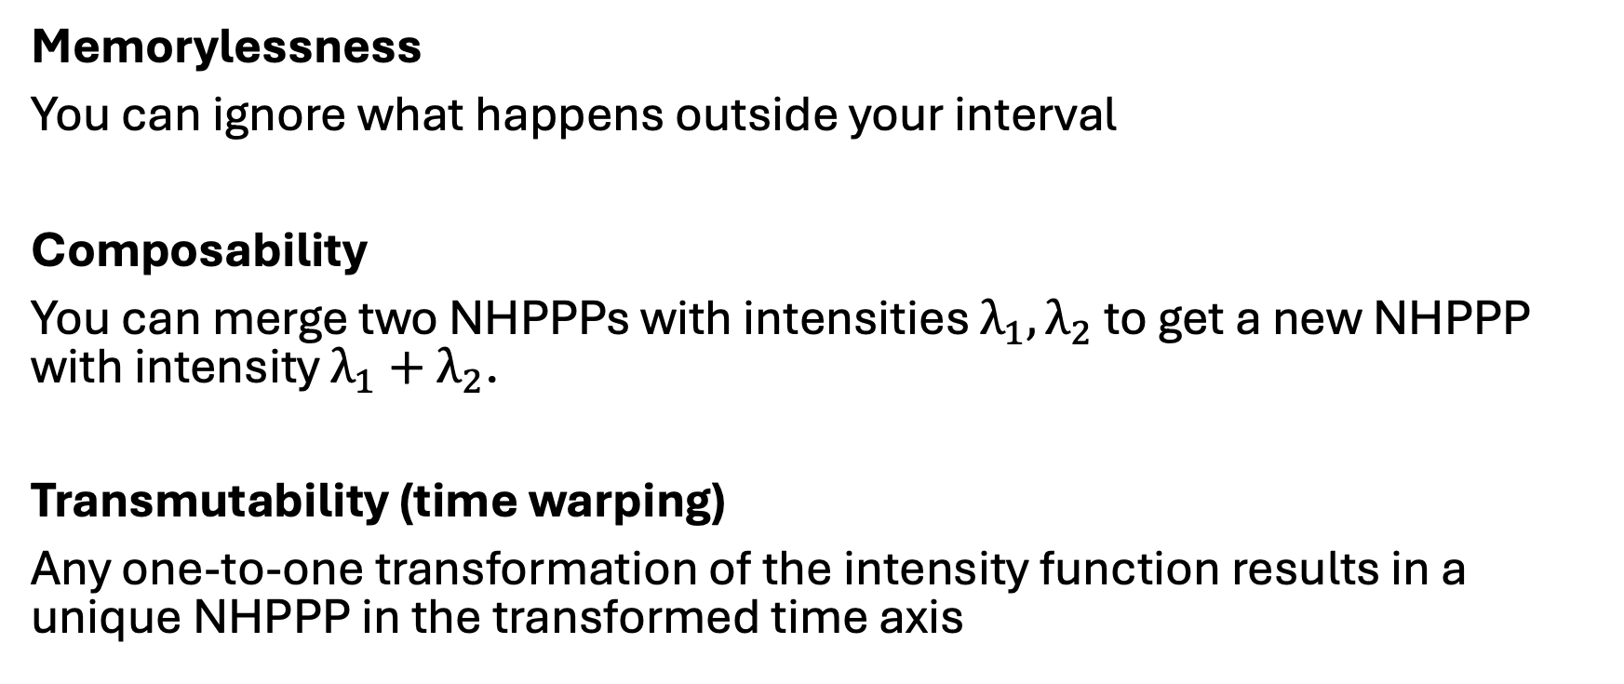
Three important properties for sampling
Memorylessness
You can ignore what happens outside your interval
Composability
You can merge two NHPPPs with intensities $λ_{1}, λ_{2}$ to get a new NHPPP with intensity $λ_{1}+λ_{2}$.
Transmutability (time warping)
Any one-to-one transformation of the intensity function results in a unique NHPPP in the transformed time axis

Slide 3
Composability
+
=

Slide 4






Transmutability
$$u$$
$$u^{−1}$$
$$u(1)$$
$$u(2)$$
$$u(3)$$
$$u(3.5)$$

Slide 5
Transmutability
$$u$$
$$u^{−1}$$

Slide 6






Constant intensity function (homogeneous PPP)
Sampling from a constant intensity function is easy.
The interarrival times have an exponential distribution.
$λ$ constant
$$Z_{(i)}−Z_{\left(i−1\right)}\sim Exponential(λ)$$
$$Z_{(0)}$$
$$Z_{(1)}$$
$$Z_{(2)}$$
$$Z_{(4)}$$

Slide 7
Piecewise constant intensity function (NHPPP)
Look at each piecewise constant interval separately
In each interval you have a constant intensity (easy)
Return the union of all events
Sampling from piecewise constant intensities is easy (memorylessness)

Slide 8


NHPPP, where you know $λ\left(t\right)$ : Thinning
The general case is more challenging
$$λ\left(t\right)=e^{−1+0.5t}$$

Slide 9
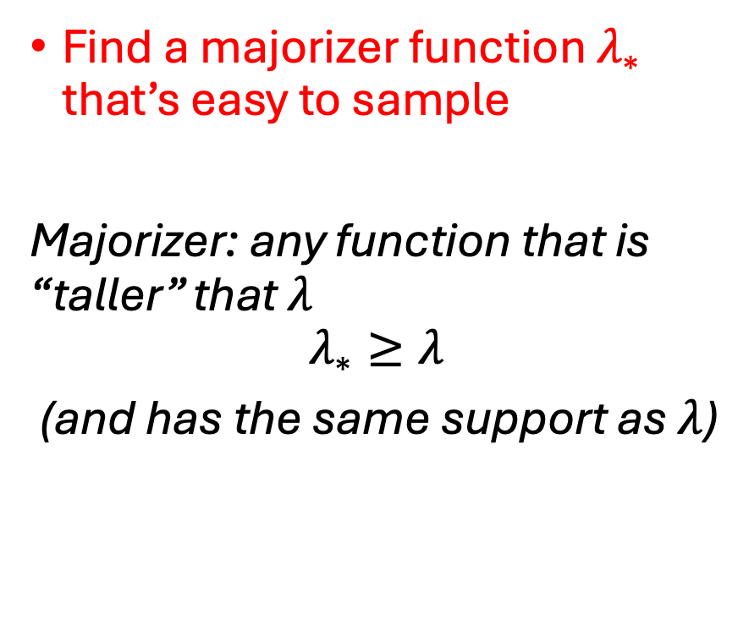

NHPPP, where you know $λ\left(t\right)$ : Thinning
Find a majorizer function $λ_{∗}$ that’s easy to sample
Majorizer: any function that is “taller” that $λ$
$$λ_{∗}≥λ$$
(and has the same support as $λ$)
$$λ_{∗}\left(t\right)=5$$
$$λ\left(t\right)=e^{−1+0.5t}$$

Slide 10

NHPPP, where you know $λ\left(t\right)$ : Thinning
Find a majorizer function $λ_{∗}$ that’s easy to sample
$$λ_{∗}\left(t\right)=λ\left(t\right)+ \left[λ_{∗}\left(t\right)−λ(t)\right]$$
$$λ_{∗}\left(t\right)=5$$
$$λ\left(t\right)=e^{−1+0.5t}$$
Sample proposals from here
Keep proposals conforming to this part
Reject the rest

Slide 11

NHPPP, where you know $λ\left(t\right)$ : Thinning
Find a majorizer function $λ_{∗}$ that’s easy to sample
Draw events $\left\{Z_{∗1},…\right\}$ from $λ_{∗}$

Slide 12


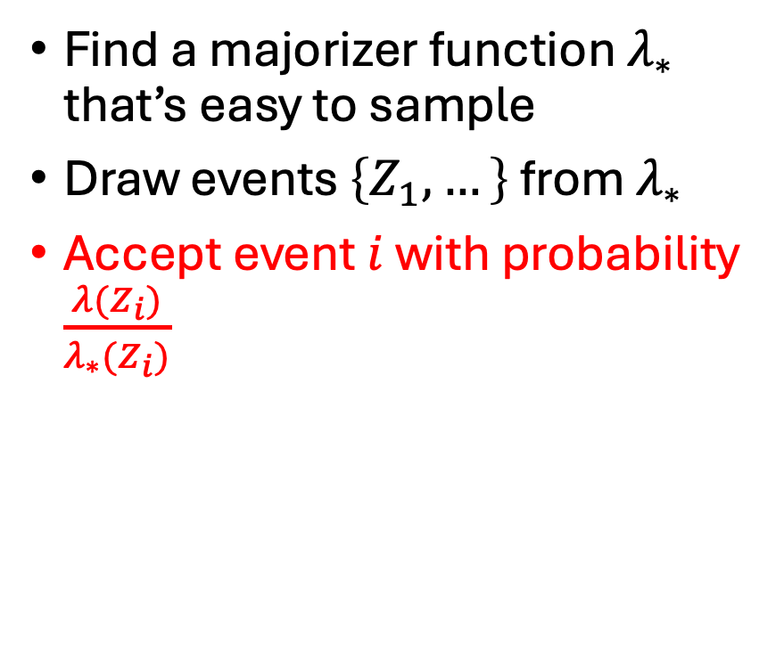
NHPPP, where you know $λ\left(t\right)$ : Thinning
Find a majorizer function $λ_{∗}$ that’s easy to sample
Draw events $\left\{Z_{1},…\right\}$ from $λ_{∗}$
Accept event $i$ with probability $\frac{λ(Z_{i})}{λ_{∗}(Z_{i})}$
$${λ_{∗}(Z}_{\left[1\right]})$$
$${λ(Z}_{\left[1\right]})$$

Slide 13
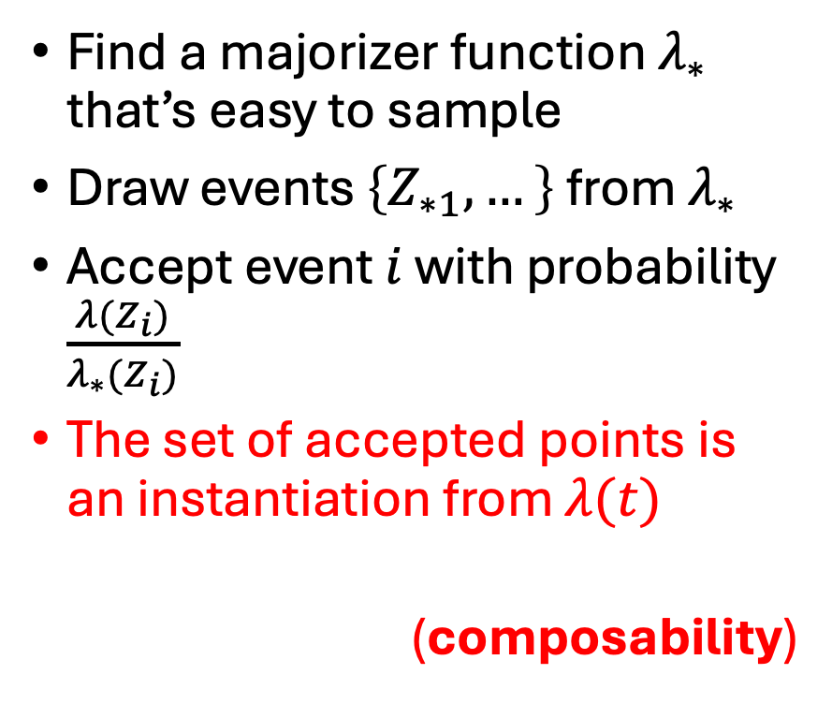

NHPPP, where you know $λ\left(t\right)$: Thinning
Find a majorizer function $λ_{∗}$ that’s easy to sample
Draw events $\left\{Z_{∗1},…\right\}$ from $λ_{∗}$
Accept event $i$ with probability $\frac{λ(Z_{i})}{λ_{∗}(Z_{i})}$
The set of accepted points is an instantiation from $λ(t)$
(composability)

Slide 14
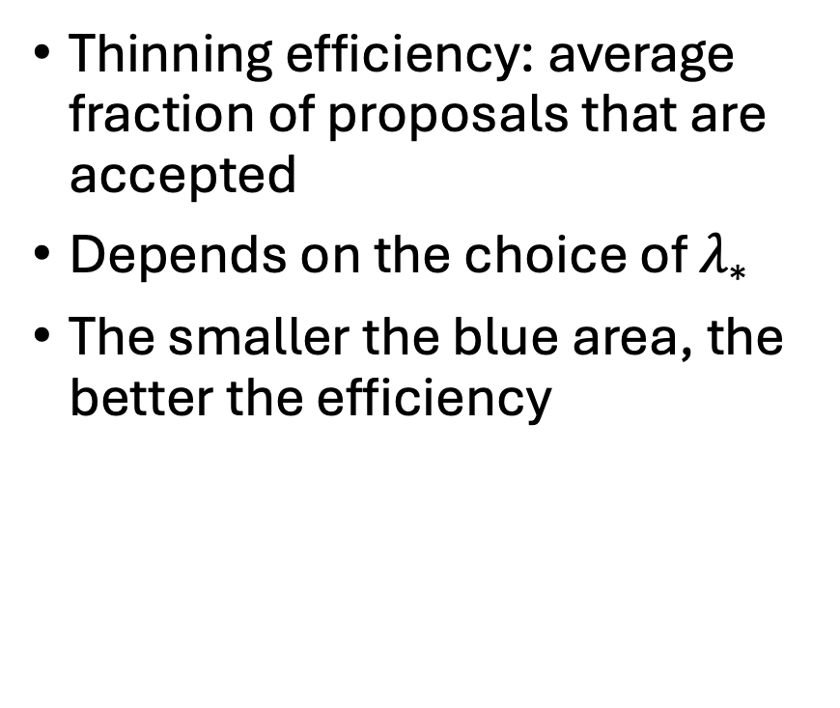
Thinning, efficiency
Thinning efficiency: average fraction of proposals that are accepted
Depends on the choice of $λ_{∗}$
The smaller the blue area, the better the efficiency
Efficiency = 32.9%

Slide 15
Thinning, efficiency
Thinning efficiency: average fraction of proposals that are accepted
Depends on the choice of $λ_{∗}$
The smaller the blue area, the better the efficiency
Efficiency = 36.7%

Slide 16
Thinning, efficiency
Thinning efficiency: average fraction of proposals that are accepted
Depends on the choice of $λ_{∗}$
The smaller the blue area, the better the efficiency
Efficiency = 78.7%

Slide 17

When you know $Λ$ and $Λ^{−1}$

Slide 18
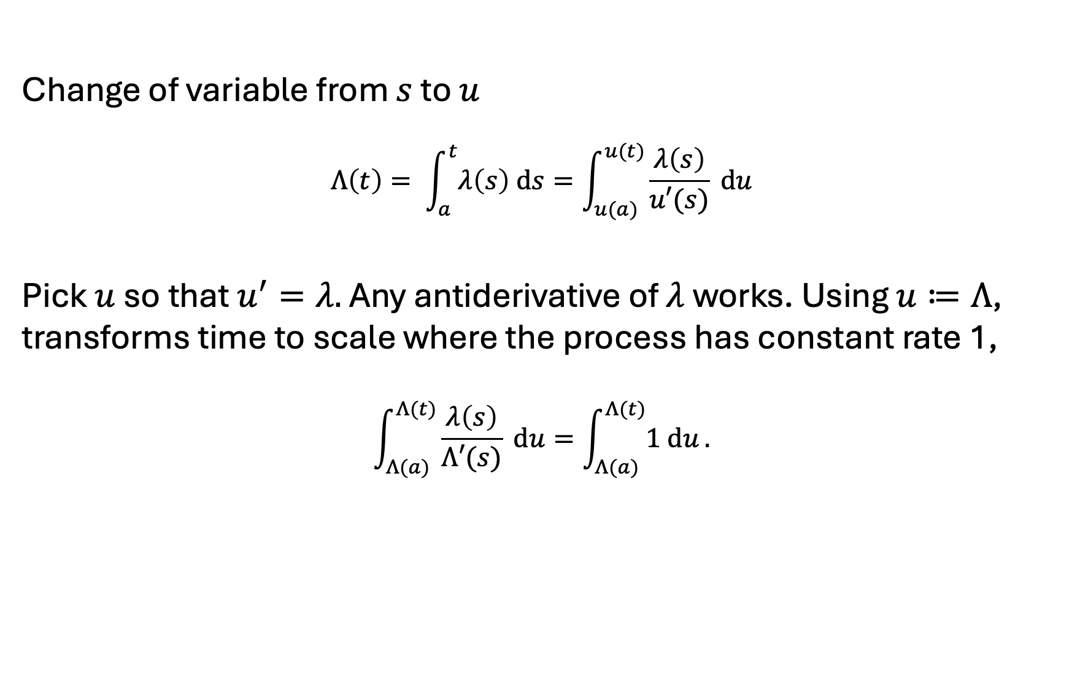

A nice $u$ is $Λ$ (and then $u^{−1}$ is $Λ^{−1}$)
Change of variable from $s$ to $u$
$$Λ\left(t\right)= \int_{a}^{t}{λ\left(s\right) ds}=\int_{u(a)}^{u(t)}{\frac{λ\left(s\right)}{u′(s)} du}$$
Pick $u$ so that $u^{′}=λ.$ Any antiderivative of $λ$ works. Using $u≔Λ$, transforms time to scale where the process has constant rate 1,
$$\int_{Λ(a)}^{Λ(t)}{\frac{λ\left(s\right)}{Λ′(s)} du=\int_{Λ(a)}^{Λ(t)}{1 du}.}$$
This is a sketch of the formal proof – omitting the rigorous bits

Slide 19
Next … Section 4: Hands-on example (simple case)

