Slide 1
10
64
64
128
128
64
64
32
32
2
input
image
output
segmentation
map
256 x 256
256 x 256
256 x 256
256 x 256
256 x 256
256 x 256
256 x 256
256 x 256
256 x 256
256 x 256
128
32
32
64
128
128
256
64
64
256 x 256
256 x 256
conv 1x1, BN, ReLU
128²
128²
128²
conv 3x3, BN, ReLU
128²
128²
128²
max pool 2x2
128
256
128
bilinear upsample
ASPP
copy and crop
64²
64²
64²
attention gate

Slide 2
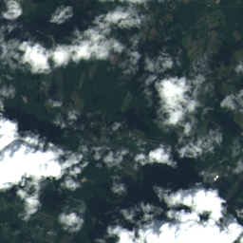
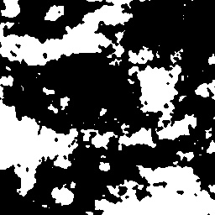
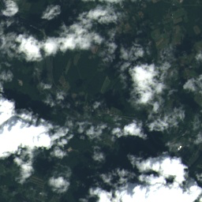
High-dimensional feature maps
Stage1:spectral feature extraction
Stage2:spatial feature extraction

Slide 3
10
64
64
128
128
64
64
32
32
input
image
256 x 256
256 x 256
256 x 256
256 x 256
256 x 256
256 x 256
256 x 256
256 x 256
256 x 256

Slide 4
10
64
64
128
32
32
input
image
256 x 256
256 x 256
256 x 256
256 x 256
256 x 256
64
128
128
256
64
64
conv 1x1, BN, ReLU
128²
128²
128²
128²
128²
128²
conv 3x3, BN, ReLU
max pool 2x2
128
256
128
bilinear upsample
64²
64²
ASPP
copy and crop
64²

Slide 5
1x1 conv
Input feature map
output feature map
Conv
kernel: 3x3
rate: 1
Conv
kernel: 3x3
rate: 2
Conv
kernel: 3x3
rate: 5

Slide 6
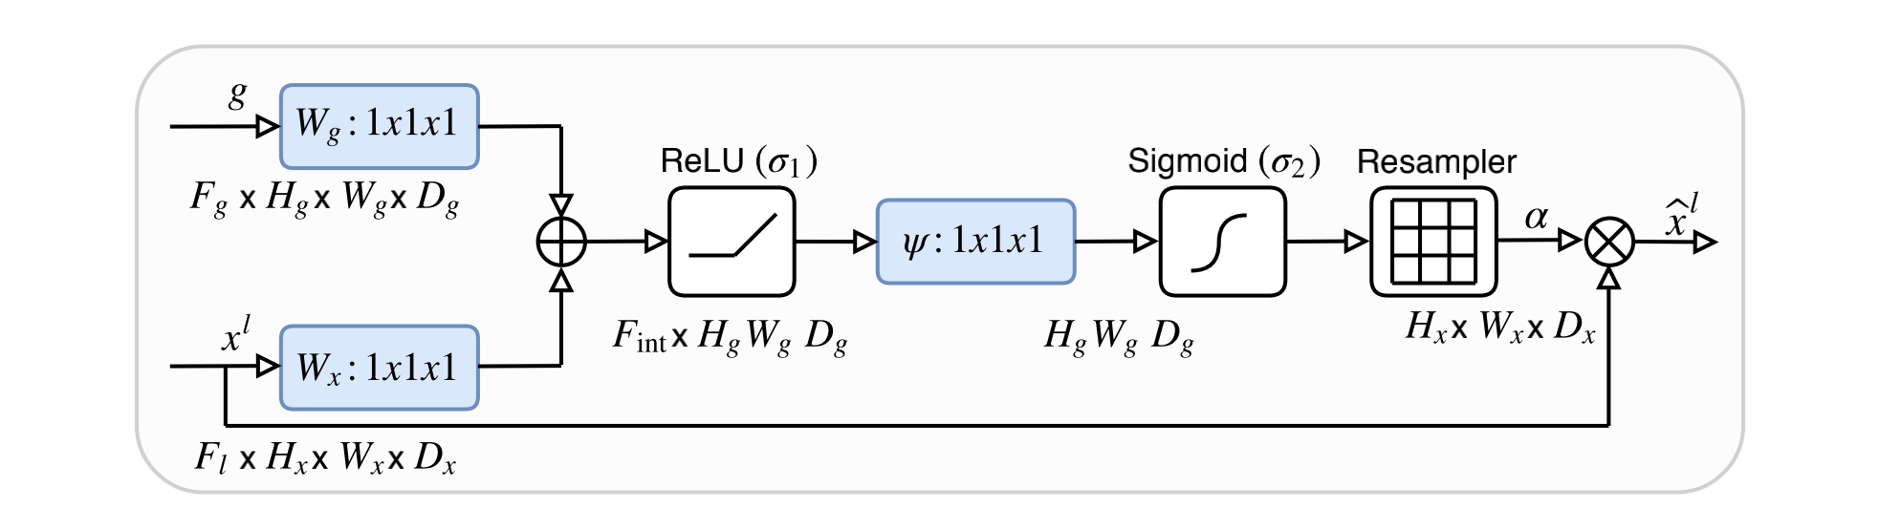
$$g$$
w_{g}:1x1xF_{int}
ReLU(σ₁)
Sigmoid(σ₂)
$$β$$
$$α$$
$$\overline{f}$$
w:1x1x1
$$f$$
w_{f}:1x1xF_{int}

Slide 7
10
64
128
128
64
3
input
image

Slide 8
Spectral extraction
Spatial extraction
10
64
64
128
128
64
64
32
32
3
6
3
2
input
output
256 x 256
256 x 256
256 x 256
256 x 256
256 x 256
256 x 256
256 x 256
256 x 256
256 x 256
256 x 256
3
3x32
3x32
6x32
3x32
3
conv 1x1, BN, ReLU
group conv 3x3, BN, ReLU
128²
128²
128²
128²
128²
128²
max pool 2x2
bilinear upsample
copy and crop
3*32
3x64
3x64
64²
64²
64²

Slide 9
1
2
1
input feature map
output feature map
256 x 256
256 x 256
1
32
32
64
32
32
conv 1x1, BN, ReLU
128²
128²
128²
128²
128²
128²
conv 3x3, BN, ReLU
max pool 2x2
32
64
64
bilinear upsample
64²
64²
64²
copy and crop

Slide 10
c_{o} filters
c_{i}
c_{o}
*
…
H
H
W
W
c_{o} filters with 2 groups
c_{i}
c_{o}
*
…
H
H
W
W

Slide 11
Spectral
extraction
Auxiliary classify
ans loss
Input image
Spatial
extraction
Final classify
ans loss

