Slide 1

PROJECT FINAL PRESENTATION
ADVENTURE WORKS July 8 2025
GROUP 5

Slide 2
Team
1.DIVYA KUMARI
2. KARUTURI ANUHYA
3. MANASIR E
4. SUDAMA RANGAPPA TALWAR
5. NALLABANDA JAGADEESH KUMAR
6. PAVAN VILAS WADURKAR
7. AKHILESH ASHOK SHAHAPURKAR

Slide 3
PROJECT TIME LINE
Review 1
June 17, 2025
Review 2
June 24, 2025
Review 3
July 01, 2025
Final Review
July 08, 2025
Introduced interactive Excel dashboards and finalized KPIs, incorporating stakeholder feedback.
Created interactive dashboard in Tableau, showcasing advanced visualizations with MySQL.
Created interactive dashboards in and Power BI, showcasing advanced visualizations.
The Final review polished dashboards presenting key business insights and demonstrating the project’s success in enabling informed decision making.
Final Review July 08, 2025

Slide 4
AGENDA :
1. Introduction
2. Dataset overview and Information
3. Business problem & Analysis
4. Objective
5. KPI’s & Insights
6. SQL Outputs
7. Dashboards in Excel, Tableau & Power BI
8. Conclusion

Slide 5
INTRODUCTION
Adventure Works Cycles is a large, multinational manufacturing company. The company manufactures and sells metal and composite bicycles to North American, European and Asian commercial markets. While its base operation is in Bothell, Washington with 290 employees, several regional sales teams are located throughout their market base.
Adventure Works Cycles is looking to broaden its market share by targeting their sales to their best customers, extending their product availability through an external Web site, and reducing their cost of sales through lower production costs.
They are focusing on increasing market share, reducing costs, and targeting key customers. The project will involve analyzing the company’s sales, production, and customer data using Excel, Tableau, MYSQL, Power BI…

Slide 6
DATA OVERVIEW
Source: Adventure Works Cycles provides sample datasets which include 8 tables like FactInternetSales, Fact_Internet_Sales_New, DimProduct, DimProductCategory, DimProductSubcategory, DimCustomer, DinSalesTerritory and DimDate.
Data Points: Sales data, Product details, Customer information, and Regions, Country insights.
Volume: Rows-60000+
Time Line of Data: 2010 to 2014…

Slide 7
DATASET INFORMATION
ABOUT | DESCRIPTION
Domain | Retail/ E-commerce/ Manufacturing
Project | Adventure Works Project
Datasets Used | DimCustomer, DimDate, DimSalesTerritory, DimProduct , DimProductCategory, DimProductSubCategory, Fact_Internet_Sales_new , FactInternetSales
Dataset Type | Microsoft Excel File (.xlsx) Format
Dataset Size | 10.1 MB
Tools To Use | Excel Power Bi Tableau, MySQL

Slide 8
Business Problem
How can Adventure Works optimize Product Sales and Profitability across different Territories and Customer Segments.
To analyse and Identify:
Which Product and Category are performing Best/Worst ?
WHICH PRODUCTS NEED PROMOTIONS AND COST ADJUSTMENTS ?
Which Sales Territories are underperforming ?
What are Customer Buying patterns ?
How seasonality and Demographics affect buying patterns ?...

Slide 9
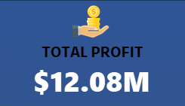
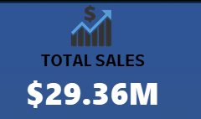
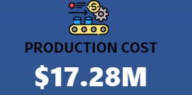
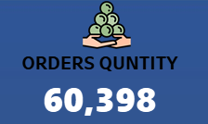
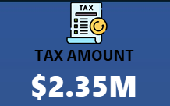
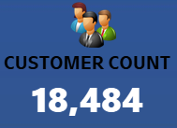
OBJECTIVES : KPI’s
OBJECTIVES:
Identify high-performing products.
Determine sales trends across regions.
Identify the most profitable customers.
KPIs:
TOTAL PROFIT
TOTAL SALES
PRODUCTION COST
ORDERS QUNTITY
TAX AMOUNT
TOTAL CUSTOMERS
CALCULATION’S:
1. Sales Amount = (Unit Price - Unit Discount) × Order Quantity
2. Production Cost = Unit Cost × Order Quantity
3. Profit = sales amount - production cost …

Slide 10
EXCEL DASHBOARD

Slide 11
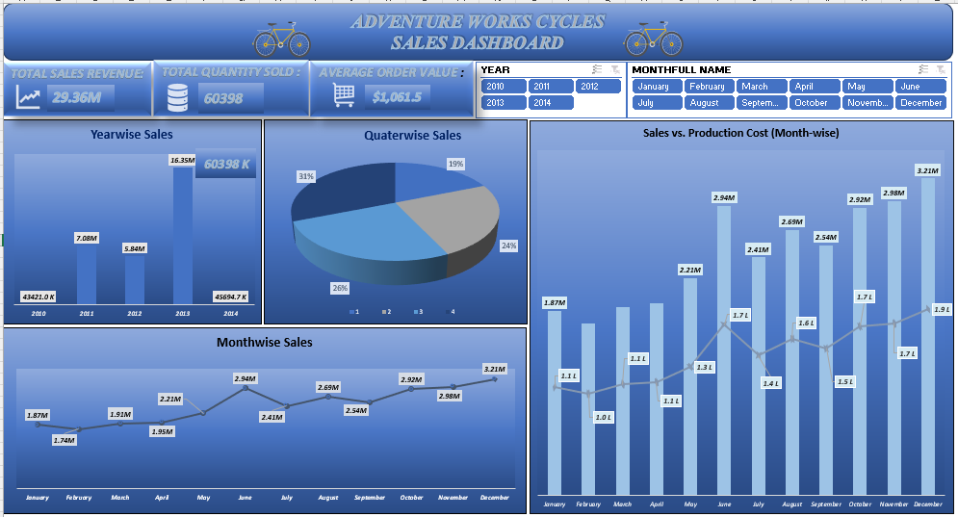

Slide 12
TABLEAU DASHBOARD

Slide 13
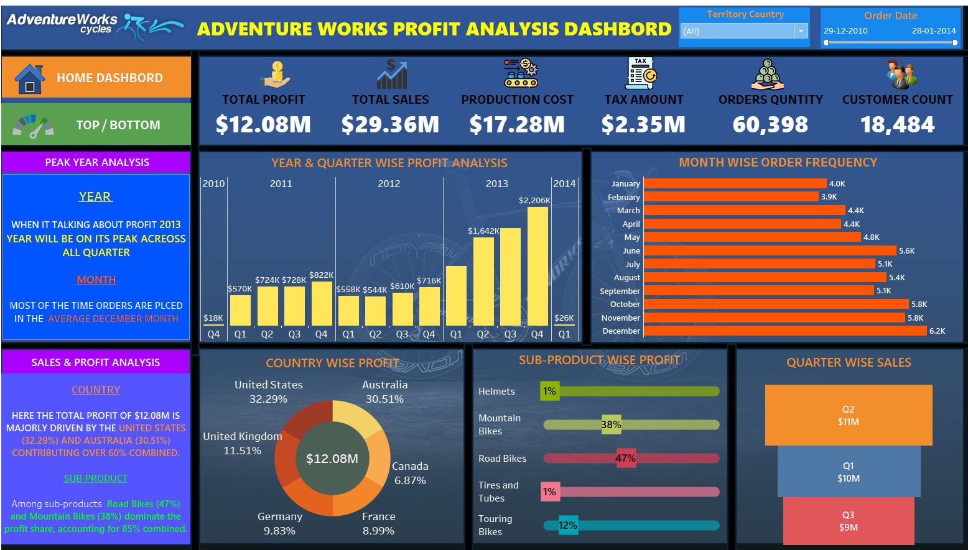

Slide 14
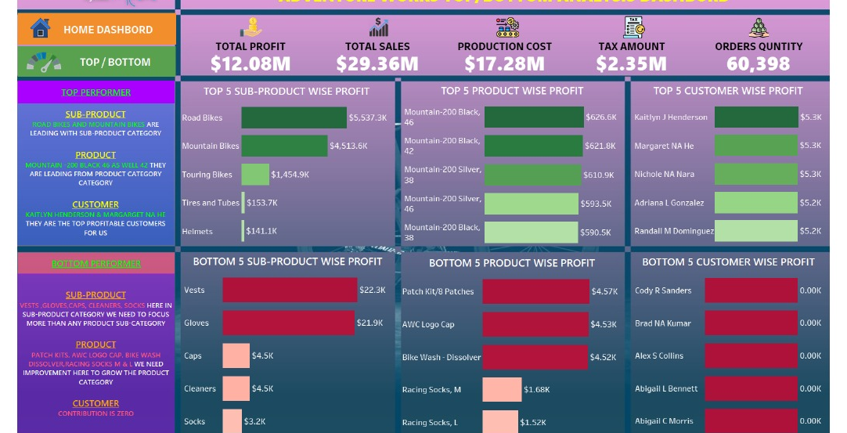

Slide 15
POWER BI DASHBOARD

Slide 16
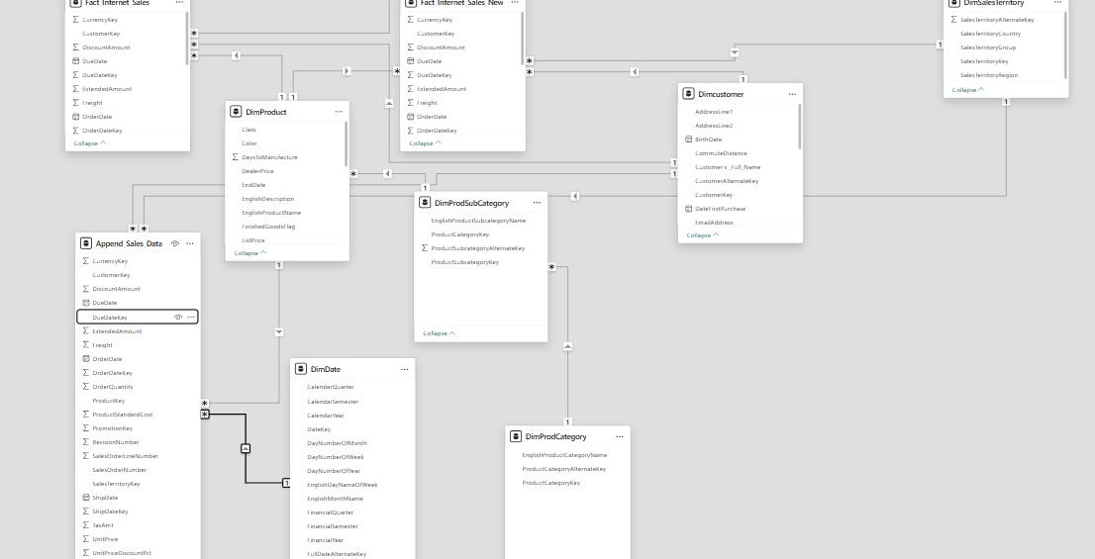
DATA MODLING

Slide 17
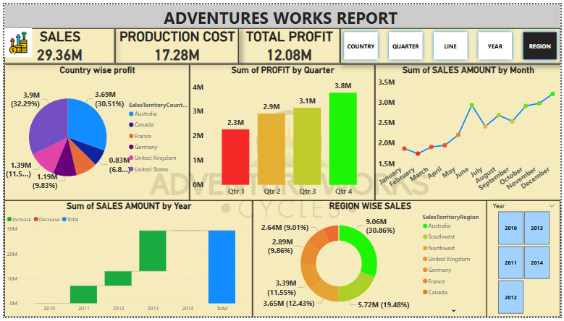

Slide 18
SQL query’s

Slide 19
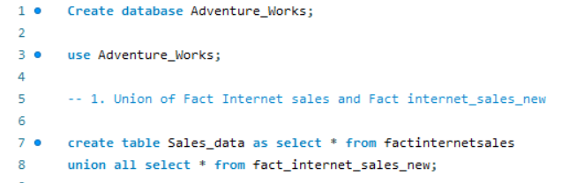
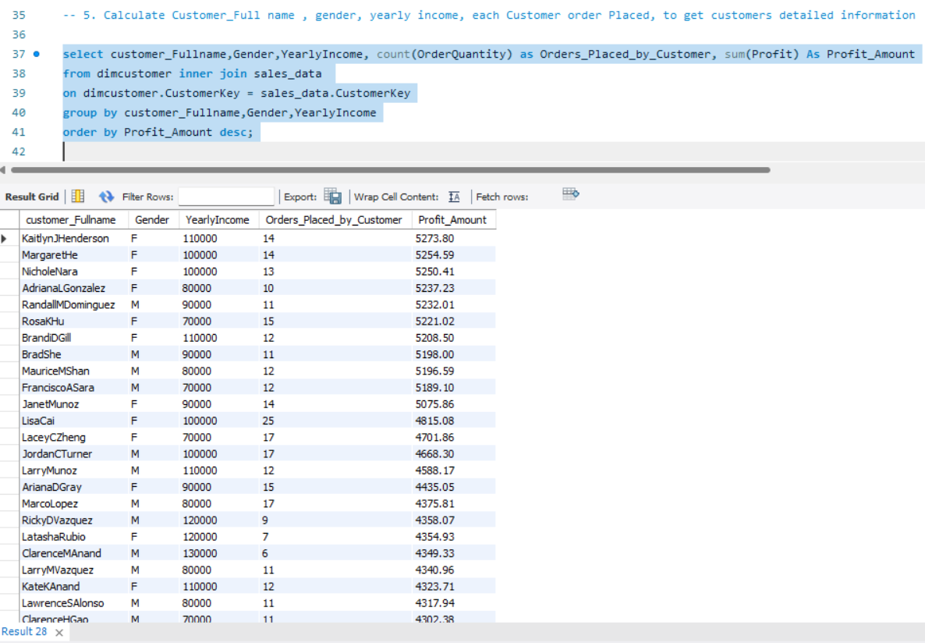
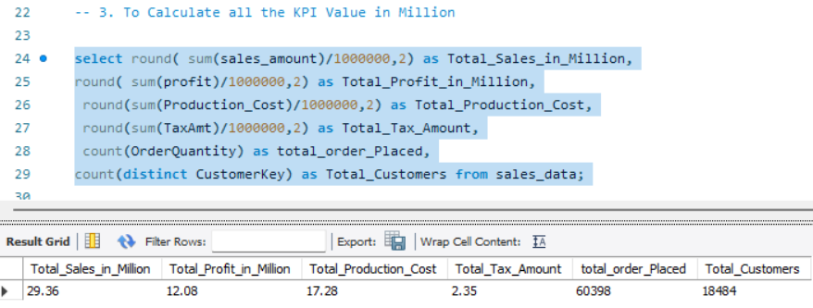

Slide 20
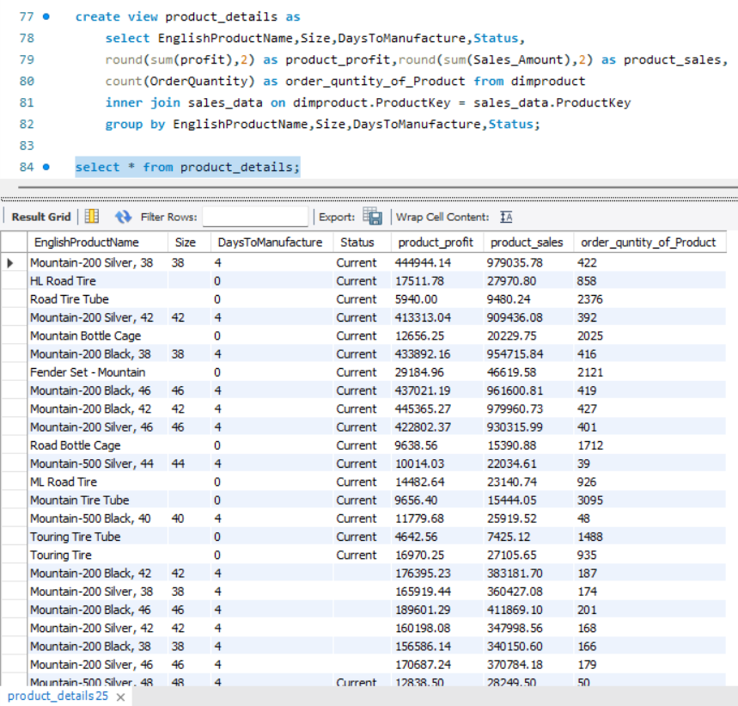
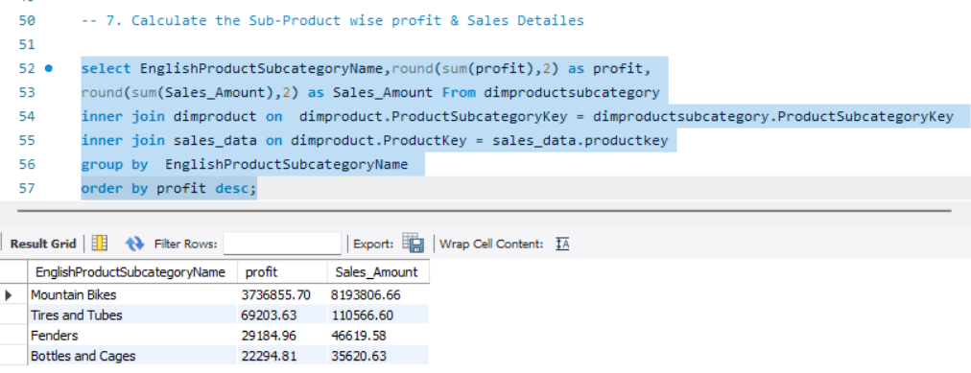
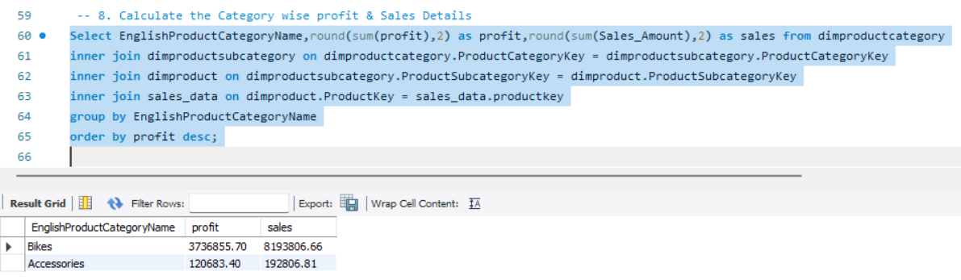

Slide 21
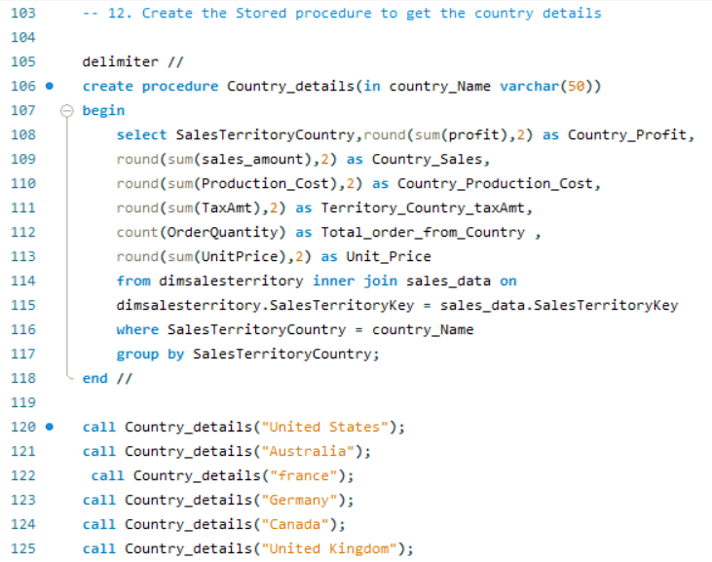
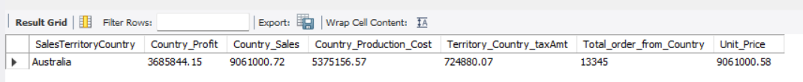
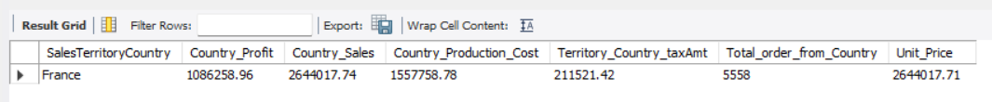
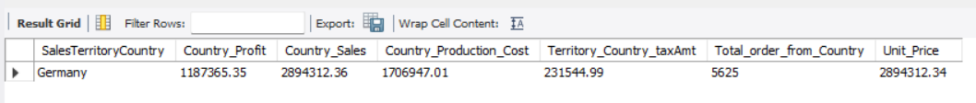
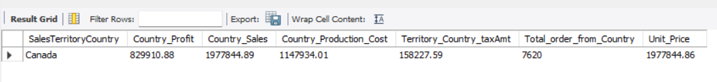

Slide 22
IMPACT OF PROJECT
"Impact of Data Analysis on Business"
Improved Decision-Making: The analysis helped leadership make informed decisions on product strategies and regional sales focus.
Cost Reduction: Identifying inefficiencies in production and logistics helped reduce costs.
Customer-Centric Approach: Insights led to better customer segmentation and targeted marketing….

Slide 23
challenges
"Challenges Encountered"
Data Quality: There were multiple data sets where the format of the data were different which had to be corrected and filtered along with filling out the null values in the sheets.
Data modelling: There were 2 sets of sales data which had to be appended and then Product, category and subcategory were linked to each other and along with Sales territory and Date had to be linked with the sales sheet using the unique keys which were common in respective sheets.
Integration Issues: Combining data from different sources (SQL database, Excel files) posed challenges.
Complexity: Creating a cohesive dashboard that represented all KPIs was a complex task….

Slide 24
RECOMMENDATIONS
Target Best Customers: Focus on high-value customers and offer loyalty programs.
Expand Product Lines: Introduce new composite bicycle models to tap into premium markets.
Market Focus: Invest more in expanding operations and marketing in Asia, where sales potential is high.
Reduce Production Costs: Optimize production processes at the Mexico plant.
TAP OTHER MARKETS ALSO : ASIAN, AFRICAN AND SOUTH AMERICAN MARKETS….

Slide 25
LEARNINGs
"Key Learnings from the Project“
As the Project is a Team work, understanding and knowing people and their skillset is important in order to work together efficiently and bring out the best results.
Understanding the data: Need to spend more time in reading and understanding the data set rather starting to build dashboard which will help us in understanding the need and requirement and visualise and present it effectively.
Data Cleaning is Crucial: Ensuring data quality is foundational to getting accurate insights.
Weekly reviews: To evaluate our learnings and upgrade ourselves by correcting the mistakes and learn more from others and implement it in next review.
Visualization Skills: Mastering tools like Tableau and Power BI enhances the ability to communicate data effectively.
SQL Proficiency: Writing complex queries was essential to extracting relevant data for analysis….

Slide 26
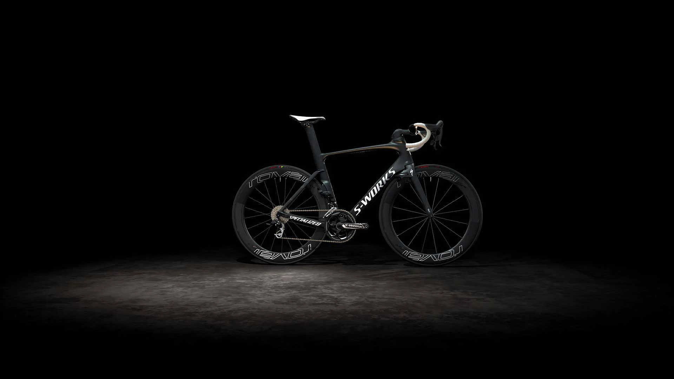
THANK YOU

