Slide 1
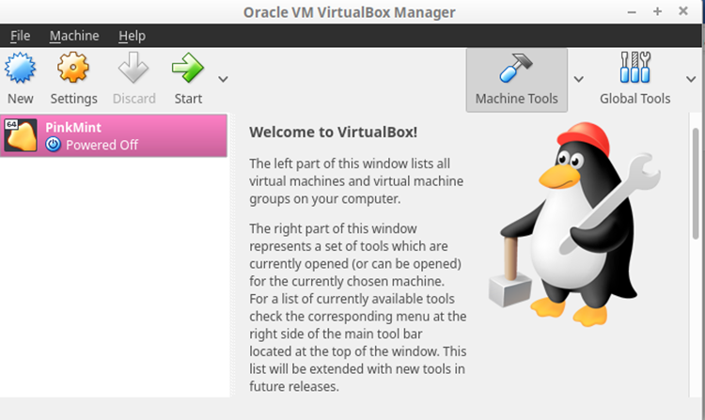
VirtualBox
An Introduction & How to
use / share Virtual Machines across Multiple platforms.

Slide 2

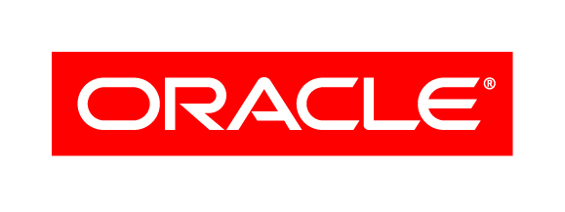
A History of virtual box
Created by Innoktek GmbH in 2007
Not initially open source – initially had a proprietary licence – free personal version included
In the same year, officially became free and open source
Acquired by Sun Microsystems in 2008
Oracle bought Sun Microsystems in 2010

Slide 3

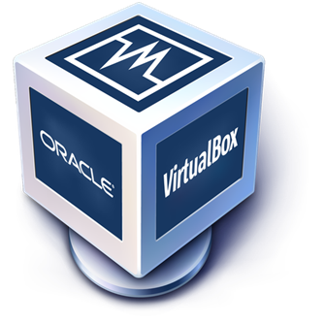
Comparing VMWare / VirtualBox
VMWare Workstation:
Enterprise grade type 2 hypervisor
Can run Windows, Linux, BSD and several other operating systems
Has extensive virtual networking through VSwitches
Can run standalone or connect to another Workstation instance or server running ESXi or vSphere
Requires a license for full feature set
VirtualBox:
Type 2 hypervisor
Unlike VMWare you do not need licensing unless you’re in a commercial environment
Also uses virtual networking (arguably simpler to implement)

Slide 4
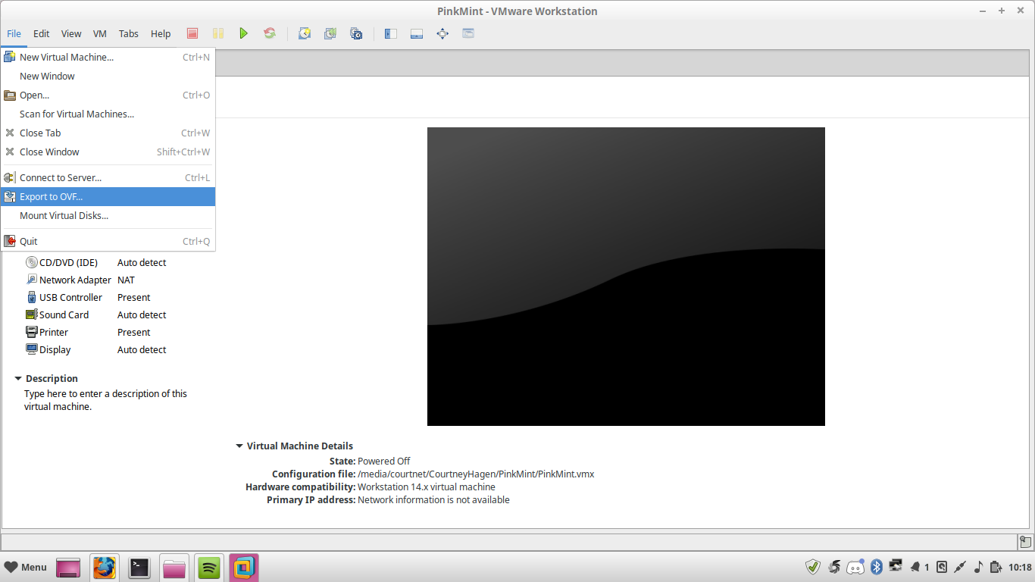
What is open virtualization format? What Is its purpose?
Open Virtualization Format is a format for virtual machines that can be used across various virtualization software interchangeably.
Useful for preventing limitations of virtual machines

Slide 5
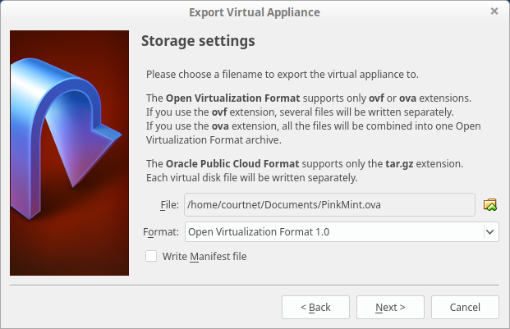
A History of Open virtualization format (OVF)
September 2007 – Major companies with virtualization software came together to propose OVF to the Distributed Management Task Force
OVF specifications have had different versions, (started with 1.0.0 in 2008)
OVF 1.1 adopted as international standard in 2011 by International Organization of Standardization

Slide 6
Open virtualization format what is the difference between ovf files and ova files
Both are file extensions for the same format
VirtualBox – OVA
Vmware – OVF
Used interchangeably between the two, only a matter of creation
All hypervisors use one of these two extensions for Open Virtualization Format

Slide 7
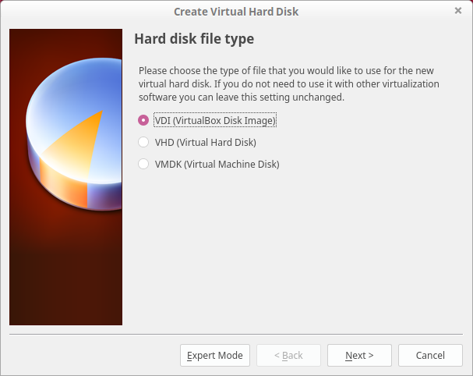
Different disk Formats What are they used for?
VDI
VMDK
VHD
HDD

Slide 8
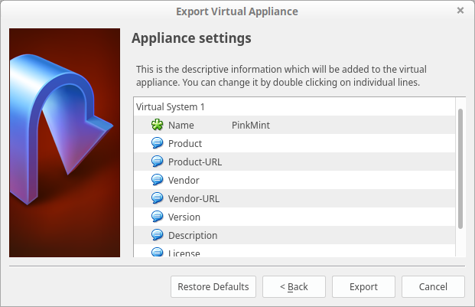
Appliance settings

Slide 9

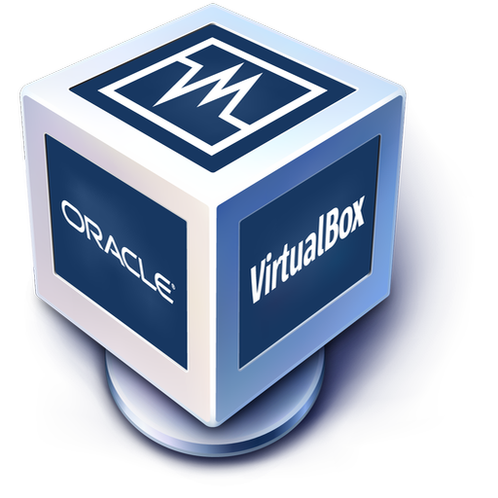
DEMO Using OVF and OVA files interchangeably between VirtualBox and VMware

Slide 10
Shared Links
OFV file link: https://drive.google.com/open?id=1pNHO1pTaEIycPxhjRe7yUS3Eg6mmft-f
MF file link: https://drive.google.com/open?id=1gqE20PnVXTlLBYmxpY2iIAx1ySUz8M2W
VMDK file link:
https://drive.google.com/open?id=1V6WHjYtV2i1K0iKxwQvKsOpnkb1xGUZb

Slide 11
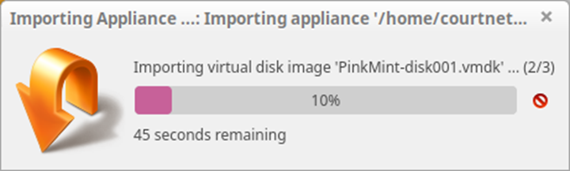
Questions?

Slide 12
Citations
VMware Workstation. (2019, January 12). Retrieved January 23, 2019, from https://en.wikipedia.org/wiki/VMware_Workstation *VMWARE LOGO graphic.
File:Virtualbox logo.png. (n.d.). Retrieved January 23, 2019, from https://commons.wikimedia.org/wiki/File:Virtualbox_logo.png *VirtualBox LOGO graphic
[Sun Microsystems Logo]. (n.d.). Retrieved February 2, 2019, from https://en.wikipedia.org/wiki/Sun_Microsystems
[Oracle Logo]. (n.d.). Retrieved February 2, 2019, from https://www.cimdata.com/de/resources/solution-provider-profiles/plm-dossier-oracle

