Slide 1


Udajuicer:
Threat Report
YOUR NAME: Samar Abdulaziz
DATE 6-11-2022

Slide 2
Purpose of this Report:
This is a threat model report for Udajuicer. The report will describe the threats facing Udajuicer. The model will cover the following:
Threat Assessment
Scoping out Asset Inventory
Architecture Audit
Threat Model Diagram
Threats to the Organization
Identifying Threat Actors
Vulnerability Analysis
Risk Analysis
Mitigation Plan
Remove this slide

Slide 3
Section 1
Threat Assessment

Slide 4
1.1: Asset Inventory
Components and Functions
[web server]: it process and manage requests and responses of HTTP/HTTPS from the client.
[database]: it store customers data and products and other information
[application server]: it hosts applications, it Serves web and enterprise-based apps
Remove this slide

Slide 5
1.1: Asset Inventory
Explanation of How A Request Goes from Client to Server
The client sends HTTP request to web server, then web server send request to Application server to retrieve content from the database and responds to the client .

Slide 6
1.2 Architecture Audit
Flaws
load balancer
Firewall
Vulnerable web application
The best secure architecture:
1- Using load balancer
2- network segment
3-use Firewalls

Slide 7
1.3 Threat Model Diagram
Using OWASP Threat Dragon, build a diagram showing the flow of data in the Juice Shop application and identify 3 possible threats to the Juice Shop. Make sure to include the following components:
Client
Web Server
Application Server
Database

Slide 8
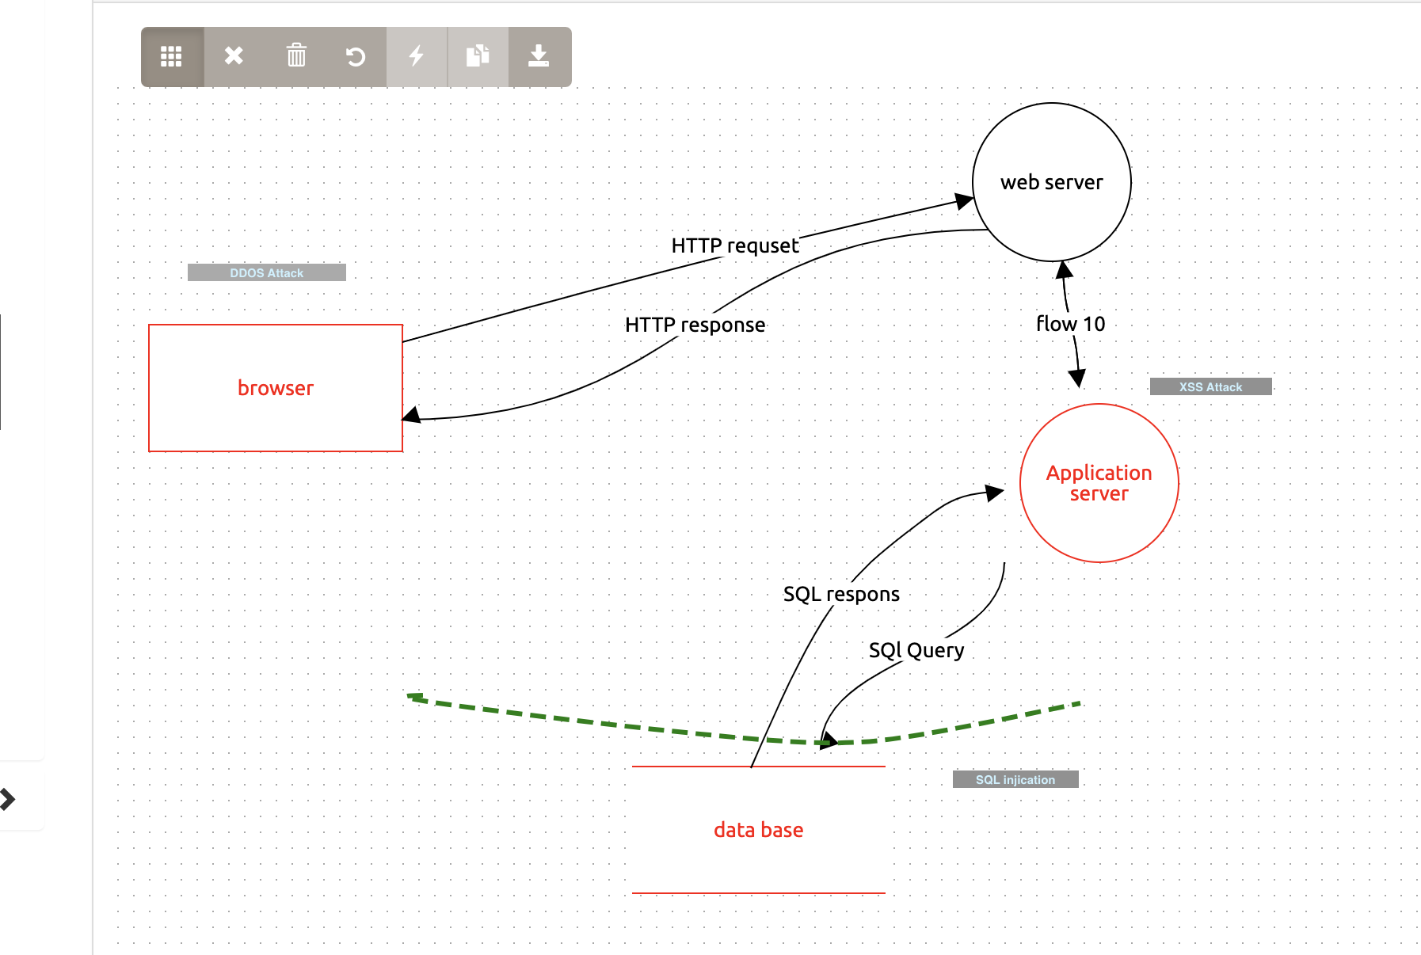
1.3 Threat Model Diagram
Insert threat Model Diagram Here:
The possible attacks:
1- XSS attack
2-DDOS attack
3-SQL injection

Slide 9
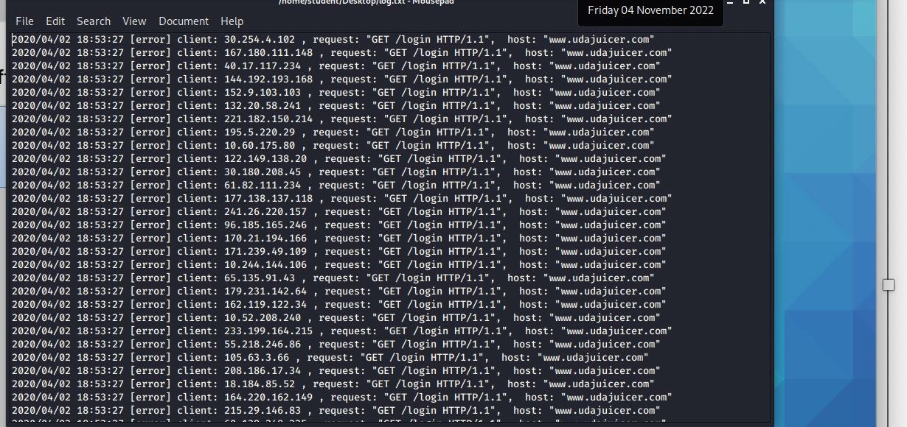
1.4 Threat Analysis
What Type of Attack Caused the Crash?
DDOS attack
What in the Logs Proves Your Theory?
The website gets tons of requests at the same time from different devices, and this causes the website down

Slide 10
1.5 Threat Actor Analysis
Who is the Most Likely Threat Actor?
Script Kiddie
What Proves Your Theory?
With few open-source tools that anyone can use it, the attacker is able to send many requests to the website which led to crashes the website and denial of service.

Slide 11
Section 2
Vulnerability Analysis

Slide 12
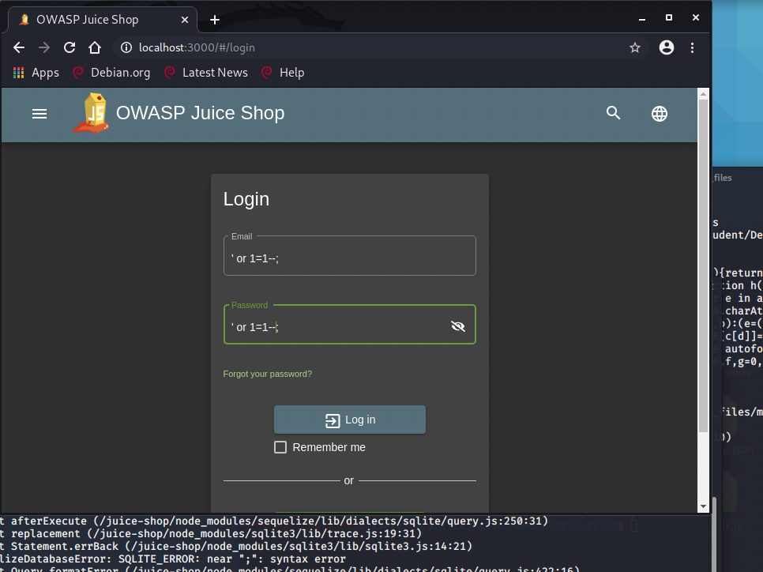
2.1 SQL Injection
Insert Screenshot of Your Commands Here:

Slide 13
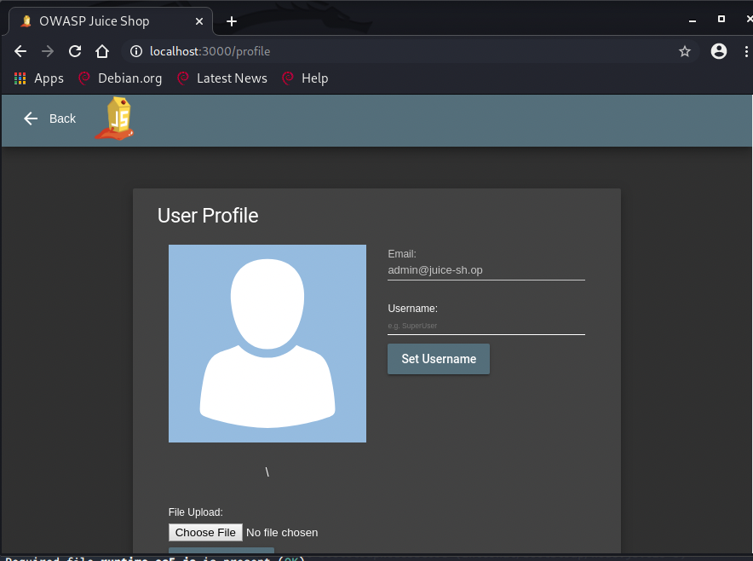
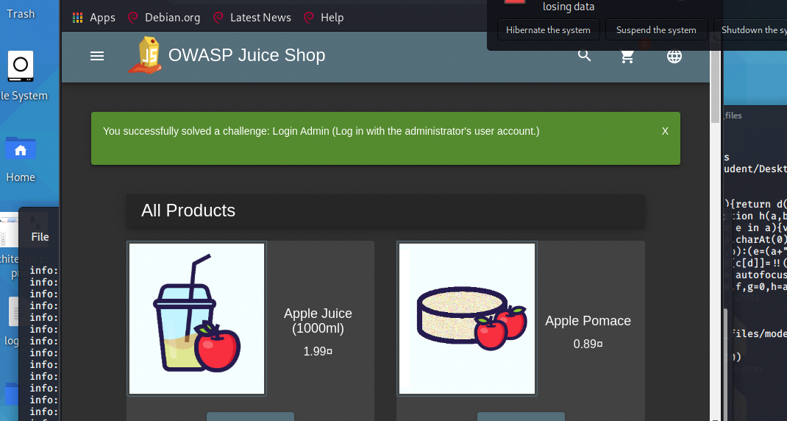
2.1 SQL Injection
Insert Screenshot of Account Settings Showing You as Admin Here:

Slide 14
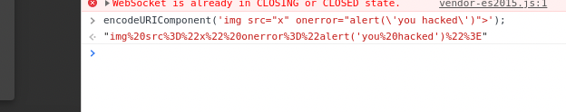
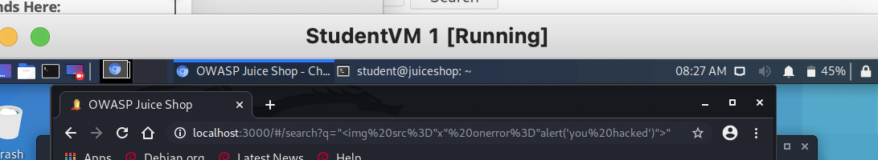
2.2 XSS
Insert Screenshot of Your Commands Here:

Slide 15
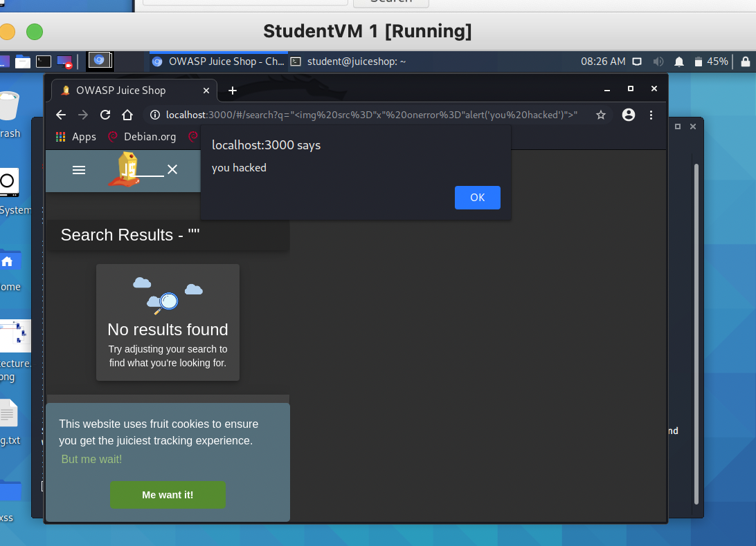
2.2 XSS
Insert Screenshot of alert() popup saying "Hacked!" Here:

Slide 16
Section 3
Risk Analysis

Slide 17
3.1 Scoring Risks
Risk | Score (1 is most dangerous, 4 is least dangerous)
DDOS | 1
Insecure Architecture | 1
SQL Injection | 1
XSS Vulnerability | 1

Slide 18
3.2 Risk Rationale
Why Did You Choose That Ranking?
DDOS
this very high risk it causes the system down and ack of availability the customer cannot access the website and can’t buy this led to financial risk for the business and
Insecure Architecture
This will cause lots of issues the lack of security in architecture makes the company vulnerable, anyone may gain access to the internal assets steal and damage in the end it will cause big finical lose
SQL injection :
It will provide unauthorized access to the system and data that led to loss of confidentiality which is very important in the CIA.
XSS :
It is high risk because attackers can steal cookies and hijack user sessions and phish user credentials also infect websites with malware

Slide 19
Section 4
Mitigation Plan

Slide 20
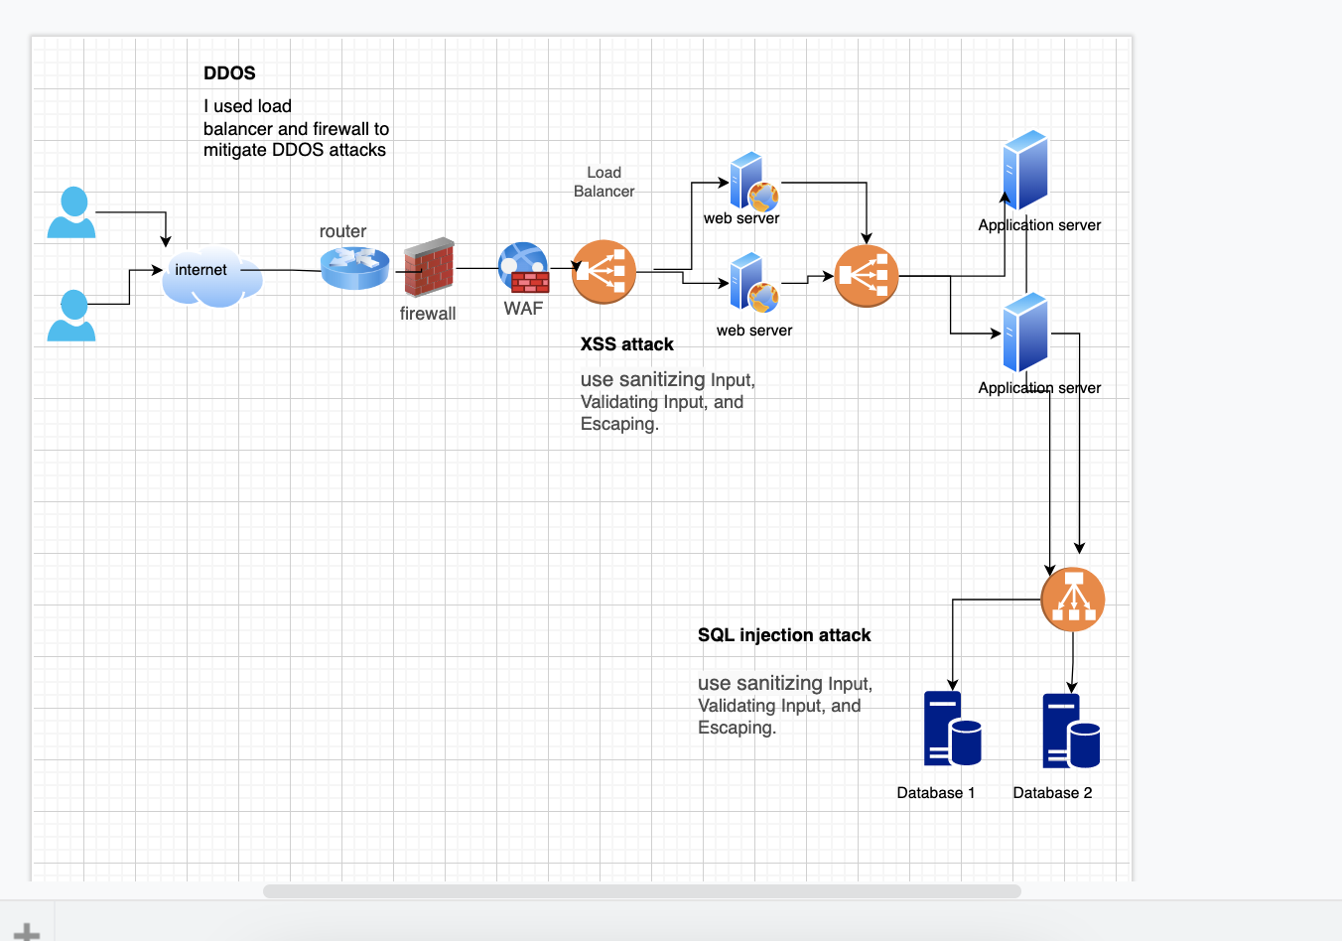
4.1 Secure Architecture
Insert Image of Your Secure Architecture Here:

Slide 21
4.2 Mystery Attack Mitigation
What is Your Mitigation Plan?
I used a load balancer to distributes incoming application traffic across multiple targets to prevent DDOS attacks also I used WAF and a firewall to secure the web and network.

Slide 22
4.3 SQL Injection Mitigation
What is Your Mitigation Plan?
Input Validation
It helps verify if the type of input submitted by a user is allowed or not and makes sure it is the accepted type, length, and format.

Slide 23
4.4 XSS Mitigation
What is Your Mitigation Plan?
Sanitizing User Input
It helps protect the system from malicious code

