Slide 1


Volunteer Training
This training packet will be emailed to all volunteers

Slide 2

Lehigh Valley Health Network Marathon for Via
Sunday, September 9, 2012
    Marathon & Relay
      7am | Lehigh Valley Hospital – Cedar Crest & I-78
    Half Marathon
      7:15am | Main & Market Streets, Bethlehem
Saturday, September 8, 2012 | ArtsQuest Center at SteelStacks, Bethlehem, PA
    Via Family Fun Walk | 9am, 8am check-in
    Expo & Race Packet Pick-Up | 10am – 5pm
    Kids Race for Via | 10:30am, 10m check-in
2011 Participants
  Teams: 227
  Marathon: 912
  Half Marathon: 881
  Walkers: 408
  Volunteers: 529
  Total: 3,865

Slide 3
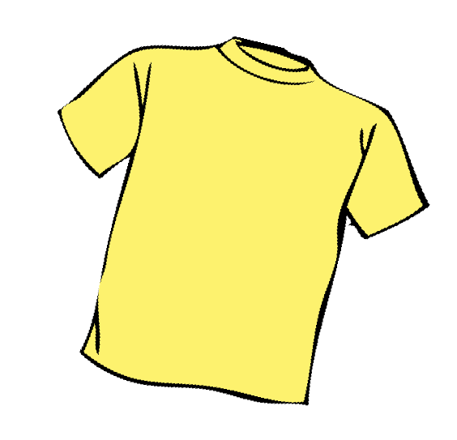


Shirt Pick-Up
Saturday, September 8, 2012 | 10am to 5 pm
  ArtsQuest Center at SteelStacks, Bethlehem, PA
Course Marshalls & Parking Volunteers
  T-shirt and foam finger
Medical Volunteers
  T-shirt, first aid kit, AED and medical vest
All other volunteers
  T-Shirt

Slide 4



What to Bring on Race Day
Volunteer shirt
Cell Phone
Volunteer Emergency Note Card
Foam Finger (if applicable)
Medical Vest (if applicable)
Sunscreen
Bug Spray
Comfortable Shoes
Water bottle
Snacks
Folding chair
Umbrella (for rain or shine)
Rake to gather up cups at Water Station

Slide 5
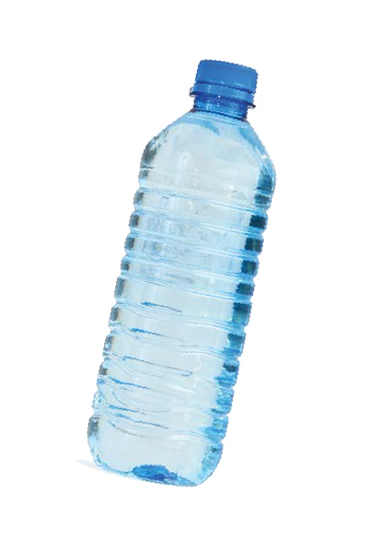
Special Note
Volunteers should drink
bottled water. Please reserve
Water in Thermos and Gatorade for runners.

Slide 6

HAM Radio Operators (red)
Lehigh Valley Amateur Radio Club provides event communication.
HAM Radio operators are stationed at the start, water stations, exchanges and finish line.
HAM Command confirms that water
station is set-up and staffed by volunteers
and Medical. If supplies run low, communicate back to HAM Command need for supplies.

Slide 7
Emergency Communication Plan
HAM radio operators stationed at every water station will provide communications back to Race Day EMS Command Center in the event a runner is in need of EMS support.
The EMS Command will triage all calls and dispatch necessary vehicles to runner (EMS bike, ALS/BLS cart, ALS unit).
In the event of an emergency, notify the HAM radio operator at your water station of the emergency. HAM radio operator will communicate emergency to EMS Command.

Slide 8
Emergency Communication Plan
In the event a volunteer is not in proximity of HAM radio operator, call EMS Command at 610-737-2083, who will dispatch necessary parties.
If you are unable to get through on the first try to EMS Command, call 911.
  State you are a volunteer for the Lehigh Valley Health Network Marathon
  State your emergency
  Give your location (i.e. Farmersville Rd and Wilson Drive in Bethlehem Township on the towpath by the river).

Slide 9
Emergency Communication Plan
Program this phone # (EMS Command 610-737-2083) into your cell phone for race day. This phone number is for emergencies only.
DO NOT call this number for supplies , directions, etc.
If you need supplies, communicate this through the HAM Radio Operator at your water station.
If you have a runner in need of transport, communicate this through the HAM Radio Operator at your water station. They will notify the nearest exchange who will dispatch a volunteer to provide transport back to that exchange.
All volunteers will receive a note card when they pick up their shirts with this information.

Slide 10
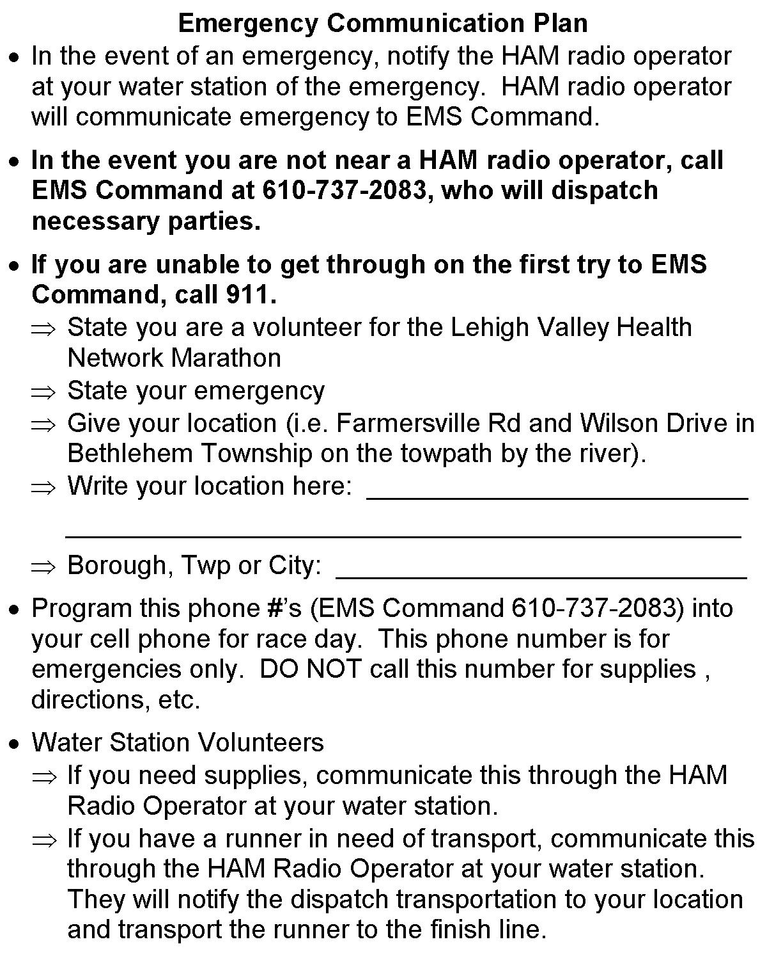
Emergency Note Card

Slide 11

Hazardous Condition, Cancellation, Alteration Plan
Race day conditions will be communicated through a flag system. Flags will be flown at remote water stations and exchanges indicating race day conditions.
  Green Flag indicates the marathon is on and there are no known hazards;
  Yellow Flag indicates to proceed with caution (in the event of moderate weather conditions such as high heat and humidity); and
  Red Flag indicates the marathon has been stopped and all runners and volunteers should proceed with caution to the nearest exchange point or seek immediate shelter due to severe weather conditions of other emergency.
Flag changes will be communicated by the EMS Command to HAM who will change the flags at Marathon water stations and exchanges if necessary.
If we are aware of adverse conditions prior to race day, we will communicate through our website and email.

