Slide 1
Electricity Fundamentals
Voltage (E): the force which causes electrons to flow in a closed circuit
Current (I): the flow of electrons in a circuit
Resistance (R): the opposition to current flow
Ohm’s Law: E = I x R I = E / R R = E / I
By convention, current flows
from positive to negative
I
+
E
R
-
Note: lots of folks use “V” instead of “E” for voltage

Slide 2
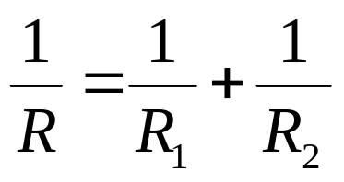
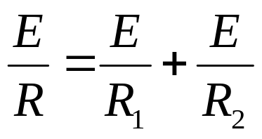
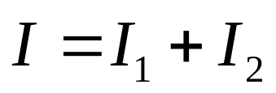
Kirchhoff’s Current Law
Remember how to find the total
resistance of resistors in parallel?
For the circuit below, the same voltage
is applied to both R1 and R2. Let’s
multiply both sides of this equation by E:
But Ohm’s law allows us to write this as:
node
This is Kirchhoff’s Current Law: the current
entering a node in the circuit is equal to the
sum of the currents leaving the node. Here,
the current I flowing to the node divides.
Some flows through R1 and the rest
through R2. But the total through both is
the same as the total in the circuit.
I
+
E
I1
R1
I2
R2
-

Slide 3


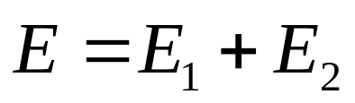
Kirchhoff’s Voltage Law
Remember how to find the total
resistance of resistors in series?
For the circuit below, the same current
flows through both R1 and R2. Let’s
multiply both sides of this equation by I:
I
But Ohm’s law allows us to write this as:
R1
+
This is Kirchhoff’s Voltage Law: the voltage added to the circuit by the battery is equal to the sum of the voltages consumed by the resistors. Here, some of the voltage from the battery is lost in each of the two resistors, and the sum of the voltage lost in the resistors is equal to the voltage of the battery.
E
-
R2

Slide 4
Measuring Current
Electric current is always measured by connecting an ammeter
in series with the component through which you’d like to know the
current.
Note that ammeters have
polarity. Make sure you connect
the + and - leads so that the
current will flow through the
meter from + to -. The + lead
is closer to the + terminal on
the battery, and the - lead is
closer to the - terminal on the
battery.
I
+
+
A
A
-
-
+
E
I1
R1
I2
R2
-

Slide 5
Measuring Voltage
Voltage is measured as either:
- the voltage drop across a component or part of the circuit, or
- the voltage at a point with respect to ground
I
Always connect the voltmeter in parallel with
the part of the circuit across which the drop
in voltage is being measured. The + lead
of the voltmeter is closest to the + terminal
on the battery. If measuring with respect to
ground, connect the - lead to the circuit
ground (the negative terminal of the battery).
+
V
R1
+
-
E
+
-
V
R2
-

Slide 6
SW+40 Block Diagram
SA612
SA612
NE5532
RX
Mixer
4 MHz
Xtal
Filter
Product
Detector
BP
Filter
RF In/Out
AF Amp
RX
(high)
BP
Filter
VFO
AF Out
3 - 3.05 MHz
RX - TX = 800 Hz
TX Filter, Amp
~4 MHz
TX
Mixer
TX
(low)
SA612

Slide 7
SW+ Voltage Regulation
D13 1N4001
+12V
C113
0.1
U2
78L08
Q: What would happen if
we hooked up the battery
backwards?
+8V Reg
C102
0.01
The 78L08 voltage regulator accepts a range of input voltages and produces a fixed 8-volt
output which is very stable. Capacitors C113 and C102 act to provide a path to ground for
any RF component in the voltage line from other parts of the circuit.
Note: capacitance values given on schematics as decimals are usually in μF, while those given as integers are
usually given in pF. Example: “0.1” is 0.1 μF, while “47” is 47 pF (remember, 1,000,000 μF = 1 F, and
1,000,000 pF = 1 μF).

Slide 8
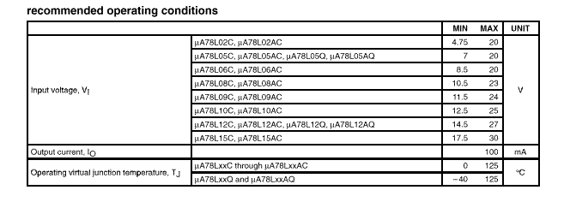
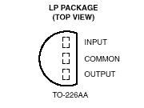
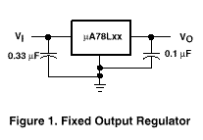
78L08 Specifications
Minimum Input Voltage: 10.5 Volts
Maximum Current Draw: 100 mA
Source: Texas Instruments

Slide 9
Diode Basics
I
+
+
-
-
Forward bias--current flows!
(low resistance)
Reverse bias--no current flows
(high resistance)
1N4001
1N4148
Anode
Cathode
Anode
Cathode

Slide 10
Diode Characteristics
+I_{F}
+I_{F}
“Regular” Diode
Zener Diode
zener
point
-40
-20
+V_{F}
-40
-20
+V_{F}
1
2
3
1
2
3
Constant
breakdown
voltage
Reverse
breakdown
No current flows
Forward bias
Zener diodes work like “regular” diodes except that when the reverse breakdown voltage is reached, the zener diode will allow conduction but will keep the voltage drop across it constant. Zener diodes are usually reverse-biased in circuits to take advantage of this characteristic. Zener diodes are manufactured with a variety of values of breakdown (or zener) voltages.
Conduction begins when forward bias is
applied which exceeds a fairly low threshold
(0.5 - 1 V). If reverse bias is applied, no
current flows until reverse bias voltage
exceeds the breakdown voltage, at which
point current increases with reverse voltage.

Slide 11
Quiz
What will be the voltage at points A, B, C, and D?
What will be the voltage drop across U2?
What will be the current through C102?
When you finish constructing this part of the circuit, measure these
voltages. Are they what you expected?
A
B
D13 1N4001
C
U2
78L08
D
+12V
C113
0.1
C102
0.01

Slide 12
Construction
Inventory all the parts in your kit--contact NN1G if you’re missing any parts
Install the following components:
  C102, C113
  D13, U2 (make sure you observe correct polarity!)
  Connector J4
  connect the 5.5mm/2.1mm coaxial jack to the wiring harness matching J4 (observe correct polarity--see NN1G’s instructions)
Test:
  Apply 12 -15 V power to J4
  Measure voltage at D13’s cathode--should be less than the input voltage by around a half a volt or so
  Measure voltage at pin 1 of J2’s location on the PC board (we haven’t installed J2 yet) -- should be 8.0 V

