Slide 1
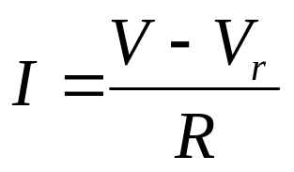
The Zener Diode
The zener diode exhibits a constant voltage
drop when sufficiently reversed-biased.
This property allows the use of the zener
diode as a simple voltage regulator.
+I_{F}
zener
point
-6
-3
+V_{F}
+V
1
2
3
Constant
breakdown
voltage
R
Here, V_{r} will be equal to the reverse breakdown voltage of
the zener diode and should be constant. What is the purpose
of the resistor in this circuit? Its job is to limit the current
flowing through the zener diode:
V_{r}
D

Slide 2
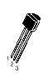
The Bipolar Junction Transistor
The transistor is a versatile device usually configured to perform as a switch or as an amplifier. The bipolar junction transistor (BJT) is the most common type and has three leads:
3
Collector
3
Collector
Base
2
Base
2
1
Emitter
1
Emitter
PNP Transistor
NPN Transistor
In a transistor, the flow of current from the collector to the emitter is controlled
by the amount of current flowing into the base of the transistor. If no current
flows into the base, no current will flow from the collector to the emitter (it acts
like an open switch). If current flows into the base, then a proportional amount
of current flows from the collector to the emitter (somewhat like a closed switch).

Slide 3
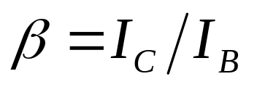
The NPN Transistor
R_{b}
c
R_{b}
c
b
b
+
I_{C}
+
+
e
+
e
-
-
-
R_{e}
-
I_{B}
R_{e}
No current flows from base to emitter, so the transistor acts like an open switch and no current flows from collector to emitter.
(Note: current never flows from base to
collector or vice versa, regardless of the
base current.)
Current now flows through the transistor from base to emitter. This causes the transistor to allow current to flow from the collector to the emitter. The size of the collector current depends on the size of the base current and the beta β of the transistor:
A typical transistor has a beta of about 100.

Slide 4
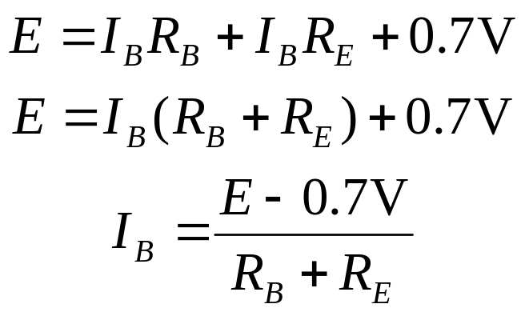
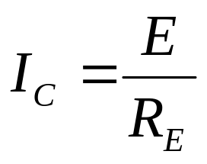
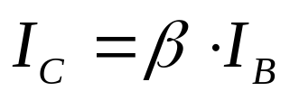
Base and Collector Currents
What’s the base current I_{B}? Use Kirchhoff’s voltage law:
R_{B}
c
b
I_{C}
+
e
E
-
0.7 volts is lost at the
junction of the base
and emitter
I_{B}
R_{E}
What’s the maximum value for the
collector current?
Now find the collector current I_{C}:

Slide 5
The PNP Transistor
R_{b}
c
b
I_{c}
-
I_{b}
e
+
R_{e}
The PNP transistor behaves identically to the NPN transistor, except that all
polarities are reversed. The voltages are applied with opposite polarity, and
the currents run opposite to those in the NPN transistor, but all other behaviors
are the same.

Slide 6
The SW+ Transmit Switch
to transmit
circuit
C111
With the key open,
Q3’s base and emitter
are at the same
potential, and no current
flows from emitter to
base. Therefore, no
collector current flows.
key (J3)
R21
Q3
1
3
10K
22K
R20
D13
circuit copyright 1998 Dave Benson NN1G
V in (12-15V)
Closing the key allows current to flow through R20 and R21. The voltage drop across R20
lowers the potential at the base of Q3 and current flows from emitter to base. This also
turns on the transistor and allows a collector current to flow. The collector current is fed to
the transmit circuit, turning it on. R20 and R21 form a voltage divider to provide the correct
bias voltage to the base. With the switch closed, what is the voltage at the base of Q3?

Slide 7
Mixers
In radios, a mixer is a device which is used to shift the frequency of a signal. It
does so by multiplying the signal with another carefully-chosen frequency:
mixer
The output of a mixer is a signal which is a combination of two frequencies: F1+F2, and F1-F2. In reality, other frequencies are also present at the output,
due to distortion. All the unwanted frequencies need to be filtered out.
Input (F1)
output (F)
local
oscillator (F2)
The SW+ has three mixers: two in the receiver and one in the transmitter. In the
receiver, the received 7 MHz signal is mixed with 3 MHz from the VFO to get the
4 MHz intermediate frequency (IF). The IF is further mixed with the beat frequency
oscillator (BFO) to get audio frequencies out. In the transmitter, the VFO is mixed
with a 4 MHz signal to get the 7 MHz output.

Slide 8
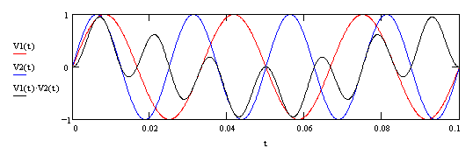
Mixing Two Signals
Here, V1 and V2 are the voltages of two signals (sine waves), and they are
plotted versus time t. V1’s frequency is 30 Hz and V2’s frequency is 40 Hz. The
third line on the graph is V1 times V2, and it has a frequency which is higher
than both V1 and V2. Can you see from the graph what the frequency is? It’s
easy to see the sum frequency, but can you see the difference frequency in
the signal?

Slide 9
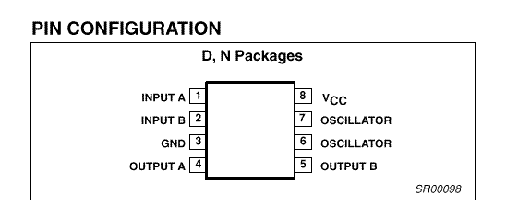
The NE602 Mixer Chip
The NE602 mixer chip (or the
SA602, NE612, or SA612, which
are all essentially identical) is a
low-cost solution for mixing needs
and is often used in kits.
In order to produce an output at pins 4 and 5, three things are required:
1) A supply voltage Vcc which is well-regulated, between 4.5 and 8 volts
2) An input (this is the signal whose frequency is to be shifted)
3) An oscillator to provide a signal to mix with the input.
The NE602 has built-in circuitry for providing the oscillator input, requiring only the addition
of a few parts which determine its frequency.

Slide 10
Inputs to the NE602
V+ (9 to 18V DC)
The input signal can be
unbalanced, as shown
here (either pin 1 or 2 can
be used). The input signal
should be small (less than
180 mV peak-to-peak).
RF input
1
NE602
1K
2
1 μF
6.8V
8
NE602
1
NE602
RF input
3
2
Pin 8 powers the NE602. It requires
from 4.5 to 8V DC. The above
configuration provides a regulated 6.8V
input. The 1K resistor serves to limit
current, while the capacitor provides a
path to ground for any AC. Pin 3 is the
chip’s ground.
The input signal can also be applied in a balanced
configuration. Here a transformer is used, and it is chosen
such that it provides a match to the 1500-ohm input
impedance of the NE602. Other configurations might add
a capacitor across pins 1 and 2 in order to form a tuned
circuit, passing only the frequencies of interest.

Slide 11
The NE602 Oscillator
NE602
6
7
Remember our simple oscillator circuit from Lesson 2? Here it is again--a tank circuit
with an amplifier to amplify and reinject a part of the signal to keep the oscillator
going. The NE602 provides the amplifier internally. To use its internal oscillator, all
that’s required is to connect a suitable tuned circuit across pins 6 and 7. Alternatively,
if we want to use our own oscillator, its output should be connect to pin 6, with pin 7
unconnected, and the input level should be between 200 and 300 mV.

Slide 12
NE602 Oscillator Circuits
NE602
NE602
6
6
C1
7
7
C1
C2
Y
C2
Y
L
Here, a crystal is used to set
the oscillator frequency. Crystals
can be thought of has having both
internal inductance and capacitance,
and these set the frequency of the
crystal. C1 and C2 form the
feedback network for the oscillator.
Here, an inductor has been added in series with
the crystal. This has the effect of increasing the
inductance of the circuit, which causes the
resonant frequency to decrease. This is known
as pulling the crystal--getting it to chance its
oscillation frequency a bit. What would happen if
we replaced the inductor with another capacitor?

Slide 13
The NE602 Outputs
Pins 4 and 5 of the NE602 are the outputs. The signals from each pin are identical but of
opposite phase (pin 4 is negative when pin 5 is positive, and vice versa). Either or both
pins can be used for output.
4
NE602
4
NE602
use either pin
for RF out
5
RF out
5
This is an example of an unbalanced output.
Only one of the two pins is used--the other is
left unconnected.
Here, both pins are used for output. Since they
are of opposite phase, the voltage between them
is twice the voltage of either with respect to
ground. The transformer is used to transform the
impedance for the next stage of the circuit.
Capacitors could be placed in parallel with either
side of the transformer to form tuned circuits to
act as a bandpass filter.

Slide 14
The SW+ Transmit Mixer
V in (12 to 15V)
from transmit switch
The transmit mixer in the SW+ mixes
the VFO output with the output from
a crystal oscillator using the
NE602’s internal oscillator.
Here, mixing only
occurs when the key
is closed.
R19
1K
0.01 μF
D11 7.6V
C109
8
NE602
from VFO
0.01
2
4
to bandpass filter
1
3
5
The desired output from the
mixer is the VFO frequency
plus the crystal oscillator
frequency (about 7 MHz).
The outputs are passed
through a bandpass filter to
get rid of unwanted
frequencies.
The tuned circuit connected to
the NE602 uses a 4.00 MHz
crystal for its main component.
The inductor connected with the
crystal in series has the effect of
lowering the frequency a few
hundred hertz. Why is this done?
7
C28
6
C29
160
Y5
47
4.0 MHz
RFC2
22 μH
circuit copyright 1998 Dave Benson NN1G

Slide 15
Troubleshooting Tips
Reasons for problems:
  poor soldering
  wrong part installed
  part installed backward
  part installed in wrong holes
  solder bridges (connecting parts which shouldn’t be)
  bad board traces
  bad parts
Tracking down problems:
  double check parts placements and values
  look for missed or bad solder joints and bridges
  ensure all parts are installed
  is power applied? Key down? etc.
  follow voltages from source
  make sure test equipment is connected correctly and working
  if you can narrow the problem to one place, suspect the part or the traces on the board

Slide 16
Construction
Install the following parts (all are in Group 5). Be sure to observe correct orientation for U5, Q3, D11, and C110.
  U5 & its socket
  Q3
  D11
  C28, C29, C108-C111
  R19-R21 (note: R21 lays down on the board)
  RFC2
  Y5
  J3
  J3 wiring harness and jacks (see enclosure instructions)
Testing:
  connect key and tuning pot
  apply power
  measure voltage at pin 8 of U5 with key down. What should it be?
  measure same voltage with key up. What should it be?
  with key down, use oscilloscope to examine signal on pin 4 or 5 of U5. Do you see RF? What does the signal look like? Why?
  any signal on pin 4 or 5 with the key up?

