Slide 1
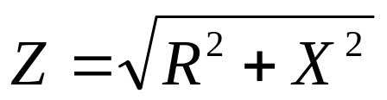
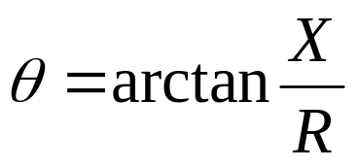
R and X in Series
Inductors and capacitors resist the flow of AC. This property is called reactance. Resistance also impedes the flow of AC. The combination of reactance and resistance in a circuit is called impedance.
Reactance and resistance which are in series cannot simply be added because they differ in the phase relationship between current and voltage. With reactance, current and voltage are out of phase (“ELI the ICE man”) while with resistance they are in phase. A method called triangulation is used to combine the two and to determine the resulting phase relationship.
The impedance of the reactance and resistance in series is found by completing the triangle whose legs are R and X:
X_{L}
This
arrow is
inductive
reactance
Z
θ
R
This
arrow is
capacitive
reactance
inductive reactance
is positive; capacitive
reactance is negative
The phase angle between current and voltage (the angle by which the
voltage leads the current is given by:
X_{C}
Make sure that X is given the correct sign (positive or negative) when finding the phase angle.

Slide 2
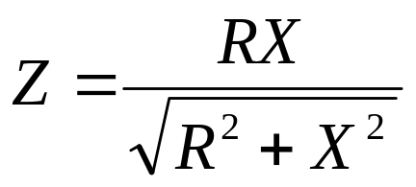
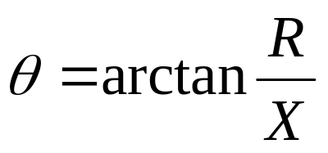
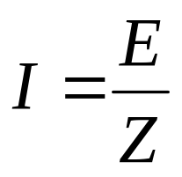
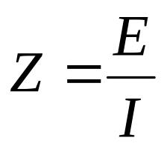

R and X in Parallel
For a parallel combination of resistance and reactance, we use a different formula for
finding the resulting impedance:
In this case, the phase angle by which voltage leads current is given by
If the reactance is capacitive, the phase angle is negative. If the reactance is inductive, the
phase angle is positive.
Ohm’s Law for Impedance

Slide 3
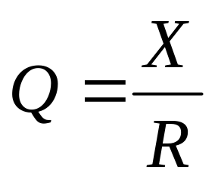
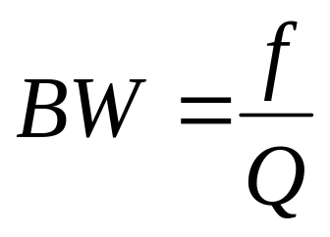
Resonant Circuits as Filters
A series resonant circuit has a very low impedance at the resonant frequency and a high impedance at other frequencies. It acts as a bandpass filter by passing the resonant frequency but impeding others.
A parallel-resonant circuit presents a high impedance to the resonant frequency and low impedance to other frequencies. It provides a path to ground for the nonresonant frequencies.
Real circuits like this have resistance as well as inductance and capacitance. The resistance plays a role in determining the bandwidth of the filter. The Q of the circuit is an indication of the bandwidth of the filter (X is the reactance of either the inductoror the capacitor):
The bandwidth of the filter (range of frequencies where the current is greater than 0.707 of its maximum value) is:

Slide 4
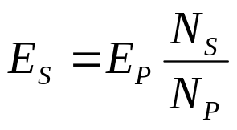
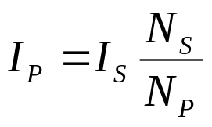
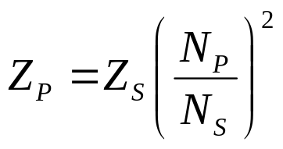
Transformers
Transformers are devices which use magnetic fields as a means of transforming (changing)
voltage, current, or impedance. They are used with AC signals. When current is made to
flow in the primary winding of the transformer, it creates a magnetic field. As the current
in the primary changes (it’s an AC signal, remember) the magnetic field changes. The
secondary winding sees the changing magnetic field, and this causes current to flow in it.
AC
Load
secondary
primary
The amount of voltage, current, and impedance in the secondary is determined by that in
the primary and the ratio of turns in the secondary to the primary:

Slide 5
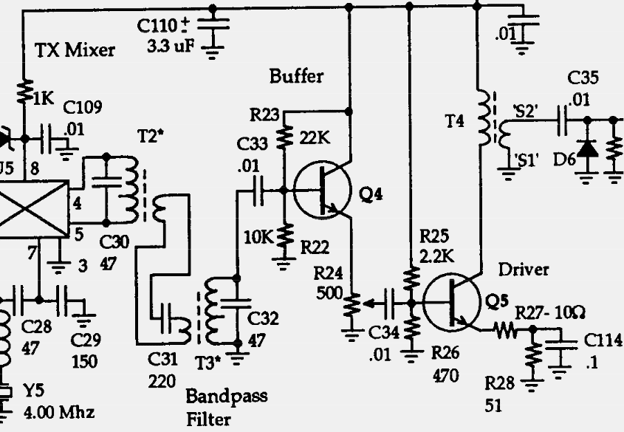
Bandpass Filter in the SW+
The SW+ uses two
10.7 MHz IF transformers
back to back as a
bandpass filter. These
transformers have built-in
capacitors to act as tuned
circuits. The SW+ adds
capacitors in parallel
with the primaries
to lower the resonant
frequency of the
transformer primaries.
Capacitor C31 acts with
the secondary windings
to form a series LC
circuit, so there are three
separate tuned circuits in
the bandpass filter.
circuit copyright 1998 Dave Benson NN1G

Slide 6
Transistor AC Amplification
Remember that changes in the base current in a
transistor cause the collector current to change. If
the base current changes due to an applied AC signal,
the collector current will change in the same way. As
the collector current changes, the voltage drop
across resistor R_{C} changes, causing the
collector voltage to change as well.
+E
R_{B}
R_{C}
V_{C}
V_{B}
saturation
E/R_{C}
linear region
In order to obtain a faithfully amplified copy of the
input signal, the transistor must be biased so that it
operates in its linear region. The transistor should be
biased so that the collector voltage never enters the
saturation region or cutoff region. In those regions, the
gain is not linear, and distortion of the signal results.
I_{C}
cutoff
0
0
V_{C}
E

Slide 7
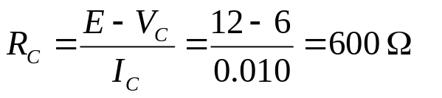
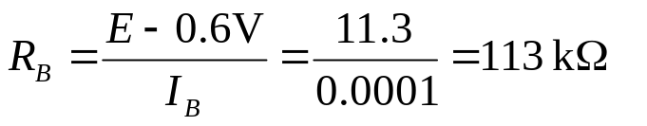
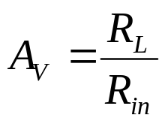
A Simple Amplifier
How do we bias this transistor so that the collector voltage
will be about half of the supply voltage E? Let’s assume
that E is 12 volts and we want a collector current of 10 mA.
That means the voltage drop across R_{C} needs to be 6V.
If 10 mA flows through R_{C} we can find the value of R_{C}:
+E
R_{B}
R_{C}
V_{C}
V_{B}
note the
inverted
output!
Next, we need to find the value of the bias resistor R_{B} so
that the base current is at the appropriate level. Base
current needs to be (assuming β of 100) 100 μA so that
the collector current is 10 mA. So, R_{B} can be found by:
The voltage gain A_{V} of this amplifier is the ratio of change in output voltage to change in input voltage and is given by:
What happens if β changes (say because of a change
in temperature? Then collector current changes, the
voltage across R_{C} changes, and the DC bias of
V_{C} changes.
R_{in} is the input impedance of the transistor.
R_{L} is the load on the output (here, R_{C}).

Slide 8
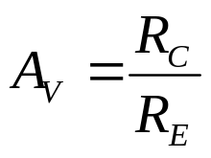
Common Emitter Amplifier
The simple amplifier we just reviewed suffers from
instability due to sensitivity to β and R_{in} with temperature.
A better design is the common emitter circuit, shown here.
R₁ and R₂ form a voltage divider which effectively sets the
DC voltage at the base. The voltage at the emitter must be
equal to the base voltage minus 0.6V, and all this voltage
must be dropped across R_{E}. This determines how much
current must flow through R_{E} and thus through R_{C}. That
sets the DC bias of the collector.
Note how the base and collector currents were figured out
without concern for the β of the transistor. This design is
much more temperature-stable than the simpler design.
For the common emitter circuit, the voltage gain is given by
+E
R₁
R_{C}
V_{C}
V_{B}
R₂
R_{E}
This circuit sacrifices high gains for stability. Adding a capacitor in parallel with R_{E} restores some of the
of the gain by making the emitter appear grounded to AC signals, much like the previous design.

Slide 9
Common Collector Amplifier
The common collector circuit (also known as the emitter
follower) changes the common emitter by deleting the
collector resistor and taking the output from the emitter.
The common collector circuit exhibits current gain but
no voltage gain. Since the emitter voltage is always less
than the base voltage, the voltage gain is essentially one.
Why use a common collector amplifier? Because of its
input and output impedances. The common collector input
is high-impedance, while its output is low impedance. The
high input impedance means that it draws very little current
from the signal source. This means that the signal source
is not affected very much by the common collector circuit.
The low output impedance means that it has the ability to
supply current to the load with no problem.
Because of its input and output characteristics, it can serve as a buffer between successive stages
of a circuit, preventing them from influencing each other.
+E
R₁
V_{B}
output not
inverted!
V_{E}
R₂
R_{E}

Slide 10
The SW+ Transmit Buffer
Q4 is the transistor used in
the SW+ buffer circuit. The
buffer keeps the rest of the
transmit chain from affecting
the output from the mixer.
The voltage divider made by
R22 and R23 biases the
base to about 4V. The
emitter resistor R24 is
actually a trimmer pot. It
is used to adjust the current
being fed to the base of Q5.
The output of the buffer is
taken from the emitter,
making this a common
collector amplifier.
circuit copyright 1998 Dave Benson NN1G

Slide 11
The SW+ Driver
The SW+ driver is a common
emitter circuit whose job is to
provide some of the gain of
the transmitter. Its output is
taken from the collector and
fed to the base of the power
transistor Q6 via a transformer
for impedance matching.
R25 and R26 provide the DC
bias for the base. Note the
use of two resistors in series
at the collector, with a
capacitor in parallel with one.
This scheme is a compromise
between gain and stability.
circuit copyright 1998 Dave Benson NN1G

Slide 12
Construction Part 1
Install the following parts:
  C30, C31, C32, C33
  T2, T3
Test:
  connect tuning pot, power jack, and key jack
  apply power
  key down, use oscilloscope to observe output from bandpass filter at base of Q4 (not installed yet)
  using screwdriver, adjust T2 and T3 for maximum amplitude at base of Q4
  Does signal look like nice clean sine wave?

Slide 13
Construction Part 2
Install the following parts:
  R22, R23, R24
  C34
  Q4
Test:
  connect tuning pot, power jack, and key jack
  apply power
  key down, use oscilloscope to observe output at base of Q5 (not installed yet)
  using screwdriver, adjust T2 and T3 for maximum amplitude at base of Q5
  Why did you have to readjust T2 and T3? (Hint: what is the purpose of the buffer?)
  Compare output of Q4 at base of Q5 with input. How do voltages compare?

Slide 14
Construction Part 3
Install the following parts:
  T4
  R25 through R29
  C35
  C114
  D6
  Q5
Test:
  connect tuning pot, power jack, and key jack
  apply power
  key down, use oscilloscope to observe output at base of Q6 (not installed yet)
  if necessary, adjust R24 for minimum distortion of sine wave
  Does signal look like nice clean sine wave?
  Compare output and input voltages of Q5. How do they compare?

