Slide 1
The JFET
The Junction Field Effect Transistor is another type of transistor, which can be
used in the same kinds of circuits as bipolar junction transistors. It has a higher
input impedance than the BJT.
drain
drain
gate
gate
source
source
P-channel JFET
N-channel JFET
The JFET is a three-terminal device. Its terminals are known as the gate, drain,
and source. The gate of a JFET is much like the base of a BJT in that it provides
the input which controls current through the transistor. Unlike the BJT, however,
it is the gate voltage that controls current flow (in a BJT, the base current controls
the flow of current through the transistor).
P-channel and N-channel JFETs operate identically, except that all polarities are
reversed between the two.

Slide 2
N-Channel JFET Biasing
For an N-channel JFET, the voltage between the gate and source determines the
amount of current which flows from the drain to the source.
G
D
G
D
S
S
When the gate and the source are at the
same voltage, the JFET freely conducts.
The current flowing from drain to source
is limited only by the resistance of the
semiconductor materials making up the
transistor.
Current from drain to source is controlled by
making the gate voltage more negative than
the source voltage. If the voltage at the gate
is made sufficiently more negative than the
voltage at the source, the JFET is cut off--no
current will flow from drain to source.
(Remember--for the p-channel JFET, reverse the polarity of each of the voltages.)

Slide 3
N-Channel JFET Construction
D
N material
D
depletion
region
P material
G
G
S
S
electron flow
The drain and source are at opposite ends of a continuous length of n-type semiconductor.
The gate is constructed of two regions of p-type semiconductor. When the gate-source
junctions are reverse biased, a depletion region (free of charge carriers--electrons and holes)
is created. This forces the electron flow to channel into a smaller area, effectively increasing
resistance and reducing current flow.

Slide 4
Testing the JFET
The JFET can be easily tested using
an ohmmeter:
1) Resistance between source and
drain will be the same with either polarity
(a few kΩ)
2) Between the gate and either the
source or the drain will depend upon
the polarity of connection of the
ohmmeter. Resistance should be high
with one polarity and low with the other.
This behavior is identical to that
observed when testing a diode with an
ohmmeter.
∞
Ω
-
-
Low
Ω
+
+
+
-
0.5 -
10kΩ
0.5 -
10kΩ
+
-
Low
Ω
+
-
∞
Ω
-
+

Slide 5
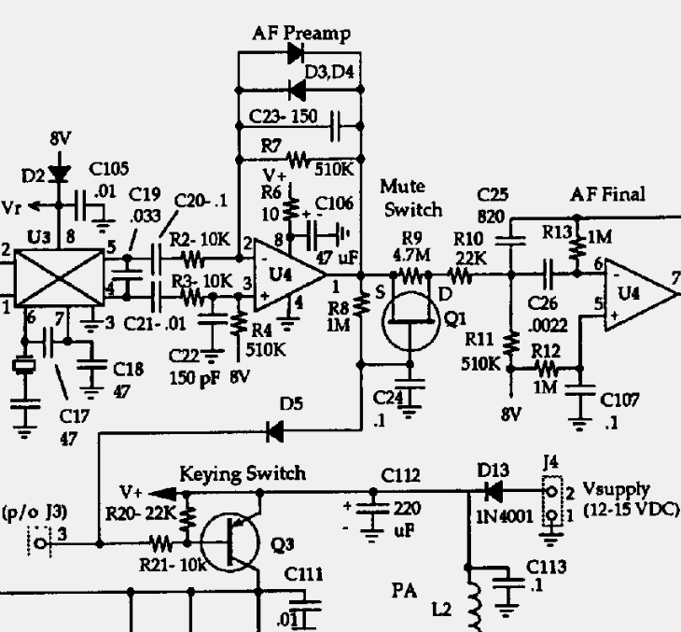
The SW+ Mute Switch
Copyright 1998
Dave Benson NN1G
With the key up, no current flows
through R8, making the voltage the
same at both the gate and source of
Q1. Under this condition, Q1 conducts
freely. When the key line is grounded,
current flows through R8, and the
gate becomes negative with respect
to the source. This causes Q1 to cut
off, muting the receiver.
Since part of the transmitted signal
gets into the receiver, resistor R9
leaks a bit of the transmitted signal
past Q1 and into the receiver final
amplifier, creating the sidetone for the
transmitter.
When the key is let up, current through
R8 decreases to zero “gradually” as
C24 charges, until current ceases to
flowand the gate and source are at
the same voltage again. Now Q1 is
conducting again.

Slide 6
Active Bandpass Filter
In addition to low-pass and high-pass filters,
the op amp can be configured to operate as
a band-pass filter.
C₁
0 db
f_{C}
C₂
R_{F}
3 db
R₁
Insertion Loss
-
60 db
+
frequency
R₂
Band-pass filter
Capacitors C1 and C2 act to pass only a certain range of frequencies in this circuit. The
capacitance of C1 is much less than the capacitance of C2. The action of C1 is to allow
the amount of feedback to increase with frequency, providing the limiting of high frequency
in the output. The function of C2 is to limit the passing of lower frequencies into the input.
This circuit acts as an inverting amplifier because the signal is applied to the inverted input.

Slide 7
Below the Passband
C₁
Remember that the impedance of a capacitor
decreases as its capacitance increases. This means
that for a given frequency, a bigger capacitor will
pass more signal than a smaller capacitor.
Also, remember that the impedance of a
capacitor decreases as frequency
increases. Below a certain frequency we can
think of a capacitor as being like an open circuit.
In the active bandpass filter, the job of C2 is to
allow signals to pass only if they are at or above
the lower cutoff frequency desired for our filter.
At that frequency, C2 will begin to pass signals, but
C1 will not since it is a smaller capacitor. C1 will
behave as an open circuit.
Summary: below the passband, neither C1 or C2 will conduct. Once the lower edge of the
passband is reached, C2 will begin to conduct but C1 will not.
C₂
R_{F}
R₁
-
+
R₂

Slide 8
Above the Passband
C₁
As the frequency increases and approaches
the upper end of the passband, the impedance
of C1 will become small enough that it will begin
to conduct. This means that the higher frequencies
in the output signal will be fed back to the
inverting input (negative feedback)
and the result is that they help
to cancel out the high-frequency
portions of the input signal (remember, increasing
the feedback reduces the gain of the amplifier).
So, as frequency increases, gain decreases due
to the feedback conducted through C1.
C2, meanwhile, continues to pass high-frequency
signals, but those signals are being reduced by the
feedback.
Summary: above the passband, both C1 and C2 are conducting. C1 provides negative
feedback whose magnitude increases with frequency, canceling the high-frequency parts
of the signal.
C₂
R_{F}
R₁
-
+
R₂

Slide 9
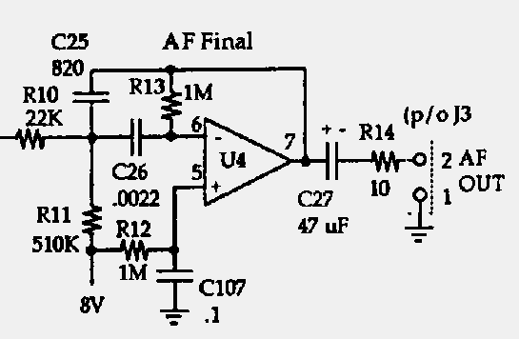
The SW+ Final Audio Amplifier
Copyright 1998
Dave Benson NN1G
In the SW+, 8 volts is applied to
both inputs of U4 as a DC bias
about which the signal voltage
will vary. R10 and R13 are used
to set the gain for the amplifier,
while C25 and C26 determine the
bandpass filter characteristics. In
this filter, the gain is about 33 at
the peak response of about
800 Hz. The signal is applied to
the inverted input of the op amp.
At the output side of the amplifier, a large capacitor is used to block the DC on the output
from reaching the headphones. The capacitor is large because we want its impedance to
be small at the audio frequencies. Resistor R4 serves to limit the current which the op amp
will try to pump through low-impedance headphones, preventing the amplifier’s current-
limiting circuitry from kicking in and clipping the output (resulting in distortion).

Slide 10
Construction
Install the following components:
  R6, R8-R14
  D5
  Q1
  C24-C27, C106, C107
Test:
  connect the tuning pot, gain pot, power connector, and headphone jack to the board
  connect headphones and a key
  turn the gain all the way up
  attach a temporary antenna to the side of C40 which does not connect to diodes D7-D10 (10 or more feet of wire should do)
  connect power
  tune and listen for signals. Adjust T1 for maximum background noise. If T1 doesn’t peak, change C1 to a higher value (try 68 pF)
  key the rig and listen for sidetone

