Slide 1
How Does That Work?
Crossband Repeating
By Paul F. Ryan
NØKIA
10 July 2003
© 2003

Slide 2
Purpose
To describe crossband repeating in the context of pedestrian portable or emergency operations.

Slide 3

Serious Subject

Slide 4
What Is Crossband Repeating?
Transmit on one band (i.e. 2 meters)
Receive on another band (i.e. 440 MHZ)
TX and RX done simultaneously in same unit
Split frequencies may be used in one or both bands
Usually split on VHF (repeater) side, simplex on UHF side.

Slide 5
Common Modes
Simplex
Split or Offset
Semi-Duplex (Repeater)
Crossband
Crossband Repeat
Crossband Repeat with a Repeater

Slide 6



Simplex
HF – 14.XXX
or
VHF – 146.565

Slide 7
Split or Offset
Base Freq.
Base Freq. +/- 5KHz

Slide 8
Semi-Duplex (Repeater)
146.940
146.340
Notes:
Hemi-Duplex – Two frequencies, no repeater function. Input units can’t hear each other. (Cab co.)
Demi-Duplex – Four frequencies. Two frequencies used as in Hemi-duplex and two frequencies from remote location are control links.
Hemi-Demi – Four frequencies as above, but control frequencies can shut off repeater function.
Hemi-demi-semi-duplex – Same as hemi, but with multiple control links, wire and wireless control.
Full duplex – Cell phone type repeater. Four frequencies

Slide 9
Crossband
VHF – 146.565
UHF – 446.125

Slide 10

Crossband Repeat
ICOM 2720H
VHF – 146.565
UHF – 446.125

Slide 11
Crossband Repeat w/Repeater
(Active)
ICOM 2720H
VHF Repeater
UHF
UHF – 446.125

Slide 12
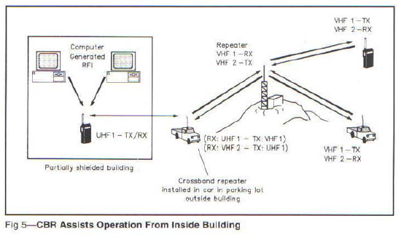
Another View from March ’93 QST

Slide 13
Crossband Repeat w/Repeater
(Passive)
ICOM 2720H
VHF Repeater
UHF
UHF – 446.125 TX
VHF - 146.94 RX

Slide 14
Issues
Identification
Power
Frequency selection
Procedure

Slide 15
Issue - Identification
Station in CBR must IDENTIFY per FCC rules
Usually only simplex side is involved in IDing
Unit may have CW ID option installed
IDing over the CBR may cause a “requirement loop”
“Site” requirement may be met by using HT?

Slide 16
Crossband Repeating
ICOM 2720H
VHF Repeater
UHF

Slide 17
Issue – Power
Use lowest power setting to accomplish task
Cooling - CBR unit is in constant transmit
Unit may overheat in cramped locations
Make sure antenna/diplexer/duplexer can handle the load

Slide 18
Issue – Frequency Selection
Use band plan for frequency selection
Usually one side will be simplex
Consider tone to reduce interference

Slide 19
Crossband Repeating
ICOM 2720H
VHF Repeater
UHF

Slide 20
Issue – Procedure
Last heard input channel has control
Cannot transmit while CBR is transmitting
Squelch tail may be a problem
Dropping tone on the tail may help

Slide 21
Demo
1 - Listen on 146.94 (71.9)
2 - Listen on 146.34 (71.9)
3 - Scan on UHF simplex.

Slide 22

Questions?

