Slide 1

Capacitors
Capacitors are devices which store charge when a voltage is applied. They
consist of two conductive plates with an insulating material (the dielectric)
placed between them. Each lead of a capacitor is attached to one of the plates.
Capacitance is a relative measure of how much charge a capacitor will store:
The greater the capacitance C, the more charge Q will be stored for a given
applied voltage E. Capacitance is given in units of Farads, while charge has
units of Coulombs. (E, of course, is in Volts).
In a DC circuit, the capacitor acts like an open circuit. Current flows in the circuit while the capacitor is charging because electrons are attracted from the positive plate of the capacitor to the positive terminal of the battery, and are repelled by the negative terminal of the battery to the negative place of the capacitor. Charge quits moving once the voltage across the capacitor is the same as the battery’s voltage.
+
+
-
-

Slide 2
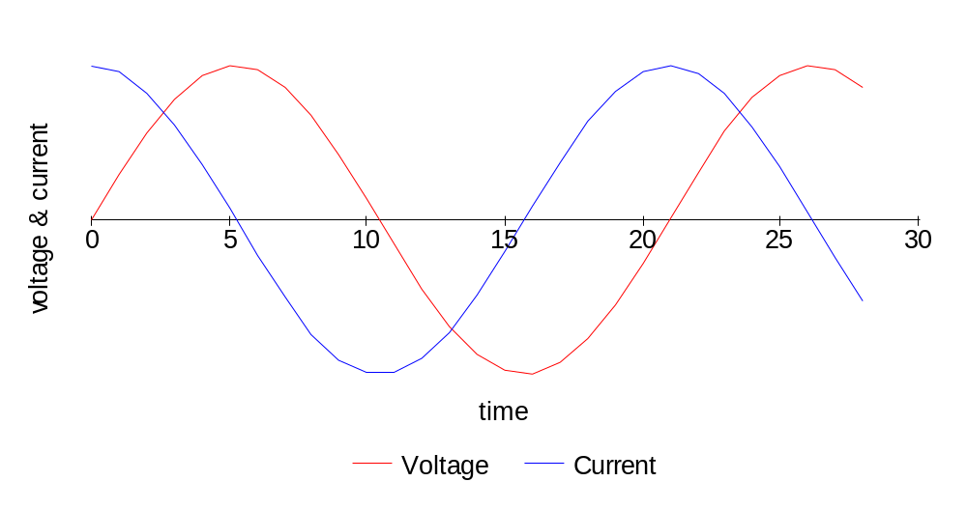
Capacitors and AC Signals
In a circuit where the voltage is always changing (AC), the
voltage across the capacitor is always changing, and
electrons are always flowing toward or away from the
plates. This charge movement is really current which
flows, making the capacitor appear to allow alternating
current to flow through it. Capacitors block DC but pass AC.
AC
Current is zero when the
voltage is greatest, and
voltage is zero when current
is greatest.
ICE: I leads E in a
Capacitive circuit.

Slide 3
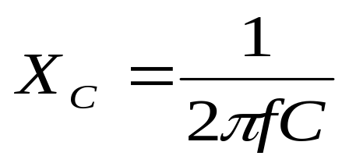
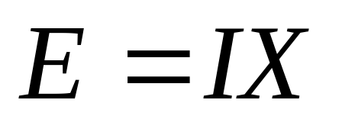
Ohm’s Law for AC Circuits
Capacitors in AC circuits allow current to flow, but they do not act like short circuits. Capacitors both pass and limit current. Their ability to pass current depends on the frequency of the signal, and is called reactance.
X_{C} is capacitive reactance, in ohms
f is frequency, in Hz (or MHz if C is in μF)
C is capacitance, in F (or μF if f is in MHz)
Energy is not lost due to reactance (like it is to resistance). Instead, the energy is stored in the electric field of the capacitor when charged, and released to the circuit as current when discharged.
To find the current in a capacitor for an applied voltage E, we use Ohm’s Law for AC
circuits:
X is the reactance of the capacitor. Remember that in a capacitor, E and I are out of
phase by 90 degrees (one-fourth of a cycle), so E and I do not have these values at
the same instant in time.

Slide 4
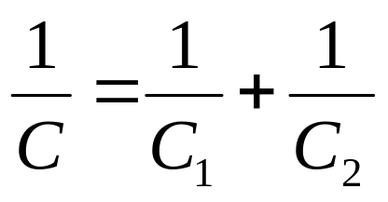
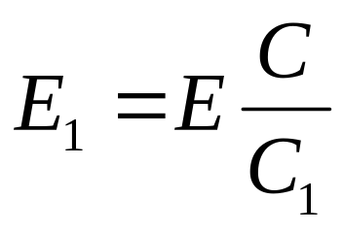
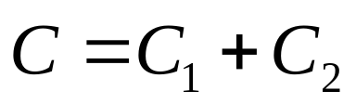
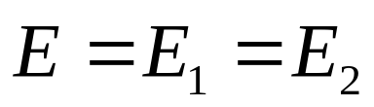
Combinations of Capacitors
Capacitors in series are like resistors in parallel:
+
C1
E
-
C2
Voltage across a capacitor is inversely proportional
to its capacitance:
Capacitors in series can serve as
voltage dividers, just like resistors
+
Capacitors in parallel are like resistors in series:
E
C1
C2
-
Each capacitor has the same voltage across it:

Slide 5
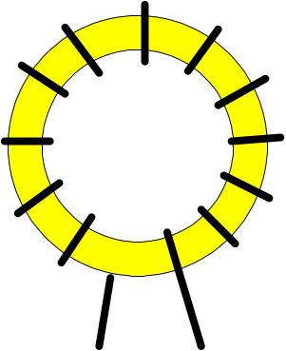
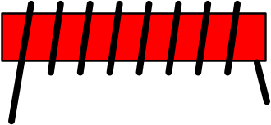
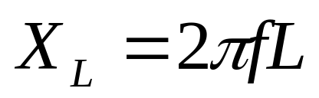
Inductors
Inductors are loops or coils of wire, usually wound around an iron core. When current flows through an inductor, a magnetic field is created in the core. This magnetic field stores energy. When the current decreases, the magnetic field gives up its energy as current to replace some of the decrease.
Inductors possess a characteristic known as inductance, which measures its ability to oppose a change in the current flowing through it. Placing an inductor in an AC circuit limits the rate at which current will change. Inductance has units of Henries.
Toroidal inductor
The value of inductance is affected by the size of the inductor, the number of turns, and the material used for the core.
Just like capacitors, inductors possess reactance:
Solenoid
Ohm’s Law for AC circuits can be used for inductors, just like
it is used for capacitors.

Slide 6
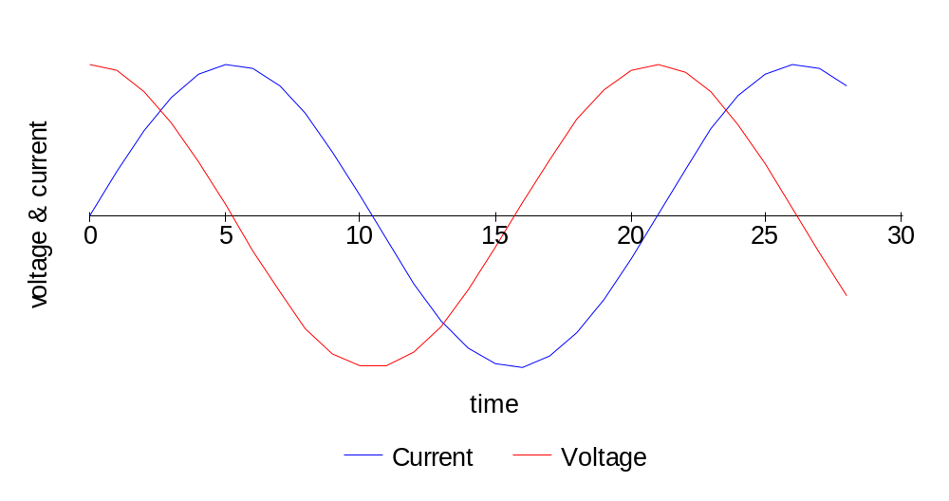
Inductors and AC Signals
In a circuit where the voltage is always changing (AC), the
voltage across the inductor is always changing, and current
flows back and forth through the inductor. The inductor both
passes and limits the current flowing through it.
AC
L
Current is zero when the
voltage is greatest, and
voltage is zero when current
is greatest.
ELI: E leads I in an
Inductive circuit.

Slide 7


Toroidal Inductors
Toroidal inductors are frequently used in radio kits because they
are compact and easy to make. The cores are either ferrite or
powdered iron, depending upon the inductance needed.
Toroid cores have three part identifiers:
FT-37-43
FT for ferrite, or
T for powdered
iron
inside diameter,
in hundredths
of an inch
the type of
material in
the core
Ferrite cores have a higher permeability, meaning they’ll give you more inductance per
turn of wire than will powdered iron cores. Powdered iron cores have a more stable
permeability, though. The number of turns N is computed using the equations below.
For powdered iron cores:
For ferrite cores:
For T-50-6 (yellow core), A_{L} is 40 μH/100 turns
For T-37-2 (red core), A_{L} is 40 μH/100 turns
(cores are color-coded by material type)
For FT-37-43, A_{L} is 420 mH/1000 turns
(ferrite cores aren’t usually painted)

Slide 8
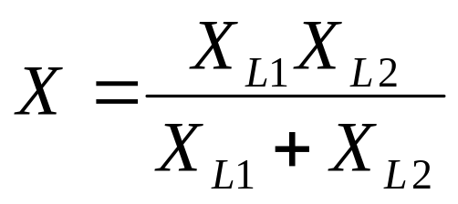
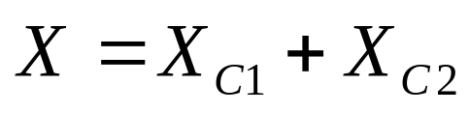
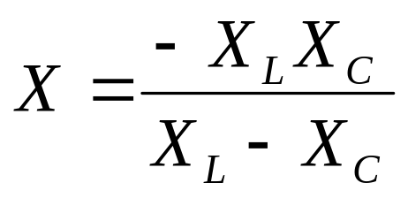
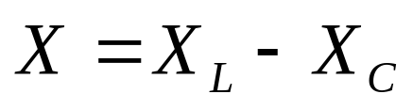
Combining Reactances
Like reactances combine just like resistors:
C1
Parallel reactances:
Series reactances:
L1
L2
C2
Unlike reactances combine differently. These are examples of
tank circuits (circuits having an inductor and capacitor):
C
Parallel reactances:
Series reactances:
L
C
L

Slide 9
Tank Circuits
Tank circuits are simply circuits containing a capacitor and an inductor, either in
series or in parallel.
C
L
C
L
What happens when the reactances of the inductor and capacitor are equal?
- the reactance of the parallel circuit becomes infinite, and no current would
flow in the circuit
- the reactance of the series circuit becomes zero, and current would flow
freely in the circuit

Slide 10
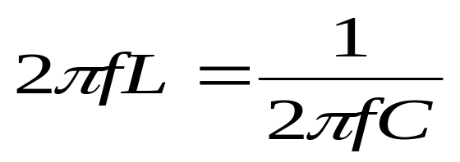
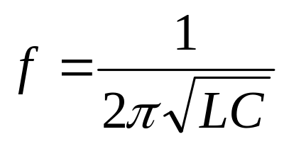
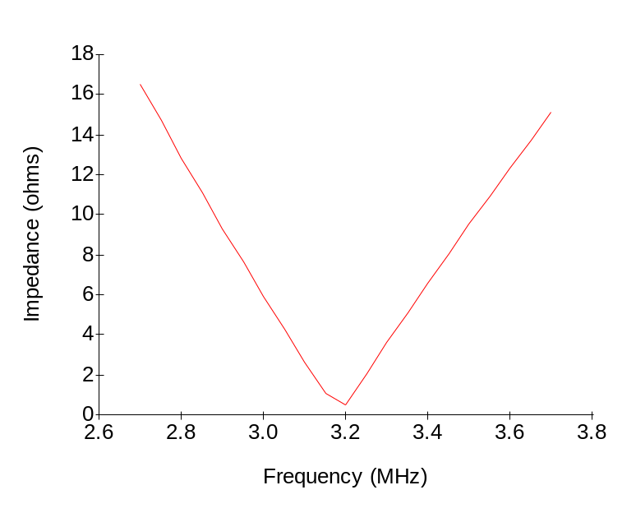
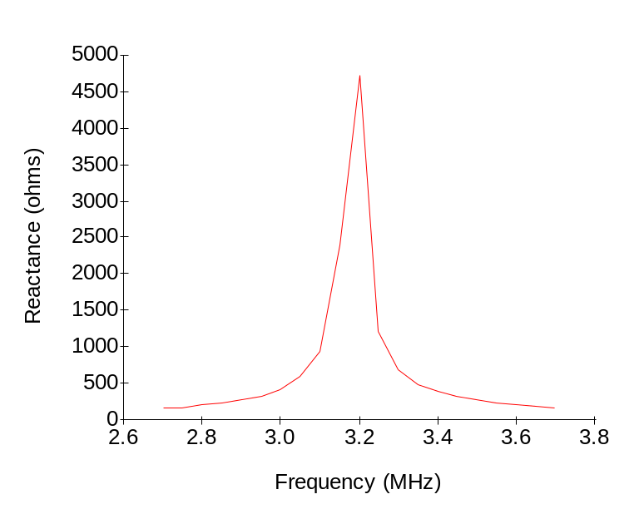
Tank Circuit Resonance
When inductive and capacitive reactances in a tank circuit are equal, the circuit is said to be resonant.
gives the resonant frequency:
Series LC circuit:
Parallel LC circuit:

Slide 11
Oscillators
An oscillator is a source of an AC signal.
L
Consider the circuit at right. When the switch is in the down
position, the capacitor is charged by the battery. Once the
capacitor is charged, the switch is moved so that the inductor
and capacitor are connected. The capacitor begins to
discharge, causing a current to flow through the circuit. The
inductor limits how quickly the current can flow, though, and
the magnetic field in the inductor becomes stronger as the
current increases.
Once the capacitor is discharged the current wants to stop flowing, but the inductor then
begins to use the stored energy in the magnetic field to keep the current flowing, causing
the current to diminish slowly rather than all at once. This causes the capacitor to charge
back up (but with the opposite polarity than before) until the current finally ceases and
the capacitor is charged. Then what happens? The capacitor begins to discharge, and the
cycle begins again in the other direction! The circuit is said to be oscillating.
C
S
E
In real life, the oscillations in this circuit would rapidly go to zero. Why?

Slide 12
Feedback
In order to combat the resistive losses in the oscillating circuit, a portion of the
signal is taken from the circuit, amplified, and fed back to the circuit. Two
conditions must be fulfilled in order for oscillation to continue:
1) The feedback must be in phase with the original signal
2) The gain due to feedback must be equal to or greater than the resistive losses
amplifier
input
What will be the frequency of the
oscillator?
output

Slide 13
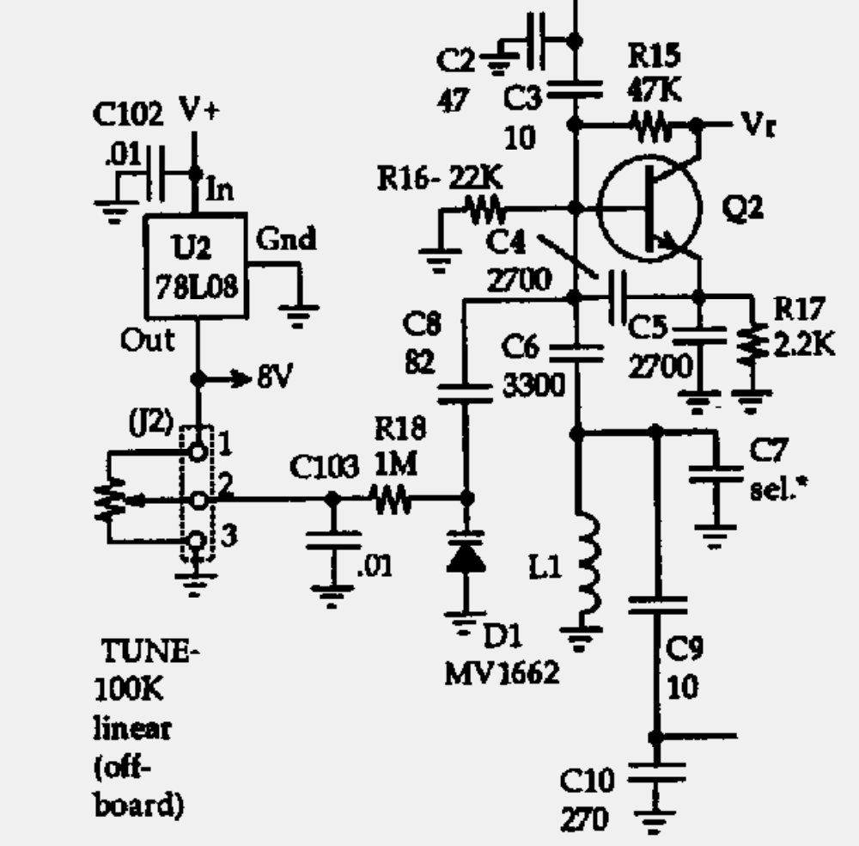
The SW+40 VFO
The following components make
up the LC circuit which determines
the frequency of the oscillator:
C2, C3, C4, C5, C6, C7, C8,
C9, C10, D1, and L1. The value
of C7 is chosen so that the
oscillator has the right frequency.
D1 is a varactor diode. When
reverse biased, it has a
capacitance which varies with
the bias voltage. Its capacitance
decreases with increasing bias
voltage. Varying the voltage with
the tuning pot causes the
frequency of the oscillator to change.
Q2 and resistors R15, R16, and R17
make up the amplifier which supplies
feedback to the oscillator.
Circuit copyright 1998 by NN1G.

Slide 14
Construction
Install the following parts:
  C2-C6, C8-C10, C103
  D1, D2
  L1
  Q2
  R15-R18
  J2 three-pin connector and wiring harness with 100K potentiometer
Apply power and use frequency counter to test for ~3 MHz signal at base of Q2. If you don’t have a frequency counter, use a general coverage receiver (use a clip lead for the antenna, lay the lead close to the SW+40 board, and tune in the signal like it was a CW signal).
Test range of VFO by adjusting the tuning pot (note: increasing the value of C8 will increase the frequency range of the VFO)

