Slide 1
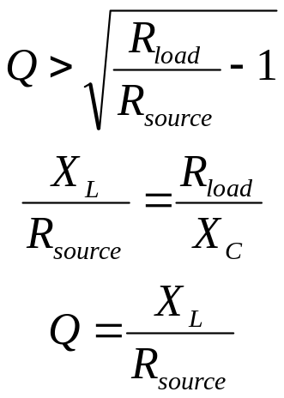
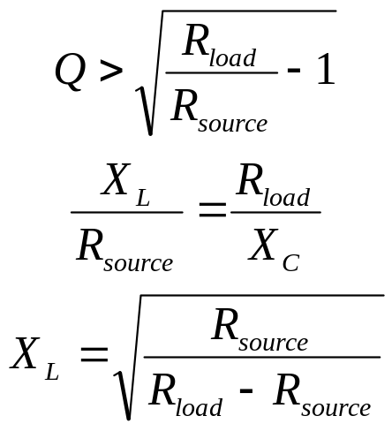
The L-Network
L-networks are used to match the output impedance of one circuit to the input of another.
R_{source} < R_{load}, 1< Q < 5
R_{source} > R_{load}, 1 < Q < 5
R_{source}
R_{load}
R_{source}
R_{load}
L
C
C
L

Slide 2
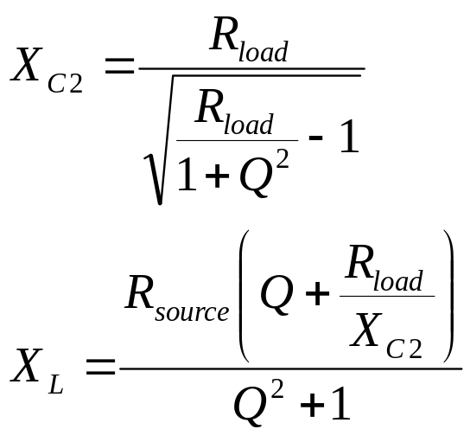
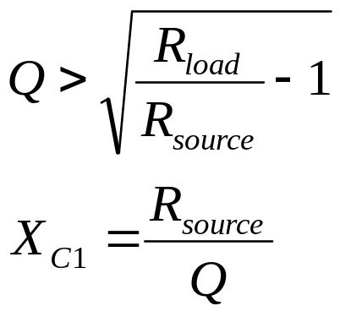
The Pi-Network
The pi-network is also used for impedance matching, with a high source impedance and
a low load impedance. Often used in vacuum tube RF power amps to match low-impedance
antennas.
R_{source} > R_{load}, 5 < Q < 15
R_{source}
R_{load}
L
C1
C2

Slide 3
Filters
Filters are an integral part of any radio transmitter or receiver. They are used to
selectively pass only certain frequencies through the circuits of the radio.
0 db
f_{C}
0 db
f_{C}
3 db
3 db
Insertion Loss
Insertion Loss
60 db
60 db
frequency
frequency
High-pass filter
Low-pass filter
0 db
f_{C}
f_{C}
0 db
3 db
3 db
Insertion Loss
Insertion Loss
60 db
60 db
frequency
frequency
Band-pass filter
Band-stop filter

Slide 4
LC Filters
L2
L4
L1
L3
L5
C1
C3
C5
C2
C4
Five-element low-pass filters
C1
C3
C5
C2
C4
L2
L4
L1
L3
L5
Five-element high-pass filters

Slide 5
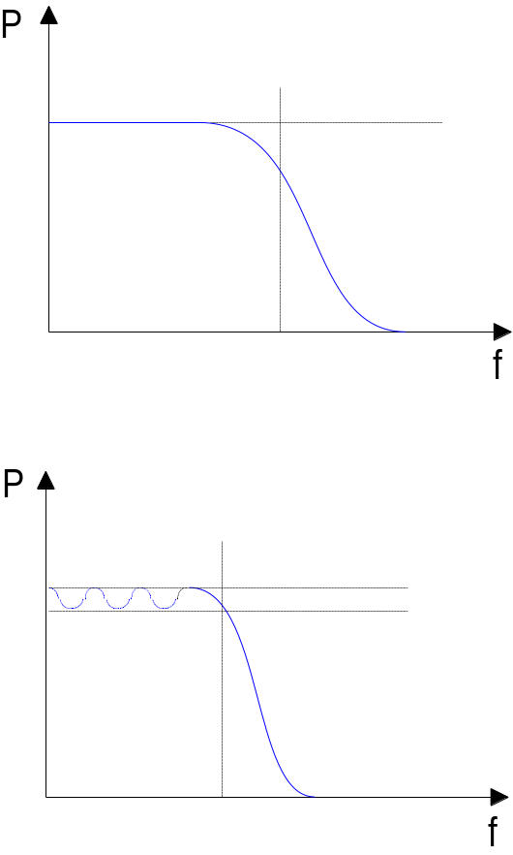
Filter Response Functions
Filter designs are based on mathematical
functions which exhibit filter-like behavior
when plotted versus frequency. Two types
of response functions are prevalent. The
first is the Butterworth response, which
exhibits high attenuation and a flat passband
but is a poor approximation for both pass
and stop bands near cutoff.
The other type of response function is the
Chebyshev response. It exhibits a “ripple”
in the passband but provides a better model
of the filter near the cutoff.
Tables have been built for both types of filters
which give values for L and C for various LC
filter configurations. These tables are scaled
as needed for particular frequencies and
other properties.

Slide 6
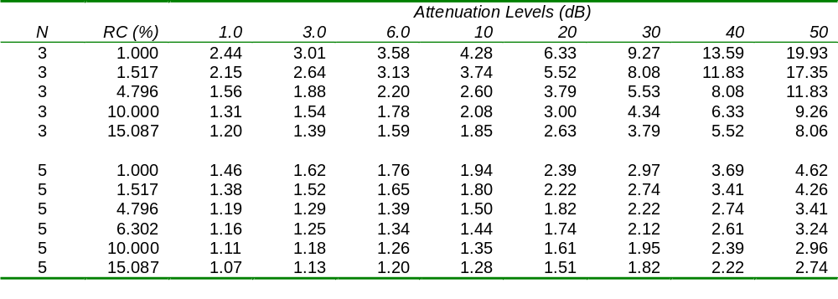
Low-Pass Filter Design
Standard tables have been created which allow for the simple calculation of appropriate
L and C values to obtain a filter with the desired properties. The first step is to select a
filter design which gives the proper attenuation. Here, the frequency multiples (of the cutoff
frequency) are given at which various attenuation levels are achieved for various filter
designs. If 30 dB attenuation is desired at twice the cutoff frequency, a five-element design
with a reflection coefficient (RC) of 10% or greater can be used.
Taken from ARRL Handbook, 1997, p. 16.14 copyright 1996 ARRL.

Slide 7
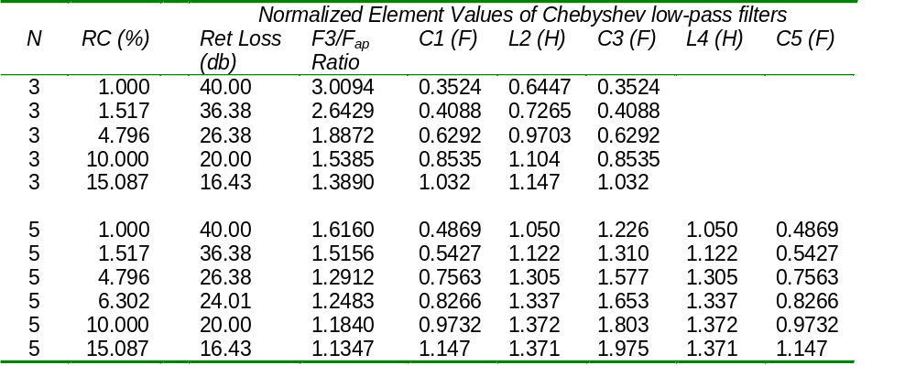
Low-Pass Filter Design
Once the design has been chosen, the normalized element values are taken from another
table. These are then scaled to arrive at the desired filter element L and C values.
Taken from ARRL Handbook, 1997, p. 16.12 copyright 1996 ARRL.

Slide 8
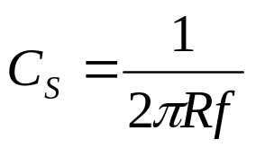
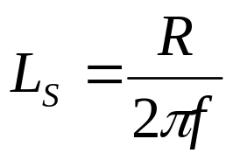
Low-Pass Filter Design
For a 5-element filter with a reflection coefficient of 10%, our normalized element values are:
C1=C5=0.9732
L2=L4=1.372
C3=1.803
Now we calculate scaling factors for C and L for the desired cutoff frequency and input/output
impedance using the following equations:
For a frequency of 7.3 MHz and an impedance of 50 ohms, we get C_{S}=4.36x10⁻¹⁰ and
LS=1.09x10⁻⁶. These factors are then multiplied by the values of C and L from the table to
get the values which result in the desired filter properties:
C1 = C5 = 0.9732 x 436 pF = 424.3 pF
C3 = 1.372 x 436 pF = 598.2 pF
L2 = L4 = 1.803 x 1.09 μH = 2.0 μH

Slide 9
Band-Pass Filter Design
The filter design tables can serve as the starting point for designing band-pass filters. The
approach is to design a low-pass filter whose cutoff frequency is the desired bandwidth of
the band-pass filter. Then the low-pass filter capacitors are combined with inductors, and
the low-pass filter inductors are combined with capacitors, such that the resulting
configuration is sets of series and parallel LC circuits resonant at the desired bandpass
frequency.
In the filter below, C1, L2, C3, L4, and C5 make up the original low-pass filter. Elements
L1, C2, L3, C4, and L5 have been added to make this a bandpass filter. Note that the L
and C combinations are parallel where the original elements were in parallel, and are
series where the original elements were in series.
L2
C2
L4
C4
L1
C1
L3
C3
L5
C5

Slide 10
Crystal Ladder Filters
For band-pass filters, the Q of the filter
elements limits the minimum-achievable
bandwidth of the filter. If crystals are used
in place of other elements, their very-high
Q values allow filters to be built which have
very narrow bandwidths.
Y1
Y2
Y3
C12
C23
L_{S}
C_{S}
R_{S}
The equivalent circuit for a crystal is shown at right.
L_{S}, C_{S}, and R_{S} are called the motional inductance,
capacitance, and resistance of the crystal. C_{P} is the
parallel plate capacitance due to the two electrodes
of the crystal and the quartz dielectric between them.
It is easy to see that each crystal forms a tuned circuit,
and using them in a crystal ladder filter results in a
configuration much like the previously-discussed band-
pass filter, but with a narrower bandpass because of the higher Q of the crystals.
C_{P}

Slide 11
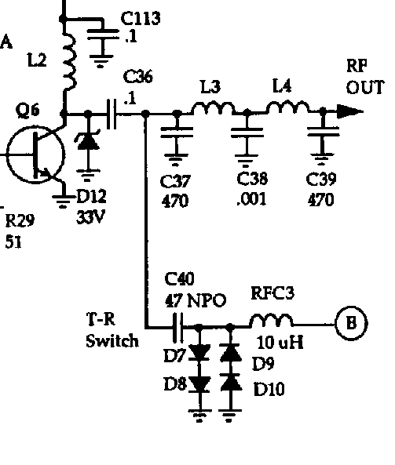
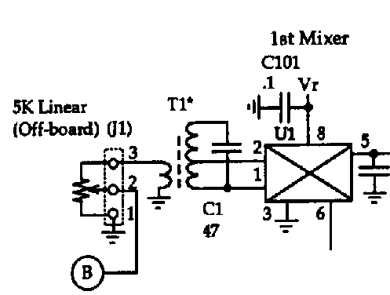
SW+ Receiver Antenna Input
Signals from the antenna are passed to the receiver after
they pass through the low-pass filter. They pass through a
band-pass filter made up of C40 and RFC3. Diodes D7
through D10 serve to limit the voltage swings seen by the
receiver when the transmitter is operating, and to “break up”
the resonance of C40 and RFC3. This serves to limit the
signal from the transmitter which is seen by the receiver.
The signal next passes through the 5k-ohm potentiometer
which serves as the RF gain control. Transformer T1 is
configured as a tuned circuit. The output from the transformer
to the receive mixer is taken from the center tap of the
transformer this time so as to better match the impedance of
the antenna (low) with the input impedance of the mixer (high).
The mixer is powered by the 8-volt regulated voltage, and the
antenna signal is mixed with the 3-MHz VFO signal to obtain
the signal at an IF of 4 MHz.
Circuits copyright 1998 Dave Benson NN1G

Slide 12
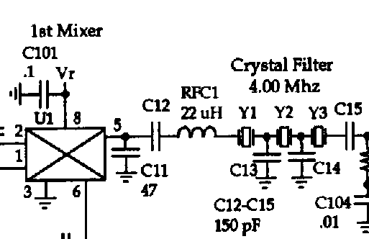
Receiver First Mixer & Filter
Circuit copyright 1998 Dave Benson NN1G
The output from the receive mixer is fed to a crystal ladder filter. C11 and RFC1 make up an L-network which matches the impedance of the mixer output to the impedance of the crystal filter. C12 and C15 serve to pull the resonant frequencies of Y1 and Y3 up a bit as needed by the filter design. The crystal filter has a narrow bandpass (probably about 1 kHz or so). This serves to pass only a narrow range of signals to subsequent stages in the receiver.

Slide 13
Construction Part 1
Install the following parts (some you may have installed previously):
  T1
  C1, C40, C101
  D7, D8, D9, D10
  RFC3
  Socket for U1
  U1
Lightly solder a jumper (use a leftover lead from an installed component) from the base of Q6 (leftmost hole) to the top hole for C36 (this leaks some transmitter signal to the receiver for testing)
Connect power jack, tuning pot, gain pot, and key jack.
Connect a key to the key jack, or use a jumper to short the contacts.
Turn gain pot all the way up.
Connect power.
Key down, use oscilloscope to check for a signal at the output (pin 5) of U1. What kind of waveform do you see? You should see a complex waveform much like we saw coming out of U5 in the transmitter.

Slide 14
Construction Part 2
Install the following parts:
  C11 through C15, and C104
  R1
  RFC1
  Y1, Y2, and Y3 (install these so they sit 1/16” above the board or so, so as not to have the crystal cases short the pads)
Connect power jack, tuning pot, gain pot, and key jack.
Connect a key to the key jack, or use a jumper to short the contacts.
Turn gain pot all the way up.
Connect power.
Key down, use oscilloscope to check for a signal at the input (pin 2) of U3 (not installed yet). What kind of waveform do you see? You should see a nice clean sine wave at 4 MHz. All the unwanted mixer products are gone!

