Slide 1
The Product Detector
The product detector’s job is to convert an incoming signal from RF frequencies to
audio frequencies. It is simply another mixer whose output is in the audio
frequency range.
4 MHz
Product
Detector
4.0008 MHz - 4 MHz = 800 Hz
RF in
Audio out
The BFO can mix with two different
frequencies to get the same output
tone--one above and the other below
the BFO’s frequency. For this reason,
the input RF signal should be filtered
so it contains only a narrow range of
frequencies. This keeps the audio
output cleaner with fewer undesired
signals.
The beat frequency oscillator
(BFO) has a frequency very close
to that of the RF input. This is so
the product detector produces a
difference signal which is in the
audio range. For CW, the
difference between the input
frequency and the BFO frequency
is about 800 Hz. This is the tone
you hear when you listen to CW.
4.0008 MHz
RF in
BFO

Slide 2
SW+ Sidetone
~3.9996 MHz
800 Hz
RX
Mixer
4 MHz
Xtal
Filter
Product
Detector
BP
Filter
RF In/Out
VFO frequency
subtracted here
AF Amp
BFO
~4.0004 MHz
BP
Filter
Some TX signal
“leaks” into RX
VFO
AF Out
~3 MHz
The SW+ sidetone is formed by allowing
a bit of the transmitted signal into the
receiver. The difference between the
transmit LO frequency and the BFO
frequency determines the pitch of the
sidetone. To zero-beat with another
station, simply tune until its pitch matches
that of your sidetone. Then you’ll both
be on the same frequency.
TX Filter, Amp
~3.9996 MHz
TX
Mixer
VFO frequency
added here

Slide 3
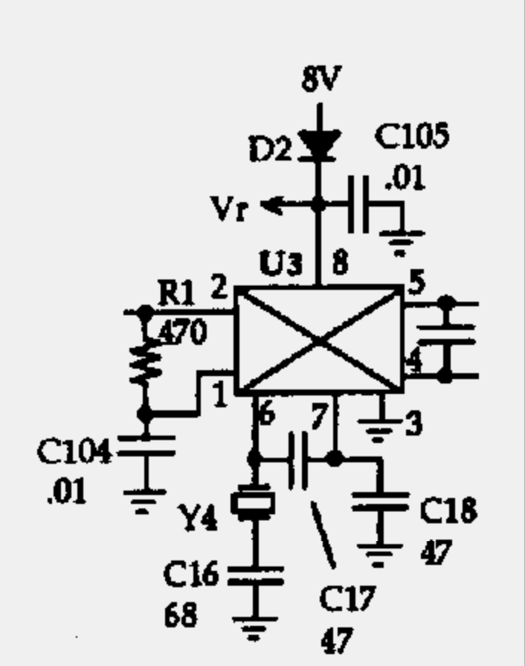
SW+ Product Detector Circuit
The SW+ product detector circuit uses an NE602
for the mixer just like we’ve seen before. Here, the
input comes in from the output of the 4 MHz crystal
filter to pin 2. R1 is used to load the output of the
filter to match it to the input impedance of the mixer.
Since pin 1 isn’t being used it’s tied to ground
through a capacitor (C104).
Crystal Y4 and capacitors C16, C17, and C18 make
up the frequency-determining components for the
BFO. C16’s purpose is to pull Y4 up a bit in frequency
just like RFC2 pulled the transmit LO down.
The output is taken from the mixer in a balanced
configuration. The capacitor across pins 4 and 5 is
there to allow the RF parts of the mixer output to pass
freely, effectively removing it from the AF signal input
to the audio amplifier stages.
Copyright 1998 Dave Benson NN1G

Slide 4
Operational Amplifiers
V+
Op amps are IC amplifiers with the
following characteristics:
high input impedance
low output impedance
high gain (up to 100,000)
relatively slow
Op amps accept two inputs, one
which is inverted and the other
not inverted. The op amp then amplifies the difference
between the two signals (it subtracts the inverted input
from the noninverted input and amplifies the result).
In open-loop mode (as shown here), the gain of the op amp is very high, and any difference
between the two inputs causes the amplifier output to saturate. If the inverted input is
larger than the noninverted input, the op amp output is a negative voltage. Otherwise, the
output is positive.
Note the two supplies:
one is positive, the
other is negative.
Inverting input
-
Output
+
noninverting input
V-

Slide 5
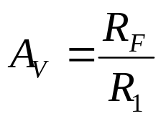
Op Amp Feedback Circuit
R_{F}
Most of the time we don’t want our amplifier
to drive to saturation, so we’d like to reduce
its gain to something manageable. We do
this by feeding a bit of the output signal back
to the inverting input. This has the effect of
reducing the difference between the two
inputs and reduces the output amplitude.
This is called negative feedback.
For example, if the inverted input is larger than the noninverted, the output is negative. The
feedback to the inverted input serves to reduce its level, lessening the difference between it
and the noninverted input. On the other hand, if the inverted input is smaller than the
noninverted input, the output is positive, and the feedback serves to increase the level of the
inverted input, again lessening the difference between the two inputs.
The voltage gain of the op amp in this configuration is simply
R₁
-
+
R₂

Slide 6
Inverting Amplifier
R_{F}
In the configuration shown here, the
inverted input is being compared to
ground. This results in the inverted
input signal itself being amplified.
Since the signal is provided at the
inverted input, the output will be
inverted with respect to the input.
The gain of the amplifier in this configuration is
R₁
-
+

Slide 7
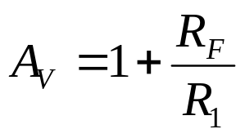
Noninverting Amplifier
R_{F}
In the configuration shown here, the
noninverted input is being compared to
ground. This results in the noninverted
input signal itself being amplified.
Since the signal is provided at the
noninverted input, the output will be
in phase with the input.
The gain of the amplifier in this configuration is
R₁
-
R₂
+

Slide 8
Source Follower
The source follower circuit is a variation
on the noninverting amplifier. Here,
the feedback resistor has been
replaced with a short circuit. This
effectively makes the gain of the
amplifier to be one.
What is the advantage of an amplifer
with no gain? Just like the emitter follower
amplifier we constructed with a transistor, the source follower has a high input impedance
and low output impedance. It will do a good job of isolating one part of the circuit from
another.
R₁
-
R₂
+

Slide 9
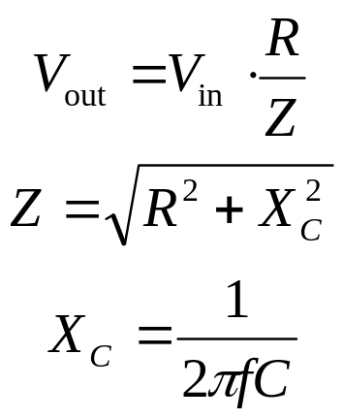
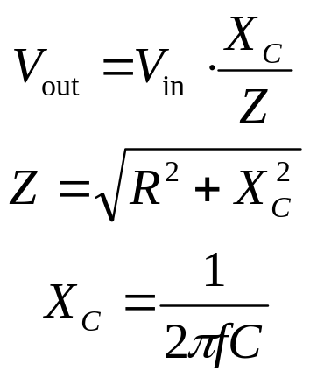
RC Filters
In combination with a resistor, a capacitor’s variation in reactance with frequency can be
used to construct a simple low-pass or high-pass filter:
V_{in}
C
V_{out}
V_{in}
R
V_{out}
High-pass filter
R
Low-pass filter
C

Slide 10
Low-Pass Active Filter
Passive filters take up lots of space in a circuit and
cause signal to be lost. Combining a passive RC
filter with an op amp for amplification creates
what is known as an active filter. By “active”
we mean that the filter requires power
to operate.
Here is an example of an
active low-pass filter. The signal
is provided to the noninverted
input through an RC low-pass filter
made up of R₂ and C₂. Feedback to
limit gain comes through C₁ and R_{F}. The
parallel combination of C₁ and R_{F} presents
an impedance which decreases with increasing
frequency, meaning that more negative feedback is provided to the inverting input at
higher frequencies, reducing gain at those frequencies.
C₁
R_{F}
R₁
-
R₂
+
C₂

Slide 11
High-Pass Active Filter
R_{F}
R₁
-
C₁
C₂
+
R₂
Here is an example of an active high-pass
filter. C₂ and R₂ make up an RC high-pass
filter at the input of the op amp. R3 provides
a path for the input when the frequency is
too low for C₂ to freely conduct. When the
input signal passes through R₃ instead of
into the amplifier, the output is tied directly to the input and the gain is reduced. So, this
amplifier has low gain at low frequencies and higher gain at high frequencies. C₁ prevent
any DC at the input from being coupled to the output.
R₃

Slide 12
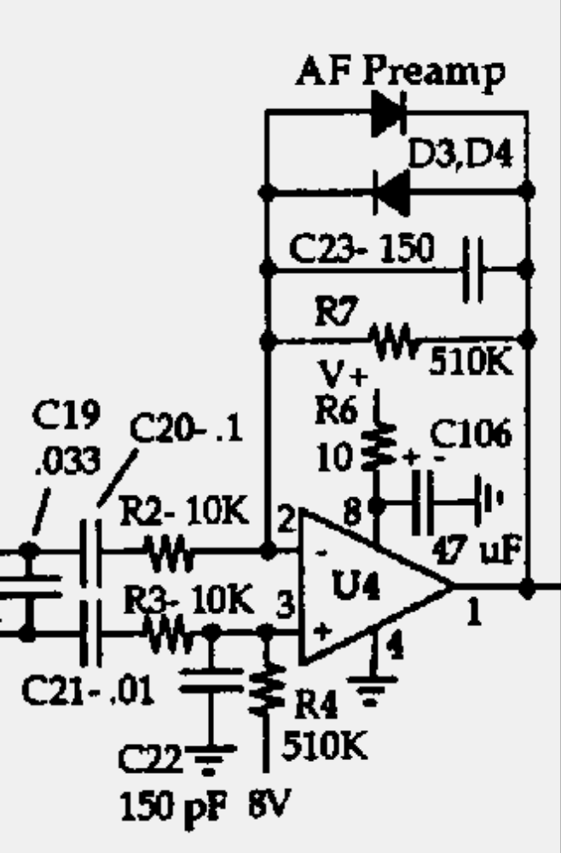
SW+ Amplifier First Stage
The SW+ first-stage audio amplifier is configured as a
low-pass filter. The RC low-pass filter is made up of R4
and C22 (8 volts DC bias is applied to the noninverted
input of the op amp through R4). C23 and R7 in the
feedback from the output to the inverting input also
serve to filter out high frequencies.
C19 provides a “short” for high frequency components
at the output of the product detector. C20 and C21 are
DC blocking capacitors, and R2 and R3 limit current
input to the amplifier. Diodes D3 and D4 limit the
voltage swing of the output so Q1 (the FET which
mutes the receiver during transmit) is not driven to
saturation.
12 volts is applied to the V+ input, while the V- is
grounded. The 8-volt DC bias on the input serves to
put the signal voltage between V+ and V-.
Copyright 1998 Dave Benson NN1G

Slide 13
Construction
Install the following parts:
  Socket for U3, and U3 (SA612)
  Socket for U4, and U4 (NE5532)
  C16 through C23
  D3 and D4
  R2, R3, R4, and R7
  Y4
Make sure that the temporary jumper from the base of Q6 (leftmost hole) to the top hole for C36 is still in place (you installed it for lesson 5).
Connect power jack, tuning pot, gain pot, and key jack.
Connect a key to the key jack, or use a jumper to short the contacts.
Turn gain pot all the way up.
Connect power.
Key down, use oscilloscope to check for a signal at the output (pin 1) of U4. You should see a clear signal of around 800 Hz.

