Slide 1
Power Amplifier Considerations
Gain:
  high gain typically required
Efficiency:
  especially important for battery-powered rigs
Linearity:
  reproduction of the input signal at higher levels
Load:
  impedance of the load must be matched to the amplifier output
Spectral purity:
  harmonics and other unwanted components must be filtered

Slide 2
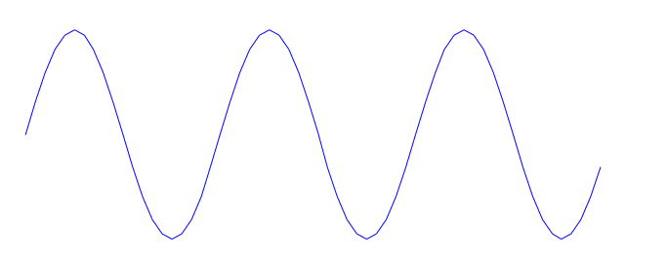
Class A Amplifiers
Class A amplifiers conduct for the entire 360 degrees of the input signal. The amplifier is never driven to cutoff. Current flows through the amplifier for the
entire cycle. Output voltage is generated by the variation of current flow through
the load resistance.
Class A amplifiers possess the following
characteristics:
- maximum linearity
- maximum gain
- low efficiency (~30%)
quiescent
current
I=0

Slide 3
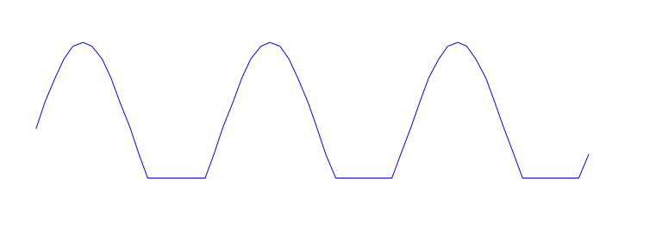
Class AB Amplifiers
Class AB amplifiers conduct for less than the the entire 360 degrees of the input signal, but greater than 180 degrees. The amplifier cuts off for a small portion of the cycle, during which time no current flows in the amplifier.
Class AB amplifiers possess the following
characteristics:
- good linearity, but not as good as
class A
- lower gain than class A
- better efficiency (~50%)
quiescent
current
I=0

Slide 4
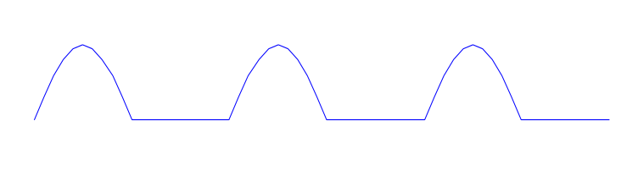
Class B Amplifiers
Class B amplifiers conduct for one half of the input signal, 180 degrees. The amplifier cuts off for half of the cycle, during which time no current flows in the amplifier.
Class B amplifiers possess the following
characteristics:
- acceptable linearity
- lower gain than class AB
- better efficiency (~65%)
I=0

Slide 5
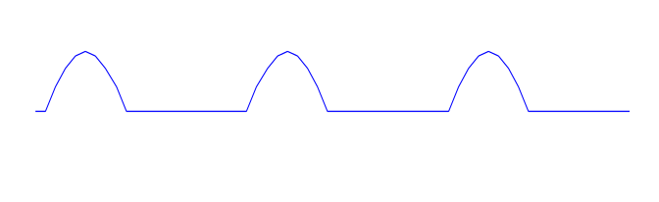
Class C Amplifiers
Class C amplifiers conduct for less than one half of the input signal, typically only 90 degrees. The amplifier cuts off for more than half of the cycle, during which time no current flows in the amplifier.
Class C amplifiers possess the following
characteristics:
- poor linearity--not acceptable for AM or
SSB but okay for CW
- lower gain than class B
- better efficiency (~75%)
I=0

Slide 6
Amplifier Linearity
How can we possibly get a clean sine wave
(or faithful reproduction of our input signal)
when class AB, B, and C amplifiers only
conduct for a portion of the signal cycle?
The answer is in the components connected
to the output of the amplifier. Generally, a
resonant circuit of some sort is found at the
output of the amplifier. The oscillations of
the resonant circuit are sinusoidal, and are
driven at the frequency of the amplifier
output. The amplifier’s output gives the
resonant oscillations a “kick” to maintain
the amplitude (not unlike the oscillators we
studied earlier). So, we get a signal out of
our output network which resembles the
input to the amplifier.

Slide 7
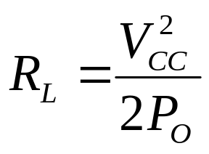
Amplifier Load
The optimum load resistance for a transistor amplifier is given approximately by
where V_{CC} is the collector DC voltage and P_{O} is the amplifier power output.
This is the load resistance which results in the best efficiency for the amplifier.
For the SW+, V_{CC} is about 12 volts, and R_{L} is about 50 ohms. At what power
will the final amplifier likely be most efficient? About 1.5 watts--exactly what the
instructions say to set it to.

Slide 8
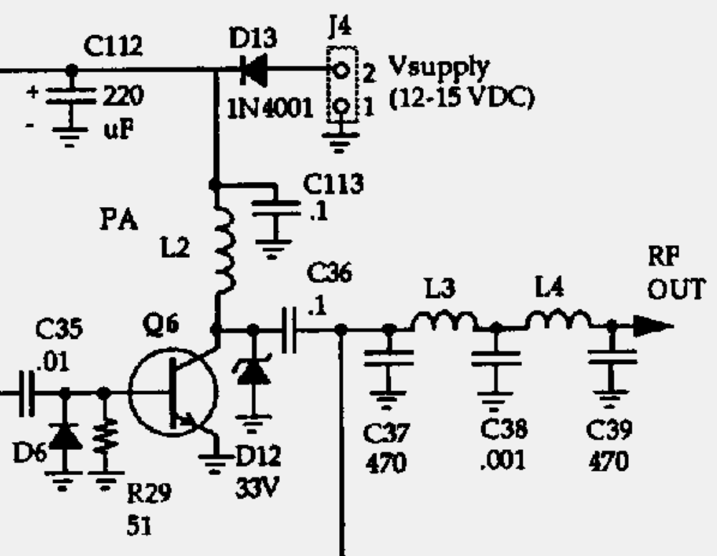
The SW+ Final Amplifier
Copyright 1998 Dave Benson NN1G
Q6 is the transistor which
provides the amplification for
the SW+. It is driven like a
class C amplifier except that
it acts more like a switch (either
full on or full off). This improves
the efficiency of the amplifier
(why?). L2 “smooths” the peaks
in the waveform while the rest
of the resonant output network
shapes it into a sine wave. D6
conducts when the input signal
voltage to Q6 is negative (while
Q6 is off) and causes C35 to
charge. C35 discharges on the
positive side, adding a bit extra
to drive Q6. D12 protects Q6 by
limiting the output voltage swing to 33 volts. L3, L4, C37, C38, and C39 make up the output
pi-network low-pass filter to remove any harmonics from the output signal. C113 serves to
keep RF from Q6 out of the supply voltage line.

Slide 9
Construction
Remove the temporary jumper you installed for testing the receiver.
Install the following parts:
  L2, L3, L4
  C36-C39, C113
  D12
  Q6
  antenna feedline and BNC connector
IMPORTANT! Connect a dummy load to the antenna output before proceeding with alignment!
Connect all controls & jacks
Follow alignment procedures on page 16 of the instructions (including operating frequency adjustment)
Do you get power output indicated with your wattmeter? Great! You’re finished! Now get on the air!

