Slide 1
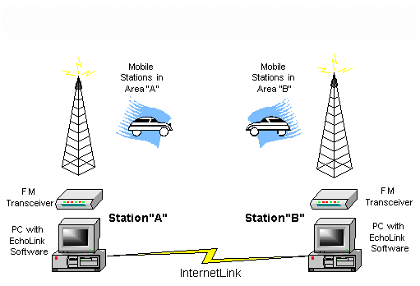
EchoLink
Internet Linking for Amateur Radio

Slide 2
General Topics
What is EchoLink?
Various Modes
Configuring EchoLink Software
  Computer to Computer via Internet
  Transceiver to Computer to the Internet
Physical Radio Interfacing
Other Linking Software
Is it really Amateur Radio?
Questions

Slide 3
What is EchoLink?
EchoLink uses VoIP (Voice Over Internet Protocol) to allow licensed Amateur Radio Operators to communicate with other Amateurs via the Internet.
It is primarily a Windows based application and is offered free of charge at http://www.echolink.org.
There is also a new EchoLinux and EchoMac available.
It was developed by Jonathan Taylor (K1RFD) in 2002 (He received Hamvention 2003 Special Achievement Award).

Slide 4
What Modes are Available?
EchoLink can be operated strictly between two computers connected to the Internet using the PC soundcard with Speakers and a Microphone.
EchoLink can be interfaced to a standard FM transceiver as a “simplex link” from your home QTH.
EchoLink can be interfaced to a VHF or UHF repeater for more coverage.

Slide 5
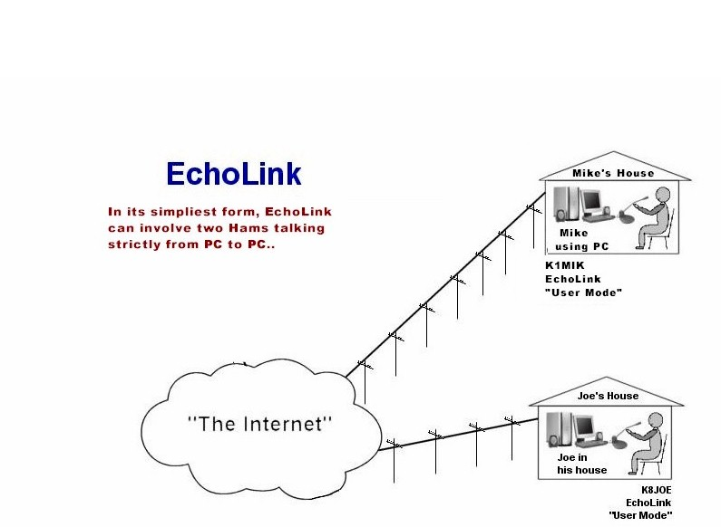
EchoLink “User Mode”

Slide 6
Is this really Ham Radio?

Slide 7
It Depends upon how you “use” it!!
Single User PC to PC involves no RF
  It is just another Internet “Chat Room”
A Simplex-Link or Repeater connection now makes it a “new” Amateur Radio Mode.

Slide 8
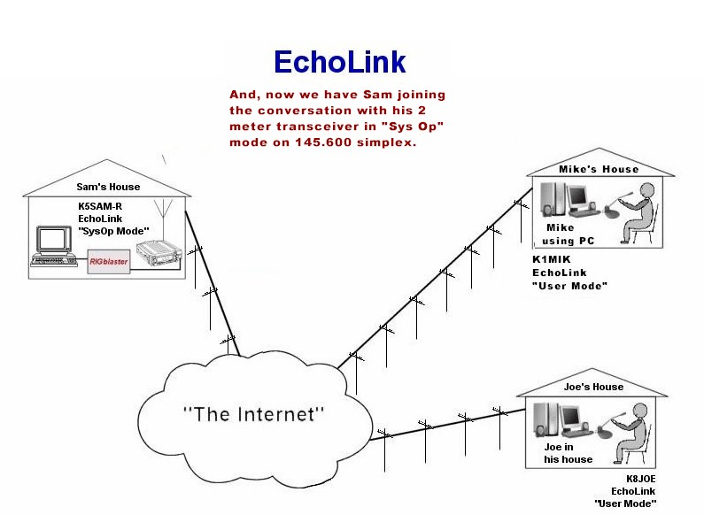
Adding a “Simplex-Link”

Slide 9
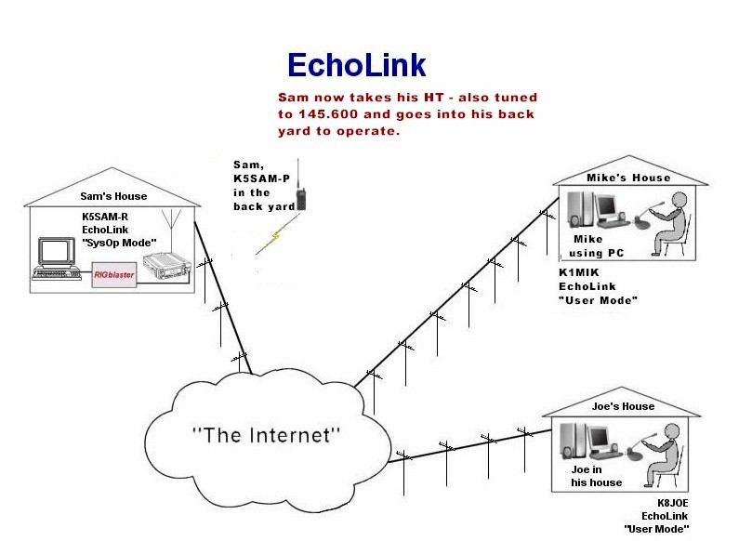
Expanding the “Link”

Slide 10
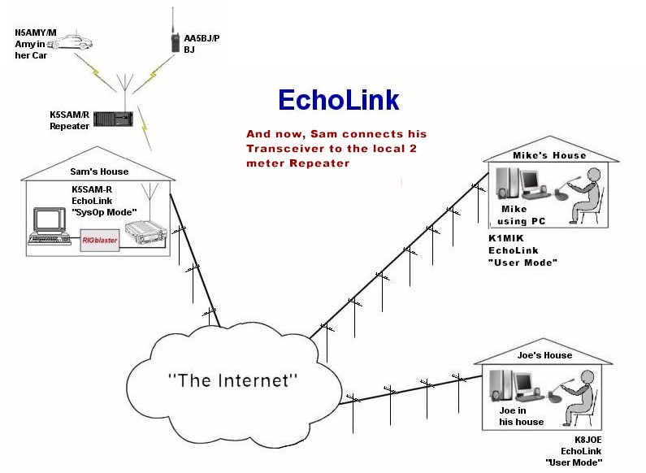
Adding a Repeater

Slide 11
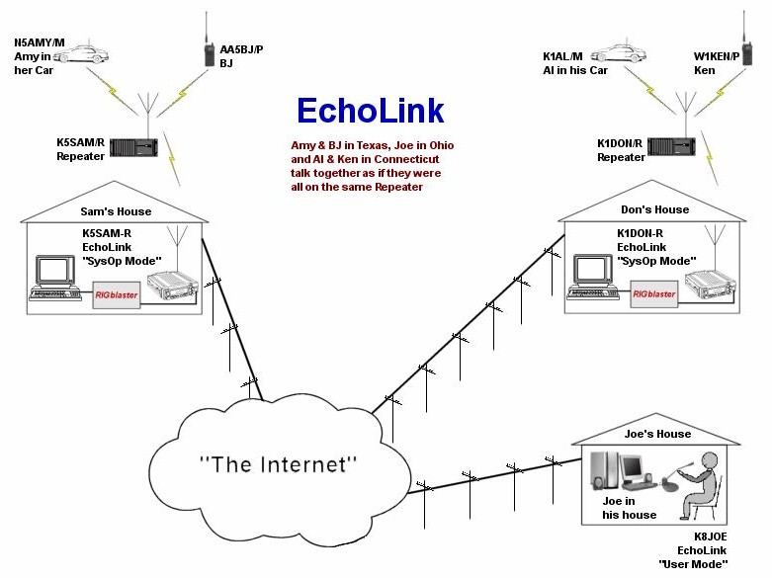
Bringing it all Together

Slide 12
Part 97 Link Requirements
The Simplex link and Repeater link as depicted here require a control operator.
If the Link is installed at the repeater side, it becomes a part of the repeater, and can then run in “automatic control”.

Slide 13
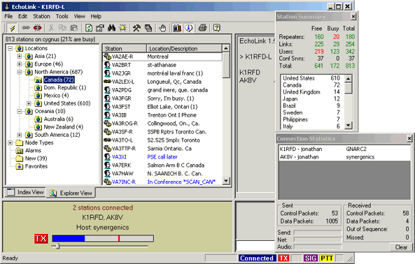
And now -- The Software…
Here is the main Screen, listing the Stations currently on the Link, by Country, Call Zone etc.
The Bottom of the Screen shows the current Transmit and Receive Audio levels in a colored bar graphic.

Slide 14
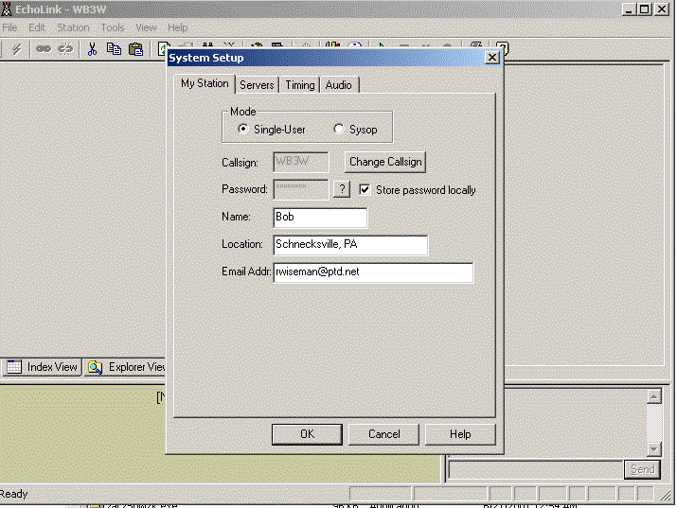
Basic Setup
The first thing to do after installing the software is to configure your Station Setup.
The first time you use Echolink, you will have to wait to be validated, before you are connected to the EchoLink server.

Slide 15
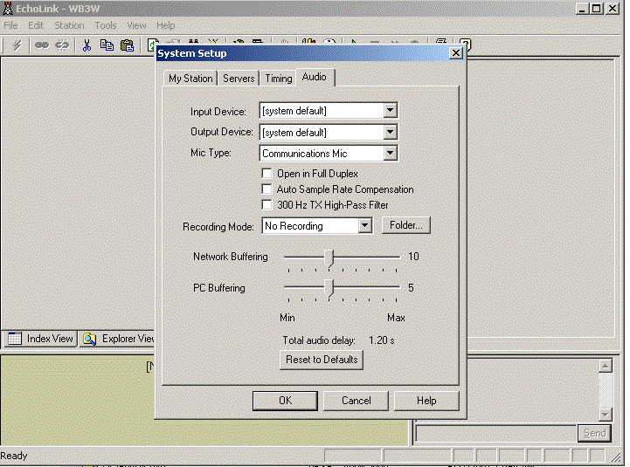
Audio Setup
This includes your Audio details, for the PC Speakers and Microphone.

Slide 16
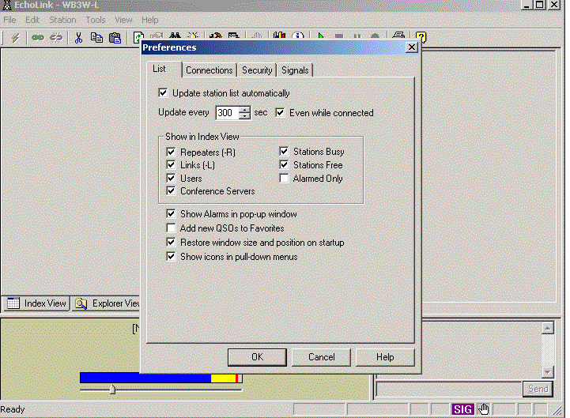
Connection Setup
This Screen allows you to configure the various Internet connections you are willing to accept.

Slide 17
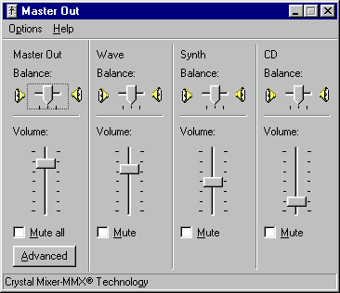
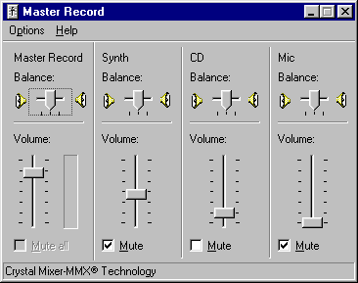
The Two Pc Audio Screens
This is the Output
This is the Input

Slide 18
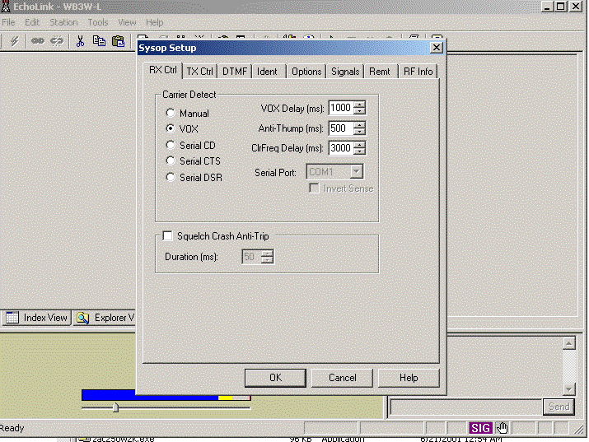
SysOp Receive
SysOp Mode is used when interfacing a Transceiver, and requires additional setup parameters.

Slide 19
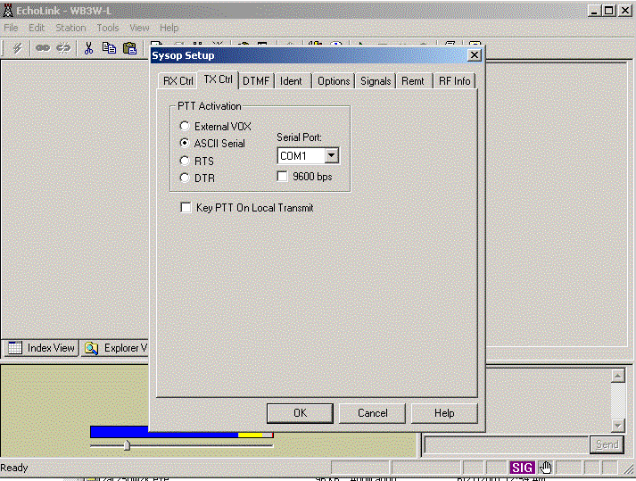
SysOp Transmit
There are a number of choices for triggering the PTT interface to the Rig.

Slide 20
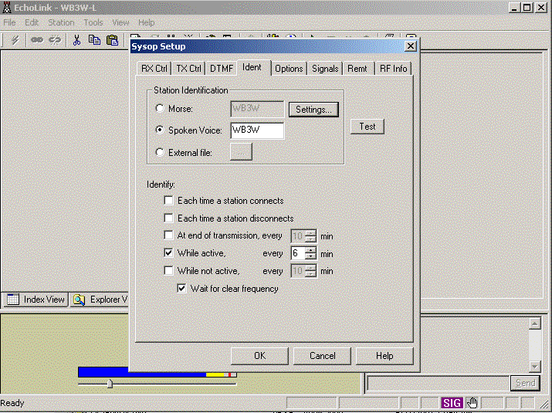
SysOp Identification
Both CW and Voice ID are available, along with the method and time interval for the ID’s

Slide 21
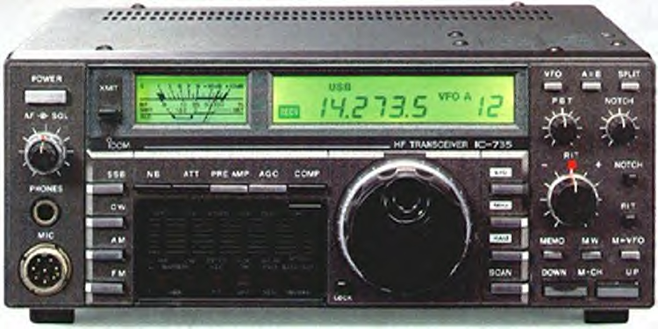
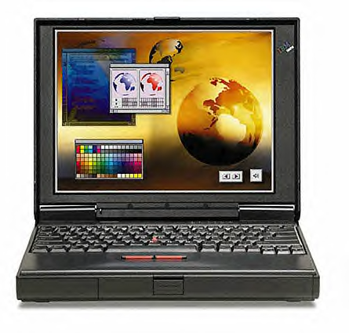
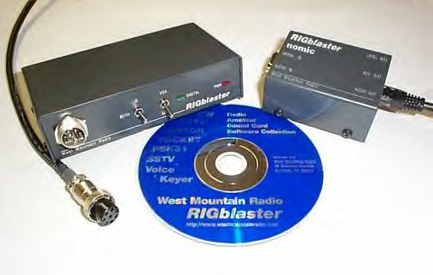
What’s Needed for SysOp Mode?
Transceiver
Computer and Software
Interface

Slide 22
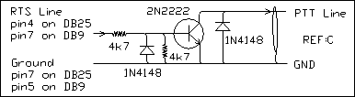
Making Your Own Interface
Stereo patch cord with 1/8” plugs from receiver audio to PC “Line-In”.
Patch cord from PC “Mic-Out” to Transmitter Audio input (should be attenuated).
Serial PTT circuitry from COM port.

Slide 23
But, a “Good” Interface should:
Isolate the computer audio from transceiver.
Attenuate the speaker/line level output.
Provide matching of audio to mic level.
Isolation of all grounds.
Be easy to hook up, and leave in-line.

Slide 24
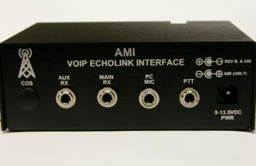
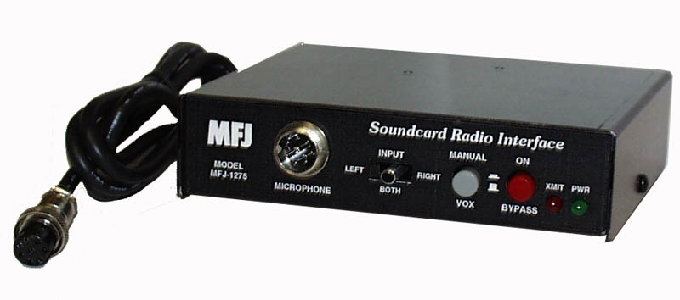
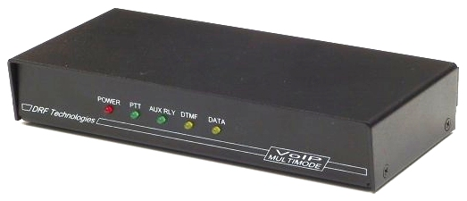
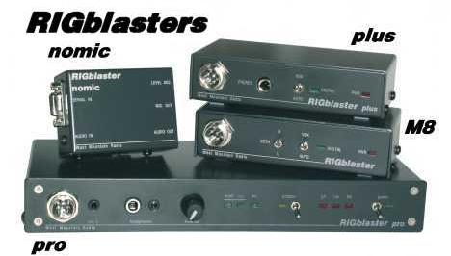
Some Soundcard Interfaces
The RIGblaster is the more common interface, with jumpers to configure any brand of microphone and rig.

Slide 25
A good Choice for the Interface
The RIGblaster from West Mountain radio is probably the most versatile.
Simple “jumper” configurations to interface to “Any” radio microphone wiring scheme.
It includes a software CD for most popular Soundcard programs including PSK, SSTV, etc.
West Mountain Radio provides excellent Internet, email and phone support.

Slide 26
RIGblaster Features
Opto-isolation prevents ground loops.
Adjustable PC speaker level output to mic input.
Plugs directly into the mic jack on your transceiver with an included 8 pin round to RJ45 adapter.
It includes a Serial cable, along with stereo speaker and microphone input cables.
It uses the existing jacks on computer and rig.
It can be used with almost any brand and model of radio, using internal microphone jumpers.
It can stay in-line at all times.
Four different models available.

Slide 27
Other VoIP Applications
Windows:
  iLink – Specialized Interface
  Wires II - Special Yaesu Interface
  eQSO - No Call Sign Validation (allows SWL connections)
Linux:
  IRLP - Linux – Specialized Interface – Strictly Repeater to Repeater.

Slide 28
The two Most Popular
EchoLink:
Allows Individual User Connections.
Interface can be homebrewed.
No on-going support expenses.
Windows operating system.
I R L P:
Connects Repeaters – not individual users.
Requires proprietary interface board at $100.00
Minimum of $30.00 year donation suggested.
Linux operating system.

Slide 29
Pros and Cons
Allows Hams traveling away to stay in contact with Hams back home through a Repeater link.
Allows Technician licensees a chance to experience DX Contacts.
QSL’s are not valid for things like DXCC.
  The “middle” connection is the Internet, and this is a “wired” connection – not wireless RF…

Slide 30
But Again – “Is it Ham Radio?”
As long as there is a Simplex or Repeater Link involved it is a new “mode” – It is that simple!
Worldwide Regulatory agencies like the FCC, ART, IBPT, OFCOM, SRR, etc. have recognized it as another Ham “tool” like SSTV or PSK31.
Using these “links” you must still ID and follow all regulations, including International rules and Third party agreements.
If we don’t keep using our Radios in as many modes as we can, we are going to lose some of the band allocations we have worked so hard for.

Slide 31
Some Comments
EchoLink allows us to expand upon our different Ham activities, and gives Amateur Radio a new dimension with a new technology….
Hook your Transceiver up to it and use it.
  Other new technologies like Cell Phones, RFID, (BPL?), are competing for our bandwidth, so lets utilize it with all the modes available..
B U T Remember…………..
Although Amateur Radio has grown to embrace new technologies and has now become more than just “Radio” , it is really “nothing” without “Radio”….

Slide 32
Credits
Some of the Graphics of the various Modes are from the “Ops Tips” page of West Mountain Radio’s Web site, and used with their permission.
http://www.westmountainradio.com

Slide 33
Questions
?
?
?
?
?

