Slide 1

NCS Planning & Operation
Presented to: Lehigh Valley ARC
By: Paul, N0KIA
On: July 3, 2012

Slide 2
Presentation Areas
Look at NCS:
  Responsibilities
  Planning Stage
  Operation Stage
Look at net stations' responsibilities
Questions

Slide 3
NCS
RESPONSIBILITIES

Slide 4
NCS Responsibilities
Establish Communications & Operational Order
Provide requested info TO served agency
1st Biker/Runner/Walker, agency manning, etc.
Request needed actions FROM served agency
Need cups, water, Medic, etc.
Keep served agency “situation aware”
Food tent collapsed, site manager quit, etc.
Keep net stations “in the loop” and announce “in use” status of frequency
Provide operator scheduling as requested
Know the event's “Big Picture”

Slide 5
Extras
May include:
  Sending maps and event info
  Having pre-event net/meeting
  Allowing “direct deployment”
  Use on-air net when possible

Slide 6
PLANNING
STAGE

Slide 7
NCS Planning
Location
  Served Agency HQ (better equipment)
  Event HQ (better communication)
  Other (home, evac site, etc.)
Manning
  Prioritize Locations
  Consider rookies and shadows
  Consider redeployment if undermanned
Relief Plan
  Meals and sleep
  Roving relief

Slide 8
EXTRAS
“Best” location may vary by event
Net Control does NOT have to be EVENT control
NCS may be a dynamic assignment
“Shadows” are important
Consider asking other clubs for resources
Use notes from last event(s) to tailor current one
Tell SA what we can do
Work with SA to define roles

Slide 9
NET OPERATIONS

Slide 10
NCS Operations
Determine type of net
Convene net and keep attendance
Record contact info for served agency POCs
cell phones, FRS, etc.
Assign ops as needed
Shelters, mess stations, dispatch areas
Keep an event log (good use of shadow!)
Keep order on the frequency
Keep eye on clock and call for relief when needed

Slide 11
Net Types
DIRECTED
All communication goes through Net Control
FREE
Net stations may directly with one another
Net type is dynamic and may change as determined by net control and event needs

Slide 12
Local Event Nets
Normally repeats of previous events and planned in advance
Normally conducted as Directed Nets
Normally located at served agency's onsite HQ
Normally no relief planned or needed
Normally staffed by repeat operators (know routine)

Slide 13
Emergency Events
No planning – SNAFU from the get-go.
May need a FREE net until order established
Volunteers usually unavailable
Escalates to FUBAR as ops get lost, can't find POCs or need replacement
Reaches stability as ops become available and crisis lessens
Typically runs many hours to many days, so NCS duty will rotate

Slide 14
THE OTHER SIDE OF THE COIN

Slide 15
Net Operators Responsibilities
Keep NCS aware of your location
Handle any requests in a timely manner
Know who your SA POC is and keep in touch
Be honest with NCS. If you need help, let them know
Request breaks/relief as needed

Slide 16
Net Ops Tasks
Equipment
  Charge batteries
  Program frequencies
  Test antennas
Gather maps and info (Google)
Be on time and in place

Slide 17
ARRL MSG FORM

Slide 18
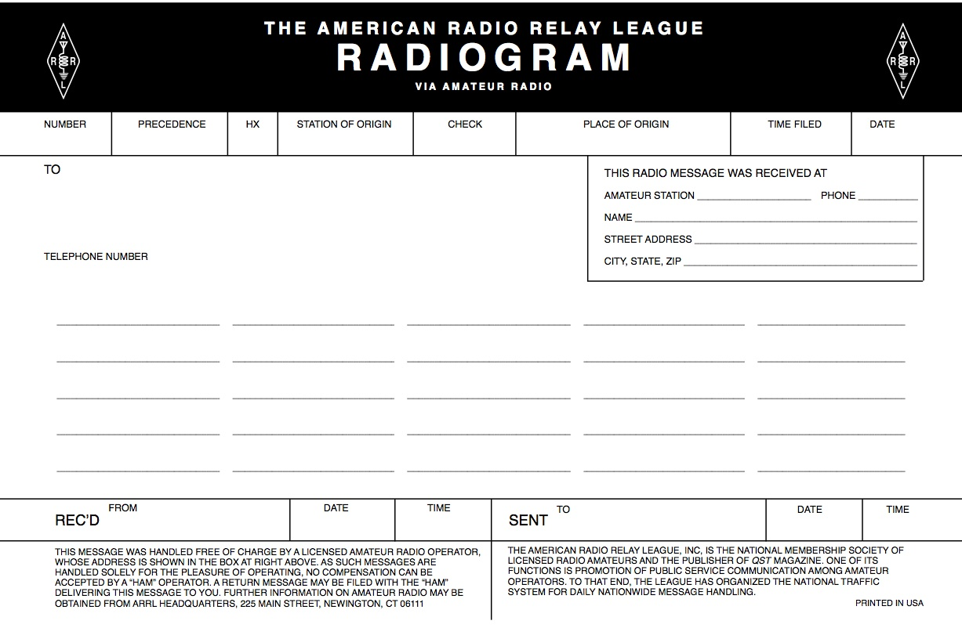
ARRL MSG FORM

Slide 19
Questions
?

