Slide 1
Propagation Index and Short Wave Communications
Rodney Wolfe
N3XG

Slide 2
HF Propagation Index
Review of ionosphere
Ap Index and Propagation Terminology
What has become of Cycle 23?

Slide 3
Ionosphere layers
In 1927, the ionosphere was thought to consist mostly of He, N, and Ar.
By 1930 the upper atmosphere was known to be composed mainly of O, N, and small amounts of H, and He.
Between 1930 and the late 1980’s, approx. 250 VIS (vertical incident sounder) stations were in operation, mapping the density of the atmosphere.

Slide 4
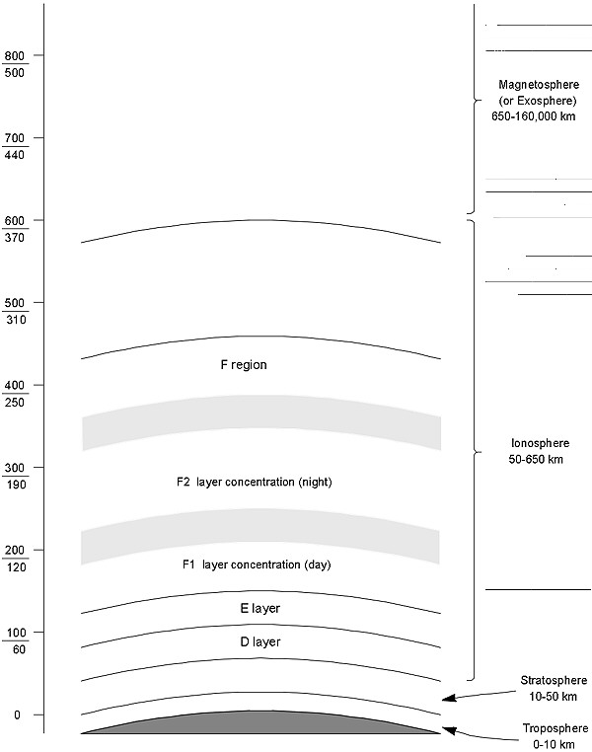
Ionosphere layers
D – Layer
  40 to 60 miles above the earth’s surface.
  Giant Attenuator
  Attenuation varies as the inverse square of the frequency
  High Frequencies have less attenuation.
  After sunset, low frequencies “go sky wave”.

Slide 5
Ionosphere layers
E – Layer
  Mainly during daylight hours between 60 and 75 miles.
  Sporadic and auroral E propagation is characteristically 2 to 10 minutes in length.

Slide 6
Ionosphere layers
F – Layers
  Most important region for long distance short-wave radio
  During daylight there are two well defined regions
  Heights vary seasonally, with Summer higher than winter

Slide 7
Ionosphere layers
F2 Layer
  Exists day and night
  Almost always capable of sustaining sky wave propagation at some HF frequency.
  Night time propagation is possible because of slow recombination rate.

Slide 8
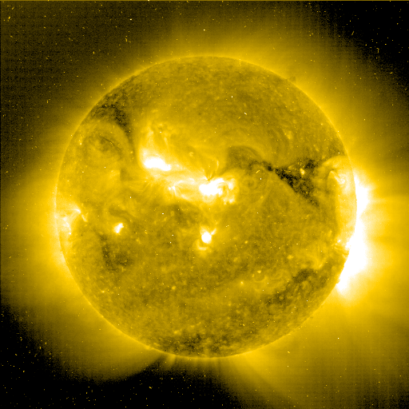
Solar Unrest

Slide 9
Ionospheric Disturbances
Increased ionization in the D layer, resulting in the absorption of the short-wave signal.
Weakening or decomposition of the F2 layer.
Primary source of disturbances is enhanced radiation from flares in those regions around sunspots, High Speed Solar Wind System, and Coronal Mass Ejections.

Slide 10
Ionospheric Disturbances
Flares, CME’s, and HSSWS send charged particles at the earth and cause ionospheric storms. (geomagnetic)
Historically, the events were believed to be peaked with the 11 year sun spot cycle.
HSSWS and CME’s are more prevalent during the declining phase of the cycle.

Slide 11
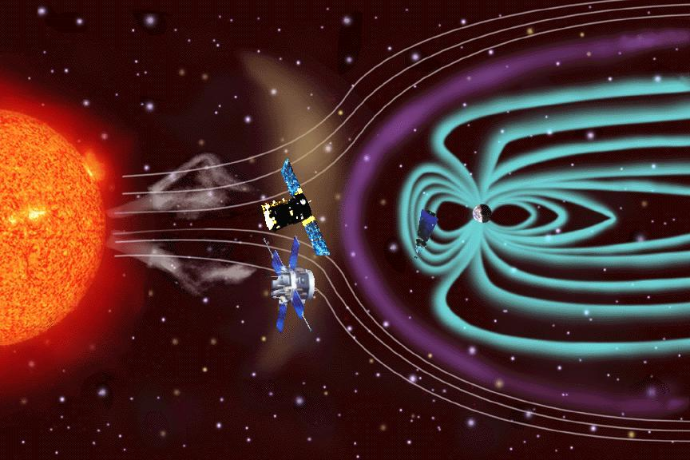

Slide 12
Polar Cap Absorption
Why can’t we hear N3SIG?
Charged solar particles are propagated along magnetic field lines into the polar regions.
Polar regions will increase HF absorption by 40 to 80 dB.
Polar blackouts can suppress short-wave signals for three to five days.
Long path propagation is down.
Aurora activity increases.

Slide 13
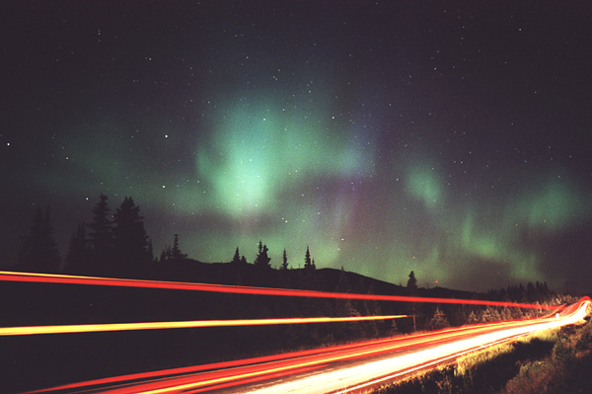

Slide 14
Propagation Indices
Ap Index
Kp Index
Solar Flux Index (SFI)
Sunspot Number (SSN)

Slide 15
Planetary K Index
Average of the World-Wide reading of the Earth’s geomagnetic field.
K0 to K9
  K0 inactive; K1 very quiet; K2 quiet
  K3 unsettled; K4 active; K5 minor storm
  K6 major storm; K7 severe storm
  K8 very severe storm; K9 extremely severe
REAL TIME

Slide 16
Planetary A Index
24-hour average of the Planetary K Index
Dynamic index
Has no maximum number
  A0 to A7 = quiet; A8 to A15 = unsettled
  A16 to A29 = active; A30 to A49 = minor storm
  A50 to A99 = major storm;
  >A100 = severe storm

Slide 17
Solar Flux Index (SFI)
Amount of radiation on the 10.7cm band (2800 MHz).
Closely related to the amount of UV.
The higher the solar flux, the stronger the ionosphere becomes, supporting refraction of higher frequencies.

Slide 18
Sunspot Number (SSN)
Calculated by counting the number of sunspot groups and then the number of individual sunspots.
The sunspot number is then given by the sum of the number of individual sunspots and ten times the number of groups.
Monthly averages show that the number of sunspots waxes and wanes with an 11-year cycle.

Slide 19
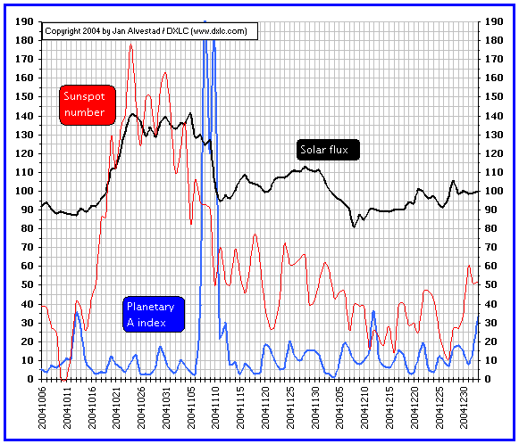

Slide 20
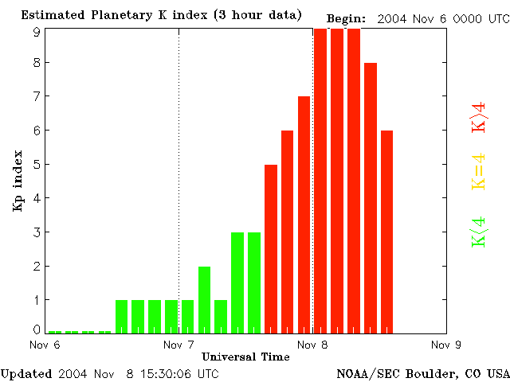

Slide 22
Cycle 23
Average cycle is 11 years. Give or take.
Cycle 23 is predicted to end in 2007
No visible sunspots on Jan 28, 2004; and October 10 and 11, 2004.
Current Predictions show Cycle 23 to end in late 2005, early to mid 2006.

Slide 23
Web Resources
http://dx.qsl.net/propagation/
http://www.hfradio.org/propagation.html
http://www.dxlc.com/solar/

Slide 24
Literary Resources
The New Short-wave Propagation Handbook
  Jacobs, Cohen, and Rose
“Could this be the last year of cycle 23?”, By Tomas Hood, NW7US, Pop Comm, January 2005.

Slide 25
