Slide 1
Building Cross-Platform Server-Side Data APIs Oct 12, 9:00AM
Julie Lerman
thedatafarm.com
@julielerman

Slide 2




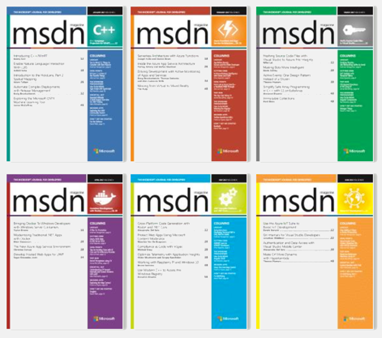

Cross-platform SQL Server Management for Developers Using VS Code
EF Core: Getting Started
Entity Framework in the Enterprise Getting Started with EF6
Domain-Driven Design Fundamentals
Looking Ahead to Entity Framework 7
EF6 Ninja Edition: What’s New in EF6
Automated Testing for Fraidy Cats Like Me
Getting Started with Entity Framework 5
Entity Framework Code First Migrations
Data Layer Validation with Entity Framework 4.1+
Entity Framework 4.1 - DbContext Data Access
Entity Framework 4.1 - Code First
Querying the Entity Framework
Designer Supported EDM Customization
Entity Framework and Data Models
Entity Framework 4.0 By Example
Not a front-end developer!

Slide 3
Plans, I’ve got plans
This is the almost last slide
Build a web api
C#, ASP.NET Core, Entity Framework Core, SQL Server
Visual Studio Code
On this MacBook right here
Not in Parallels
In macOS
Really!

Slide 4
A few more plans
This is the really almost last slide
Explore a “serverless” data API
Azure Function
In the Azure Portal (Visual Studio has tools for this)
Hitting Azure CosmosDB
Does some other fun stuff
Quick look at a Node.js data API
Hitting Azure CosmosDB

Slide 5
Resources
OK, this is really the last slide
Pluralsight EF Core: Getting Started bit.ly/PS_EFCoreStart
ASPNetCore: dot.net EF Core: docs.microsoft.com/efcore
How to Send Daily SMS Reminders Using C#, Azure Functions and Twilio : https://www.twilio.com/blog/2017/01/how-to-send-daily-sms-reminders-using-c-azure-functions-and-twilio.html Azure CosmosDb:
https://docs.microsoft.com/en-us/azure/cosmos-db/documentdb-get-started
Azure Functions:
https://docs.microsoft.com/en-us/azure/azure-functions/functions-create-first-azure-function

Slide 6
Please use EventsXD to fill out a session evaluation.
Thank you!
Julie Lerman
thedatafarm.com
@julielerman
I lied! This is the last slide

