Slide 1
Building Serverless Data APIs
Julie Lerman TheDataFarm.com @julielerman

Slide 2
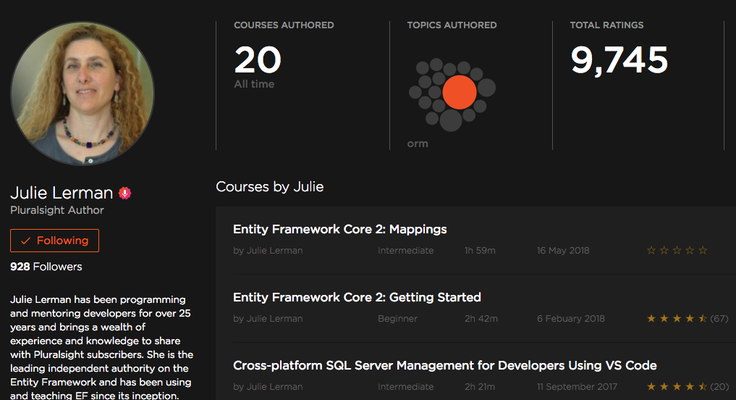
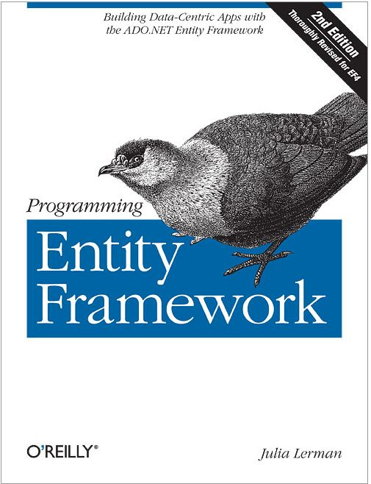
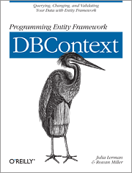
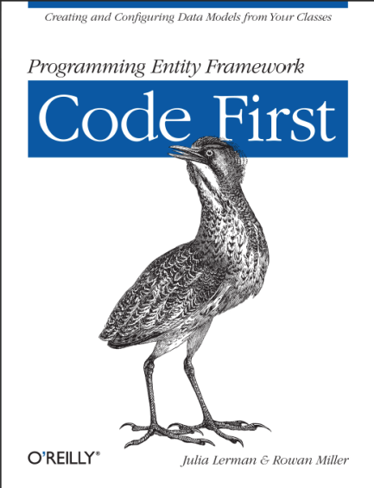
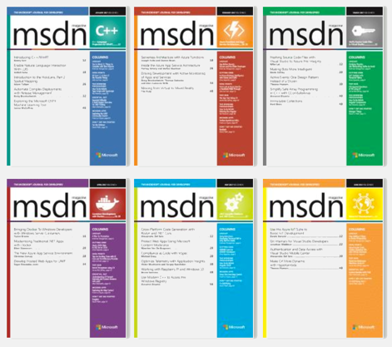

Slide 3
Yes, there’s a server … somewhere

Slide 4
Serverless Functions
“Function as a Service” (FaaS)
“Serverless compute”
Abstract away implementation details
You can focus on the code

Slide 5
The “Big Guns”
Azure Functions
AWS Lambda

Slide 6


Your business
logic
Infrastructure
External APIs
{ }
Some config
Your only real effort
Some config

Slide 7
DEMO
Get Basic Concepts
Azure Functions via Azure Portal
Easy integration w Azure Cosmos DB & Twilio
Dev, Debug, Test in an IDE
Create, test & debug it all locally in VS Code (Visual Studio 2017 also has extensions)

Slide 8
Function App
Application Settings
Function
Function
Function
Function
Function

Slide 9
Function
Trigger
Input Bindings
Code
Output Bindings
Configuration
Configuration
Configuration

Slide 10
A Trio of Azure Functions
HTTPTrigger Body: He Ate!
Output to
Collection 1:
SampsonAte
Cosmos DB Trigger Read from subscriber collection
SMS to subscribers
Collection 2:
Subscribers
HTTPTrigger Body: Phone #
Output to
Cosmos DB Database

Slide 11
Heading into V2
V1.x (General availability)
Stable
Dev & host on Windows
More portal integrations so far
V2.x. (Preview)
Dev/host cross-platform (.NET Core)
New bindings model (simpler versioning)
More bindings will be supported
Portal integrations are coming online

Slide 12
Resources
The code from these demos are at github.com/julielerman/ServerlessFall2018
Julie’s Pluralsight Author Page bit.ly/2t6m83w
Creating Azure Functions to Interact with Cosmos DB (Jan 2018 MSDN Mag) msdn.microsoft.com/magazine/mt846723
Replacing a Bulky API with Azure Functions (May 2018 MSDN Mag) msdn.microsoft.com/magazine/mt846723
Azure CosmosDb: aka.ms/CosmosDb
Azure Functions: aka.ms/Azure/Functions
Julie Lerman thedatafarm.com @julielerman about.me/julielerman

