Slide 1

Pushing Trees Up Hills aka Gradient Boosted Trees
Central London Data Science Project Nights

Slide 2
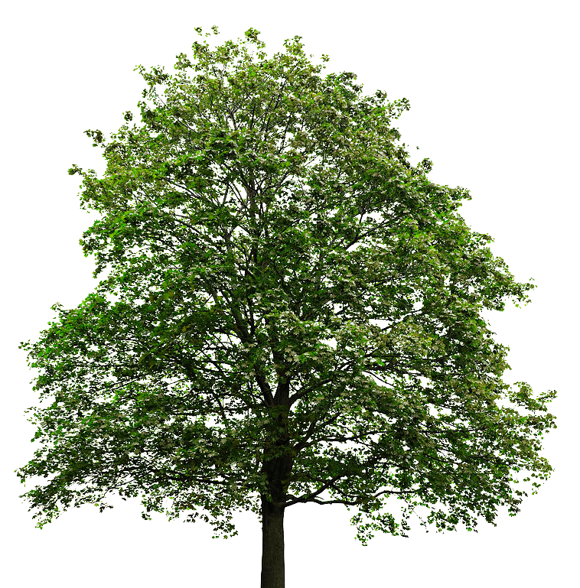

What are trees?
Supervised machine learning technique
i.e. the data does need to have labels
Our Data
Possible Labels:
Name = Oak Tree
Height = 20m
Branches = 452
Leaves = 200000
Leaf size = 4cm
Trees use observations about an item of data to predict other properties about the item
Possible Labels:
Name = Lily
Height = 20cm
Branches = 1
Leaves = 3
Leaf size = 4cm

Slide 3
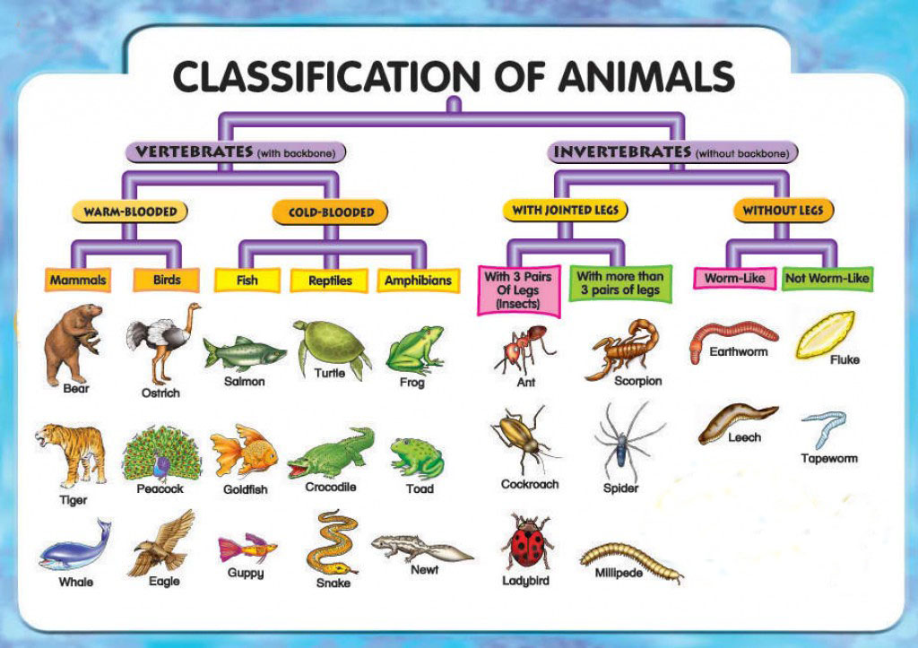
Classification Trees
Predict what class the data belongs to, e.g. what animal is it

Slide 4
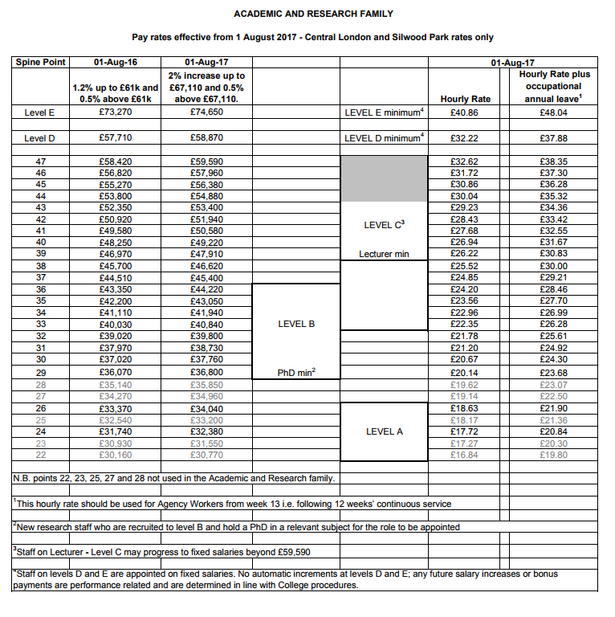
Regression Trees
Predict a real number about the data,
e.g. what is that person’s salary
Possible Predictors:
Years Experience
Previous Job
Number of Grants won
Number of students they supervise

Slide 5
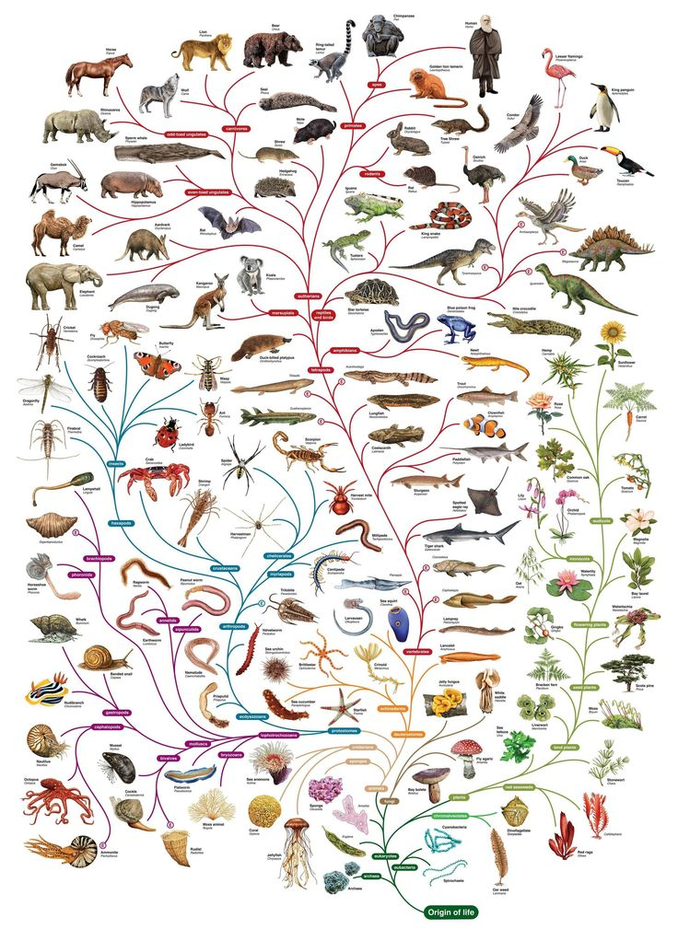
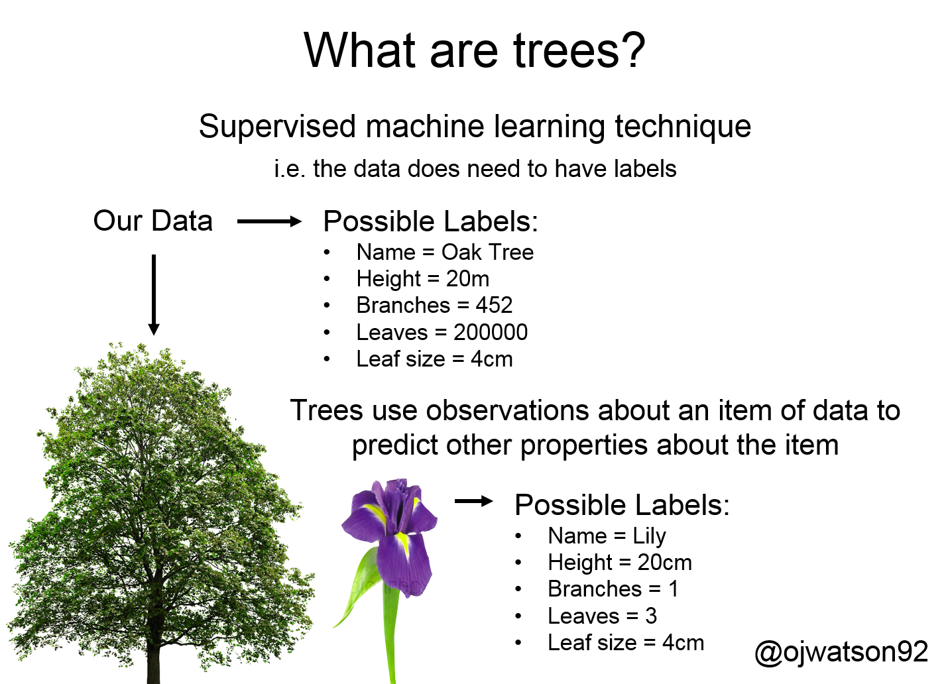
Tree properties
What properties does a tree have:
Branches - # of splits
Height - # of levels
Leaves - # of end nodes
Leaf size - # of samples in an end node

Slide 6
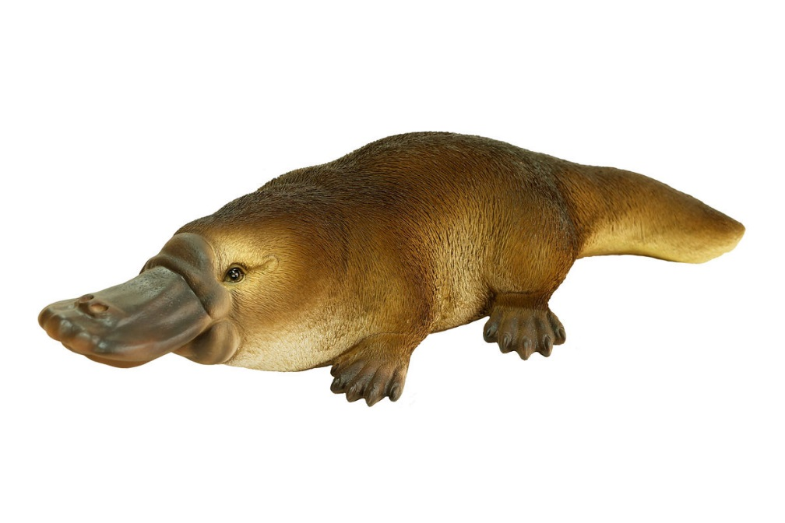

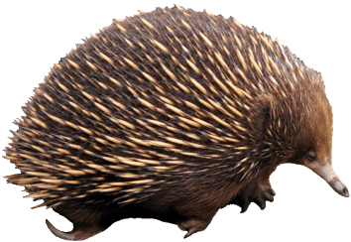
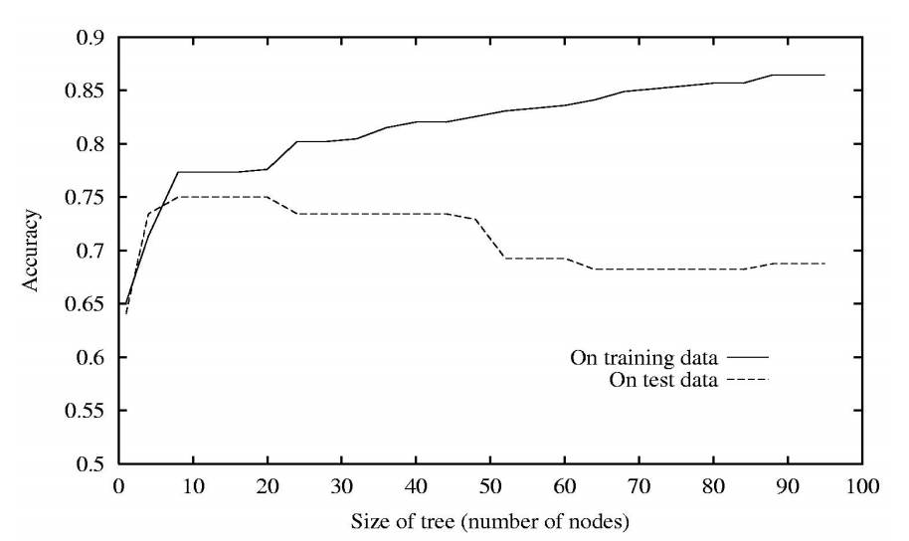
How do I pick trees though?
Possible Mammal
vs Bird Predictors:
Has a beak
Lays Eggs

Slide 7
How to prevent overfitting?
Control the tree parameters:
Branches - # of splits
Height - # of levels
Leaves - # of end nodes
Leaf size - # of samples in an end node
• Stop growing when data split is not significant
• Acquire more training data
• Remove irrelevant attributes
• Grow full tree, then post-prune
How to pick best tree?
Performance Metrics:
Classification - # of correct observations (gini impurity, entropy etc)
Regression – how close are predictions (standard error, RMSE, bias)
Measure against validation set

Slide 8

How to improve my (tree) models?
Sample 1
Sample 2
.
.
Sample n
Bagging, e.g. random forest
Notes:
Everyone how many cows
Bagging is a simple ensembling technique in which we build many independent predictors/models/learners and combine them using some model averaging techniques. (e.g. weighted average, majority vote or normal average)
We typically take random sub-sample/bootstrap of data for each model, so that all the models are little different from each other. Each observation has the same probability to appear in all the models. Because this technique takes many uncorrelated learners to make a final model, it reduces error by reducing variance. Example of bagging ensemble is Random Forest models.

Slide 9
How to improve my (tree) models?
Sample 1
Sample 2
Increase probability of
sampling so we can learn
from our errors
Boosting, e.g. gradient boosting
Notes:
How many cows, 10 off, how many cows now
Boosting is an ensemble technique in which the predictors are not made independently, but sequentially.
This technique employs the logic in which the subsequent predictors learn from the mistakes of the previous predictors. Therefore, the observations have an unequal probability of appearing in subsequent models and ones with the highest error appear most. The predictors can be chosen from a range of models like decision trees, regressors, classifiers etc. Because new predictors are learning from mistakes committed by previous predictors, it takes less time/iterations to reach close to actual predictions. But we have to choose the stopping criteria carefully or it could lead to overfitting on training data. Gradient Boosting is an example of boosting algorithm.

Slide 10
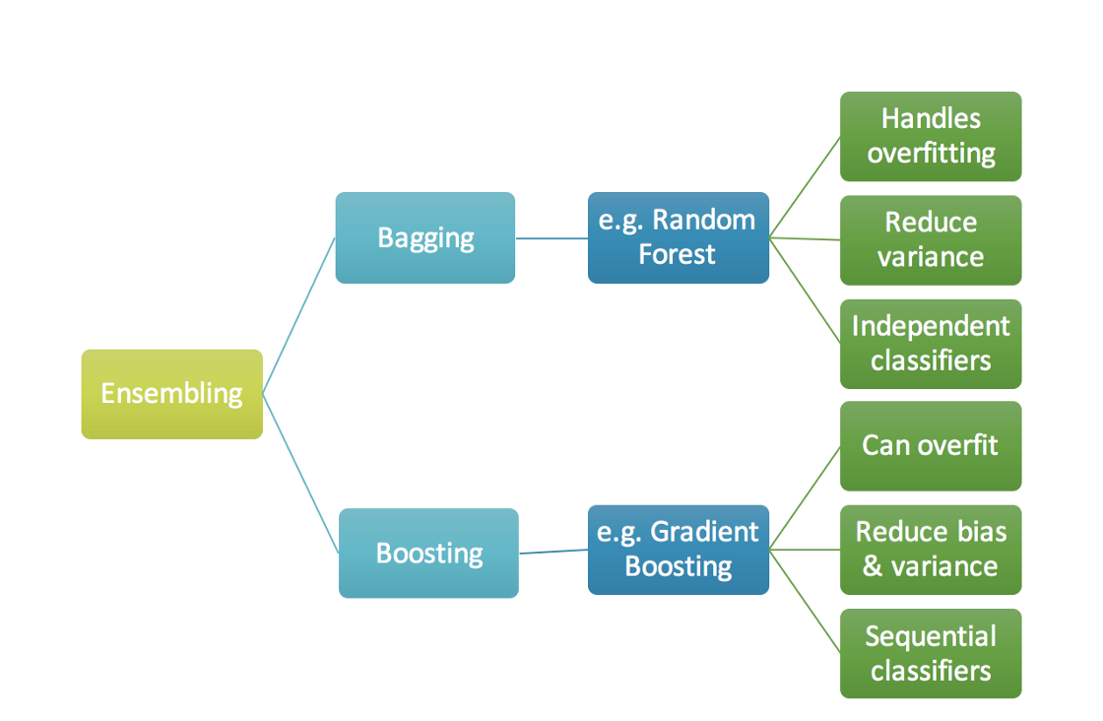
Boosting vs Bagging

