Slide 1

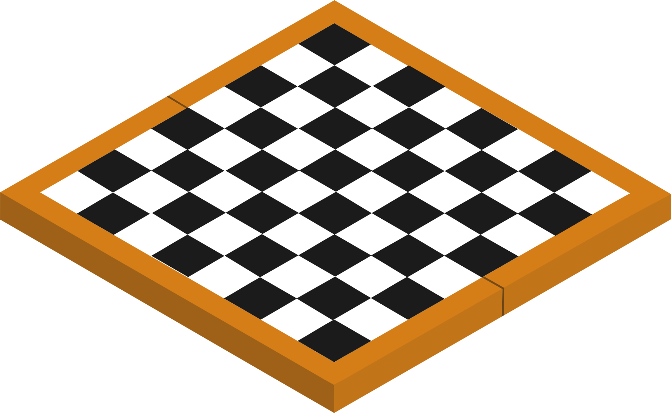


Game AI for Chess
Team:
A . Bhavik - AM.SC.U4AIE23023
V . Pavan Krishna - AM.SC.U4AIE23063
P . Vishnu Chaitanya - AM.SC.U4.AIE23 051
L . Ayyapa Reddy - AM.SC.U4AIE23046

Slide 2
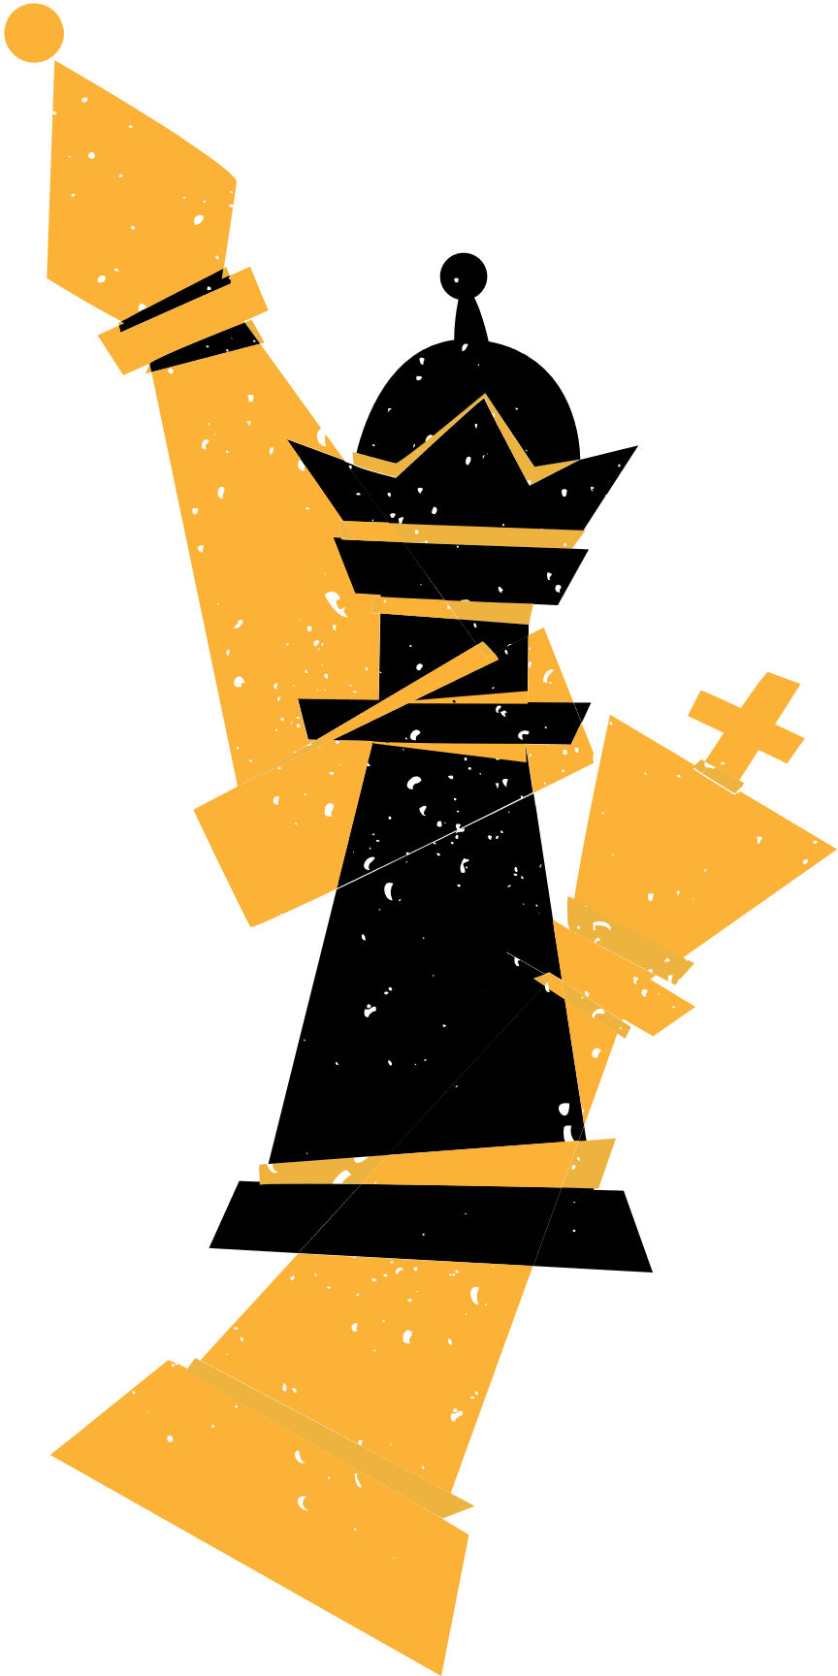
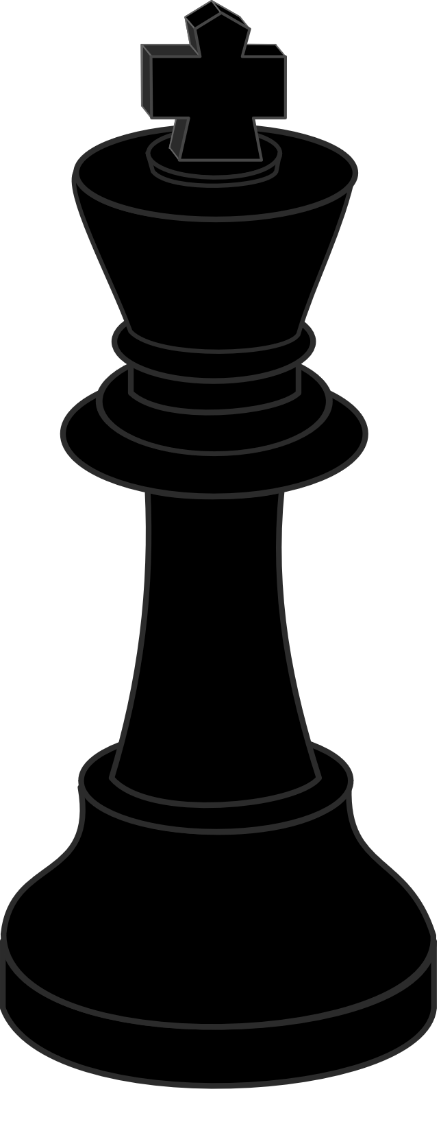


Main.py
Role: This is the entry point of the program. It contains the logic to start and control the flow of the entire chess game.
Algo.py
Role: This file contains the artificial intelligence (AI) or algorithm that controls the AI’s moves in the chess game.
chess_engine.py
Role: This file is the engine that handles the mechanics of the chess game itself, such as the rules of chess, board representation, and move validation.

Slide 3
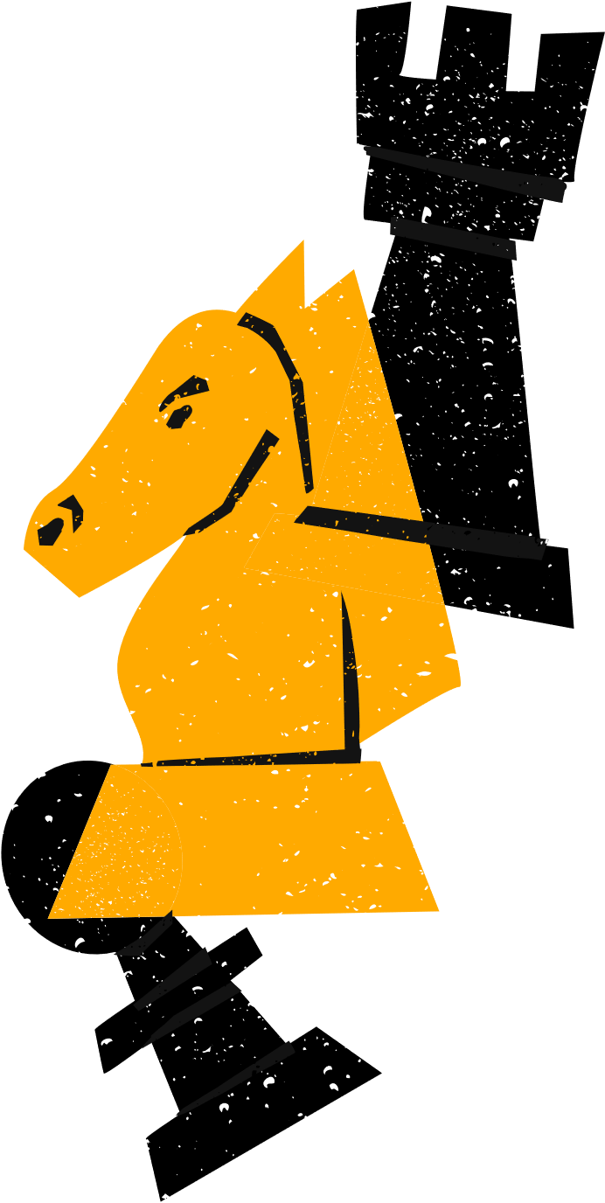
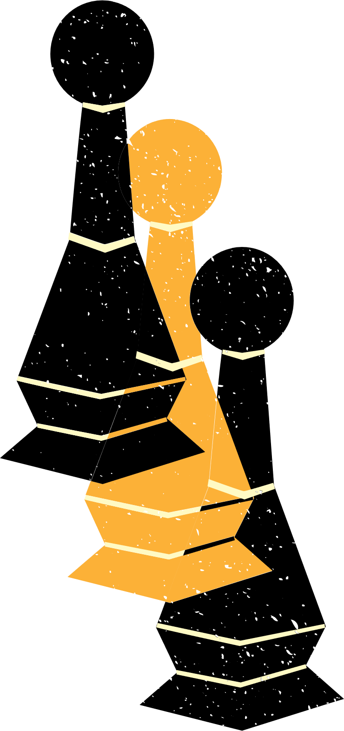
1
Game setup : When we run the main.py it gives a interface where user can choose the diffculty level and the color of choice to start the game
2
Game Loop : For each move, the game state (board position) is updated and passed to the chess engine. The chess engine then returns the set of all possible valid moves
3
Finding the Best Move : Now using the set of all possible valid moves the AI caliculates the next best move by using negmax and alpha beta pruning and it looks n moves ahead (and n is based on the difficulty selected by the user)
4
End Conditions: After each move, the game checks for checkmate, stalemate, or game over conditions.

Slide 4
Algorithms Used in This project
Primary Algorithm:
Negamax with Alpha-Beta Pruning
Negamax:
Assumes the game's value for one player is the negation of the opponent's value.
Simplifies code with a single evaluation function.
Alpha-Beta Pruning:
Prunes branches that cannot influence the final decision.
Improves efficiency by avoiding unnecessary evaluations.

Slide 5
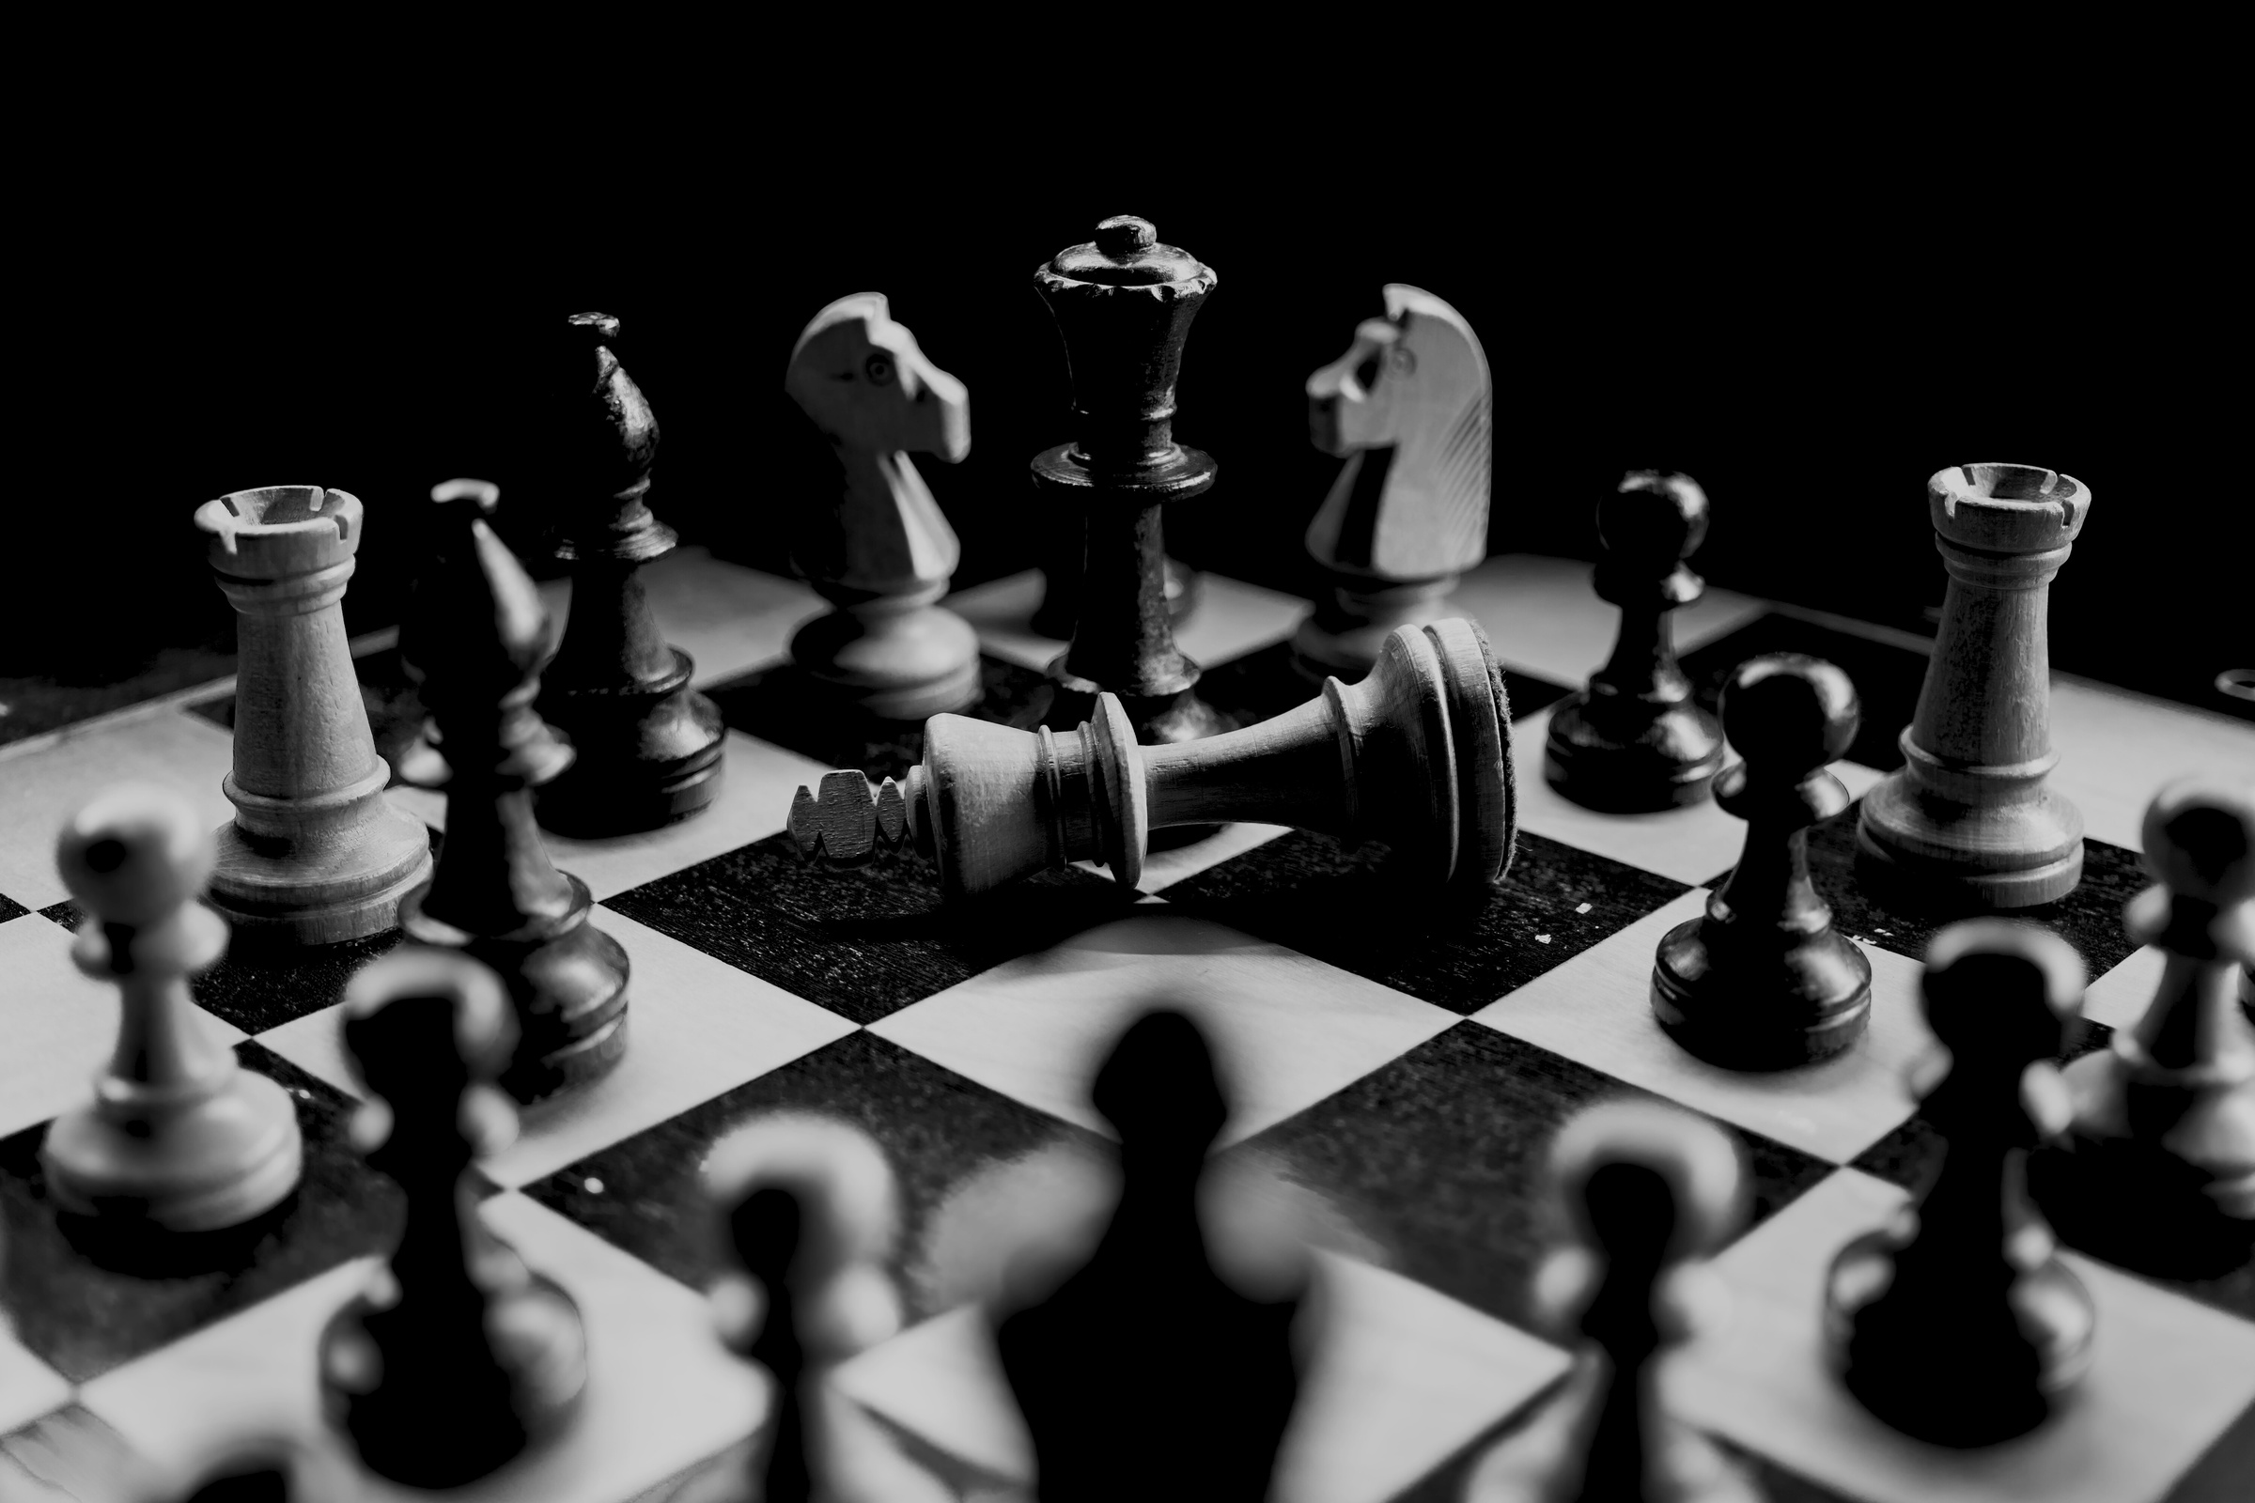
1
Simplified Search: Same function for both AI and opponent, reducing complexity.
Why negmax with alpha beta pruning ??
2
Efficiency: Alpha-beta pruning speeds up search by eliminating unnecessary branches.
3
Optimal Moves: Ensures AI picks the best possible move,by evaluating different game states
4
Handles Complexity: Efficiently navigates large decision trees in chess.
5
Scalable: Allows deeper searches within limited time for better performance.

Slide 6
Feature | Minimax | Negamax
Players | Separate logic for Max and Min | Single evaluation function for both
Evaluation Function | Separate functions for maximizing and minimizing | Single function (due to symmetry)
Complexity | More complex logic | Simpler, cleaner code
Zero-Sum Games | Works, but requires two functions | Ideal for zero-sum games like chess
Implementation | Requires two separate recursive calls | Uses a unified recursive call

Slide 7
GitHub link:
https://github.com/W4RG0Dpk/Chess-AI-Game
The screenshots of working model are in README.md and also in screenshots folder in github.

Slide 8
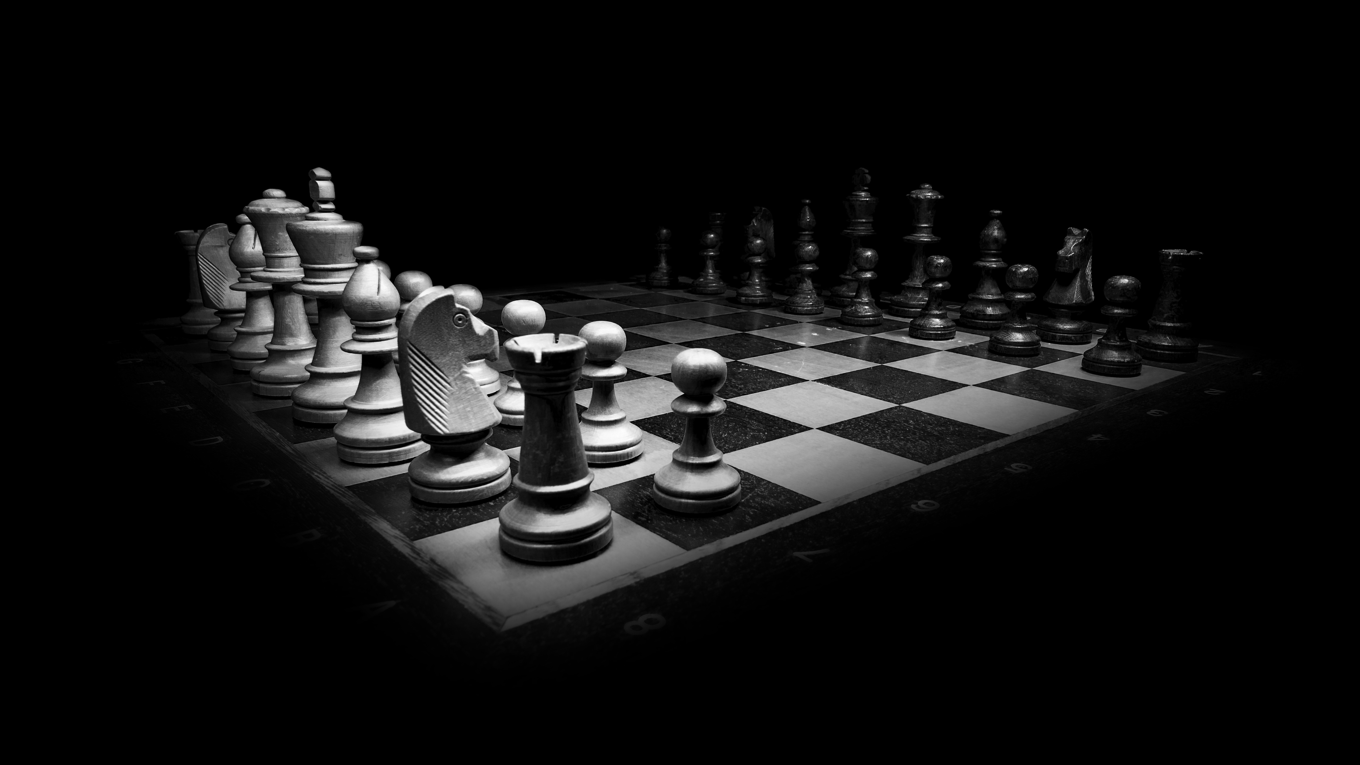
Thank You
"Chess is fun, challenging, and makes you smarter!"

