Slide 1



Analysing Parallel Programs
using Constraint-Based-Analysis
Alex Hirsch

Slide 2
Table of Content
Motivation
Data-flow Analysis
Control-flow Graph
Lattice
Bit vector problems
Constraint-based approach
Analysing Parallel Programs
Effect Analysis

Slide 3
Why Program Analysis?
Vital part in compiler theory
  Basis for different kinds of optimizations
  Detecting semantics of the input program
Automatic extraction of properties (facts)
  … can be used for all kinds of things, like auto-tuning

Slide 4
Data-flow Analysis (DFA)
Control-flow sensitive
Operates on the control-flow graph
Conventional DFA builds a set of equations to model the relevant program properties.
Since these properties obey certain mathematical traits, the solution to this system of equations is a fixed point.

Slide 5
Control-Flow Graph (CFG)
Graph representation of the input program
Similar to the AST but easier to work with
As the name gives away, it models the control-flow of a program
Commonly encountered in compilers, most algorithms work directly on the CFG
A lot of variations exist, extend with what you need

Slide 6
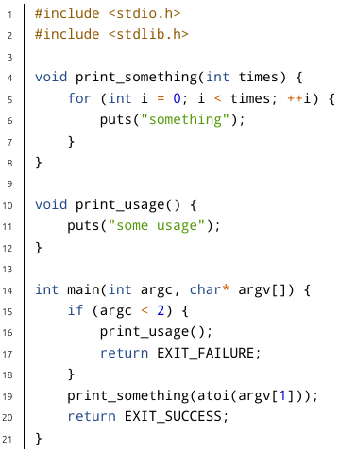
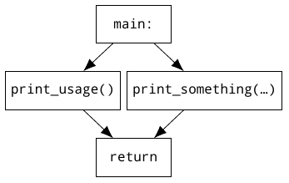
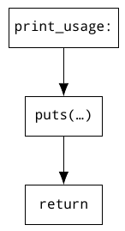
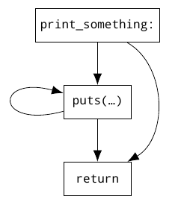

Slide 7
Data-flow Analysis on the CFG
Each block (node) will be associated with two sets
  one for information just before the block is executed (in)
  the other for information just after the block has been executed (out)
Each block should be labeled to correctly associate the related sets

Slide 8
About Data-flow Analysis
Most data-flow analyses only require one traversal of the CFG
  this can be either in forward, or backward direction
  although, there are some analyses which require information to flow in both directions
Further, information will be merged at certain points (branching and merging of the CFG)
  must (logical and) vs. may (logical or)

Slide 9
But now, lattice
mathematical structure of a
  partially ordered
  set
  with unique least upper bound (join)
  and unique greatest lower bound (meet)
regarding analysis
  domain for program properties
  best-case (top) vs. worst-case (bottom)

Slide 10
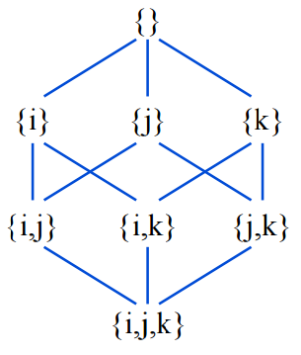
But now, lattice
Bottom = { }
Top = {i,j,k}
height = 4
meet operator describes what happens when 2 branches merge
  could be set union here

Slide 11
Semi-lattice
similar to lattice, but only features either
  a least upper bound (join lattice)
  or greatest lower bound (meet lattice)

Slide 12
Example Time (Reaching Definition)
A definition at program point p1 reaches program point p2 if there is a control-flow path from p1 to p2 along which the variable defined by p1 is not redefined.

Slide 13
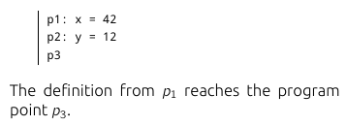
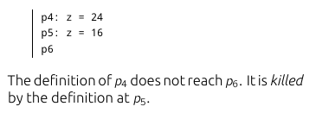
Example Time (Reaching Definition)

Slide 14
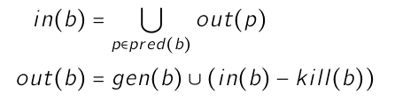
Example Time (Reaching Definition)
Forward / May analysis

Slide 15
Bit Vector Problems
Program properties can be efficiently modeled as bit vectors
Using bit-wise operations like and, or their respective meet operation can be computed very fast

Slide 16
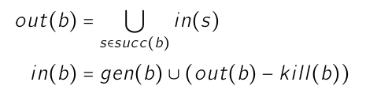
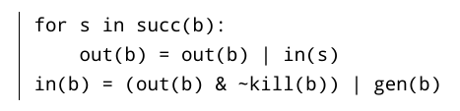
Bit Vector Problems
live-variable analysis, backward / may

Slide 17
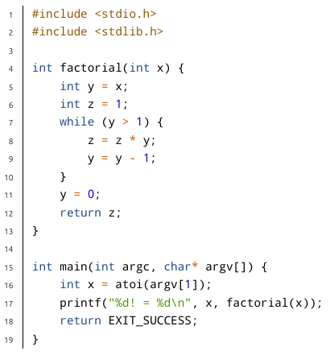
More real example

Slide 18
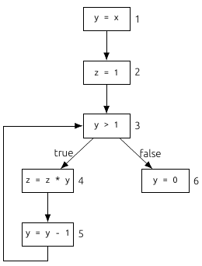
More real example

Slide 19
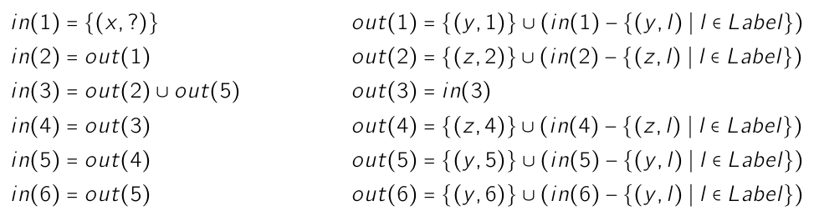
More real example
Reaching definition

Slide 20
Constraint-based Approach
In conventional DFA we encounter constraints and use them for our calculations directly
Now we model these constraints explicitly and operate on a system of constraints rather than a system of equations

Slide 22
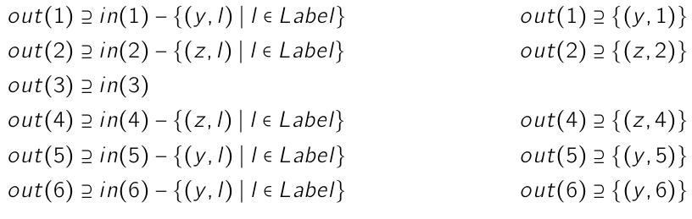
Information flowing through a block

Slide 23
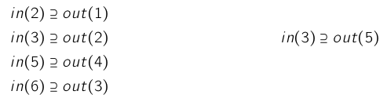
Information flowing between blocks

Slide 24

Information about input data

Slide 25
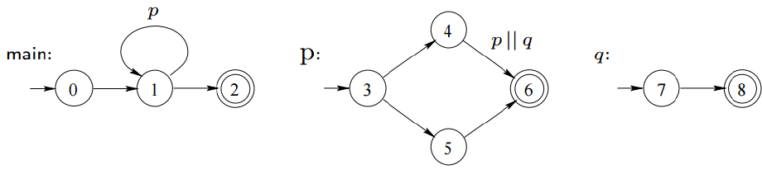
And now for parallel programs

Slide 26
Interleaving Semantic
some complicated looking mathematics
start off with two sets of edges
and a sequence of edges (word)
map each edge within that sequence either to the first, or the second set
do this for all possible combinations

Slide 27
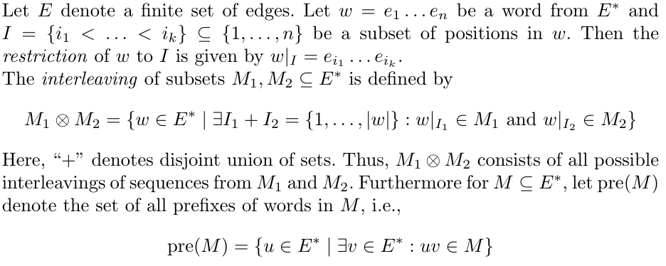
Interleaving Semantic

Slide 28
Example
A
B
D
C
E
F

Slide 29
Considering Paths
We mainly focus on procedures and program points when analysing parallel control-flows
  for a given procedure p the set Π(p) contains all possible execution paths
  for a given program point v inside procedure p the set Π(v) contains all paths from the entry point of p reaching the point v (on the same level)

Slide 30
Considering Paths
  the set Πr(p) contains all paths starting from main and reaching procedure p
  the set Πr(v) contains all paths starting from main and reaching program point v

Slide 31
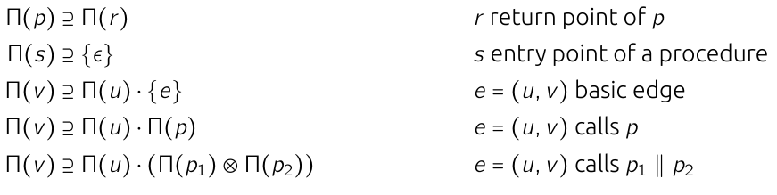
Constraint System

Slide 32
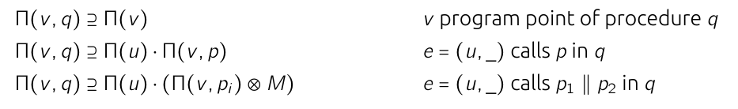

Constraint System

Slide 33
Effect Analysis
Going a step further, each edge of the CFG is associated with a function.
There are some restrictions on what that function can look like, but this will be skipped for brevity.
The function associated with an edge models its effect (transformation of program properties) when control-flow passes from its source to its destination

Slide 34
Effect Analysis (cont.)
This kind of effect modelling can be extended to paths (sequence of edges) and procedures.
In the end we will compute a merge over all paths solution by combining the effects of all paths.

Slide 35
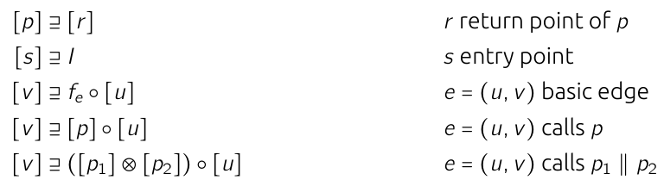
Effect Analysis (cont.)

Slide 36
Thank you for your attention
“Principles of Program Analysis” by Nielson
“Constraint-Based Inter-Procedural Analysis of Parallel Programs” by Seidl and Steffen
“Insieme --- A Compiler Infrastructure for Parallel Programs” by Herbert Jordan

