Slide 1

HR OPERATIONS · GOVERNANCE BY DESIGN
Govern.ai
The operating layer for
trustworthy HR work
Specialized agents act. Policy evidence grounds.
Human checkpoints keep sensitive decisions in control.
Powered by Fireworks AI and AMD
Govern.ai · HR Command Center
01

Slide 2
THE TENSION
HR automation fails when action outruns evidence
A chatbot can answer. A real operating layer must coordinate work, show why it acted, and know when to stop.
01
Action without context
“Why did this happen?”
A model can trigger a workflow without showing the policy or case evidence behind it.
In HR, the answer must be more than
‘the model said so.’
02
Automation without a stop
Sensitive actions need a human checkpoint—not a hidden confidence threshold.
03
Inference without a record
The product thesis
If the decision is not captured with who, when, and why, it cannot be audited.
Fleet + evidence + governance
Source: PITCH.md · MISSION.md
02

Slide 3
THE PRODUCT
Three legs turn ‘an AI’ into an HR operating layer
Remove any one of them and the system collapses into a toy, a search box, or a black box.
FLEET
POLICY EVIDENCE
GOVERNANCE
Action
Grounding
Trust
Five specialized agents do the work: triage, policy Q&A, resume review, onboarding, and attrition advisory.
Versioned policy chunks and citations keep answers tied to the organization’s own documents.
Approvals, RBAC, PII controls, bias guardrails, and immutable audit make the system deployable.
Govern.ai = action that can explain itself and stop safely
Source: PRODUCT.md · README.md
03

Slide 4
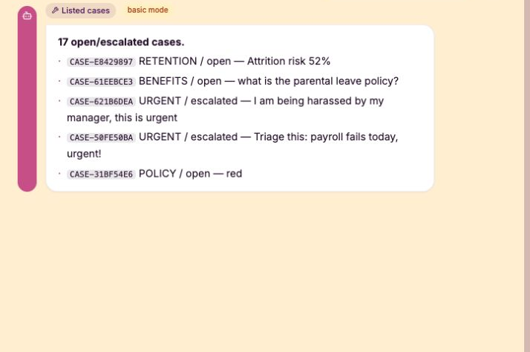
THE FLEET
One console coordinates five workloads—with a human boundary
The system is designed for HR operators, not as a general-purpose employee dashboard.
Ticket triage
Routes routine and urgent work; urgent cases escalate.
Policy Q&A
Answers from versioned evidence; weak evidence triggers review.
Resume screening
Transparent advisory rubric; never auto-rejects.
Onboarding
Runs a checklist and pauses sensitive steps for approval.
Attrition advisory
Surfaces risk factors; never a punitive verdict.
HR OPERATORS
Employees get a focused, chat-first surface; the command center is reserved for the people who operate it.
Source: PRODUCT.md · docs/webapp-test-chat-result.png
04

Slide 5
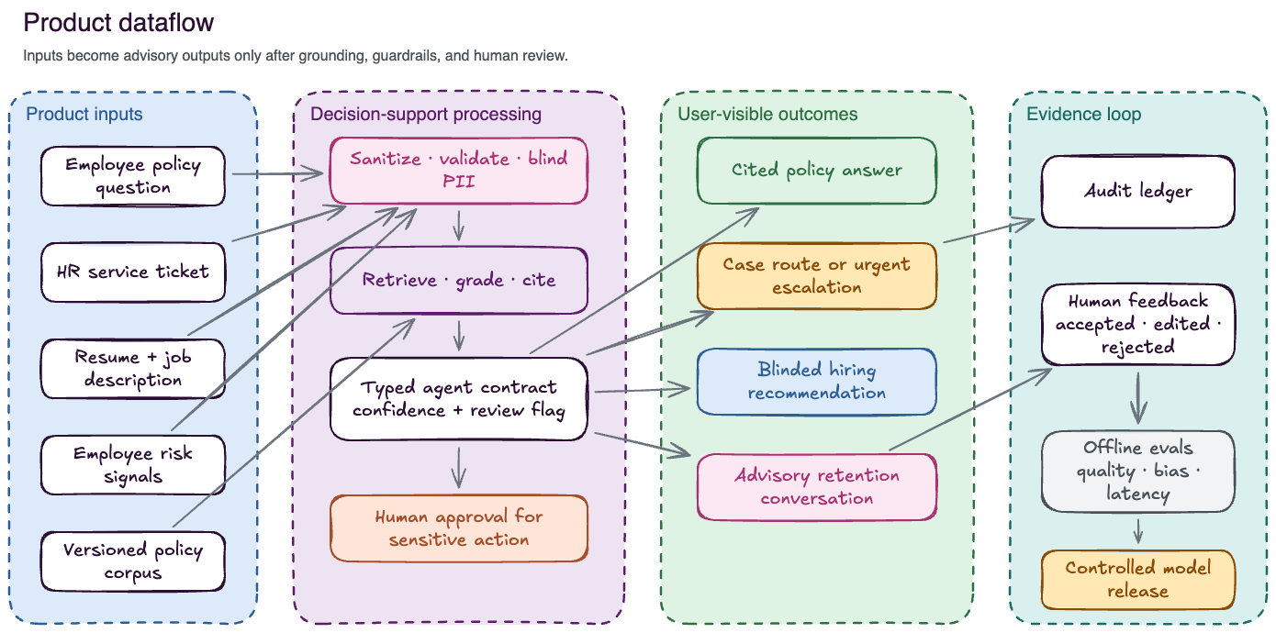
FLAGSHIP WORKFLOW
The proof is an auditable resume review
Decision support is useful only when the handoff is transparent, PII-safe, and human-approved.
01
Intake
Resume arrives as PDF, image, or text.
02
Blind + structure
Identity is blinded; skills and experience become a typed profile.
03
Guard + explain
Policy guard checks the rubric and generates reasons—not a verdict.
04
Approve + audit
A human checkpoint closes the loop and records the decision.
A2A-shaped handoffs carry certified, PII-safe artifacts—not raw text.
Source: PRODUCT.md · A2A_TECHNICAL_PLAN.md
05

Slide 6
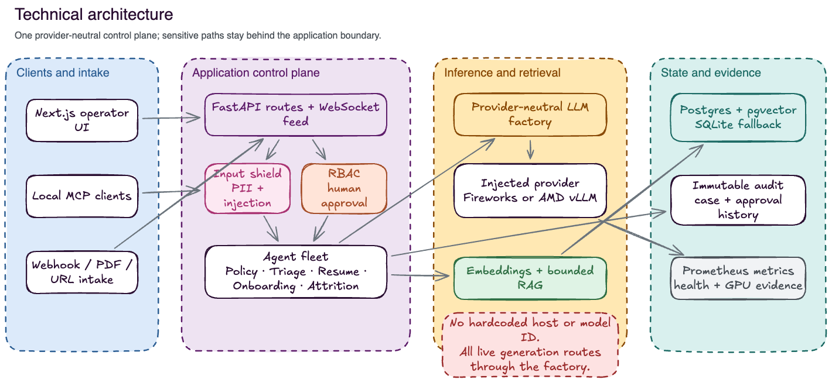
RUNTIME ARCHITECTURE
Provider routing is explicit, cost-bounded, and reversible
The durable control plane keeps workflows useful even when model inference is unavailable.
Deterministic first
Obvious triage, local scoring, and templated explanations use zero model spend.
Fireworks AI online
Interactive ambiguity, grounded synthesis, and streaming are opt-in and allowlisted.
AMD / vLLM optional
A self-hosted route exists; live hardware claims stay gated by named runtime evidence.
Source: README.md · CLAIMS.md · technical-architecture.png
06

Slide 7
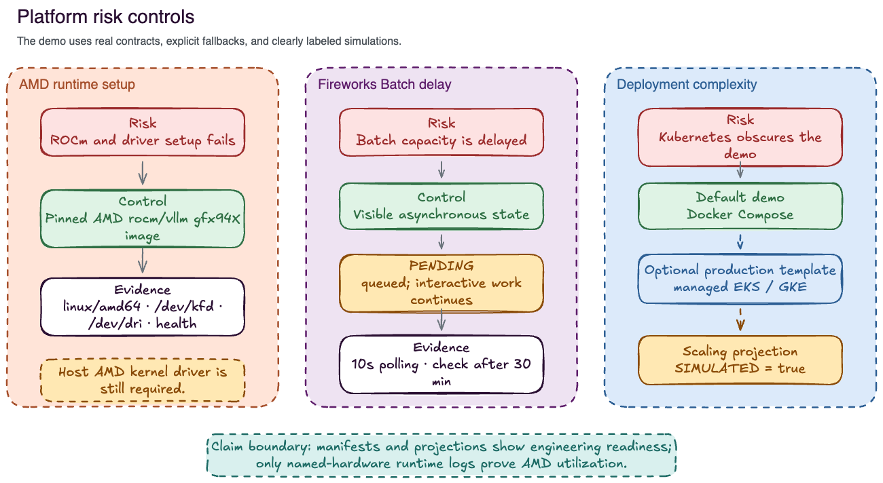
TRUST CONTROLS
Governance is product behavior—not a footer
The system makes the safe path visible: role boundaries, human approvals, redaction, and evidence all live in the workflow.
Human checkpoints
Sensitive actions pause for explicit approval.
Least privilege
Viewer → analyst → manager → admin scopes the surface and the action.
PII boundaries
Audit and provider payloads use redacted representations.
Append-only evidence
Every agent action and human decision is exportable for review.
Source: MISSION.md · SECURITY.md · platform-risk-controls.png
07

Slide 8
THE HONEST CLOSE
A deployable reference today; measured depth next
Govern.ai is designed to make trustworthy AI in HR inspectable now—and to earn stronger claims with evidence, not optimism.
Proven in the repository
Gates still required
Zero-secret deterministic evaluation
Credentialed Fireworks AI smoke
Policy RAG with pgvector + citations
Named AMD/ROCm/vLLM runtime evidence
Human approval gates + immutable audit
Hardware benchmark + numerical error evidence
Provider-neutral routing + batch lifecycle
Tenant isolation + enterprise identity
Build HR automation people can question, review, and trust.
Source: README.md · CLAIMS.md · HACKATHON_JUDGE_BRIEF.md
08

