Slide 1
Bash Shell “For” Loops – Lecture 1
By Rex Djere

Slide 2
Objectives
Discuss bash shell “for” loops.

Slide 3
What is the purpose of a “for” loop?
A “for” loop is used to automate a repetitive task.
When a “for” loop is executed, it allows code to be run repeatedly, and certain parameters of the code can be changed automatically with each run.
Each run of the “for” is called an iteration.
In the bash shell, a “for” loop can be implemented in a script, or directly from the command line.

Slide 4
A simple bash “for” loop
for x in 1 2 3 4 5
do
echo “This is iteration $x of this for loop.”
done

Slide 5
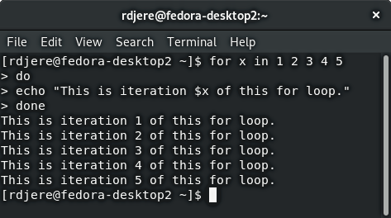
A simple bash “for” loop – bash window

Slide 6
Simple bash “for” loop number 2
for x in {1..10}
do
echo “This is loop $x.”
done

Slide 7
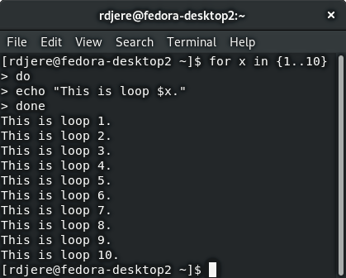
Simple bash “for” loop number 2 – bash window

Slide 8
Objectives Reviewed
Discuss bash “for” loops.

Slide 9
The End
Thank you for viewing this lecture!

