Slide 1
Bash Shell “For” Loops – Lecture 2 – Pinging a List of Hosts using a “For” Loop
by Rex Djere

Slide 2
Objectives
Construct a “for” loop to ping a list of hosts.

Slide 3
Construct a “for” loop to ping a list of hosts. Creating the hostlist file.
Commands:
  touch hosts.list (creates the empty hostlist file)
  vim hosts.list (opens the hostlist file in vim editor)
  “i” (enters “insert mode” in vim to edit the file)
  “esc” and then “:wq!” (exits “insert mode” and saves the file)
The next next slide reviews what we have done in a terminal window.

Slide 4


Construct a “for” loop to ping a list of hosts. Creating the hostlist file.
Creating hosts.list:
Editing hosts.list in vim:

Slide 5
Construct a “for” loop to ping a list of hosts. Creating the “for” loop.
We need to represent each line in hosts.list with a variable. I chose “x” as this variable.
We will use the “cat” command to read the contents of hosts.list.
We will use the “ping” command to ping the servers:
  -c1 tells the ping command to ping each host 1 time.
  -w1 tells the ping command to time out after 1 second on each attempt.
We send the output of the ping command to the null device “/dev/null”. We don’t care about the data, we only care about the result: success or failure.
We use the echo command to print out the host name, and 1 for ping success, or 0 for ping failure.
In the next slide, we’ll look at our script.

Slide 6
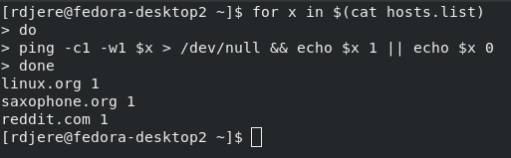
Construct a “for” loop to ping a list of hosts. Running the “for” loop.

Slide 7
Objectives Reviewed
Construct a “for” loop to ping a list of hosts.

Slide 8
The End
Thank you for viewing this lecture!

