Slide 1
Bash Shell “While” Loops – Lecture 1: Pinging a List of Hosts
By Rex Djere

Slide 2
Objectives
Discuss pinging a list of hosts with a bash shell “while” loop.

Slide 3
What is a “while” loop?
A “while” loop is used to automatically execute repetitive code while a condition is true.
Parameters within the “while” loop may change during each repetition.
Each repetition of the “while” loop is called an iteration.

Slide 4
What is the ping command?
ping is a utility that is used to test whether an IP network host is reachable.
Examples:
  ping Google.com
    This command will ping Google.com repeatedly until the computer’s operator stops it by entering CTRL+C.
  ping -c 2 Google.com
    This command will ping Google.com 2 times, provide statistics, and then exit.

Slide 5
Why a “while” loop?
A “while” loop allows you to ping a list of several hosts.
The hosts are typically listed in a single separate file.
The “while” loop then reads the file, and pings each of the hosts, one at a time.

Slide 6
First, let’s create the Hostlist
At a command prompt, we’ll enter the following command to create an empty file named “hosts.list”:
user@host ~] touch hosts.list

Slide 7
Next, we’ll edit the hosts.list in vim
At a command prompt, we’ll enter the following command to edit the new file in vim.
user@host ~] vim hosts.list

Slide 8
Next, we’ll add the hosts to hosts.list
Linux.com
Redhat.com
IBM.com

Slide 9
Now, let’s write the “while” loop
while read x
do
ping -c1 -w1 $x
done < hosts.list

Slide 10
Now, let’s write the “while” loop
while read x
do
ping -c1 -w1 $x
done < hosts.list

Slide 11
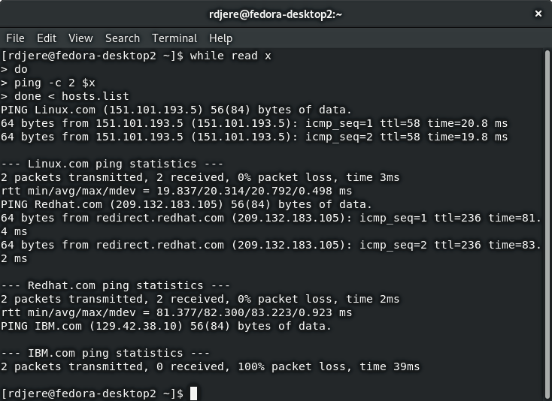
Finally, let’s run the “while” loop in bash

Slide 12
Objectives Revieved
Discuss pinging a list of hosts with a bash shell “while” loop.

Slide 13
The End
Thank you for viewing this lecture!

