Slide 1
fdisk -l by Rex Djere

Slide 2
fdisk -l Objectives
Discuss the general uses of fdisk.
Discuss the use of the fdisk -l command.

Slide 3
fdisk
fdisk:
  stands for fixed disk
  also stands for format disk
  is a powerful disk manipulation/viewing utility for the Linux/Unix command-line

Slide 4
fdisk uses
creating or destroying disk partitions
resizing disk partitions
displaying disk partition information

Slide 5
fdisk -l
Used to list all existing disk partitions on a Linux/Unix system.
Disk partitions are displayed in formats similar to the list below:
  “/dev/sda1”
  “/dev/sda2”
  “/dev/sda3”

Slide 6
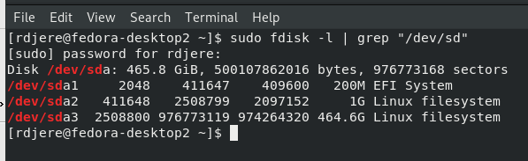
Discuss the use of the fdisk -l command.
In the example above, we have used fdisk -l to display all of the disk partitions, and filtered the output using the grep command to show only the partitions that start with “sd”.

Slide 7
fdisk -l Objectives Reviewed
Discuss the general uses of fdisk.
Discuss the use of the fdisk -l command.

Slide 8
The End
Thank you for reviewing this lecture!

