Slide 1
GREP
by Rex Djere

Slide 2
GREP Objectives
Describe the purposes of grep.
Discuss the history of grep.
Demonstrate the usage of grep.

Slide 3
Describe the purposes of grep.
Purpose 1: Search for a given text pattern in a string of text.
Purpose 2: Search for a given text pattern in a file.
Purpose 3: Return to standard output, or to a redirected output (e.g. a file), each line that matches the given pattern.

Slide 4
Discuss the history of grep.
March 3, 1973:
grep’s official birthday
Several years
prior to
3/3/1973:
Ken Thompson
creates grep
for personal
use.
More details:
http://bit.ly/2TMdfW2

Slide 5
Demonstrate the usage of grep.
Let’s start with a list of Tech Companies from Wikipedia:
Rank Country Company Revenue($B-USD) # of Employees Headquarters Wikipedia Ref.
1 United States Apple Inc. $265.6 132,000 Cupertino, CA, US [2]
2 South Korea Samsung $223.4 320,670 Suwon, South Korea [3][4]
3 United States Amazon.com $177.8 566,000 Seattle, WA, US [5]
4 Taiwan Foxconn $154.7 1,300,000 New Taipei City, Taiwan [6]
5 United States Alphabet Inc. $110.8 80,110 Mountain View, CA, US [7]
6 United States Microsoft $110.4 131,300 Redmond, WA, US [8]
7 China Huawei $89.3 180,000 Shenzhen, China [9]
8 Japan Hitachi $84.5 307,275 Tokyo, Japan [10]
9 United States IBM $79.1 397,800 Armonk, NY, US [11]
10 United States Dell Technologies $78.6 145,000 Round Rock, TX, US [12]
11 Japan Sony $77.1 117,300 Tokyo, Japan [13]
12 Japan Panasonic $72 274,143 Osaka, Japan [14]
13 United States Intel $62.7 102,700 Santa Clara, CA, US [15]
14 South Korea LG Electronics $54.3 74,000 Seoul, South Korea [16]
15 China JD.com $53.9 157,831 Beijing, China [17]
16 United States HP Inc. $52 49,000 Palo Alto, CA, US [18]
What if we want to search this list for the companies with headquarters in the United states? grep easily solves this problem.

Slide 6
Demonstrate the usage of grep.
What if we want to search this list for the companies with headquarters in the United states? grep easily solves this problem.
Rank Country Company Revenue($B-USD) # of Employees Headquarters Wikipedia Ref.
1 United States Apple Inc. $265.6 132,000 Cupertino, CA, US [2]
2 South Korea Samsung $223.4 320,670 Suwon, South Korea [3][4]
3 United States Amazon.com $177.8 566,000 Seattle, WA, US [5]
4 Taiwan Foxconn $154.7 1,300,000 New Taipei City, Taiwan [6]
5 United States Alphabet Inc. $110.8 80,110 Mountain View, CA, US [7]
6 United States Microsoft $110.4 131,300 Redmond, WA, US [8]
7 China Huawei $89.3 180,000 Shenzhen, China [9]
8 Japan Hitachi $84.5 307,275 Tokyo, Japan [10]
9 United States IBM $79.1 397,800 Armonk, NY, US [11]
10 United States Dell Technologies $78.6 145,000 Round Rock, TX, US [12]
11 Japan Sony $77.1 117,300 Tokyo, Japan [13]
12 Japan Panasonic $72 274,143 Osaka, Japan [14]
13 United States Intel $62.7 102,700 Santa Clara, CA, US [15]
14 South Korea LG Electronics $54.3 74,000 Seoul, South Korea [16]
15 China JD.com $53.9 157,831 Beijing, China [17]
16 United States HP Inc. $52 49,000 Palo Alto, CA, US [18]
Let’s assume that the companies are listed in a file named tech_companies.lst.

Slide 7
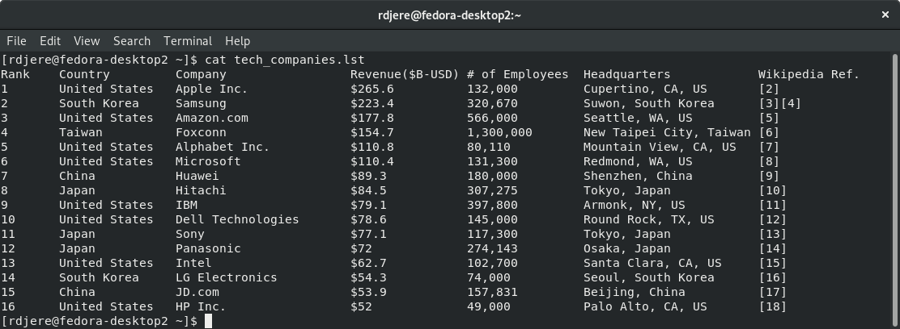
Demonstrate the usage of grep.
Let’s assume that the companies are listed in a file named tech_companies.lst. Here is how that file looks from a terminal window on our Linux system:

Slide 8
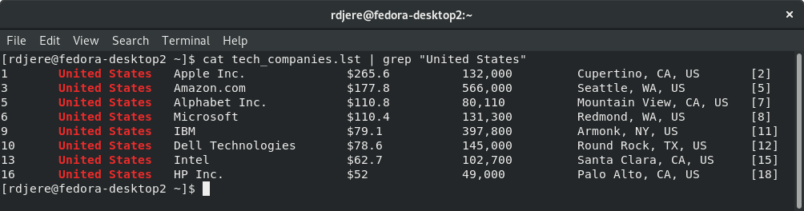
Demonstrate the usage of grep.
Now, let us use the cat command to view the contents of tech_companies.lst, and use the grep command to filter the output of cat to show only the companies based in the United States:

Slide 9
Demonstrate the usage of grep.
In review, we used the cat command to display the contents of tech_companies.lst:
cat tech_companies.lst
Then we “piped” the output of the cat command to the input of the grep command:
| grep “United States”
The full command looked like this:
cat tech_companies.lst | grep “United States”
The output looked like this:
1 United States Apple Inc. $265.6 132,000 Cupertino, CA, US [2]
3 United States Amazon.com $177.8 566,000 Seattle, WA, US [5]
5 United States Alphabet Inc. $110.8 80,110 Mountain View, CA, US [7]
6 United States Microsoft $110.4 131,300 Redmond, WA, US [8]
9 United States IBM $79.1 397,800 Armonk, NY, US [11]
10 United States Dell Technologies $78.6 145,000 Round Rock, TX, US [12]
13 United States Intel $62.7 102,700 Santa Clara, CA, US [15]
16 United States HP Inc. $52 49,000 Palo Alto, CA, US [18]

Slide 10
GREP Objectives Reviewed
Describe the purposes of grep.
Discuss the history of grep.
Demonstrate the usage of grep.

Slide 11
The End
Thank you for viewing this lecture!

