Slide 1
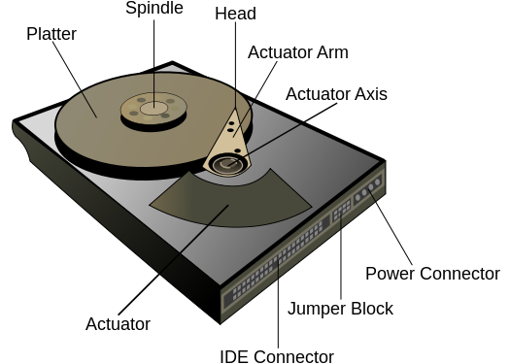
HDD Actuators
by Rex Djere

Slide 2
HDD Actuators - Objectives
Discuss the purpose of an HDD actuator.
Discuss the construction of an HDD actuator.

Slide 3
Discuss the purpose of an HDD actuator.
HDD stands for hard disk drive.
The HDD actuator contains a motor that moves the actuator arm.
The read/write head is attached to the end of the actuator arm.
The read/write head reads/writes data from/to the spinning magnetic hard disk platters which rotate on a central spindle.

Slide 4
Discuss the construction of an HDD actuator.
Older HDD actuators used stepper motors.
A stepper motor is a brushless DC electric motor that divides a full rotation into a number of equal steps.
Newer HDD actuators use servomotors.
A servomotor is a rotary/linear actuator that allows very precise control of angular/linear position, velocity, and acceleration.

Slide 5
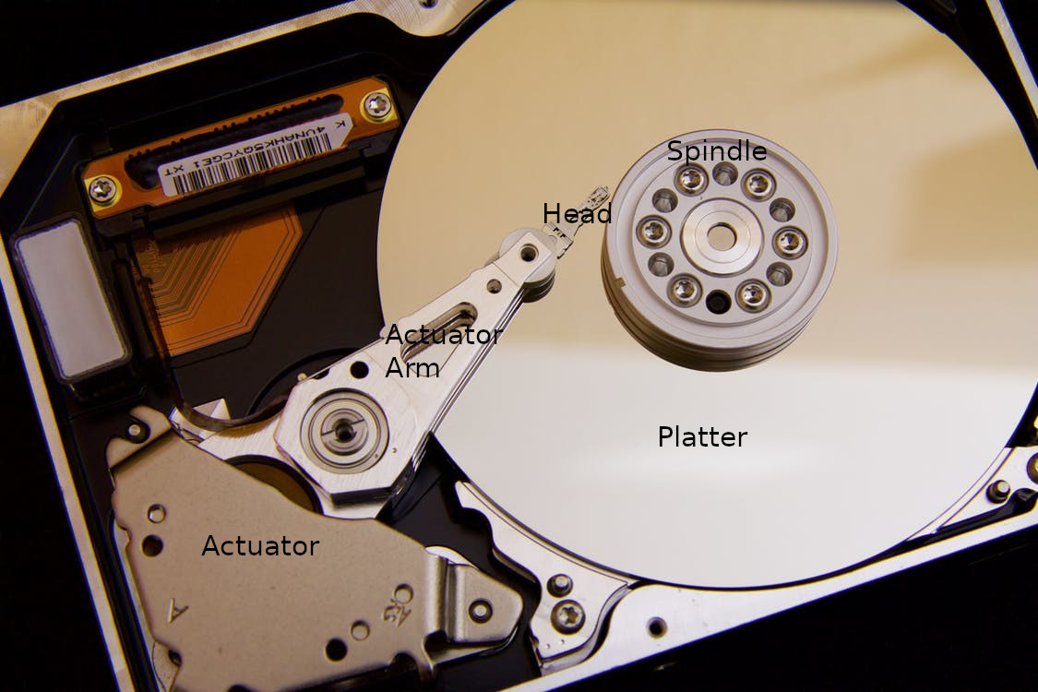
The internals of an HDD
CC0 licensed photo from https://www.pexels.com/photo/silver-hard-drive-interals-33278/

Slide 6
HDD Actuators – Objectives Reviewed
Discuss the purpose of an HDD actuator.
Discuss the construction of an HDD actuator.

Slide 7
The End
Thank you for viewing this lecture!

