Slide 1
Linux Logical Volume Management
by Rex Djere

Slide 2
Linux LVM Objectives
Define the Logical Volume Manager (LVM).
Discuss the history of the LVM.
Describe physical volumes (PVs).
Describe logical volumes (LVs).
Describe logical volume management.

Slide 3
Define the Logical Volume Manager (LVM).
Utilizes the device mapper framework built into the Linux kernel.
Maps physical block devices, such as hard drives and solid-state drives (SSDs), onto higher-level virtual block devices.
Provides logical volume management for the Linux kernel.

Slide 4
Discuss the history of the LVM.
LVM = Logical Volume Manager.
The original LVM code was written by Heinz Mauelshagen in 1998.
LVM’s primary design guidelines were inspired by the HP-UX volume manager.
Heinz Mauelshagen is now affiliated with Red Hat’s office in Germany.

Slide 5
Describe physical volumes (PVs).
A physical volume can be a partition of a whole physical disk, a whole physical disk, or Logical Unit Numbers (LUNs) of an external storage device.
The Logical Volume Manager creates logical volumes (LVs) out of these physical volumes (PVs).

Slide 6
Describe logical volumes (LVs).
physical volumes (PVs) are the basic building blocks.
volume groups (VGs) are composed of 1 or more PVs.
PVs can be added to or removed from VGs.
logical volumes (LVs) are created from VGs.
LVs can be thought of as “partitions” of VGs.
LVs are where the actual file systems and data resides.

Slide 7
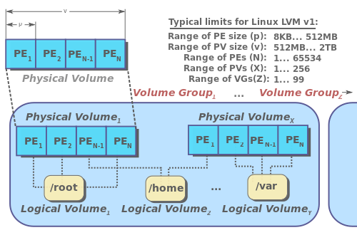
Describe logical volumes (LVs).
Image courtesy https://upload.wikimedia.org/wikipedia/commons/b/ba/LVM1.svg

Slide 8
Describe logical volume management.
Logical volume management is known as LVM.
It provides a more flexible means of allocating space on mass storage devices than traditional physical partitioning.
Logical volume management allows combining physical partitions (PVs) into logical volume groups (VGs).
These VGs can then be partitioned into logical volumes (LVs) where file systems can be created, and data can be stored.

Slide 9
Linux LVM Objectives Reviewed
Define the Logical Volume Manager (LVM).
Discuss the history of the LVM.
Describe physical volumes (PVs).
Describe logical volumes (LVs).
Describe logical volume management.

Slide 10
The End
Thank you for viewing this lecture!

