Slide 1
/dev/null: The Null Device
by Rex Djere

Slide 2
Objectives
State the function of /dev/null.
Describe the history of /dev/null.
Explain the usage of /dev/null.
Show examples of the usage of /dev/null.

Slide 3
State the function of /dev/null.
/dev/null is known as the null device.
It is a device file.
It discards all data written to it.
However, it reports that the write operation succeeded.
/dev/null is always empty, and is primarily used to destroy the output of commands.
/dev/null is a character device file (as opposed to a block device file). This means that it communicates by sending and receiving single characters. In contrast, a block device send and receive blocks of data.

Slide 4
Describe the history of /dev/null.
/dev/null, a.k.a. the null device, was introduced in Version 7 Unix.
Version 7 Unix was released in 1979 by AT&T.

Slide 5
Explain the usage of /dev/null.
/dev/null has 2 major uses.
Use 1: destroy unwanted output streams of a command/process.
Use 2: a convenient empty file for input streams.
Both uses are done by redirection (e.g. >, >>, <, or <<).
Examples:
  Destroying an output stream: ls -al > /dev/null
  Receiving an empty input stream: cat < /dev/null

Slide 6
Show examples of the usage of /dev/null.
This bash shell script is used to ping a set of hosts (listed in hosts.list, and write a report to report.rpt:
while read x
do
ping -q -w1 -c1 $x &>/dev/null && echo $x 1 >> report.rpt || echo $x 0 >> report.rpt
done < hosts.list

Slide 7
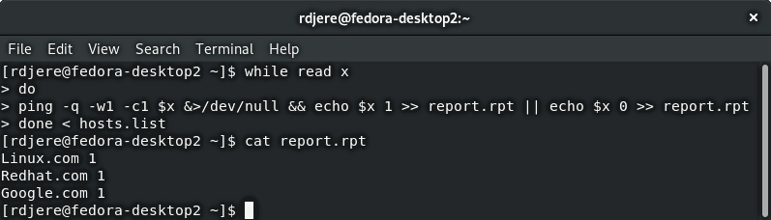
Show examples of the usage of /dev/null – bash screenshot

Slide 8
Objectives Reviewed
State the function of /dev/null.
Describe the history of /dev/null.
Explain the usage of /dev/null.
Show examples of the usage of /dev/null.

Slide 9
The End
Thank you for viewing this lecture!

