Slide 1
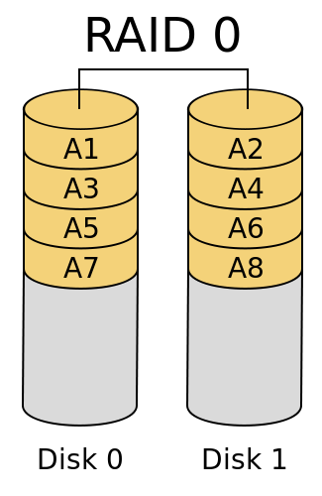
RAID 0
by Rex Djere

Slide 2
Objectives
Define RAID.
Discuss the general characteristics of RAID 0.
Discuss stripe sets/striped volumes.
Discuss parity information.
Discuss redundancy.
Discuss fault tolerance.
Discuss RAID 0 performance.

Slide 3
Define RAID.
Stands for Redundant Array of Independent Disks, or Redundant Array of Inexpensive Disks.
Is a data storage virtualization technology.
Combines multiple physical disk drives into one or more logical units.
This provides data redundancy, performance improvements, or both.

Slide 4
Discuss the general characteristics of RAID 0.
Splits data evenly across stripe sets/striped volumes on 2 or more disks.
No parity information is stored.
There is no redundancy.
There is no fault tolerance.
Failure of one drive will cause the entire array to fail.
RAID 0 is used to increase speed performance.

Slide 5
Discuss the general characteristics of RAID 0.

Slide 6
Discuss stripe sets/striped volumes.
Striping spreads data across 2 or more physical drives.
The data is divided into blocks, and those blocks are spread across stripe sets/striped volumes on 2 or more disks.
The disks can be hard drives, SSDs, etc.
Multiple stripes increase read/write throughput, leading to better read/write performance.
No fault tolerance or redundancy makes striping best suited for non-critical data sets.

Slide 7
Discuss parity information.
Uses a parity bit or check bit.
Parity bits are the simplest form of error detecting code.
A bit is added to a string of binary code to ensure that the total number of 1-bits in the string is even or odd.
There are 2 variants of parity bits:
  even parity bits.
  odd parity bits.
Error detection: If the number of bits, including the parity bit, are transmitted incorrectly, this means that the parity bit will be incorrect, indicating a parity error in the transmission.

Slide 8
Discuss redundancy.
RAID 0 has no redundancy.
The failure of one disk in the array will cause the entire array to fail.
Since data is striped across multiple disks, the failure of one disk will cause total data loss.
Due to its lack of redundancy, RAID 0 is not appropriate for mission-critical data storage.

Slide 9
Discuss fault tolerance.
Fault tolerance allows a system to continue operating, even in the event of a failure or fault in one or more of its components.
RAID 0 has no fault tolerance.
A single fault (the failure of one disk) will cause a RAID 0 to fail (complete loss of data).

Slide 10
Discuss RAID 0 performance.
RAID 0 provides very good read/write performance.
For example, a RAID 0 array with n number of drives can theoretically provide n times the read/write performance (speed) of a single drive.
RAID 0 is used in applications that require high performance, but that can accept lower reliability (e.g. scientific computing and computer gaming).

Slide 11
Objectives Reviewed
Define RAID.
Discuss the general characteristics of RAID 0.
Discuss stripe sets/striped volumes.
Discuss parity information.
Discuss redundancy.
Discuss fault tolerance.
Discuss RAID 0 performance.

Slide 12
The End
Thank you for viewing this lecture!

