Slide 1
Regular Expressions
by Rex Djere

Slide 2
Regular Expression Objectives
Define regular expressions.
Discuss regular expression patterns.
Discuss the history of regular expressions.
Discuss the basic concepts of regular expressions.

Slide 3
Define regular expressions.
Also known as regex, regexp, and rational expression.
Is a sequence of characters that defines a search pattern.

Slide 4
Define regular expressions.
3 uses of regular expression string search patterns in string searching algorithms:
  find
  find and replace
  input validation

Slide 5
Discuss regular expression patterns.
Example of regular expression patterns:
  (?<=\.)
  {2,}
  (?=[A-Z])
  {1..10}

Slide 6
Discuss regular expression patterns.
A regular expression is a short text syntax that represents a pattern for matching text.
For example, let us consider these 2 sentences in a file: 1. “GNU is not UNIX.” 2. “UNIX is UNIX.”
We want to create a regular expression that will ONLY return the sentence that STARTS with the word GNU.
That regular expression looks like this: “^GNU”
We can then use a text-matching utility such as grep to search the file looking for this pattern. Let us assume that the file is named gnu.txt:
  cat gnu.txt | grep “^GNU”
In the next slide, we’ll look at the output of this command.

Slide 7

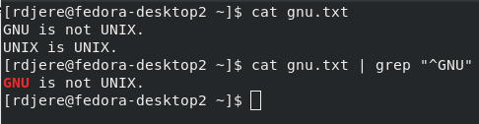
Discuss regular expression patterns.
cat gnu.txt | grep “^GNU”
Here are the contents of gnu.txt:
Now, let us use the “^GNU” regular expression to process the file:

Slide 8
Discuss the history of regular expressions.
The concept of regular expressions was originated in 1951 by mathematician Stephen Cole Kleene.
Regular expressions used text to define text patterns in the same way that mathematical symbols had been used the define mathematical patterns.

Slide 9
Discuss the basic concepts of regular expressions.
Booleans => or. gray|grey will match either word.
Groupings => parentheses. gr(a|e)y
Quantification:
  colou\?\r: matches “color” and “colour” (echo “color colour” | grep “colou\?\r”)
  : ab*c (zero or more occurrences) matches “ac”, “abc”, “abbbc” etc.
  +: ab\+\c (one or more occurrences) matches “abc”, abbc, but not “ac”
  {n}: preceding item is matched exactly n times.
  {min,}: preceding item is matched min or more times.
  {min,max}: preceding item is matched at least min times, but not more than max times.
  Let’s look at examples on the next slide.

Slide 10
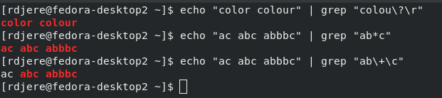
Discuss the basic concepts of regular expressions.

Slide 11
Discuss the basic concepts of regular expressions.
Wildcard:
  .: . is a wildcard that matches any character.
  For example, a.b matches any string that contains “a”, then any other character, and then a “b”.
  Let’s use grep to search for the word albatross in this sentence:
    “The bumbling albatross walked across the street”.
    echo “The bumbling albatross walked across the street.” | grep “a.b”

Slide 12
Regular Expression Objectives Reviewed
Define regular expressions.
Discuss regular expression patterns.
Discuss the history of regular expressions.
Discuss the basic concepts of regular expressions.

