Slide 1
xargs
by Rex Djere

Slide 2
Objectives
State the purpose of the xargs command.
Discuss the history of xargs.
Show examples of how xargs is used.
List xargs references.

Slide 3
State the purpose of the xargs command.
xargs is a command on Linux/Unix computer operating systems.
It is used to build and execute commands from standard input (stdin).

Slide 4
Discuss the history of xargs.
xargs first appeared in PWB/UNIX in 1977.
PWB/UNIX stands for Programmer’s Workbench UNIX.
PWB/UNIX is now discontinued.
It was a version of UNIX created to provide a time-sharing computer operating system to a large group of computer programmers.
PWB/UNIX was created by the Computer Science Research Group at AT&T’s Bell Labs.

Slide 5
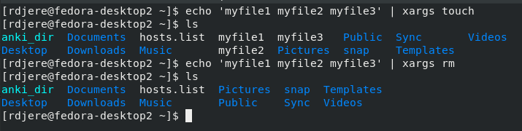
Show examples of how xargs is used.
Let us use xargs to create and then delete a list of files.

Slide 6
List xargs references.
https://en.wikipedia.org/wiki/Xargs
https://www.freebsd.org/cgi/man.cgi?xargs
https://gist.github.com/porras/5b109bce228fb29784d5a0ab2c93c00c
https://pubs.opengroup.org/onlinepubs/009695399/utilities/xargs.html

Slide 7
Objectives Reviewed
State the purpose of the xargs command.
Discuss the history of xargs.
Show examples of how xargs is used.
List xargs references.

Slide 8
The End
Thank you for viewing this lecture!

