Slide 1
SOFTWARE DEFINED RADIO
From Bits to Airwaves
A live demo with GNU Radio Companion, a HackRF One, and a 144/440 MHz handheld
Mark Grennan • W5TSU • 2026

Slide 2
BEFORE WE TOUCH THE RADIO
The Airwaves: 3 Hz – 3 THz
By international convention (ITU), everything humans use for wireless communication -- from submarine navigation to satellite links -- lives somewhere in this range. Twelve decades, back to back, and every one of them is already spoken for.
ELF
SLF
ULF
VLF
LF
MF
HF
VHF
UHF
SHF
EHF
THF
3 Hz
3 THz
Each band spans one decade -- band N runs 0.3×10ᴺ Hz to 3×10ᴺ Hz.
Tonight lives here: VHF / UHF
• 2m (144-148 MHz) and 70cm (420-450 MHz) -- our ham bands -- plus FM broadcast (88-108 MHz), all three narrow slivers of one 270:1 span (30 MHz-3 GHz).
ITU Radio Regulations, Article 2 -- band designations ELF-THF
1 / 24

Slide 3
BEFORE WE TOUCH THE RADIO
Every Signal Arrives Already Mixed With Noise
Noise From Nature
Noise We Make Ourselves
• Thermal noise: the atoms in your receiver's own components are vibrating with heat -- that's noise, before an antenna is even involved.
• Modeled as Gaussian / "white" noise -- flat across the whole band. That's the hiss you hear with nothing tuned in.
• Lightning sferics: crackly pops from distant thunderstorms, audible from VLF up through HF.
• Ionized meteor trails briefly reflect distant signals into a receiver -- noise and signal from the same natural event.
• Every switching power supply, phone charger, and LED driver in this room is radiating RF -- one of the most common interference sources hams fight.
• USB 3.0 leaks clock noise at multiples of 480 MHz; HDMI cables can splatter interference across roughly 148-742 MHz.
• Monitors, DisplayPort, powerline networking adapters -- all of it adds more.
• None of it is malicious. It's just what happens when fast digital clocks run next to a receiver.
Every demo tonight starts here: find the signal you want inside everything else that's already there. Watch the noise floor on the very first demo -- it's not empty.
Sources: pysdr.org (Ch. 10, Noise and Random Variables) and sigidwiki.com (Interfering Emissions category)
2 / 24

Slide 4
BEFORE WE TOUCH THE RADIO
Hear It For Yourself, Live
RECEIVE ONLY
• Everything on the last slide -- thermal noise, atmospheric sferics, switching power supplies -- is audible right now, live.
• The entire 20-meter ham band (14.000-14.350 MHz), captured all at once and played as one audio stream -- not tuned to any single station, just the raw mix of everything active on the band.
Prefer to go exploring on your own later? A worldwide network of live receivers anyone can tune:
websdr.org -- listen live
Try it: pick any frequency and just listen.
websdr.org -- University of Twente WebSDR, public since April 2008 (Pieter-Tjerk de Boer, PA3FWM)
3 / 24

Slide 5
BEFORE WE TOUCH THE RADIO
Finding a Signal in the Noise
• A receiver doesn't remove noise -- it narrows down. Filter to just the channel bandwidth of the signal you want, and every watt of noise outside that channel disappears with it.
• What actually matters is SNR: not "is there noise" (there always is) but "is the signal stronger than the noise inside the bandwidth you're listening in."
• Modulation is what makes a signal findable in the first place -- FM, AM, PSK, and friends each carve a distinct, structured shape into the spectrum that a demodulator can lock onto and reject everything else.
Wideband Capture (mostly noise)
Filter to Channel Bandwidth
Demodulate (now readable)
Once you can pick a signal out of the noise, the next question is "what am I even listening to" -- a crowdsourced field guide:
sigidwiki.com -- Signal Identification Guide
sigidwiki.com -- ~600 identified signals with example sounds and waterfall images, from VLF to UHF
4 / 24

Slide 6
THE IDEA
What Is Software Defined Radio?
• Traditional radios: filtering, mixing, and demodulation are done by dedicated analog/digital hardware built for one job.
• SDR: an antenna feeds a wideband ADC/DAC, and everything after that -- tuning, filtering, demodulating, decoding -- happens in software.
• Same box, endless radios: change the software, not the hardware.
• Today's demo does this literally -- one HackRF, six different “radios,” just by loading a different flowgraph.
Antenna
Analog RF in/out
ADC / DAC (HackRF)
Samples ↔ RF
Software (GNU Radio)
Filter · demod · decode
SDR Demo -- GNU Radio + HackRF + Ham Handheld
5 / 24

Slide 7
THE HARDWARE
HackRF One
Core Specs
TX Capabilities
• 1 MHz – 6 GHz tuning range
• Up to 20 Msps, 8-bit quadrature ADC/DAC (8-bit I, 8-bit Q)
• Half-duplex (RX or TX, never both at once)
• Hi-Speed USB 2.0, USB-powered, open source hardware
• This talk: driven via SoapySDR from GNU Radio
• Two software-controlled TX gain stages -- no physical knobs: an on/off RF amp (~+11 dB) and a VGA/IF gain stage, 0-47 dB in 1 dB steps.
• Max output power varies with frequency -- roughly +5 to +15 dBm from 1 MHz-2.17 GHz, dropping to about 0-10 dBm up through 4 GHz. Best performance is actually 2170-2740 MHz.
• Tonight's TX demos default to just 10 dB of VGA gain -- comfortably at the low end, per the "minimum power necessary" guidance.
• No built-in per-band TX filtering -- it's a general-purpose transmitter, so staying inside our allocated ham segments is on us.
Sources: hackrf.readthedocs.io, greatscottgadgets.com/hackrf/one
6 / 24

Slide 8
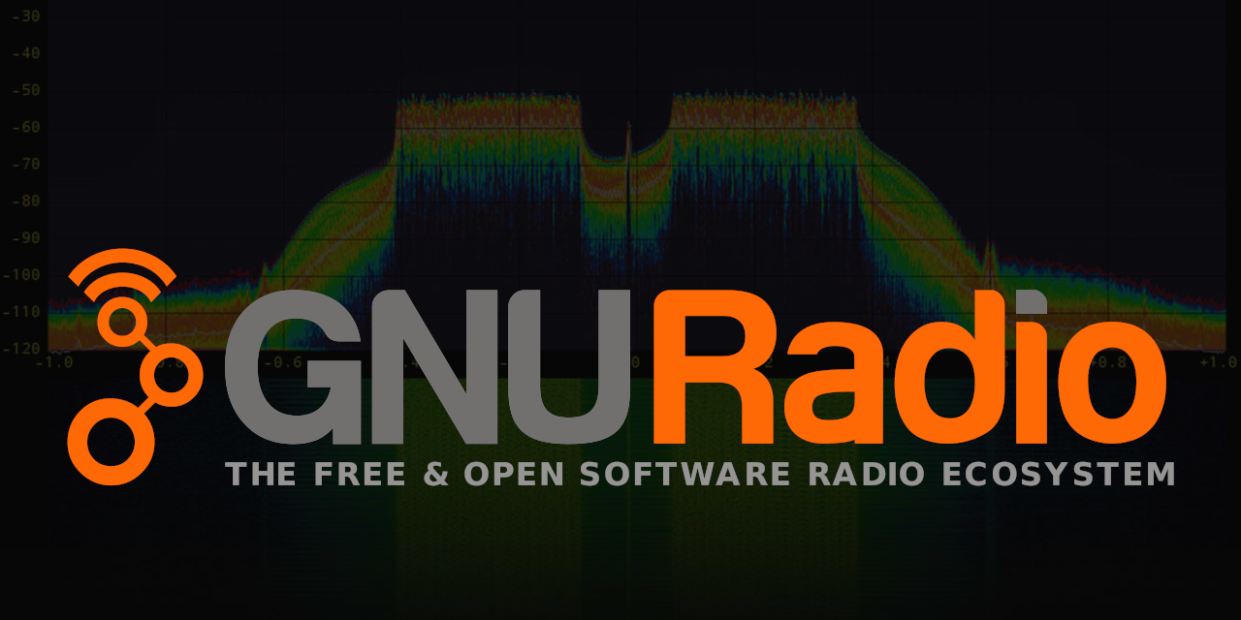
THE SOFTWARE
GNU Radio + GNU Radio Companion
• GNU Radio: open-source DSP toolkit -- filters, modulators, demodulators, resamplers, all as reusable building blocks.
• GNU Radio Companion (GRC): drag-and-drop flowgraph editor that generates the underlying Python for you.
• SoapySDR: hardware abstraction layer -- the same flowgraph blocks work whether it's a HackRF, RTL-SDR, LimeSDR, or others.
• Every flowgraph in this demo is a plain-text .grc file -- versionable, diffable, shareable.
Toolchain
Flowgraph (.grc)
GNU Radio Companion
Generated Python
GNU Radio runtime + SoapySDR
HackRF One
SDR Demo -- GNU Radio + HackRF + Ham Handheld
7 / 24

Slide 9
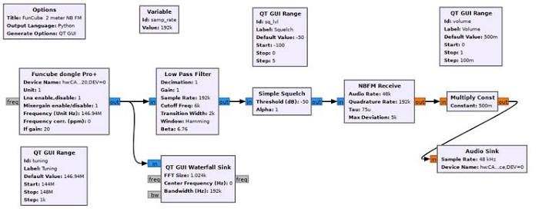
CORE CONCEPT
Reading a Flowgraph
• Blocks are connected left to right: a Source produces samples, middle blocks process them, a Sink consumes them.
• Everything on the RF side flows as complex IQ samples -- one number for signal strength/phase in two dimensions (I and Q), captured at the sample rate.
• Sample rate sets your instantaneous bandwidth: capture at 6 Msps and you're watching 6 MHz of spectrum at once, not just one channel.
HackRF Source
Filter / Resample
Demodulate
Audio / File Sink
SDR Demo -- GNU Radio + HackRF + Ham Handheld
8 / 24

Slide 10
DEMO 0 · ICEBREAKER
FM Broadcast Receiver
RECEIVE ONLY
• A quick tune to any strong local FM station brings music through the laptop speakers, instantly.
• Not a ham-band demo -- it proves the whole chain works (driver, HackRF, GNU Radio, audio out) before the ham material, and it needs no license to receive.
SDR Demo -- GNU Radio + HackRF + Ham Handheld
9 / 24

Slide 11
DEMO 1
Live Spectrum & Waterfall
RECEIVE ONLY
• One flowgraph covers both ham bands -- we'll retune live between 2m and 70cm.
• Watch the spectrum plot and waterfall light up in real time as a handheld transmission appears.
• It's the same slice of RF spectrum a traditional radio can only look at one narrow channel of at a time.
SDR Demo -- GNU Radio + HackRF + Ham Handheld
10 / 24

Slide 12
DEMO 2
Tunable NBFM Voice Receiver
RECEIVE ONLY
• A real narrowband FM voice receiver -- channel filter, resampler, FM demodulator, straight to the speakers.
• Tuned to 146.520 MHz, the national 2m simplex calling frequency.
• This whole receiver -- normally a dedicated chip in an off-the-shelf radio -- is about a dozen blocks of software here.
SDR Demo -- GNU Radio + HackRF + Ham Handheld
11 / 24

Slide 13
⚠ BEFORE WE TRANSMIT
Part 97 Ground Rules
• A licensed control operator is present the entire time we transmit.
• We identify with callsign at the start/end and every 10 minutes.
• No music, no broadcast content -- a brief, identified test transmission only.
• Power stays at the minimum needed -- TX gain starts low and only comes up as far as the demo needs.
• No control operator today, or want zero on-air emission? The HackRF TX port can go into a dummy load instead of an antenna -- same demo, nothing radiated.
SDR Demo -- GNU Radio + HackRF + Ham Handheld
12 / 24

Slide 14
DEMO 3 · THE HEADLINE DEMO
Record the Entire 2m Band
• Tunes to 146.0 MHz center at 6 Msps -- covers 143.0 to 149.0 MHz, the whole 144-148 MHz 2m band with margin to spare.
• Not one channel -- every signal on the entire band, captured at once
– Raw IQ, written to a self-describing file (sample rate + center frequency saved in the header)
• A single recording captures everything transmitted on the band during that window -- roughly 2.9 GB per minute at this sample rate.
SDR Demo -- GNU Radio + HackRF + Ham Handheld
13 / 24

Slide 15
DEMO 3B · THE PAYOFF
...And Play It Back Over the Air
TRANSMITS — SEE NEXT SLIDE
• Reads the file back and feeds it straight into the HackRF's transmitter -- the exact recorded band reappears on the air.
• The waterfall reproduces exactly what was captured; the handheld hears the same signal a second time, live.
• This is the moment that makes SDR click: the recording *is* the radio signal -- numbers on disk, transmitted back as RF.
SDR Demo -- GNU Radio + HackRF + Ham Handheld
14 / 24

Slide 16
DEMO 4 · OPTIONAL
NBFM Voice Transmitter
TRANSMITS — CONTROL OP REQUIRED
• The reverse direction: laptop microphone → NBFM modulator → HackRF → antenna.
• Live two-way on the same 146.520 MHz simplex frequency as Demo 2.
SDR Demo -- GNU Radio + HackRF + Ham Handheld
15 / 24

Slide 17
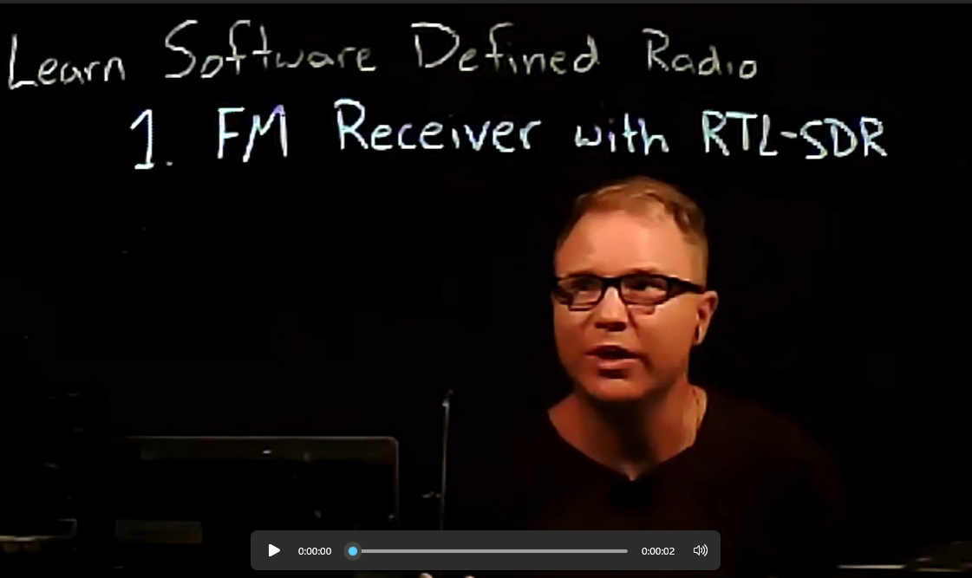
THE SOFTWARE, REVISITED
GNU Radio: What It Is, How It's Used
What It Actually Is
How to learn GNU-Radio Companion
• Started in 2001 (Eric Blossom); now stewarded by the GNU Radio Project and the GNU Radio Foundation.
• C++ underneath for real-time DSP performance; Python (and GNU Radio Companion) on top for building and scripting flowgraphs.
• A scheduler manages sample buffers between blocks -- the same runtime whether the samples are live from a HackRF or read back from a file.
• Hundreds of built-in blocks -- filters, modulators, channel coding, synchronization -- plus a large ecosystem of out-of-tree (OOT) modules for specific protocols.
https://www.youtube.com/playlist?list=PLywxmTaHNUNyKmgF70q8q3QHYIw_LFbrX
Source: gnuradio.org -- GNU Radio Conference (GRCon) happens every year
16 / 24

Slide 18
BEYOND TONIGHT'S SETUP
Connecting GNU Radio to Other Radios
Other SDRs
Analog / Non-SDR Radios
• Same GRC blocks, different hardware -- SoapySDR supports RTL-SDR, LimeSDR, PlutoSDR, Airspy, SDRplay, and more through one common driver API.
• USRP hardware typically goes through UHD instead -- GNU Radio ships dedicated UHD blocks for it.
• Swapping hardware is usually a one-block change in the flowgraph, not a redesign.
• Audio interface: a USB sound card wired to a radio's mic/speaker (or data) port runs digital modes -- APRS, PSK31, and more -- through a normal transceiver, no RF-direct hardware needed.
• Rig control (CAT): Hamlib-based blocks let a flowgraph key PTT and set frequency on a physical radio over serial/USB.
• Direct RF coupling: exactly what tonight's demo did -- the SDR transmits or receives over the air, and the other radio just needs an antenna.
Tonight only used one SDR and one handheld over RF -- the same tools bridge to almost anything with an antenna or an audio jack.
17 / 24

Slide 19
ONE WORD, THREE MEANINGS
Three Kinds of Bandwidth
SDR (RF) Bandwidth
Interface Bandwidth (USB)
Receive Bandwidth (What the Software Decodes)
• Instantaneous bandwidth = sample rate itself -- spans -Fs/2 to +Fs/2 around wherever you're tuned.
• HackRF: up to 20 Msps -> up to 20 MHz of spectrum visible at once.
• Rule of thumb: trust only the center ~4/5 of that ("Sean's 4/5 rule") -- the anti-alias filter rolls off near the edges.
• A separate bottleneck: getting every sample off the SDR and into the computer, in real time, without dropping any.
• HackRF: USB 2.0 Hi-Speed. At 20 Msps complex 8-bit, that's ~320 Mbps -- already close to USB2's practical ceiling.
• Exactly why hackrf_info warns about other devices sharing the USB bus at high sample rates.
• The RF capture and the channel actually being decoded are two different numbers.
• Demo 3 captured 6 MHz of the 2m band; one NBFM voice channel is only ~16 kHz wide.
• That gap is exactly the Filter/Resample block from "Reading a Flowgraph" -- narrowing a wide capture down to one channel.
Source: pysdr.org (Ch. 3, IQ Sampling -- sample rate = instantaneous bandwidth, Nyquist, "Sean's 4/5 rule")
18 / 24

Slide 20
WHERE THIS GOES NEXT
More Demo Ideas
Quick wins
Bigger swings
• CTCSS/PL tone squelch decode
• CW (Morse) ID transmitter
• RDS decode from FM broadcast
• APRS decode (144.390 MHz)
• WSPR / FT8 weak-signal decode
• ADS-B aircraft tracking (1090 MHz)
• Cross-band digital repeater
• Digital voice (DMR / D-STAR) decode
Full writeup with effort/dependency notes: BRAINSTORM.md
Working GNU Radio flowgraphs for many of these modes (ham club tutorial repo): github.com/argilo/sdr-examples
19 / 24

Slide 21
REFERENCE
Specs at a Glance
Frequency range
1 MHz – 6 GHz (HackRF One)
Sample rate used today
2–10 Msps depending on demo
2m band
144.000 – 148.000 MHz
70cm band
420.000 – 450.000 MHz
2m simplex calling freq
146.520 MHz
Demo 3 capture
146.0 MHz center @ 6 Msps ≈ 2.9 GB/min
HackRF TX power (typical)
≈ 10–15 dBm max, kept low for these demos
SDR Demo -- GNU Radio + HackRF + Ham Handheld
20 / 24

Slide 22
RESOURCES
Go Build Something
• GNU Radio
– gnuradio.org — the toolkit, docs, and tutorials
• HackRF One
– greatscottgadgets.com/hackrf — hardware + firmware
• SoapySDR
– github.com/pothosware/SoapySDR — the hardware abstraction layer used today
• ARRL
– arrl.org — licensing info and Part 97 reference
• This kit
– All flowgraphs, README, and brainstorm doc are in this repo’s flowgraphs/ and top-level README.md / BRAINSTORM.md
SDR Demo -- GNU Radio + HackRF + Ham Handheld
21 / 24

Slide 23
SOFTWARE DEFINED RADIO REQUIRES SOFTWARE
Learn the DSP, in Python: pysdr.org
• Everything tonight ran through GNU Radio Companion's drag-and-drop canvas -- pysdr.org teaches the same DSP by writing the Python (NumPy/SciPy) yourself, concept by concept.
• Free, written for engineers, no textbook required first -- the same site cited earlier tonight for noise (slide 3) and bandwidth/Nyquist (slide 17).
Fourier Transforms
Filters
Digital Modulation
RX & TX in Python
• Fourier Transforms: the FFT math behind every spectrum plot and waterfall shown tonight.
• Filters: the same low-pass/channel-select filtering every flowgraph tonight used, written out by hand.
• Digital Modulation: ASK, PSK, QAM, FSK -- how bits become RF, from first principles.
• RX & TX in Python: PlutoSDR, USRP, RTL-SDR, and HackRF, each driven directly from a Python script -- no GRC canvas required.
pysdr.org -- "A Guide to SDR and DSP using Python"
22 / 24

Slide 24
Thank You
Questions? Let's get on the air.
Mark Grennan • W5TSU • mark@grennan.com

