Slide 1
Diabetes Health Indicator
Wesley Wijaya

Slide 2
Problem
Diabetes is increasing rapidly in Indonesia, and "WHO estimates the number of people with type 2 DM in Indonesia will increase significantly to reach 21.3 million people by the year of 2030.“ In this project , we will use Machine Learning model classification to create diabetes classification, understand factors that increase the risk of diabetes, and create recommendation base on the data we have.

Slide 3


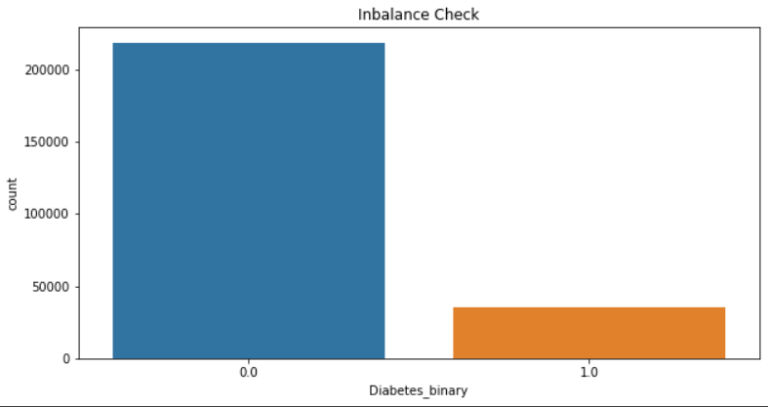
Data collection and understanding
Data has 253680 row and 22 columns
No null value
All dtype is float64
Data is inbalance

Slide 4
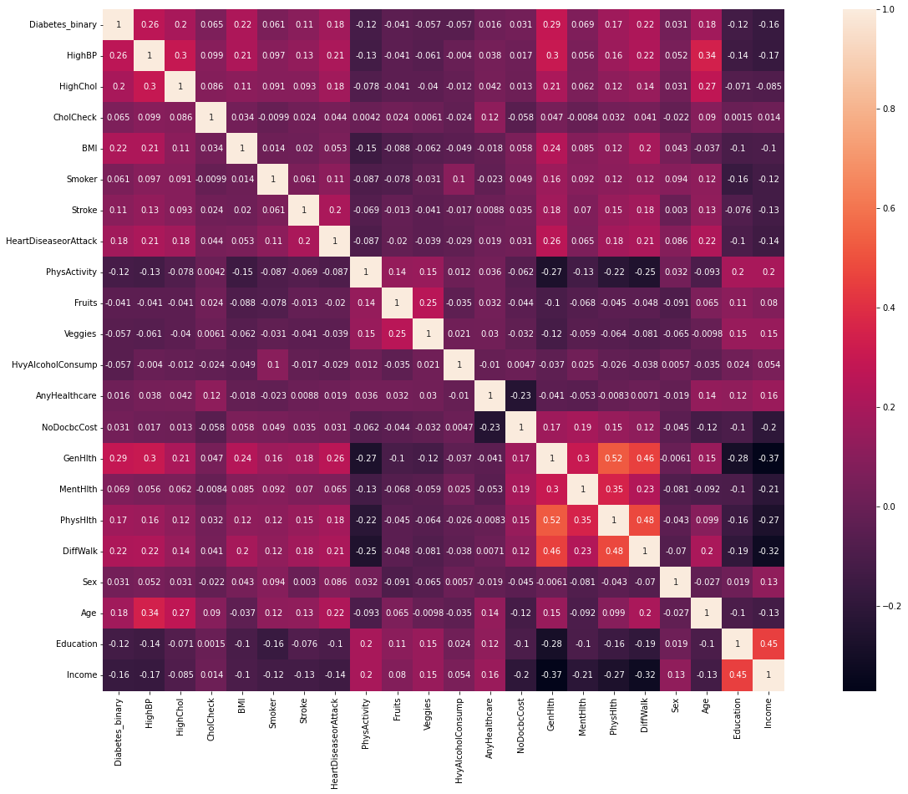
Data and features analysis
Highest Corr ~0.2 against Diabetes_binary
HighBP
HighChol
BMI
HeartDiseaseorAttack
GenHlth
DiffWalk
Age

Slide 5
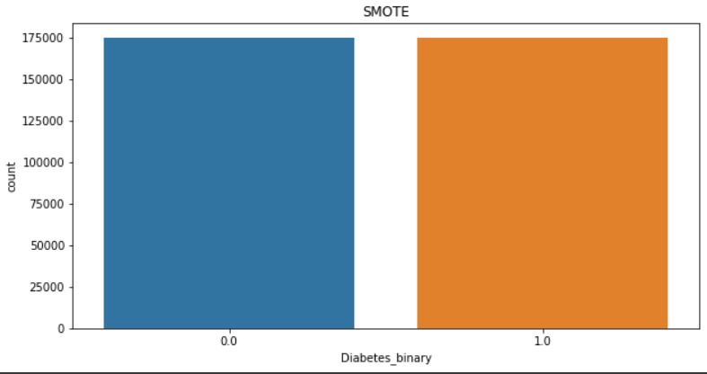
Modeling step
Train Split Data
Inbalance Handling
Multiple Modeling
Naïve Bayes
Logistic Regression
Random Forest
Decision Tree
Train
80%
Data
20%
Test
Train Data Having 349326 Rows
Train Data Having 202944 Rows

Slide 6
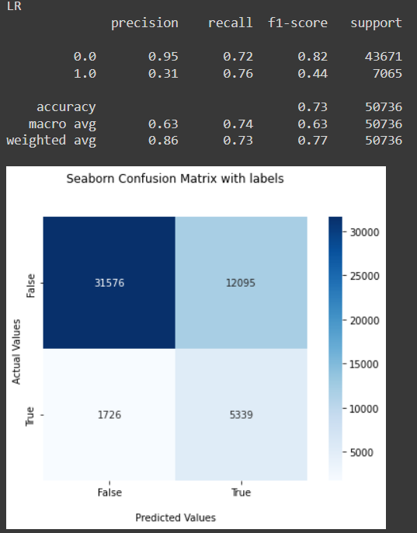
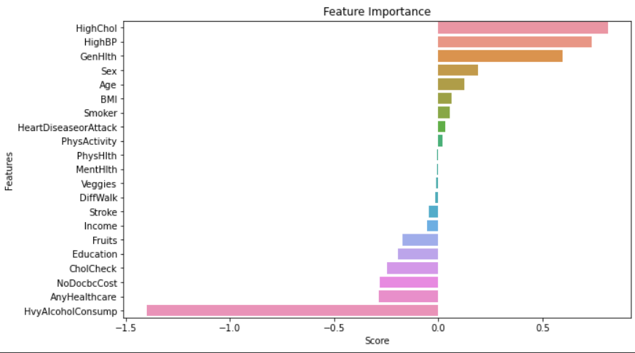
evaluation
Best Model
Features Importance

Slide 7

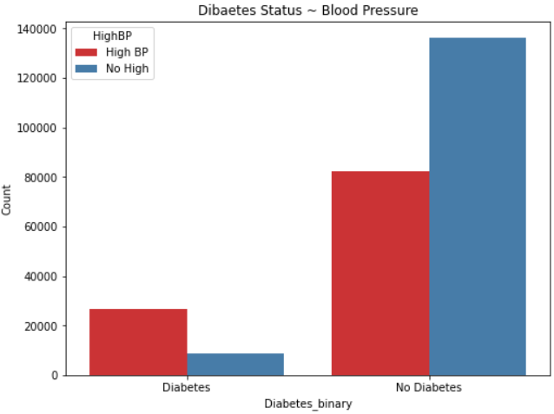
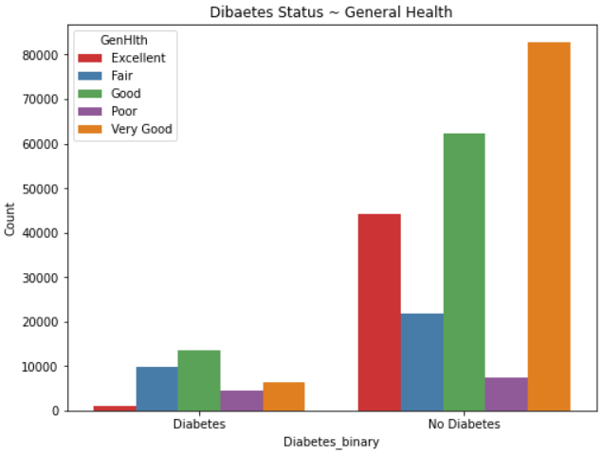
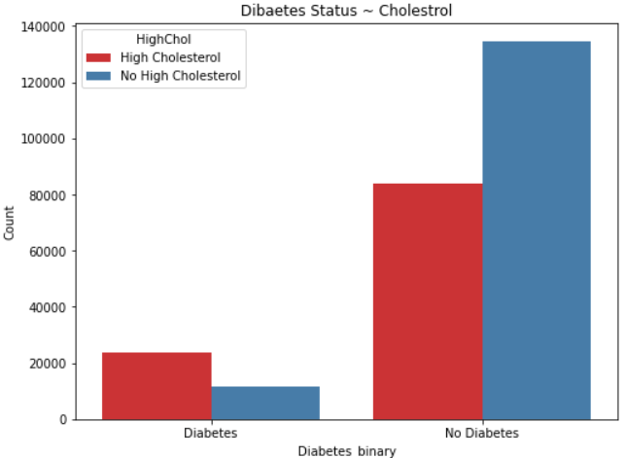
Understanding Feature Importance

Slide 8
Conclusion and recomendation
Conclusion
High Cholesterol
High Blood Presssure
General Health
This 3 factors is main point at increasing risk of diabetes
Recommendation
Physical activity
Mental Health
BMI

