Slide 1


Washington-British Columbia & Idaho Chapter American Fisheries Society
2024 Joint Annual Meeting
Salmon Forecasting Workshop
April 29, 2024
Mark Scheuerell
Assistant Unit Leader
Washington Cooperative Fish and Wildlife Research Unit
University of Washington
Matt Falcy
Assistant Unit Leader
Idaho Cooperative Fish and Wildlife Research Unit
University of Idaho

Slide 2

Just add covariates?

Slide 3
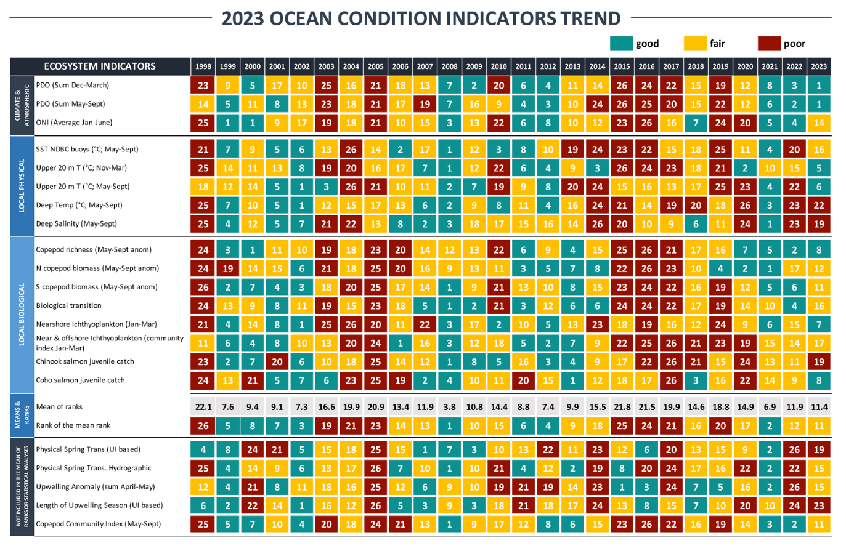
https://www.fisheries.noaa.gov/west-coast/science-data/ocean-conditions-indicators-trends

Slide 4

This one will maximize out-of-sample predictive performance.
Too simple
Just right
Too complex

Slide 5

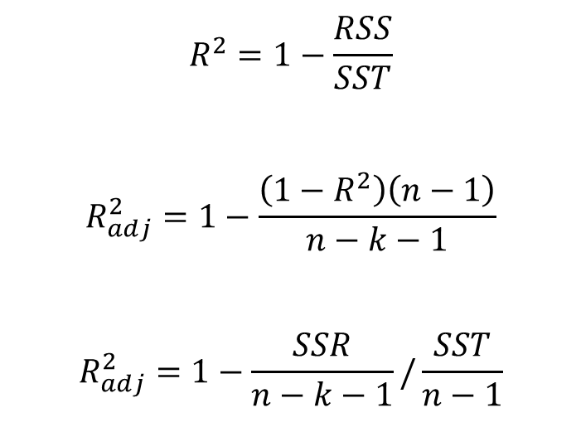
$$R^{2}=1−\frac{RSS}{SST}$$
$$R_{adj}^{2}=1−\frac{\left({1−R}^{2}\right)\left(n−1\right)}{n−k−1}$$
$$R_{adj}^{2}=1−\frac{SSR}{n−k−1}/\frac{SST}{n−1}$$
Always goes up as variables are added
Doesn’t always go up as variables are added
Overfitting.R

Slide 6


Slide 7
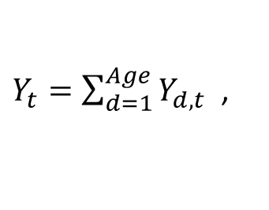
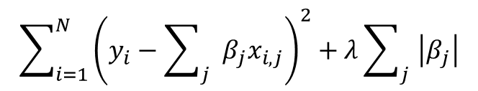

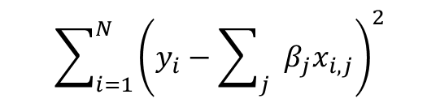
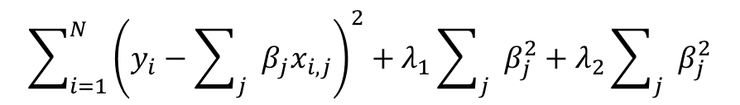
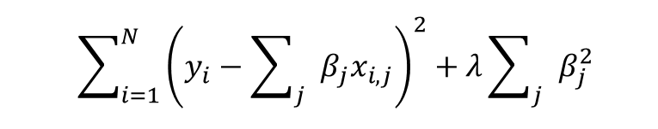
$$\sum_{i=1}^{N}{{\left(y_{i}−\sum_{j}{β_{j}x_{i,j}}\right)}^{2}}$$
Ordinary least squares
Chosen by cross validation
Least absolute shrinkage & selection operator (LASS0)
$$\sum_{i=1}^{N}{{\left(y_{i}−\sum_{j}{β_{j}x_{i,j}}\right)}^{2}}+λ\sum_{j}{\left|β_{j}\right|}$$
$$\sum_{i=1}^{N}{{\left(y_{i}−\sum_{j}{β_{j}x_{i,j}}\right)}^{2}}+λ\sum_{j}{β_{j}^{2}}$$
“Shrinkage” techniques
Ridge regression (RR)
$$\sum_{i=1}^{N}{{\left(y_{i}−\sum_{j}{β_{j}x_{i,j}}\right)}^{2}}+λ_{1}\sum_{j}{β_{j}^{2}}+λ_{2}\sum_{j}{β_{j}^{2}}$$
Elastic Net (EN)
where $\left(1−α\right)\left|β\right|+αβ^{2}$, and $α=\frac{λ_{2}}{λ_{1}+λ_{2}}$
Chosen by human
Sibling Regression
$$Y_{d,t}=a+bY_{d−1,t−1}+ε_{d,t}$$
$Y_{t}=\sum_{d=1}^{Age}{Y_{d,t}}$ ,
$$Var\left(A+B\right)=Var\left(A\right)+Var\left(B\right)+2cov(A,B)$$

Slide 8

Sibling Regression
$$Y_{d,t}=a+bY_{d−1,t−1}+ε_{d,t}$$
 | ages
Run year | 2 | 3 | 4 | 5 | 6 | 7
1975 | 125 | 89 | 237 | 122 | 5 | 0
1976 | 80 | 57 | 152 | 78 | 3 | 0
1977 | 136 | 96 | 257 | 132 | 5 | 0
1978 | 259 | 184 | 490 | 252 | 10 | 0
1979 | 232 | 165 | 439 | 226 | 9 | 0
1980 | 450 | 320 | 853 | 439 | 18 | 0
1981 | 575 | 409 | 1090 | 560 | 22 | 0
1982 | 653 | 464 | 1238 | 636 | 25 | 0
1983 | 1011 | 718 | 1914 | 984 | 39 | 0
1984 | 1687 | 1199 | 3196 | 1643 | 66 | 0
1985 | 6399 | 639 | 4075 | 494 | 0 | 0
1986 | 1353 | 1445 | 833 | 1199 | 43 | 0
1987 | 1618 | 1023 | 5048 | 552 | 0 | 0
1988 | 344 | 1938 | 3773 | 3394 | 122 | 0
1989 | 4026 | 3301 | 8395 | 4017 | 92 | 0
1990 | 442 | 2026 | 3729 | 2993 | 433 | 0
1991 | 5349 | 2749 | 11208 | 3274 | 149 | 0
1992 | 1917 | 3849 | 8784 | 6317 | 102 | 0
1993 | 689 | 1534 | 3043 | 3499 | 45 | 0
Age 3, time t+1
Age 2, time t

Slide 9
Sibling Regression
$$Y_{d,t}=a+bY_{d−1,t−1}+ε_{d,t}$$
 | ages
Run year | 2 | 3 | 4 | 5 | 6 | 7
1975 | 125 | 89 | 237 | 122 | 5 | 0
1976 | 80 | 57 | 152 | 78 | 3 | 0
1977 | 136 | 96 | 257 | 132 | 5 | 0
1978 | 259 | 184 | 490 | 252 | 10 | 0
1979 | 232 | 165 | 439 | 226 | 9 | 0
1980 | 450 | 320 | 853 | 439 | 18 | 0
1981 | 575 | 409 | 1090 | 560 | 22 | 0
1982 | 653 | 464 | 1238 | 636 | 25 | 0
1983 | 1011 | 718 | 1914 | 984 | 39 | 0
1984 | 1687 | 1199 | 3196 | 1643 | 66 | 0
1985 | 6399 | 639 | 4075 | 494 | 0 | 0
1986 | 1353 | 1445 | 833 | 1199 | 43 | 0
1987 | 1618 | 1023 | 5048 | 552 | 0 | 0
1988 | 344 | 1938 | 3773 | 3394 | 122 | 0
1989 | 4026 | 3301 | 8395 | 4017 | 92 | 0
1990 | 442 | 2026 | 3729 | 2993 | 433 | 0
1991 | 5349 | 2749 | 11208 | 3274 | 149 | 0
1992 | 1917 | 3849 | 8784 | 6317 | 102 | 0
1993 | 689 | 1534 | 3043 | 3499 | 45 | 0
Age 3, time t+1
Age 2, time t

Slide 10
Sibling Regression
$$Y_{d,t}=a+bY_{d−1,t−1}+ε_{d,t}$$
 | ages
Run year | 2 | 3 | 4 | 5 | 6 | 7
1975 | 125 | 89 | 237 | 122 | 5 | 0
1976 | 80 | 57 | 152 | 78 | 3 | 0
1977 | 136 | 96 | 257 | 132 | 5 | 0
1978 | 259 | 184 | 490 | 252 | 10 | 0
1979 | 232 | 165 | 439 | 226 | 9 | 0
1980 | 450 | 320 | 853 | 439 | 18 | 0
1981 | 575 | 409 | 1090 | 560 | 22 | 0
1982 | 653 | 464 | 1238 | 636 | 25 | 0
1983 | 1011 | 718 | 1914 | 984 | 39 | 0
1984 | 1687 | 1199 | 3196 | 1643 | 66 | 0
1985 | 6399 | 639 | 4075 | 494 | 0 | 0
1986 | 1353 | 1445 | 833 | 1199 | 43 | 0
1987 | 1618 | 1023 | 5048 | 552 | 0 | 0
1988 | 344 | 1938 | 3773 | 3394 | 122 | 0
1989 | 4026 | 3301 | 8395 | 4017 | 92 | 0
1990 | 442 | 2026 | 3729 | 2993 | 433 | 0
1991 | 5349 | 2749 | 11208 | 3274 | 149 | 0
1992 | 1917 | 3849 | 8784 | 6317 | 102 | 0
1993 | 689 | 1534 | 3043 | 3499 | 45 | 0
Age 3, time t+1
Age 2, time t

Slide 11
Sibling Regression
$$Y_{d,t}=a+bY_{d−1,t−1}+ε_{d,t}$$
 | ages
Run year | 2 | 3 | 4 | 5 | 6 | 7
1975 | 125 | 89 | 237 | 122 | 5 | 0
1976 | 80 | 57 | 152 | 78 | 3 | 0
1977 | 136 | 96 | 257 | 132 | 5 | 0
1978 | 259 | 184 | 490 | 252 | 10 | 0
1979 | 232 | 165 | 439 | 226 | 9 | 0
1980 | 450 | 320 | 853 | 439 | 18 | 0
1981 | 575 | 409 | 1090 | 560 | 22 | 0
1982 | 653 | 464 | 1238 | 636 | 25 | 0
1983 | 1011 | 718 | 1914 | 984 | 39 | 0
1984 | 1687 | 1199 | 3196 | 1643 | 66 | 0
1985 | 6399 | 639 | 4075 | 494 | 0 | 0
1986 | 1353 | 1445 | 833 | 1199 | 43 | 0
1987 | 1618 | 1023 | 5048 | 552 | 0 | 0
1988 | 344 | 1938 | 3773 | 3394 | 122 | 0
1989 | 4026 | 3301 | 8395 | 4017 | 92 | 0
1990 | 442 | 2026 | 3729 | 2993 | 433 | 0
1991 | 5349 | 2749 | 11208 | 3274 | 149 | 0
1992 | 1917 | 3849 | 8784 | 6317 | 102 | 0
1993 | 689 | 1534 | 3043 | 3499 | 45 | 0
Age 3, time t+1
Age 2, time t

Slide 12
Sibling Regression
$$Y_{d,t}=a+bY_{d−1,t−1}+ε_{d,t}$$
 | ages
Run year | 2 | 3 | 4 | 5 | 6 | 7
1975 | 125 | 89 | 237 | 122 | 5 | 0
1976 | 80 | 57 | 152 | 78 | 3 | 0
1977 | 136 | 96 | 257 | 132 | 5 | 0
1978 | 259 | 184 | 490 | 252 | 10 | 0
1979 | 232 | 165 | 439 | 226 | 9 | 0
1980 | 450 | 320 | 853 | 439 | 18 | 0
1981 | 575 | 409 | 1090 | 560 | 22 | 0
1982 | 653 | 464 | 1238 | 636 | 25 | 0
1983 | 1011 | 718 | 1914 | 984 | 39 | 0
1984 | 1687 | 1199 | 3196 | 1643 | 66 | 0
1985 | 6399 | 639 | 4075 | 494 | 0 | 0
1986 | 1353 | 1445 | 833 | 1199 | 43 | 0
1987 | 1618 | 1023 | 5048 | 552 | 0 | 0
1988 | 344 | 1938 | 3773 | 3394 | 122 | 0
1989 | 4026 | 3301 | 8395 | 4017 | 92 | 0
1990 | 442 | 2026 | 3729 | 2993 | 433 | 0
1991 | 5349 | 2749 | 11208 | 3274 | 149 | 0
1992 | 1917 | 3849 | 8784 | 6317 | 102 | 0
1993 | 689 | 1534 | 3043 | 3499 | 45 | 0
Age 3, time t+1
Age 2, time t

Slide 13
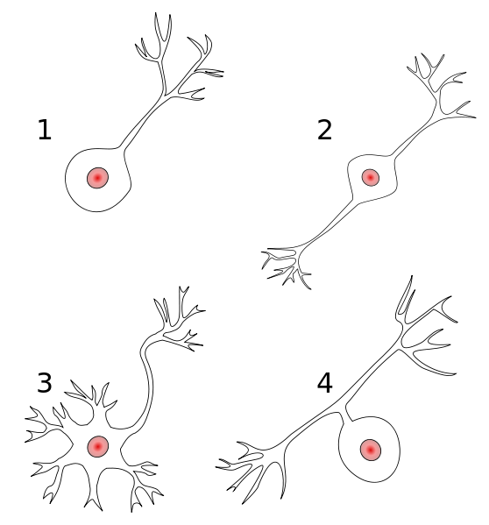
Biological Neural Networks
Output
If Σ(inputs)>crit, then 1
else 0
Input

Slide 14
Artificial Neural Network (ANN)
w_{j,i}
Σ
f
Ocean Nino Index, x₁
βj=1
Σ
βj=2
f
w_{j=1}
Σ
βj=3
f
N. Pacific Gyre, x₂
Σ
f
βj=4
Σ
f_{out}
y
Σ
f
βout
Upwelling Index, x₃
βj=5
Σ
f
βj=6
w_{j=8}
Σ
f
Pacific Decadal Oscillation, x₄
βj=7
Σ
f
βj=8
Input Layer
Hidden Layer
Output Layer

Slide 15

“…computational models are very appealing in application domains where one has little or incomplete understanding of the problem to be solved but where training data are readily available.”
Pros
Cons
Model complex phenomena
nonlinear systems
many covariates
interactions among covariates
feedback loops
Great at pattern recognition
classification
prediction
“Universal” approximator
arbitrary degree of fitting
“Black box”
What is the effect of X on Y?
Useless for hypothesis testing
Most useful when data are abundant
Overfitting is a big issue!

Slide 16


Slide 17
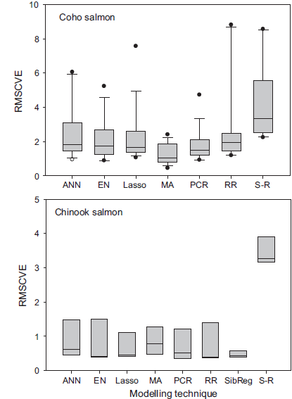

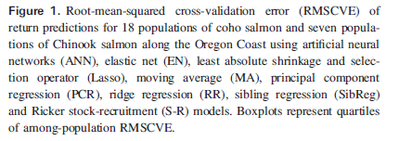

Slide 18
Leave one out cross validation (LOOCV)
Run Year | Abundance | Predictor1 | Predictor2
2001 | 3211 | 1.2 | 5.64
2002 | 3473 | -0.03 | 9.55
2003 | 2918 | -0.58 | 9.15
2004 | 7791 | -1.91 | 6.15
2005 | 2318 | 1.99 | 6.23
2006 | 2321 | -0.44 | 8.79
2007 | 5226 | -1.44 | 7.32
2008 | 6730 | -1 | 9.47
2009 | 8750 | 1.9 | 8.82
2010 | 7263 | 0.57 | 6.34
2011 | 4741 | 0.98 | 6.25
2012 | 6474 | 1.58 | 7.49
2013 | 1617 | -0.43 | 7.38
2014 | 4854 | 0.54 | 9.63
2015 | 8820 | 1.71 | 7.79
2016 | 2368 | -0.16 | 9.95
2017 | 2916 | 0.66 | 7.46
2018 | 2204 | 0.12 | 8.04
2019 | 3704 | -1.21 | 7.12
2020 | 7887 | 2 | 8.03
2021 | 4222 | -1.73 | 6.9
2022 | 1330 | -1.13 | 5.6
2023 | 5103 | 1.99 | 5.35
2024 | 7852 | -0.96 | 8.42
FORECAST
MODEL

Slide 19
Leave one out cross validation (LOOCV)
Run Year | Abundance | Predictor1 | Predictor2
2001 | 3211 | 1.2 | 5.64
2002 | 3473 | -0.03 | 9.55
2003 | 2918 | -0.58 | 9.15
2004 | 7791 | -1.91 | 6.15
2005 | 2318 | 1.99 | 6.23
2006 | 2321 | -0.44 | 8.79
2007 | 5226 | -1.44 | 7.32
2008 | 6730 | -1 | 9.47
2009 | 8750 | 1.9 | 8.82
2010 | 7263 | 0.57 | 6.34
2011 | 4741 | 0.98 | 6.25
2012 | 6474 | 1.58 | 7.49
2013 | 1617 | -0.43 | 7.38
2014 | 4854 | 0.54 | 9.63
2015 | 8820 | 1.71 | 7.79
2016 | 2368 | -0.16 | 9.95
2017 | 2916 | 0.66 | 7.46
2018 | 2204 | 0.12 | 8.04
2019 | 3704 | -1.21 | 7.12
2020 | 7887 | 2 | 8.03
2021 | 4222 | -1.73 | 6.9
2022 | 1330 | -1.13 | 5.6
2023 | 5103 | 1.99 | 5.35
2024 | 7852 | -0.96 | 8.42
FORECAST
MODEL

Slide 20
Leave one out cross validation (LOOCV)
Run Year | Abundance | Predictor1 | Predictor2
2001 | 3211 | 1.2 | 5.64
2002 | 3473 | -0.03 | 9.55
2003 | 2918 | -0.58 | 9.15
2004 | 7791 | -1.91 | 6.15
2005 | 2318 | 1.99 | 6.23
2006 | 2321 | -0.44 | 8.79
2007 | 5226 | -1.44 | 7.32
2008 | 6730 | -1 | 9.47
2009 | 8750 | 1.9 | 8.82
2010 | 7263 | 0.57 | 6.34
2011 | 4741 | 0.98 | 6.25
2012 | 6474 | 1.58 | 7.49
2013 | 1617 | -0.43 | 7.38
2014 | 4854 | 0.54 | 9.63
2015 | 8820 | 1.71 | 7.79
2016 | 2368 | -0.16 | 9.95
2017 | 2916 | 0.66 | 7.46
2018 | 2204 | 0.12 | 8.04
2019 | 3704 | -1.21 | 7.12
2020 | 7887 | 2 | 8.03
2021 | 4222 | -1.73 | 6.9
2022 | 1330 | -1.13 | 5.6
2023 | 5103 | 1.99 | 5.35
2024 | 7852 | -0.96 | 8.42
FORECAST
MODEL

Slide 21
Leave one out cross validation (LOOCV)
Run Year | Abundance | Predictor1 | Predictor2
2001 | 3211 | 1.2 | 5.64
2002 | 3473 | -0.03 | 9.55
2003 | 2918 | -0.58 | 9.15
2004 | 7791 | -1.91 | 6.15
2005 | 2318 | 1.99 | 6.23
2006 | 2321 | -0.44 | 8.79
2007 | 5226 | -1.44 | 7.32
2008 | 6730 | -1 | 9.47
2009 | 8750 | 1.9 | 8.82
2010 | 7263 | 0.57 | 6.34
2011 | 4741 | 0.98 | 6.25
2012 | 6474 | 1.58 | 7.49
2013 | 1617 | -0.43 | 7.38
2014 | 4854 | 0.54 | 9.63
2015 | 8820 | 1.71 | 7.79
2016 | 2368 | -0.16 | 9.95
2017 | 2916 | 0.66 | 7.46
2018 | 2204 | 0.12 | 8.04
2019 | 3704 | -1.21 | 7.12
2020 | 7887 | 2 | 8.03
2021 | 4222 | -1.73 | 6.9
2022 | 1330 | -1.13 | 5.6
2023 | 5103 | 1.99 | 5.35
2024 | 7852 | -0.96 | 8.42
FORECAST
MODEL

Slide 22
Leave one out cross validation (LOOCV)
Run Year | Abundance | Predictor1 | Predictor2
2001 | 3211 | 1.2 | 5.64
2002 | 3473 | -0.03 | 9.55
2003 | 2918 | -0.58 | 9.15
2004 | 7791 | -1.91 | 6.15
2005 | 2318 | 1.99 | 6.23
2006 | 2321 | -0.44 | 8.79
2007 | 5226 | -1.44 | 7.32
2008 | 6730 | -1 | 9.47
2009 | 8750 | 1.9 | 8.82
2010 | 7263 | 0.57 | 6.34
2011 | 4741 | 0.98 | 6.25
2012 | 6474 | 1.58 | 7.49
2013 | 1617 | -0.43 | 7.38
2014 | 4854 | 0.54 | 9.63
2015 | 8820 | 1.71 | 7.79
2016 | 2368 | -0.16 | 9.95
2017 | 2916 | 0.66 | 7.46
2018 | 2204 | 0.12 | 8.04
2019 | 3704 | -1.21 | 7.12
2020 | 7887 | 2 | 8.03
2021 | 4222 | -1.73 | 6.9
2022 | 1330 | -1.13 | 5.6
2023 | 5103 | 1.99 | 5.35
2024 | 7852 | -0.96 | 8.42
FORECAST
MODEL

Slide 23
Leave one out cross validation (LOOCV)
Run Year | Abundance | Predictor1 | Predictor2
2001 | 3211 | 1.2 | 5.64
2002 | 3473 | -0.03 | 9.55
2003 | 2918 | -0.58 | 9.15
2004 | 7791 | -1.91 | 6.15
2005 | 2318 | 1.99 | 6.23
2006 | 2321 | -0.44 | 8.79
2007 | 5226 | -1.44 | 7.32
2008 | 6730 | -1 | 9.47
2009 | 8750 | 1.9 | 8.82
2010 | 7263 | 0.57 | 6.34
2011 | 4741 | 0.98 | 6.25
2012 | 6474 | 1.58 | 7.49
2013 | 1617 | -0.43 | 7.38
2014 | 4854 | 0.54 | 9.63
2015 | 8820 | 1.71 | 7.79
2016 | 2368 | -0.16 | 9.95
2017 | 2916 | 0.66 | 7.46
2018 | 2204 | 0.12 | 8.04
2019 | 3704 | -1.21 | 7.12
2020 | 7887 | 2 | 8.03
2021 | 4222 | -1.73 | 6.9
2022 | 1330 | -1.13 | 5.6
2023 | 5103 | 1.99 | 5.35
2024 | 7852 | -0.96 | 8.42
FORECAST
MODEL

Slide 24
Leave one out cross validation (LOOCV)
Run Year | Abundance | Predictor1 | Predictor2
2001 | 3211 | 1.2 | 5.64
2002 | 3473 | -0.03 | 9.55
2003 | 2918 | -0.58 | 9.15
2004 | 7791 | -1.91 | 6.15
2005 | 2318 | 1.99 | 6.23
2006 | 2321 | -0.44 | 8.79
2007 | 5226 | -1.44 | 7.32
2008 | 6730 | -1 | 9.47
2009 | 8750 | 1.9 | 8.82
2010 | 7263 | 0.57 | 6.34
2011 | 4741 | 0.98 | 6.25
2012 | 6474 | 1.58 | 7.49
2013 | 1617 | -0.43 | 7.38
2014 | 4854 | 0.54 | 9.63
2015 | 8820 | 1.71 | 7.79
2016 | 2368 | -0.16 | 9.95
2017 | 2916 | 0.66 | 7.46
2018 | 2204 | 0.12 | 8.04
2019 | 3704 | -1.21 | 7.12
2020 | 7887 | 2 | 8.03
2021 | 4222 | -1.73 | 6.9
2022 | 1330 | -1.13 | 5.6
2023 | 5103 | 1.99 | 5.35
2024 | 7852 | -0.96 | 8.42
FORECAST
MODEL

Slide 25

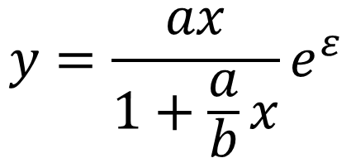

$$y=\frac{ax}{1+\frac{a}{b}x}e^{ε}$$
Correct model
$y= α+ βx+ε$
Incorrect model
$$ε \sim Normal(0, σ)$$
LOOCV.R

Slide 26
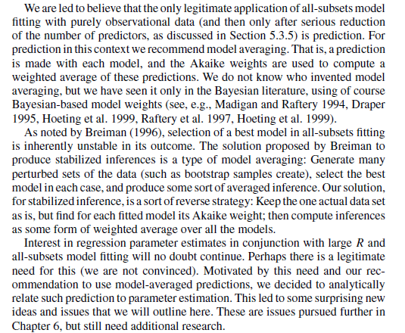
Burnham and Anderson 2002 page 252
Model Averaging

Slide 27
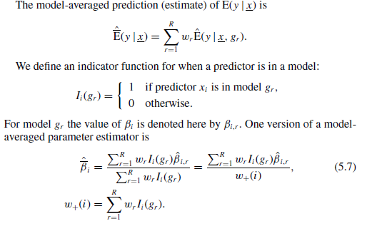
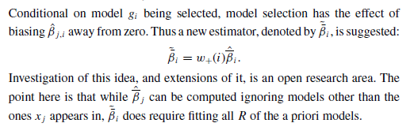
Burnham and Anderson 2002
page 252 and 449
Model Averaging

Slide 28

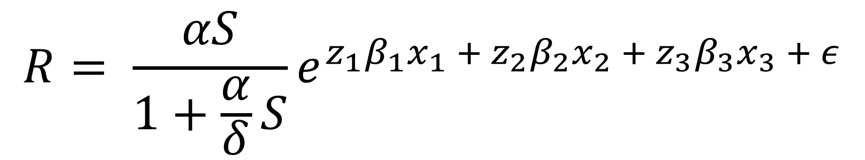


Reversible Jump Markov Chain Monte Carlo
Kuo and Mallick (1998) with Beverton-Holt
True Model
β₁ = 0.4
β₂ = -0.2
β₃ = NA
$$\left.p_{i}\sim beta(1,1\right)$$
$$\left.z_{i}\sim Bernoulli(p_{i}\right)$$
$$R= \frac{αS}{1+\frac{α}{δ}S}e^{z_{1}β_{1}x_{1} + z_{2}β_{2}x_{2} + z_{3}β_{3}x_{3} + ε}$$
$$ε\sim Normal(0,σ)$$

Slide 29

Test results of Kuo and Mallick variable selection
$$β_{i}| z_{i}=1$$

