Slide 1


Washington-British Columbia & Idaho Chapter American Fisheries Society
2024 Joint Annual Meeting
Salmon Forecasting Workshop
April 29, 2024
Mark Scheuerell
Assistant Unit Leader
Washington Cooperative Fish and Wildlife Research Unit
University of Washington
Matt Falcy
Assistant Unit Leader
Idaho Cooperative Fish and Wildlife Research Unit
University of Idaho

Slide 2

Salmon live in vast, diverse, and dynamic environments. They are difficult to detect. The solution to the “forecasting problem” may not be better forecast math, but better means of coping with uncertainty.
Decision-making

Slide 3
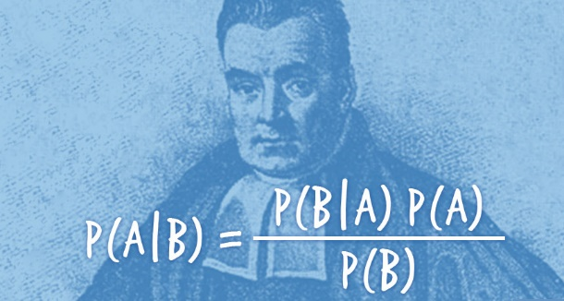
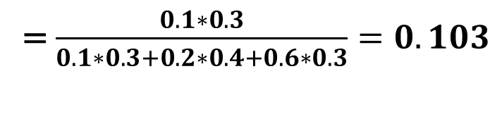
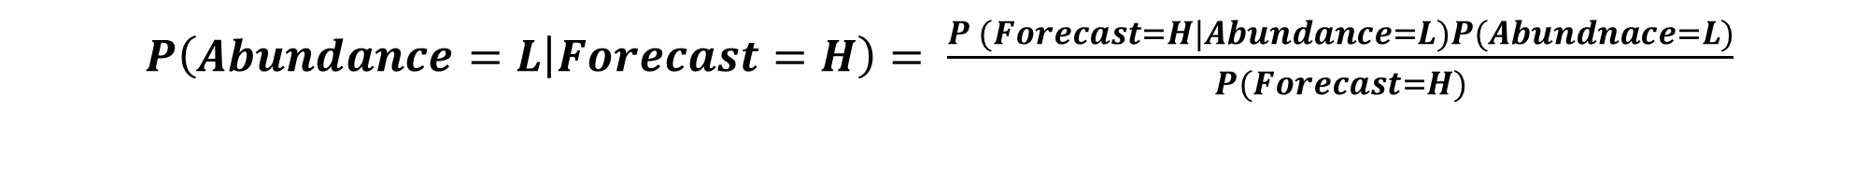
 |  | Marginal Probability |  | Forecast
 |  |  | Low | Medium | High
Abundance | Low | 0.3 | 0.6 | 0.3 | 0.1
 | Medium | 0.4 | 0.2 | 0.6 | 0.2
 | High | 0.3 | 0.1 | 0.3 | 0.6
Bayes
Table 1. Marginal probabilities of three levels of abundance and uncertainty in the forecast of abundance.
This year’s forecast is High. What is the probability that the abundance is actually Low?
$P\left(Abundance=L | Forecast=H\right)= \frac{P (Forecast=H|Abundance=L)P(Abundnace=L)}{P(Forecast=H)}$
= $\frac{0.1∗0.3}{0.1∗0.3+0.2∗0.4+0.6∗0.3}=0.103$

Slide 4

 |  | Marginal Probability |  | Forecast
 |  |  | Low | Medium | High
Abundance | Low | 0.3 | 0.6 | 0.3 | 0.1
 | Medium | 0.4 | 0.2 | 0.6 | 0.2
 | High | 0.3 | 0.1 | 0.3 | 0.6
Table 1. Marginal probabilities of three levels of abundance and uncertainty in the forecast of abundance.
This year’s forecast is High. What harvest rate should be implemented?
Table 2. Utilities reaped by a decision maker under all possible combinations of abundance and harvest decisions.
 |  | Abundance
 |  | Low | Medium | High
Harvest | Low | 80 | 40 | 10
 | Medium | 30 | 80 | 80
 | High | 0 | 30 | 100
Expected utility low harvest=
$$p\left(low\right)∗80+p\left(med\right)∗40+high(10)$$
Expected utility med harvest=
$$p\left(low\right)∗30+p\left(med\right)∗80+high(80)$$
Choose max
Expected utility high harvest=
$$p\left(low\right)∗0 +p\left(med\right)∗30+high(100)$$

Slide 5
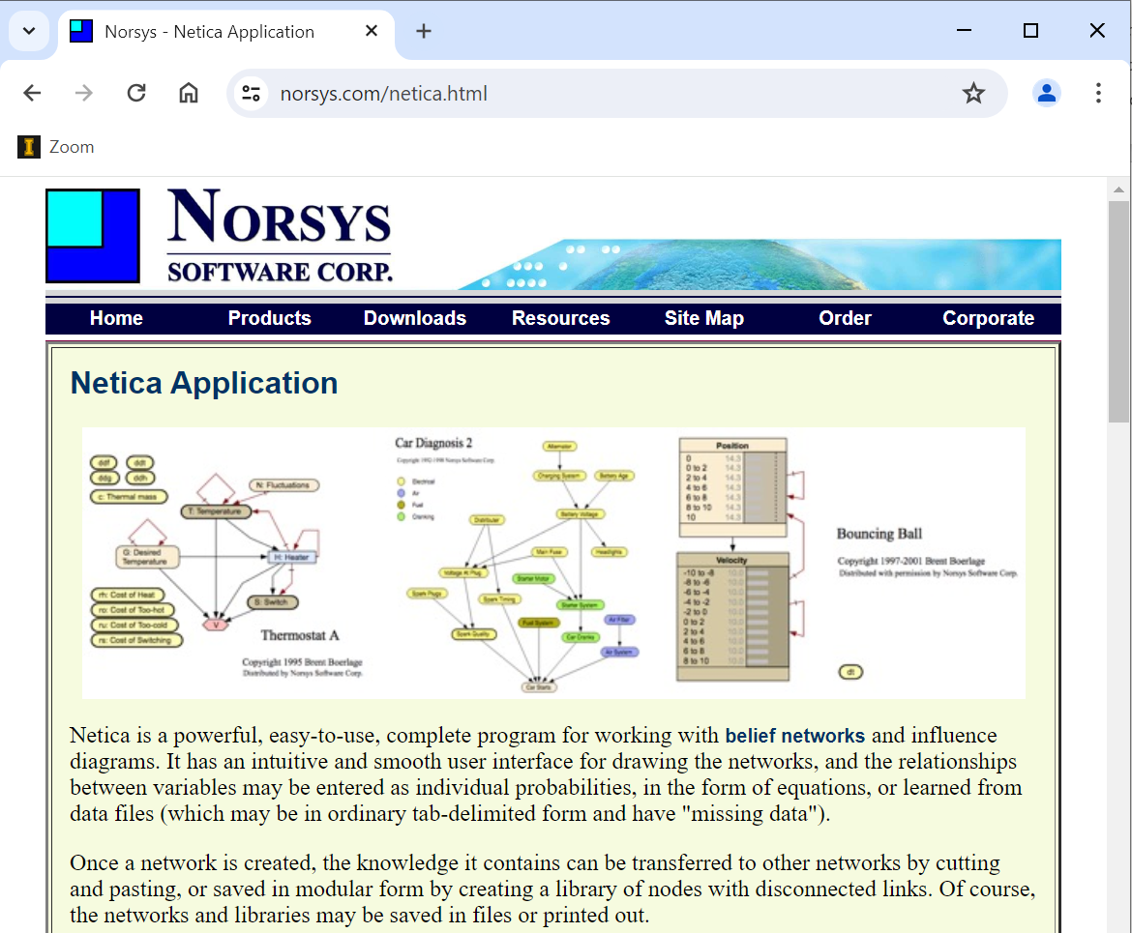
norsys.com/netica.html

Slide 6
Where is the greatest return on investment? (discussion)
Development of better analytical techniques to forecast salmon
AI
Bayesian
?
Data collection efforts
Escapement
Harvest
Age
?
3. Capacity to make decisions under uncertainty
4. ?

Slide 7

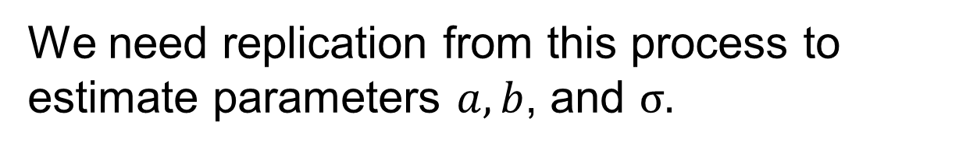

Nonstationarity (discussion)
We need replication from this process to estimate parameters $a, b$, and $σ.$
$$y=\frac{ax}{1+\frac{a}{b}x}e^{ε}$$
What if these parameters vary through time?
$$ε \sim Normal(0,σ)$$
Can a very long time series of data be a bad thing?

