Slide 1
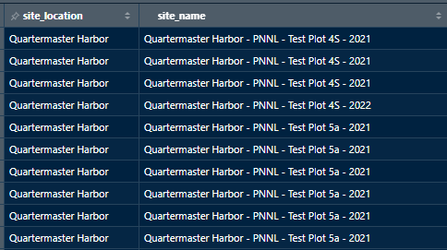
Monitoring records unmatched with Plantings records (GPS point table)

