Slide 1
Need help with sorting about donor site information.
6/22/2026

Slide 2
Reconciling two lists of donor sites from Matrix
Two Issues:
A few records in one table do not match any records in other table
3 donor sites have no GPS coords to place them on a map
Matching record in source 2?
Donor site name
Matching record in source 1?
Missing coords
Donor site name
Anderson Island | Not matched
Bell Point
Creosote Point
Cutts Island
Dumas Bay
DuPont Wharf
Fay Bainbridge
Freshwater Bay
Green Point
Henry Island
Ketron Island
Mitchell Bay
PNNL - MSL Tanks
Point Julia
Quilcene Bay
Rocky Bay
Rocky Point
Sandy Hook
Sandy Point
Shine Beach | Not matched
Ship Harbor
Skagit Bay
Stuart Island
Thompson Cove
Windy Bluff
Bell Point
Creosote Point
Cutts Island sandspit
Dumas Bay
DuPont Wharf
Elwha Delta | Not matched
Fay Bainbridge |  | No coords
Freshwater Bay |  | No coords
Green Point
Henry Island
Ketron Island NW
Mitchell Bay
PNNL - MSL Tanks
Point Julia
Quilcene Bay
Rocky Bay
Rocky Point
Sandy Hook
Sandy Point
Ship Harbor |  | No coords
Skagit Bay
Stuart Island
Thompson Cove
Windy Bluff
Source 1
GPS points table
‘Planting’ table in Matrix
Planting GPS points with planting donor sites
Most donor sites are listed multiple times
When a donor site is used for multiple plantings.
The list shown here is a list of unique donor site names
Source 2
donor_sites table
‘Donor Sites’ table in Matrix with coords & attributes
List of all donor sites with attributes

Slide 3
Issue #1 – two ‘not matching’ records in Source 1
( we can ignore the 1 case of a donor site (Elwha Delta) in Source 2 not matching any plantings)
donor_site_name = ‘Anderson Island’ → slides 4-5
donor_site_name = ‘Shine Beach’ → slide 6

Slide 4
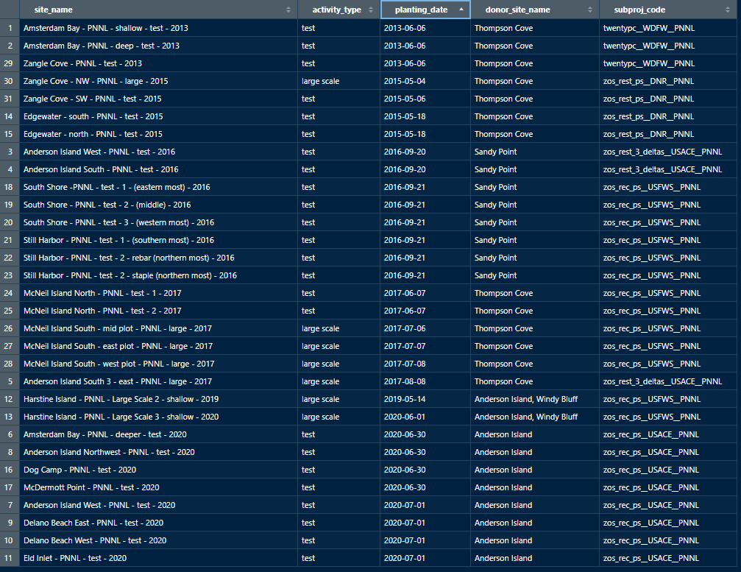
All GPS point records with Anderson Island donor sites
A filtered view of the ‘Planting’ sheet in the Matrix
Sorted by planting date
Sort column
There are 3 donor site names associated with Anderson Island
Donor site name | Years used in plantings
Thompson Cove | 2013-2015, 2017
Sandy Point | 2016
Anderson Island | 2019-2020

Slide 5
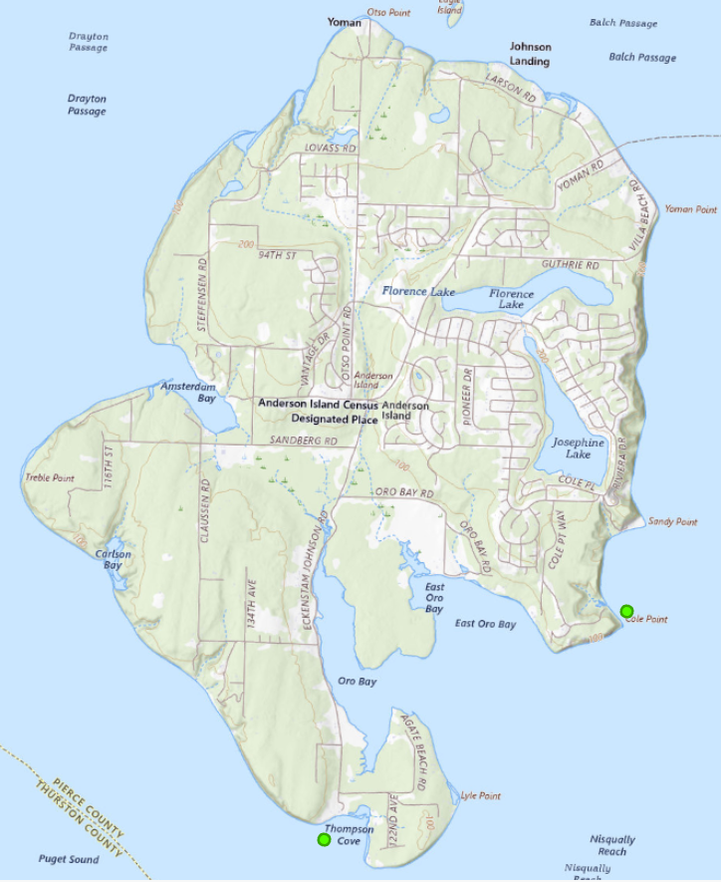
Is the ‘Anderson Island’ donor site the same as either ‘Thompson Cove’ or ‘Sandy Point’?
If it is a different donor site location, can you place a marker on the map to the right to give us a general location for mapping?

Slide 6
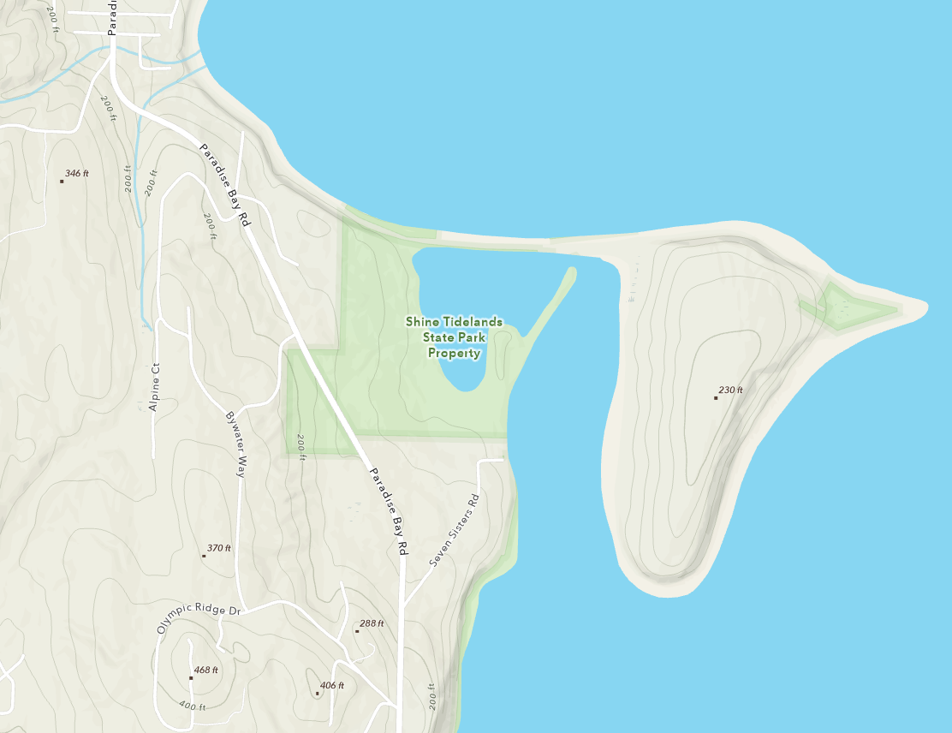
‘Shine Beach’ donor site
Does this donor site name refer to Shine Tidelands State park?
Can you place a marker at approximate location?

Slide 7
Issue #2 – three donor sites with no coordinates
Can you place markers for approximate locations on 3 following slides?

Slide 8
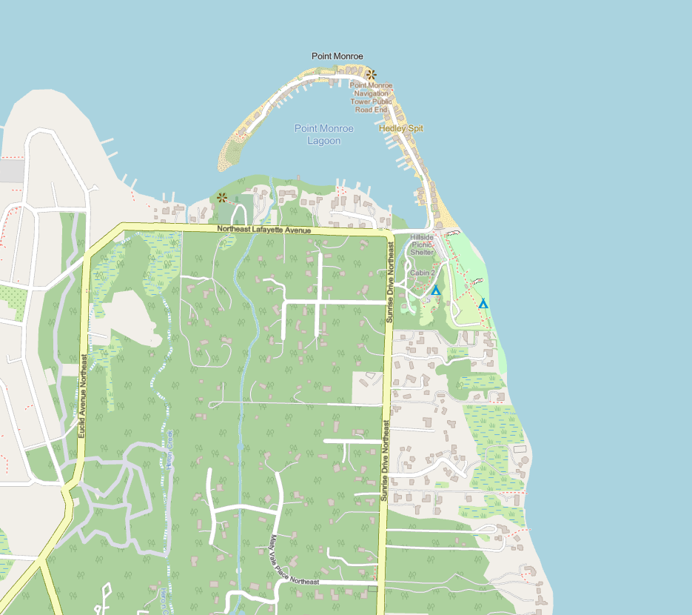
Fay Bainbridge

Slide 9
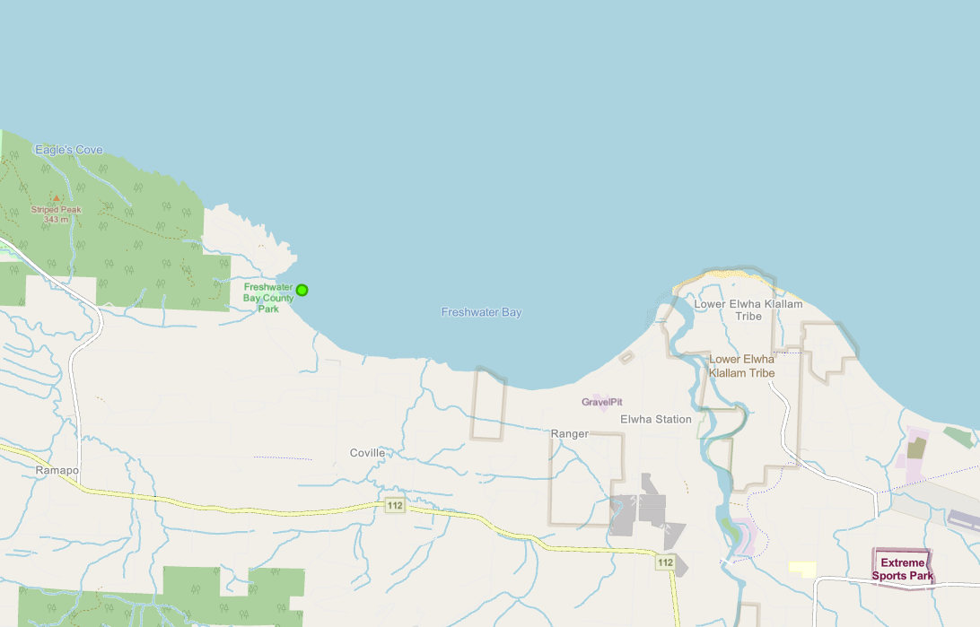
Freshwater Bay

Slide 10
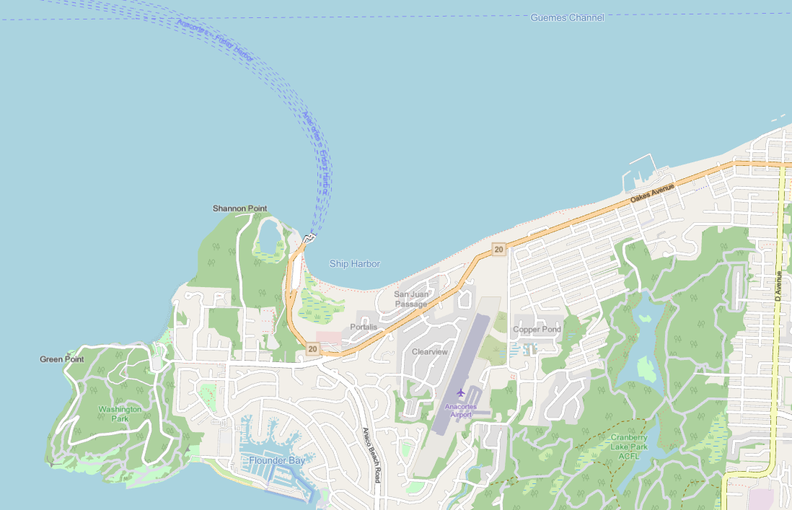
Ship Harbor

