Slide 1



Data for Seagrass Restoration Storymap
This file created Feb 2026 as part of data update and app migration (WAB->EB)
BESE – including both BESE sets for now

Slide 2
Task list
Move to loading individual packages, rather than tidyverse
Add to header records – calling and called functions
logging

Slide 3
Jeff’s responses to slides in donor_site_issues.pptx
Slide 5:
Anderson Island Donor site = Thompson Cove (cps1277). The USACE project primarily harvested from Thompson Cove donor site. This donor site has also been used for other transplant efforts in south Sound. Only 3000 shoots were harvested from the Sandy Point donor site in 2016.
It would be safe to use these coordinates for the Anderson Island / Thompson Cove donor site: 47.1266, -122.7080.
Slide 6:
This test transplant effort was a common garden effort. Eelgrass was harvested from the existing eelgrass bed along the tidelands on Shine Road, Squamish Harbor, and then transplanted into bare areas at -0.9 m (MLLW). I can check my GPS to see if I have coordinates, but an approximate location is 47.866685, -122.672543. It’s also SVMP site hdc2517.
Slide 8: approximate location
Fay Bainbridge = 47.703800, -122.506259
North end of cps1063.
Slide 9:
Freshwater Bay = 48.1463, -123.6368
This is listed in the Donor Sites worksheet as Elwha Delta (site_name) and Freshwater Bay (water_body).
Slide 10: approximate location
Ship Harbor = 48.505130, -122.675595
SVMP site = nps1489

Slide 5
data entry
data processing
go live

Slide 6
import Matrix
data entry
Data processing
go live

Slide 7
new monitoring data entered
make graphs
new planting, donor_site, project data
make View
import Matrix
data entry
data processing
go live

Slide 8

QA Map Viewer
import Matrix
publish Matrix
data entry
make monitoring graphs
make QA database view
go live
local Excel spreadsheet
local file geodatabase
Enter new data Online
Online layers
Online layers (DB)
Online layers (DEV)
Online layers (PROD)
local file geodatabase
local monitoring graphs
Local memory (View)
local file geodatabase
Online layers (DEV)
local monitoring graphs
monitoring graphs on K:
Online layers (View)
monitoring graphs on K:
“local” = local network; C: drive and K: drive if connected to network.

Slide 9





srtools
Startup workflow
Main continuing workflow
Monitoring
Data graphs
(1.5MB, n=124)
matrix
Matrix edit
Import
Matrix
DB
(file geodatabase)
Publish
Matrix
DNR Network
web accessible location
M:\web_data_aqr
6/23/2026
User file system
ArcGIS Online
Make Monitoring Graphs
Data Entry
QA Map Viewer
Feature Layers
Feature Layers
Experience Builder
QA
PROD
Survey 123
DB
(hosted data)
Make DB View
Go Live
DB View
(hosted data)
DB View
(hosted data)

Slide 10
QA Map Viewer
Feature Layers
Feature Layers
Experience Builder
QA
PROD
Survey 123
DB
(hosted data)
Make DB View
Go Live
DB View
(hosted data)
DB View
(hosted data)

Slide 11
srtools
Monitoring
Data graphs
(1.5MB, n=124)
DNR Network
web accessible location
M:\web_data_aqr
User file system
ArcGIS Online
Make Monitoring Graphs
QA Map Viewer
Feature Layers
Feature Layers
Experience Builder
QA
PROD
Survey 123
DB
(hosted data)
Make DB View
Go Live
DB View
(hosted data)
DB View
(hosted data)

Slide 12
srtools
Startup workflow
Main continuing workflow
Monitoring
Data graphs
(1.5MB, n=124)
matrix
Matrix edit
Import
Matrix
DB
(file geodatabase)
Publish
Matrix
DNR Network
web accessible location
M:\web_data_aqr
6/23/2026
User file system
ArcGIS Online
Make Monitoring Graphs
QA Map Viewer
overwrites
Feature Layers
Feature Layers
Experience Builder
appends
QA
PROD
Survey 123
DB
(hosted data)
Make DB View
Go Live
DB View
(hosted data)
DB View
(hosted data)

Slide 13
srtools
Startup workflow
Main continuing workflow
Monitoring
Data graphs
(1.5MB, n=124)
matrix
Matrix edit
Import
Matrix
DB
(file geodatabase)
Publish
Matrix
DNR Network
web accessible location
M:\web_data_aqr
6/23/2026
User file system
ArcGIS Online
Make Monitoring Graphs
Data Entry
QA Map Viewer
Feature Layers
Feature Layers
Experience Builder
QA
PROD
Survey 123
DB
(hosted data)
Make DB View
Go Live
DB View
(hosted data)
DB View
(hosted data)

Slide 15
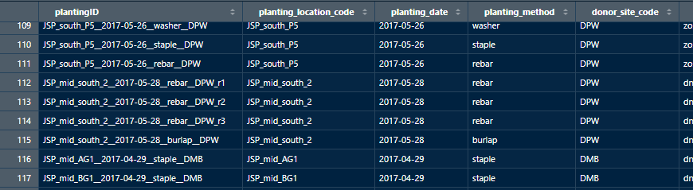
Plantings
Automated construction of unique plantingID
Location – Date – Method
Location – Date – Method – DonorSite
Location – Date – Method – DonorSite – r1
Concatenation of planting attributes to make plantingID
Suffix for replicates
Screenshot of plantings table
Plantings with mixed donor site plants is coded ‘Mix’
Concatenated pieces separated by double underscore “__”

Slide 16
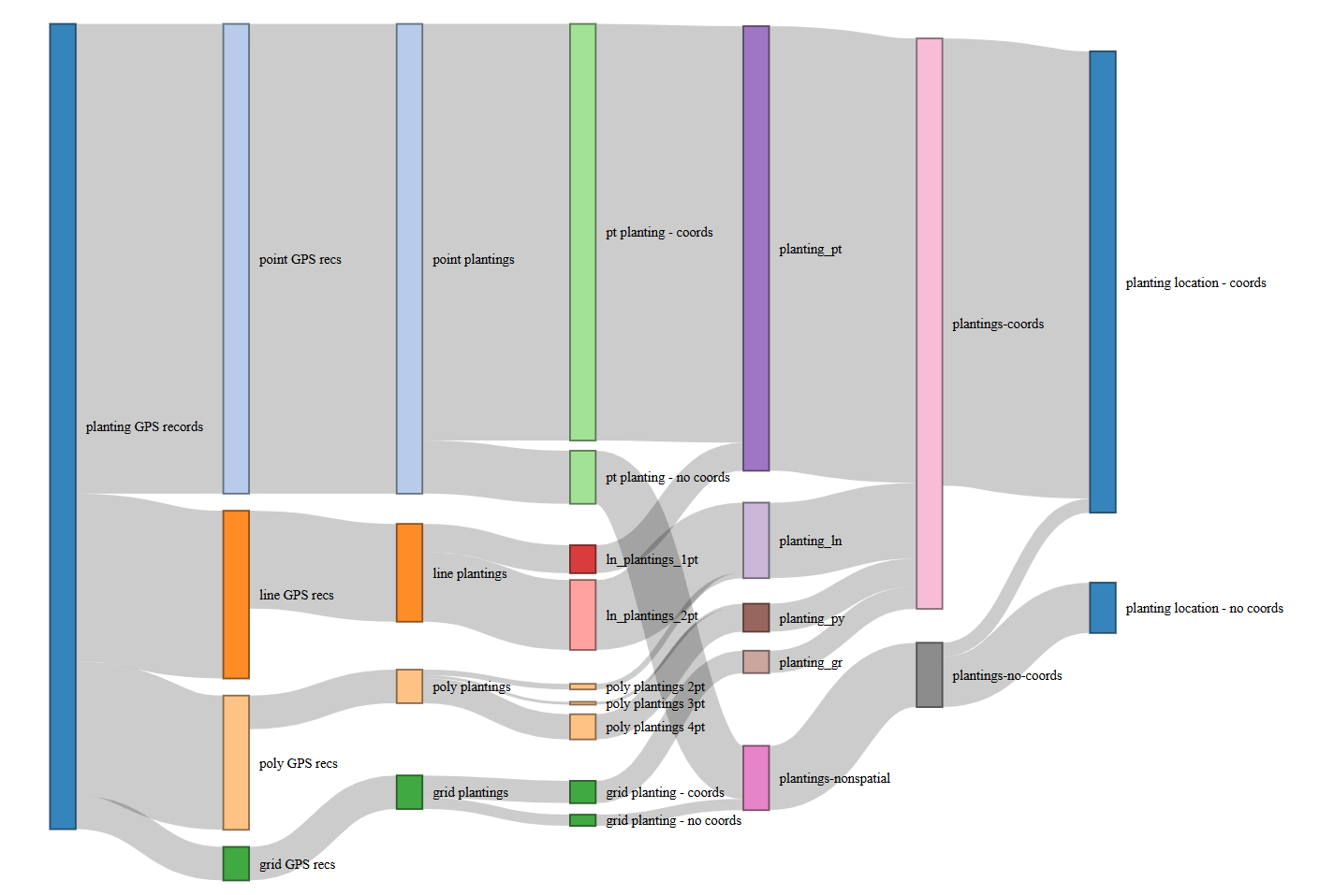
7
1
2
3
4
5
6
point plantings with
coordinates
149
plantings represented as points
159
point GPS records
168
point plantings
168
160
planting locations with
coordinates
plantings with
coordinates
204
160
planting GPS
records
288
19
10
27
60
13
25
10
2
8
23
1
9
48
23
8
4
12

Slide 17
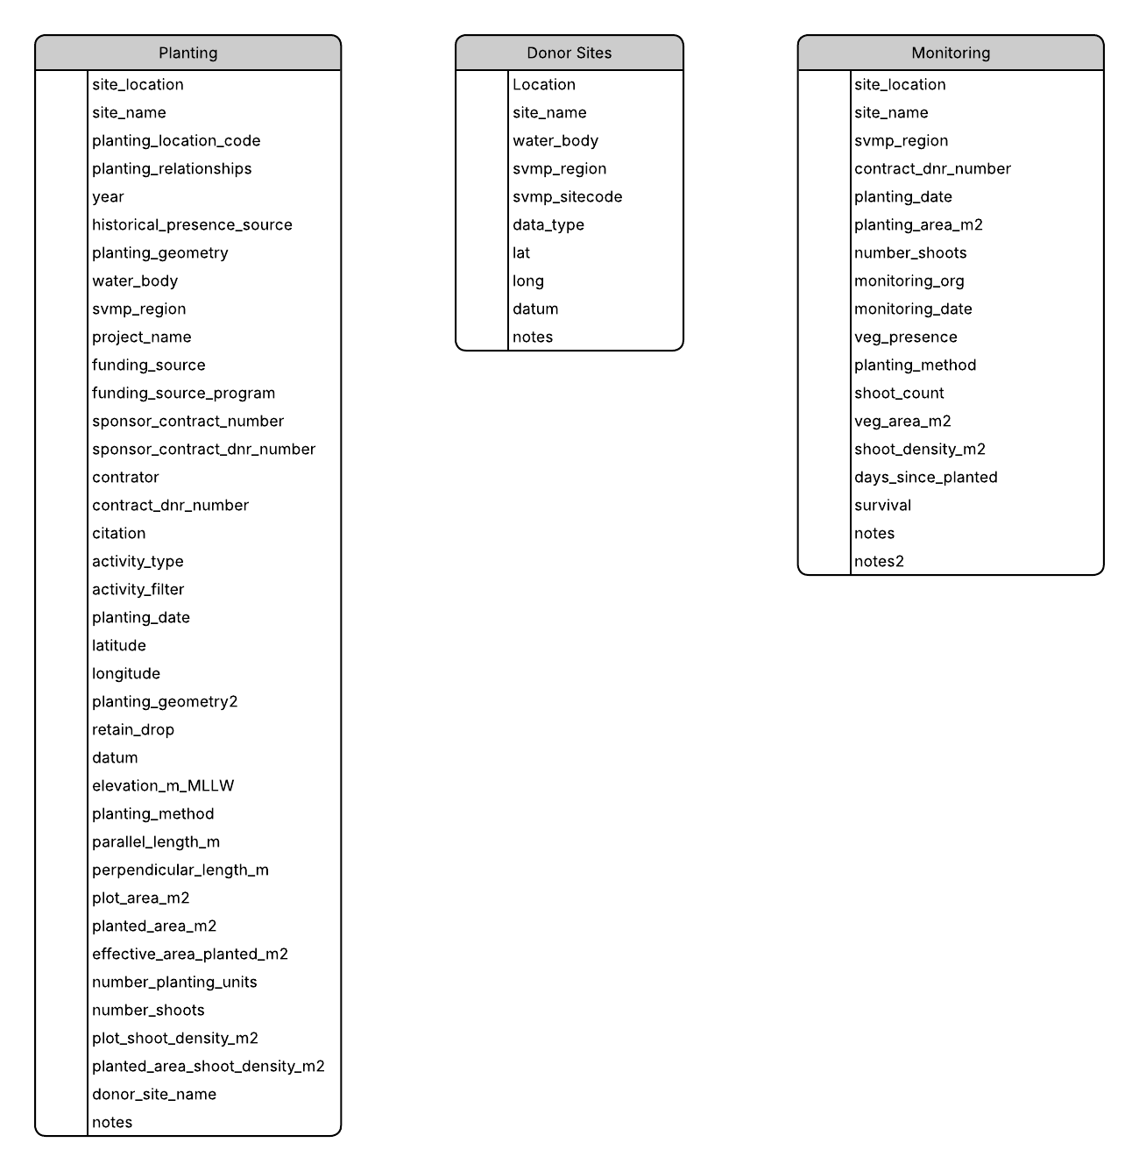
[24, 10]
matrix
[629, 18]
[299, 38]

Slide 18
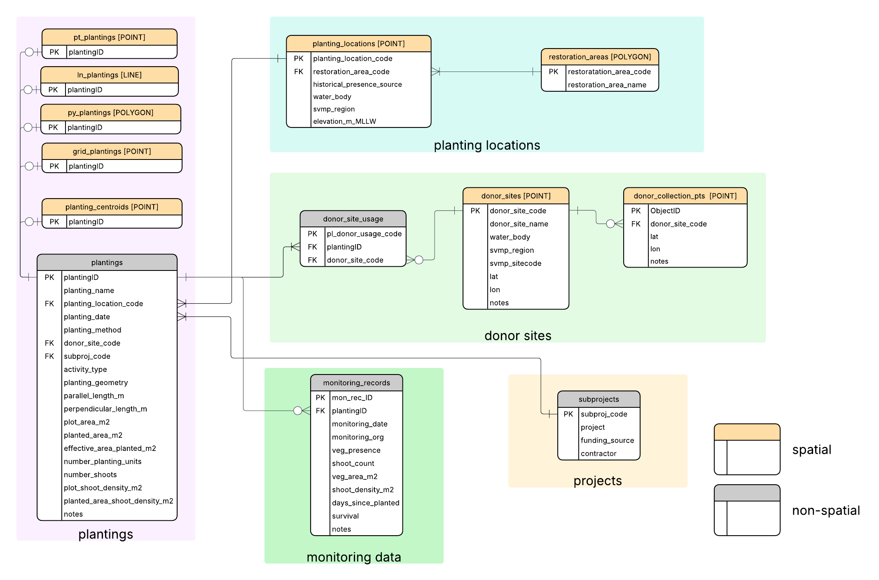
Relational
Database
Entity-relationship (ER) Diagram

Slide 19
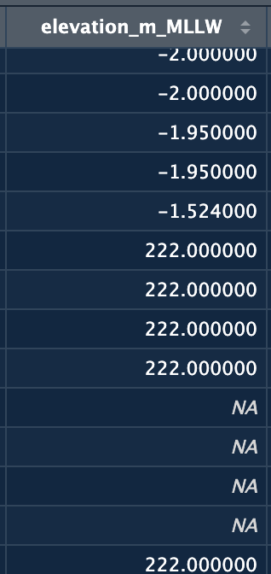
Planting Relationships
Not captured in attributes / counts not determined
Elevation
single
initial
planting locations
one elevation
130
planting locations with
coordinates
160
plantings with
coordinates
204
planting locations
multiple elevations
11
planting locations
elevation is NA
19
collocated
repeat
replicates
planting relationships within a planting occasion
planting relationships across planting occasions

Slide 20
Monitoring
Presence
only
192
Veg_presence
“present”
460
Plantings
With Monitoring data
182
Monitoring records
629
Plantings
227
Monitoring records
Matched with a planting
626
Measurements
268
Plantings
No Monitoring data
45
Veg_presence
“absent”
145
Planting attributes in Monitoring table matching Planting table
Planting_data: 96% matching
Planting_area: 49% matching
Number_shoots: 92% matching
Planting method: 96% matching
Recalculate days_since_planting using planting_date from plantings table
15 monitoring records missing monitoring_date
“unknown”
2
Monitoring records
NOT Matched with a planting
3
NA
19

Slide 21
Data Entry
Planting_locations
planting
Donor_sites
Select existing
Enter new
Sub-project
Monitoring data
Planting
Select existing
Planting_locations
Restoration area
Select existing
Enter new restoration area name
Donor_sites
Donor_collection_pts
Enter new donor site
Enter new donor collection pt
Enter new
Sub-project

Slide 22
Show spatial layers on Maps
Restoration areas – multi-element features

Slide 23
Discussion Points
How to more appropriately represent the methods study ‘grid’ plantings?
Two sets of BESE plantings are now included and none were removed from the Matrix Planting sheet.
Now bringing in ‘Name’ from Matrix (requires an input table for naming when multiple gps-pt-names)
Simplify two notes columns in Monitoring table?
Does the ‘monitoring_collection_points’ layer make sense?
Use of dev & prod
Identified data gaps
Planting table
13 planting locations have no coordinates
11 planting locations with multiple elevations
Line plantings “DEL” extends onto land.
Monitoring
Three monitoring records not linked to plantings (no matching name)
15 records missing monitoring date
21 records no monitoring data (19 have veg_presence=NA; 2 have veg_presence=“unknown”)
plantingID = DB_test_6___2022-06-16__rebar__DPW; has monitoring date (05-31-2022) that precedes the planting date (6-16-2022).

Slide 24
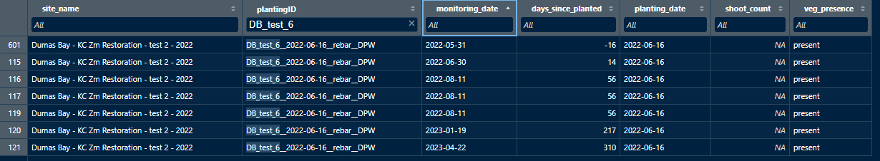
Monitoring data table
Instance of negative value for ‘days_since_planted’
Should the monitoring date by 5/31 but in 2023?

Slide 25
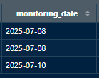
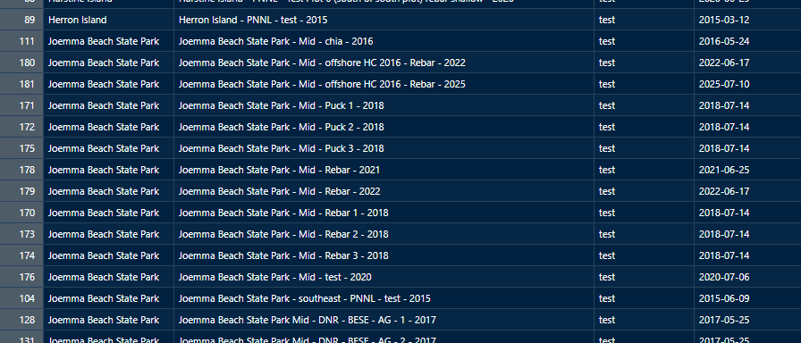
3 Monitoring records - no match to Planting records
Possible matching records from Planting sheet

Slide 26
3 Monitoring records - no match to Planting records
Possible matching records from Planting sheet
Method = ‘rebar’

Slide 27
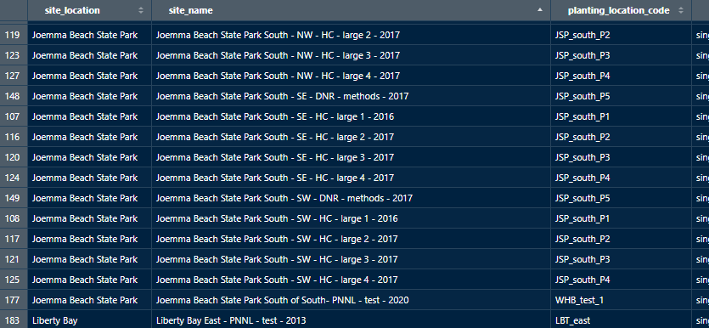
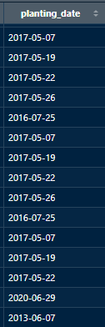
3 Monitoring records - no match to Planting records
Possible matching records from Planting sheet
No planting date match

Slide 28
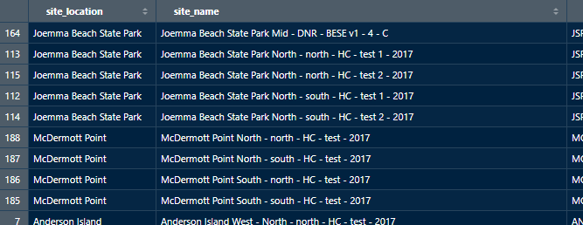
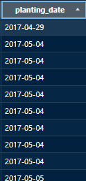
3 Monitoring records - no match to Planting records
Plantings on 5/4/2017

Slide 29
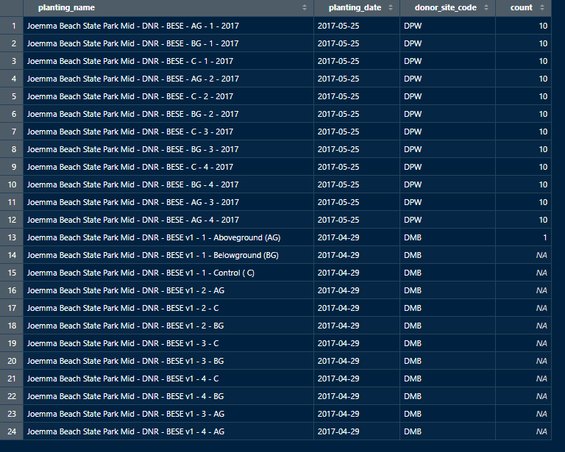
BESE plantings
Meeting notes: “Dumas donor source successful. Dupont Wharf failed”
Count of monitoring records
BESE plantings
Dupont Wharf donor site
Dumas Bay donor site
Notes: “setup was incorrect”

Slide 30
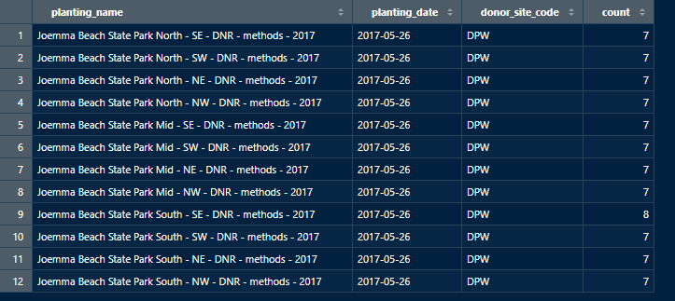
Grid (“methods”) plantings
count of monitoring records

Slide 32
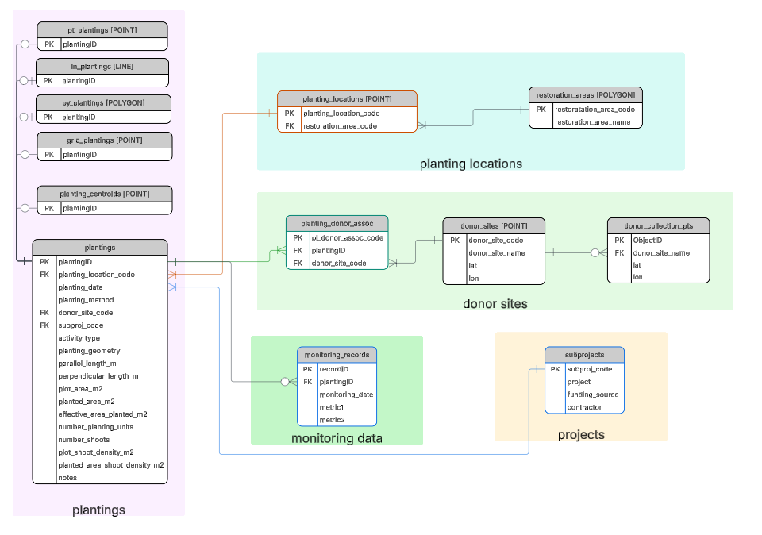
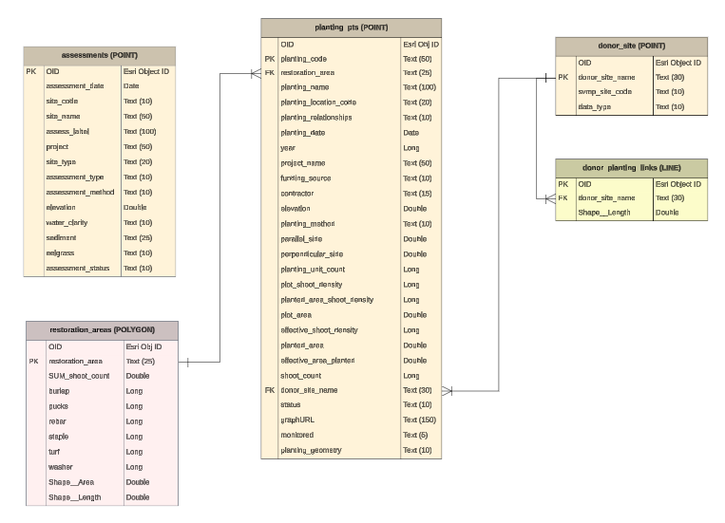

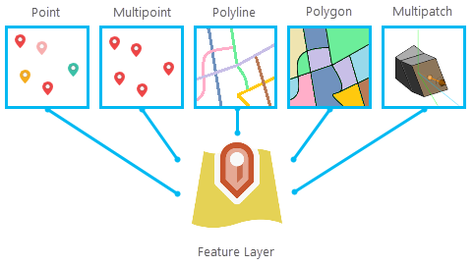
matrix
Enforceable data integrity
Enables automated data manipulation
Enables automated data views
6/23/2026
snapshot
List of edits
Relational database
Monitoring
Data graphs
(1.5MB, n=124)
Organized for human interaction
Supports app UI (Experience B.)
Data
Entry
tables to publish
Survey 123
ArcGIS Online
Publish
Experience Builder
Feature Layer
Sharing

Slide 33
matrix
Enforceable data integrity
Enables automated data manipulation
Enables automated data views
6/23/2026
file system
snapshot
List of edits
Relational database
Monitoring
Data graphs
(1.5MB, n=124)
Organized for human interaction
Supports app UI (Experience B.)
Data
Entry
ArcGIS Online
K:
tables to publish
Survey 123
ArcGIS Online
Publish
Experience Builder
Feature Layer
Sharing

Slide 34
matrix
Enforceable data integrity
Enables automated data manipulation
Enables automated data views
6/23/2026
snapshot
List of edits
K:
Relational database
ArcGIS Online
Monitoring
Data graphs
(1.5MB, n=124)
Organized for human interaction
Supports app UI (Experience B.)
Data
Entry
tables to publish
Survey 123
ArcGIS Online
Publish
Experience Builder
Feature Layer
Sharing

Slide 35
matrix
Matrix edit
DB
(file geodatabase)
6/23/2026
Monitoring
Data graphs
(1.5MB, n=124)
Import
Matrix
Publish
Matrix
List of edits
Make Monitoring Graphs
DNR Network
(web accessible location)
User file system
ArcGIS Online
Go Live
Data
Entry
Make
View-
DEV
QA Map Viewer
Survey 123
DB
(hosted data)
Feature Layer
PROD
Experience Builder
Feature Layer

Slide 36

Workflow requires overwriting the hosted data.
The processing and resulting data reside at the users computer/machine/system.
hosted data
feature layer
Memory
Memory

Slide 37

matrix
Web map for QA
Survey 123
DB - dev
DB - prod
View - prod
Web app
(Experience Builder)

Slide 38
DB - dev
View - dev
Survey 123
Web app DEV
Process
Data
entry
Promote
DB - prod
View - prod
Web app PROD

Slide 39
matrix
Split into:
Process new planting data
Process new monitoring data
Import Matrix
Process
Publish
Experience Builder
Experience Builder
Promote
Workspace (memory)
K:
DB
AppView
Monitoring Graphs
Feature Layer
Feature Layer
ArcGIS Online

Slide 40
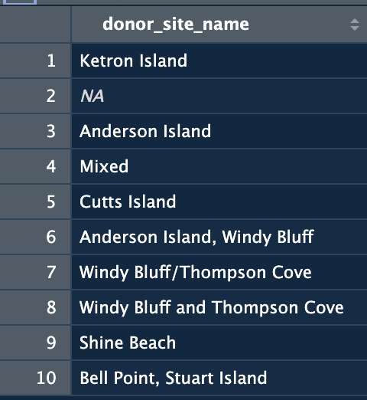
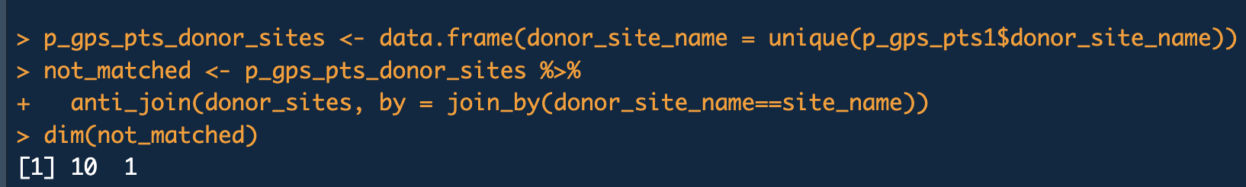

p_gps_pts
donor_sites
(Matrix sheet)
donor_site_codes
(csv file)
29 unique values & NA donor_site_name
30 records (all with site names)
24 unique site names
3 of 24 without coords
25 donor sites + Mixed
donor_site_name
site_name
donor_site_name
donor_site_code
not matched
Add a Mixed logical variable to planting_donor_assoc
5 donor site in gps_pts not matched in donor_sites table:
Ketron Island
Anderson Island
Cutts Island
Shine Beach
Stuart Island

Slide 41
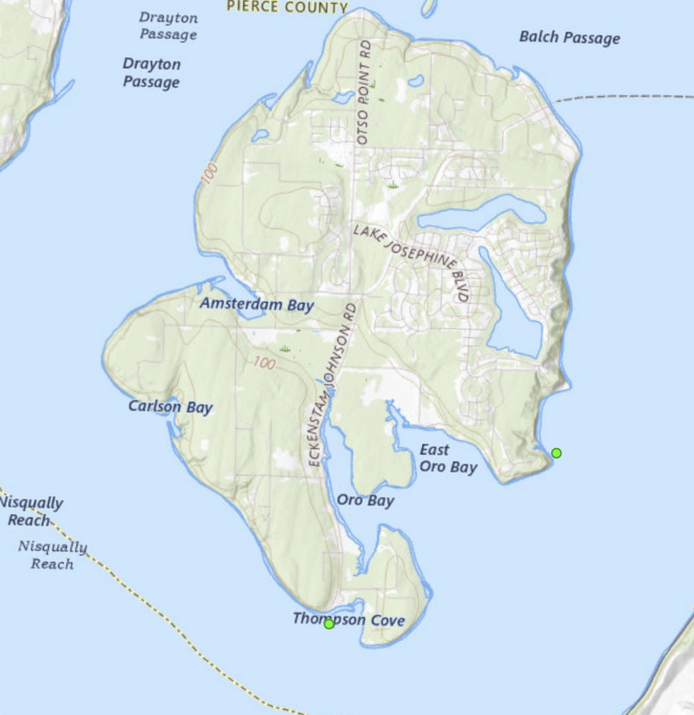
Step through donor_sites from matrix and refer to map for any ambiguity
Create csv with vicinity, name, alt name
Identify cases with no coords and add coords
Issue 1: ambiguity in donor sites listed in gps_pts at Anderson Island. The matrix gps_pts includes:
10 records with donor_site = “Anderson Island”
8 records with donor_site = “Sandy Point”
13 records with donor_site = “Thompson Cove”
Donor sites sheet in matrix only has records (with coords) for:
Sandy Point
Thompson Cove
Need clarification on the 10 records with “Anderson Island”

Slide 42
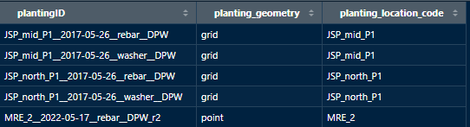
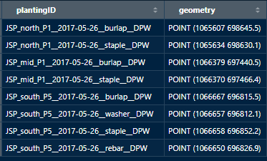
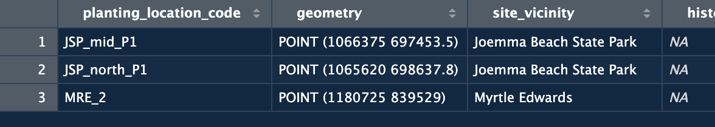
Sankey completed.
Next
Rehab plantings into pt-plantings and centroids
get rehab list of plantingIDs with planting_location_code
sf: how to append features?
construct records in pt_plantings structure
append
Create restoration areas
Create donor tables
Integrate monitoring table
Make and stage graphs
Make web tables with graphURL
Update service
FK
Get land polygon layer
Create convex hull for restoration areas with obstacles
Use rehab list planting_location_code to select records from planting_locations
copy points and modify attributes
Bind to existing spatial layer for that geometry
join
PK
planting_locations
select

Slide 43
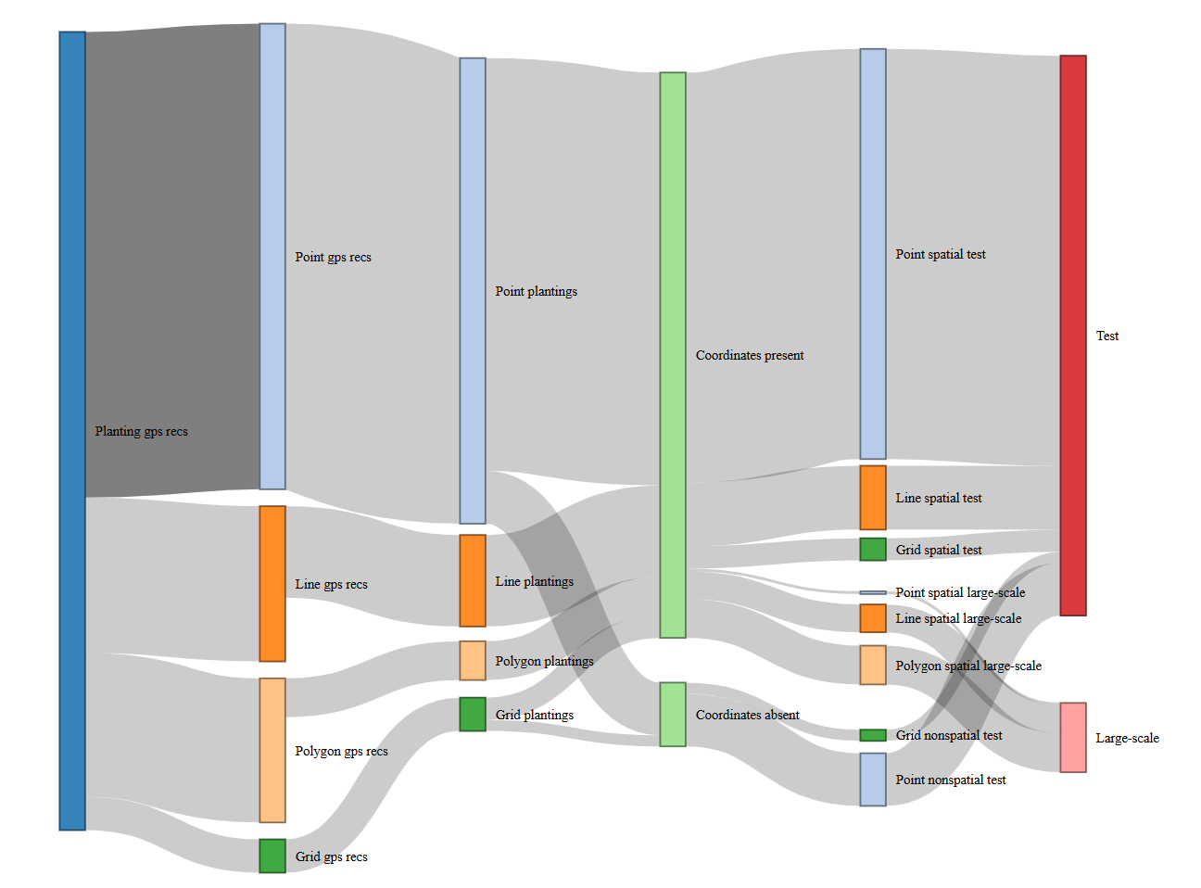

Slide 44
5
1
2
3
4
6
7
8
pt_plantings_cln
149
planting_pt
159
pt_recs
168
pt_plantings
168
gps_recs
288
pt_plantings_no coords
19
Plantings with
coordinates
204
Planting_location_codes
known coordinates
160
Planting_location_codes
known coordinates
165
ln_plantings
35
ln_plantings_1pt
10
Planting_location_codes
known coordinates
5
ln_recs
60
ln_cln_plantings_2pt
25
Plantings with
unknown coords
23
Planting_location_codes
unknown coordinates
18
planting_ln
27
Planting_location_codes
unknown coordinates
18
py_plantings_cln_4pt
9
planting_py
10
py_recs
48
py_plantings
12
py_plantings_cln_3pt
1
py_plantings_cln_2pt
2
grid_plantings_cln
8
planting_gr
8
grid_recs
12
grid_plantings
12
planting relationships within a planting occasion
planting relationships across planting locations
Test / Large-scale
Planting_method
grid_plantings_no coords
4

Slide 45
Example of use of logger:
https://www.google.com/search?q=write+r+code+using+logger+package+to+set+log+file+path%2C+set+logging+level+and+configure+file+rotation+with+log_appender&oq=write+r+code+using+logger+package+to+set+log+file+path%2C+set+logging+level+and+configure+file+rotation+with+log_appender&gs_lcrp=EgRlZGdlKgYIABBFGDkyBggAEEUYOTIICAEQ6QcY_FUyBwgCEOsHGEDSAQk0MjAzOGowajmoAgCwAgE&sourceid=chrome&source=chrome.ob&ie=UTF-8
Argument for distributing log statements throughout nested functions:
Using logger package in r for logging. Have a main that orchestrates calling functions. Should logging statements be distributed through all functions or just in main? - Google Search
Sending logs to file and console:
when using the logger package in r for logging to file, is it still possible to send messages to the console to notify the user immediately - Google Search
dir.exists function - RDocumentation

Slide 46









Final application prelim thoughts
UI for publishing new data
Command line using Rscript (Powershell)
Source main script from Rstudio
ArcGIS Pro script tool (local install only for R script tool)
Shiny GUI
New data entry
Survey 123
Integrated in Shiny app
Functions:
Enter data
Process data (?) & make graphs
Publish for review
Promote to prod
Separate dev and prod?

Slide 47
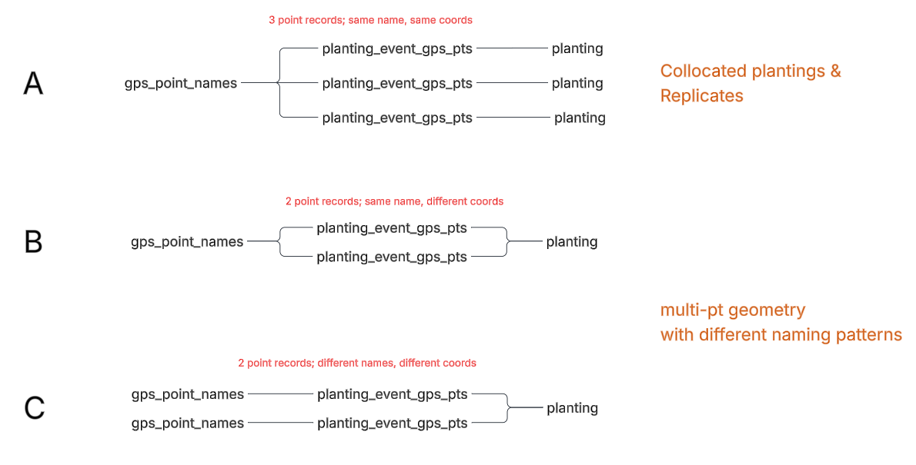

Slide 48
Logic to construct plantingID
Planting GPS points
Add group number
(activity_filter)
plantings
Add donor_site_code
(from file; clean up Mixed)
Summarize
on group_no
Basic plantings table
Add initial plantingID
Add plantingID_init counts
P_gps_pts
(w/donor_site_code & plantingID)
Left-join
on group_no
Add plantingID
(add replicate suffixes)

Slide 49

matrix
subprojects
p_gps_pts
p_gps_pts
clean
extract
projects
p_gps_pts
extract
plantings
plantings
snapshot
import
donor_sites
Planting_locations
Initial spatial layers
subprojects
Get list of PLC with multiple locations
Get centroids
Plantings_pt
Plantings_ln
Plantings_py
Planting_centroids
(prior to no-coord recovery)
p_gps_pts
plantings
import
import
import
p_gps_pts
p_gps_pts
p_gps_pts

Slide 50
Questions
Two “Mixed” donor site cases. Is the mix of donor plants from the other collocated plantings? YES
3 cases of single polygon planting with different methods at corners. Grid planting. Treat as separate plantings – just the corners as points but with planting_geometry=“grid” (edited in snapshot). This treatment should be subject to revision based on monitoring data granularity.
How to handle MRE replicates. Yes treat as replicates – add to key. Done, and discovered total three sets of replicates.
Use of ‘collocated’ and retain/drop. Collocated confirmed. Ignore retain/drop
Treating BESE as a single planting – or 3 AG BG C; Dumas donor source successful. Dupont Wharf failed.
Plantings at same GPS coords but different dates:
Spread through season: ‘repeat’ plantings
Consecutive days: ‘collocated’ plantings
d
JG email:
sum the number of large scale and test transplant activity types
So, the simpler version of calling BESE a single test transplant effort works here.

Slide 52
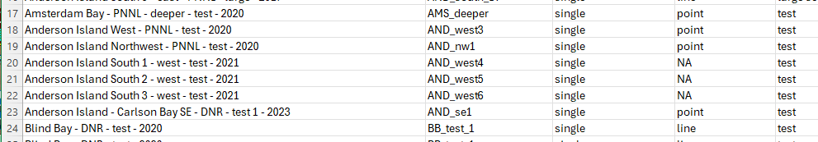
Edits to matrix spreadsheet – Planting sheet
Aston citation on Planting tab in two different forms (edit made to snapshot so all are Sequim Richland.
Aston, L.A., A.B. Borde and J. Vavrinec. 2015. Final Summary Report - Eelgrass Restoration in Puget Sound Project Summary. Pacific Northwest National Laboratory, Richland, WA. PNNL-24445.
Aston, L.A., A.B. Borde and J. Vavrinec. 2015. Final Summary Report - Eelgrass Restoration in Puget Sound Project Summary. Pacific Northwest National Laboratory, Sequim, WA. PNNL-24445
Manually changed all in snapshot to be Richland version
Modified headers rows on Planting tab so that a clean set of column titles (no spaces, symbols) is immediately adjacent to the table (edit made to “_pd” version that propagated to snapshot). The number of rows at the top to ignore is stored in a config file.
3 Anderson island plantings: NA changed to “point”
Planting tab: added planting location codes to the one BESE group that had NA
changed activity_filter values for each of the two BESE groups so that each row of p_gps_pts is a distinct planting (no instances of “--”)
Planting tab: added planting geometry (col G) as ‘point’ for two planting_gps_pt records:
Delano Beach West - DNR - shallow - test – 2021
Delano Beach West - DNR - deep - test - 2021

Slide 53
Edits to matrix spreadsheet – Planting sheet
Joemma Beach State Park North - SE - DNR - methods - 2017
Joemma Beach State Park North - SW - DNR - methods - 2017
Joemma Beach State Park North - NE - DNR - methods - 2017
Joemma Beach State Park North - NW - DNR - methods - 2017
Joemma Beach State Park Mid - SE - DNR - methods - 2017
Joemma Beach State Park Mid - SW - DNR - methods - 2017
Joemma Beach State Park Mid - NE - DNR - methods - 2017
Joemma Beach State Park Mid - NW - DNR - methods - 2017
Joemma Beach State Park South - SE - DNR - methods - 2017
Joemma Beach State Park South - SW - DNR - methods - 2017
Joemma Beach State Park South - NE - DNR - methods - 2017
Joemma Beach State Park South - NW - DNR - methods - 2017
Planting_geometry in snapshot changed from ‘polygon’ to ‘grid’
Changed activity filter so separate plantings (“--” changed to “test”)
Changed column name of second planting_geometry (edit not needed in latest matrix 6/30/2026 and this step removed)
Change planting_geometry from polygon to line for the 2 AND_South_L2 records and the 2 AND_South_L3 records
Changed equation in column C (planting_location_code) to extend lookup table:
=VLOOKUP(B4,'lookup table'!$A$2:$C$285,2,FALSE) - previous
=VLOOKUP(B4,'lookup table'!$A$2:$C$400,2,FALSE) - updated

Slide 54
Edits to matrix spreadsheet - ‘donor_sites’ sheet
Switch the 2 header rows so column names adjacent to data
Based on info from Jeff by email:
Donor site name |  |  | Edit made
Elwha Delta = Freshwater Bay |  |  | Edit to donor_sites sheet. 1 record. DONE.
Anderson Island = Thompson Cove |  |  | Edits to Plantings sheet. 8 records single donor records; 2 mixed donor records. DONE.
Thompson Cove | 47.1266, -122.7080 | cps1277 | No edits needed.
Shine Rd in Squamish Harbor | 47.866685, -122.672543 | hdc2517 | Added record to donor_sites sheet. DONE.
Fay Bainbridge | 47.703800, -122.506259 | cps1063 | Added record to donor_sites sheet. DONE.
Freshwater Bay | 48.1463, -123.6368 |  | No edits needed.
Ship Harbor | 48.505130, -122.675595 | nps1489 | Added record to donor_sites sheet. DONE.
Edit 2 donor site names in donor_site sheet to match names used in Plantings sheet:
‘Ketron Island NW’ → ‘Ketron Island’
‘Cutts Island sand spit’ → ‘Cutts Island’

Slide 57

















Point
records
single
point planting
Solo
line endpoint
records
test
all plantings
Collocated
initial
line planting
polygon diagonal
records
Replicates
large scale
polygon planting
repeat
polygon 4 corner
records
288
Add project associations
all rows

Slide 58



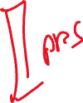












Slide 59
Source | Target | Value
Planting gps recs | Point gps recs | 168
Planting gps recs | Line gps recs | 56
Planting gps recs | Polygon gps recs | 52
Planting gps recs | Grid gps recs | 12
Point_gps_recs | Point plantings | 168
Line gps recs | Line plantings | 33
Polygon gps recs | Polygon plantings | 14
Grid gps recs | Grid plantings | 12
Point plantings | Coordinates present | 149
Point plantings | Coordinates absent | 19
Line plantings | Coordinates present | 33
Polygon plantings | Coordinates present | 14
Grid plantings | Coordinates present | 8
Grid plantings | Coordinates absent | 4
Coordinates present | Point spatial test | 148
Coordinates present | Point spatial large-scale | 1
Coordinates present | Line spatial test | 23
Coordinates present | Line spatial large-scale | 10
Coordinates present | Polygon spatial large-scale | 14
Coordinates present | Grid spatial test | 8
Coordinates absent | Point nonspatial test | 19
Coordinates absent | Grid nonspatial test | 4
Point spatial test | Test | 148
Line spatial test | Test | 23
Grid spatial test | Test | 8
Point spatial large-scale | Large-scale | 1
Line spatial large-scale | Large-scale | 10
Polygon spatial large-scale | Large-scale | 14
Point nonspatial test | Test | 19
Grid nonspatial test | Test | 4
Sankey data
geometry | Spatial / non-spatial | Test count | Large count
point | spatial | 148 | 1
line | spatial | 23 | 10
poly | spatial | 0 | 14
grid | spatial | 8 | 0
point | nonspatial | 19 | 0
grid | nonspatial | 4 | 0

Slide 60
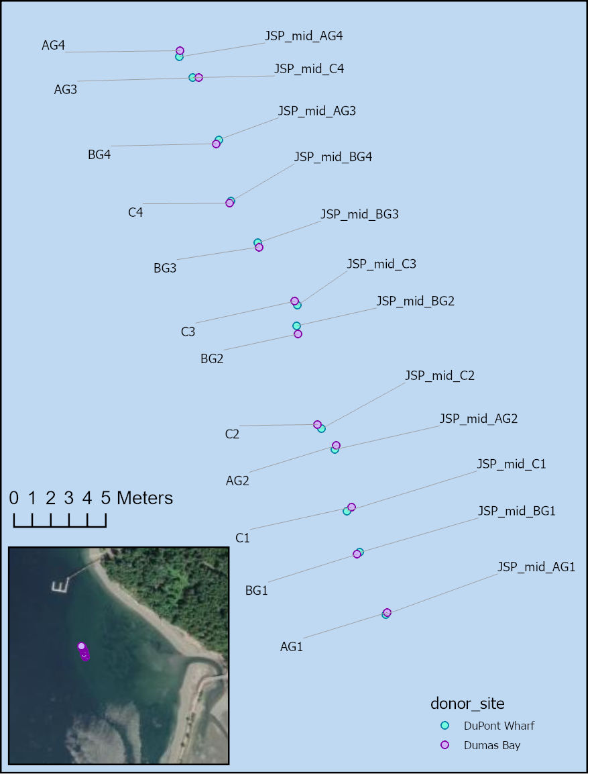
Clarifying BESE plantings
Donor site | Planting_date | Notes
Dupont Wharf | 5/25/2017 | Biodegradable ecosystem engineering elements (BESE) for Marjolijn Christianen, Wageningen University & Research, Netherlands. Overall area was 1 m2. Actual was 0.1 m2 (10 x 10 cm area in center of BESE. 3 planting units with 4 shoots each. DuPont Wharf shoots.
Dumas Bay | 4/29/2017 | BESE setup version 1 - setup was incorrect. Rather than removing all the eelgrass, it was left in place and new BESEs set just westward. 3 planting units with 4 shoots each. Dumas Bay shoots.
Monitoring data in Matrix spreadsheet only for plantings on 5/25/2017
Notes from last meeting:
Dumas Bay successful
Dupont Wharf failed
Q1: If Dumas Bay plantings successful, the monitoring data should presumably track the 4/29 plantings, not 5/25. Is that right?
Q2: The 4/29 “setup was incorrect” plantings were superceded by “just westward” plantings. Can we associate same GPS coords with the westward plantings? If Dumas plantings were successful, this refers to the westward plantings – is that right?

Slide 61
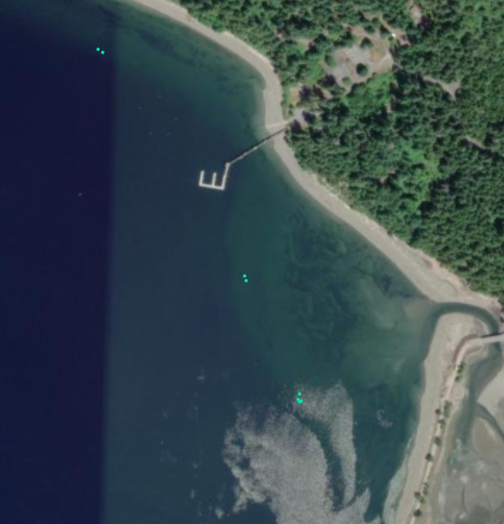
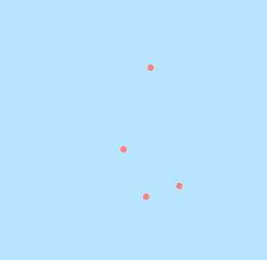
JSP_north_P1
JSP_mid_P1
JSP_south_P1

Slide 62

























Slide 63









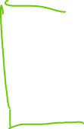






planting_GPS_pts
plantings
monitoring_events
assessments
donor_sites

Slide 64
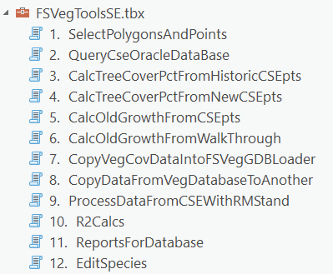


Seagrass Restoration web service
A tool to update ArcGIS Online feature layer from Excel source data
Data flow & components
>_
SeagrassRestorationTools
Spreadsheet tables (sheets)
Construct geometry tables
Update Planting Web Layers
QA &
clean
Validate Planting Tables
planting_GPS_pts
plantings
Construct spatial layers
Data summary
monitoring_events
Read from Excel
assessments
Write to fgdb
memory
cloud
donor_sites
disk
Update AGOL feature layer
Matrix
Version management?
Is writing to fgdb on disk necessary? (network GIS restoration dataset; where?)
Can the API for Python update an AGOL feature layer from data in memory?

Slide 65
Matrix Workflow -- Versioning / Archiving
SeagrassRestorationTools
Update Planting Web Layers
working
Validate Planting Tables
SeagrassRestorationTools
Update Planting Web Layers
archive2024
Validate Planting Tables
archive2025
archive2026
snapshot_20240101
SeagrassRestorationTools
Update Planting Web Layers
snapshot_20250301
Validate Planting Tables
working
snapshot_20260501

Slide 66
planting_GPS_points
Original | Revised
SITE LOCATION | site_location
SITE NAME | site_name
planting_location_code | planting_location_code
planting_relationships | planting_relationships
YEAR | year
HISTORICAL PRESENCE | historical_presence_source
DATA TYPE | planting_geometry
WATER BODY | water_body
SVMP REGION | svmp_region
PROJECT NAME | project_name
FUNDING SOURCE | funding_source
FUNDING SOURCE PROGRAM | funding_source_program
CONTRACT 1 | sponsor_contract_number
CONTRACT 1 | sponsor_contract_dnr_number
CONTRACT 2 | contractor
CONTRACT 2 | contract_dnr_number
CITATION | citation
ACTIVITY TYPE | activity_type
ACTIVITY FILTER | activity_filter
PLANTING DATE | planting_date
LATITUDE | latitude
LONGITUDE | longitude
data_type | planting_geometry
retain_drop | retain_drop
DATUM | datum
ELEVATION | elevation_m_mllw
PLANTING METHOD | planting_method
PARALLEL SIDE | parallel_length_m
PERPENDICULAR SIDE | perpendicular_length_m
PLOT AREA | plot_area_m2
PLANTED AREA | planted_area_m2
EFFECTIVE AREA PLANTED | effective_area_planted_m2
# OF PLANTING UNITS | number_planting_units
# OF SHOOTS | number_shoots
PLOT SHOOT DENSITY | plot_shoot_density_m2
PLANTED SHOOT DENSITY | planted_area_shoot_density_m2
DONOR SITE NAME | donor_site_name
NOTES | notes
Changes to Matrix Column Names
Attributes of plantings
plantings
Original | Revised
SITE NAME | site_name
planting_location_code | planting_location_code
planting_relationships | planting_relationships
data_type | planting_geometry
retain_drop | retain_drop
Are there ever cases of multiple donor sites utilized for a single planting?
Attributes of plantings

Slide 67
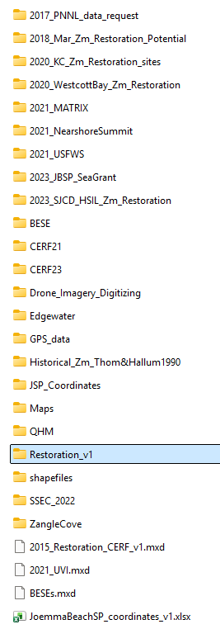
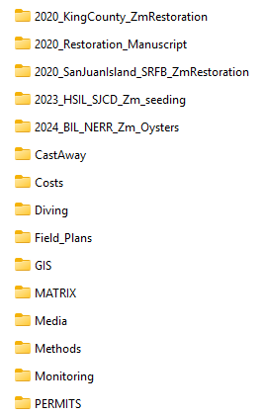
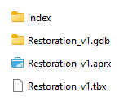

Two roles for restoration GIS dataset:
Authoritative GIS data in central location for internal users (“production”)
Location for ArcGIS tool to write GIS data updates. Ideal workflow would write to non-production dataset to allow for review before replacing production copy.
K:\projects\Eelgrass_Restoration

Slide 68
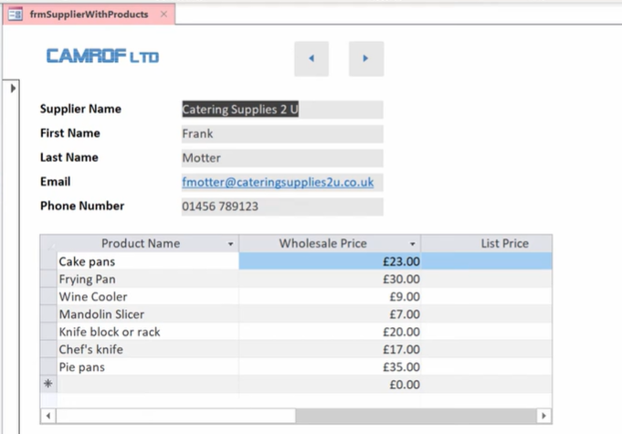
Data entry into multiple related tables
Using Access forms and subforms

Slide 69

planting_locations
planting_event_gps_pts
Matrix
spreadsheet
plantings
donor_sites
feature layers
pt_plantings
ln_plantings
py_plantings
feature layers
planting_regions
planting_all_pts
py_plantings
new
planting
data
Survey 1-2-3
planting_event_gps_pts_newrecs
planting_newrecs

Slide 70
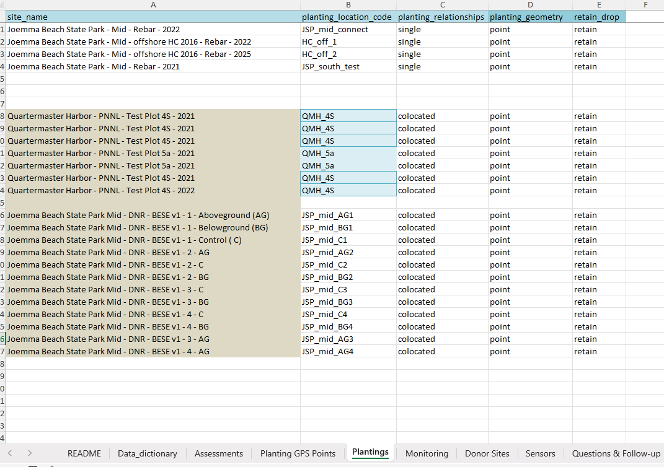
“point” and “retain” added for these records in the snapshot “Plantings” sheet.

Slide 71
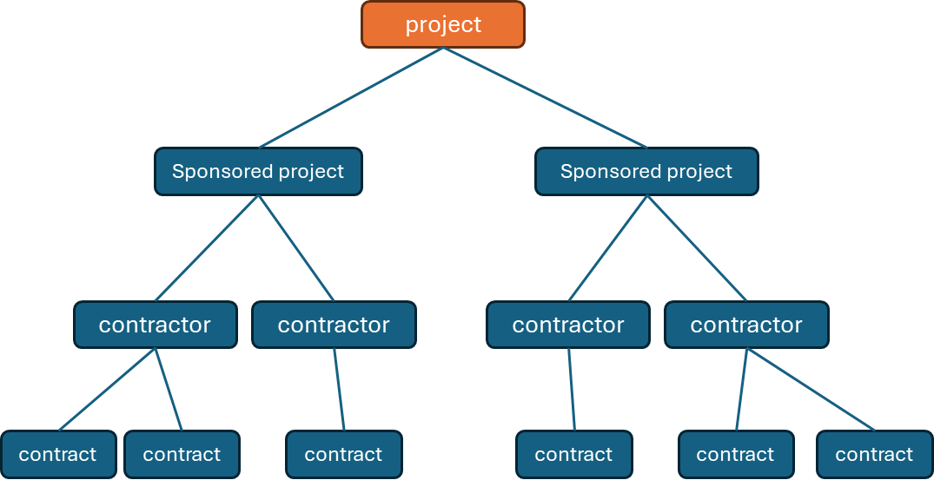
project
Sponsored project
Sponsored project
contractor
contractor
contractor
contractor
contract
contract
contract
contract
contract
contract
sub-project code = project_code + funding source + contractor

Slide 72
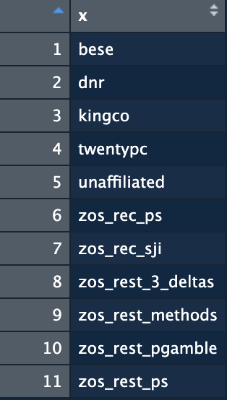
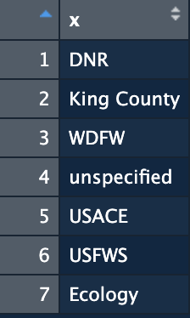
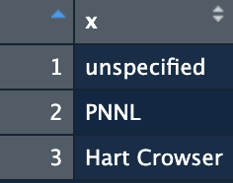
sub-project code
funding source
=
project code
+
+
contractor

Slide 73






Eelgrass Restoration Matrix_2021_0113abb_jg_pd_v1_pd.xlsx
Fixed funding source & activity-type equations (Monitoring sheet)
Renamed tabs:
Plantings → Planting_GPS_Points
lookup_table → Plantings
Modified header column names
Lower case, no spaces
Some new names
Eelgrass Restoration Matrix_2021_0113abb_jg_pd_v1.xlsx
README
Data_dictionary
Assessments
Planting GPS Points
Plantings
Monitoring
Donor Sites
Sensors
Questions & Follow-up
Missing Data
Success Rates

Slide 74
Need automated processing and publishing (will require development time)
Balancing expedient update with movement toward automation
Online feature layer – made ER diagram
Made ER diagram (table relationships)
Update graphs?
Keep donor-planting links (line features)?
Any need for line and polygon feature classes for plantings?
Matrix spreadsheet
Suggested sheet name changes for clarity
Greater automation will require a ‘production’ tables (i.e. clean & systematic)
planting_relationship attribute ??
Domain = {single, initial, repeat, collocated}
Retain_drop (shift to automated determination?)

Slide 75
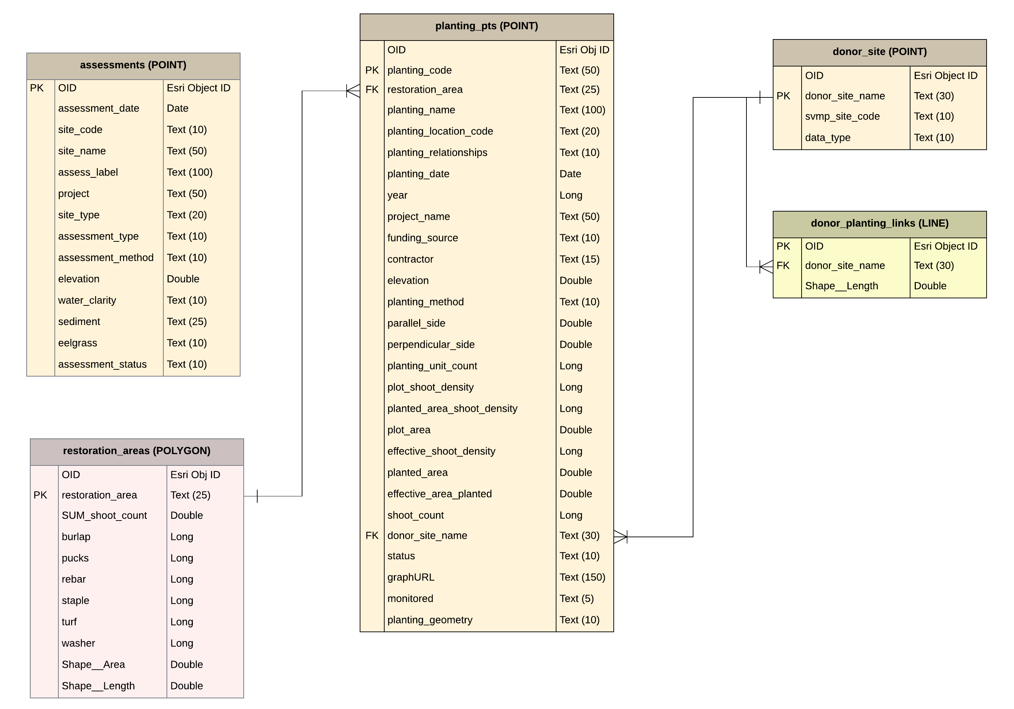
Seagrass Restoration
ArcGIS Online feature layer
Feb. 20, 2026 (prior to update)
Contains five spatial sublayers – point (3), line (1) and polygon (1).
Associated attribute tables shown here in an ER diagram (Entity-Relationship).

Slide 76
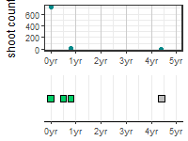
? “point”
planting_code
QMH_3D_20180601_rebar
JSP_mid_1_20180714_rebar
JSP_mid_1_20180714_pucks
Text (8000)
planting_location_code
planting_method
“Planted Shoots”
planting_date

Slide 77
planting_centroids.csv
Planting
entity: planting GPS points
unique
planting ID & edits
Planting_edit
planting_v0.csv
import, project & make lines/polys
planting_pt.csv
planting_pt
planting_pt_all
edits & split data,
create
”plantings” table
planting_ln.csv
planting_ln
planting_poly.csv
planting polygons
plantings_table.csv
planting_pts_all.csv
area_method_join_table.csv
filter out second header row
filter out rows missing lat/lon & related rows (same planting)
rename all columns
summarize methods by location
restoration area polygons

Slide 80
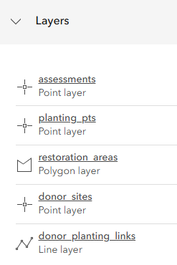

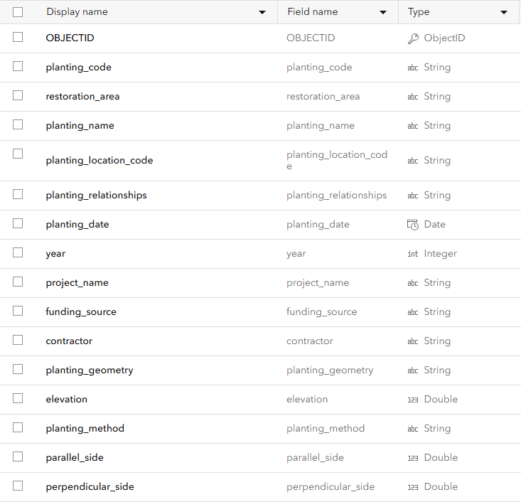
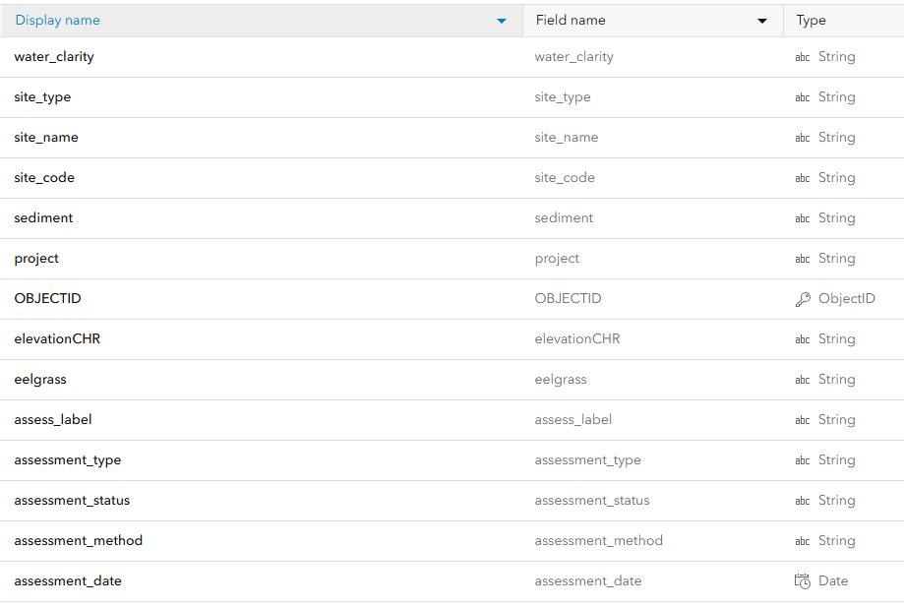
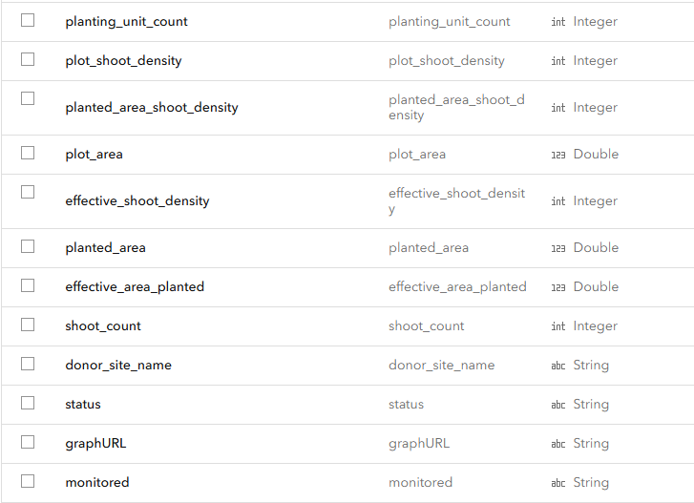
Seagrass restoration storymap supported by 1 feature layer with 5 sub-layers
assessments
Planting_pts

Slide 81
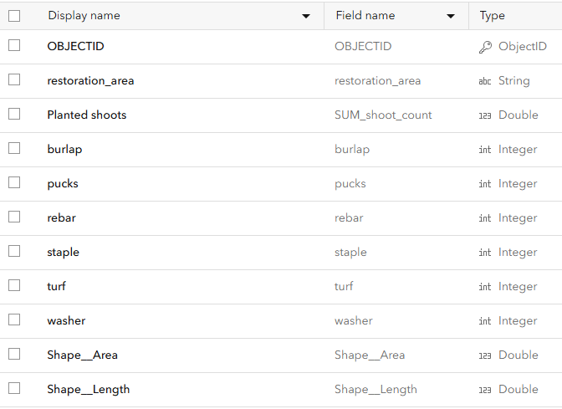
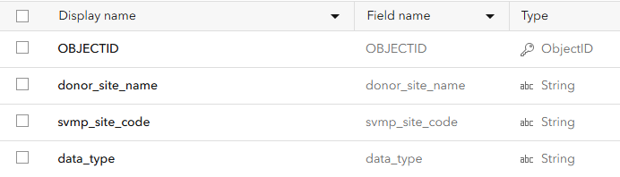
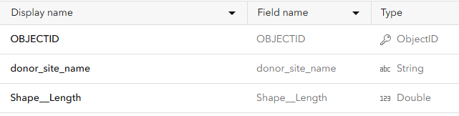
Restoration_areas
Donor_sites
Donor_planting_links

Slide 82








Slide 84

Reconciling existing feature layer attribute tables with Lucidchart ER diagram
assessments
N=15
N=14

Slide 85

Planting_pts
N=23
N=22

Slide 86

Restoration_areas

Slide 87





