Slide 1

Arduino
LED Blink
Homework

Slide 2

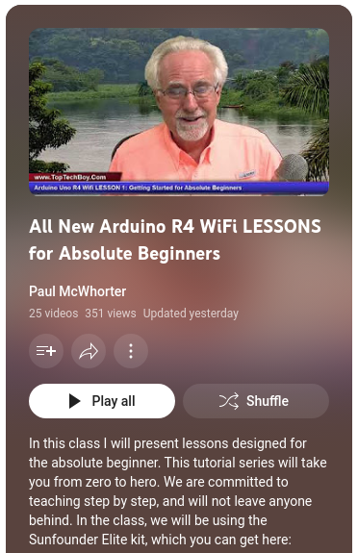
Paul McWhorter Arduino Lesson 1
https://youtu.be/S66Iwhk2V7A?si=ToSA4rnzvSwYrEkw

Slide 3
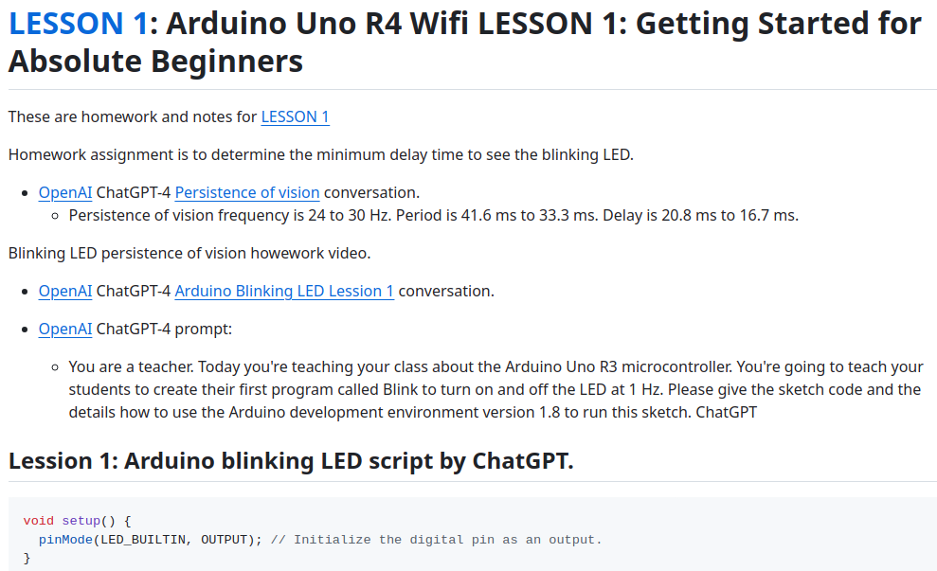

David WA9ONY Lesson 1 Homework
https://github.com/WA9ONY/Arduino-Homework/blob/main/README.md

Slide 4
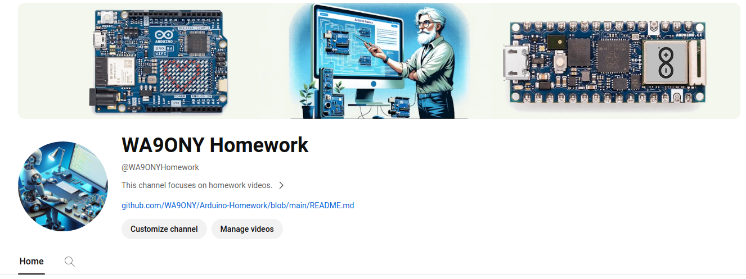

David WA9ONY Lesson 1 Homework
https://www.youtube.com/@WA9ONYHomework

Slide 5

Summary
LED
  Persistence of vision
Use ChatBots to
  Code
  Explore
  Analyze

